Slide 1
Introduction to Variables and Data Types – part 2

Slide 2
Student Learning Objectives
TClark

Slide 3
TClark
Student Learning Objectives
By the end of this lesson, you should be able to:
Be familiar with Java’s 8 primitive data types
Understand the declaration and assigment statement
Declare Strings and perform String concatenation
Overflow and Round-off errors
Use flags with printf
Understand references variables

Slide 4
TClark
Defining vs. Assigning
Java allows you to define a variable or object and assign it in a single statement, or to define a variable or object and assign it later your program.
int stuScore = 93;
char stuGrade;
stuGrade = 'A';
String f = "Student Score = %d\n";
System.out.printf(f, stuScore);
System.out.printf(f, stuGrade);
Student Score = 93
Student Grade = A
Notes:
Java allows you to define and assign a variable in one statement (definition and assignment), or define a variable (definition only) and assign it later in the program (assignment only).

Slide 5
TClark
Declaration and Assignment
More than one variable may be defined and assigned on one line.
int low = 70, high = 100;
double minWage = 7.25;
char bigZ = 'Z', littleZ = 122;
out.printf("%d\n", low);
out.printf("%d\n", high);
out.printf("%.2f\n", minWage);
out.printf("%c\n", bigZ);
out.printf("%c\n", littleZ);
70
100
7.25
Z
z
Notes:
Variable definitions and assignments can be performed on one line.
int intFun=75; //definition and assignment
More than one variable can be defined and assigned on the same line.
int go=3, stop=2, pause=1; //separate with a comma

Slide 6
Primitive Data Types
TClark

Slide 7
TClark
Review of Primitive Data Types
Type | Bits | Range
byte | 8 | -128 to 127
short | 16 | -32768 to 32767
int | 32 | -2147483648 to 2147483647
long | 64 | -9223372036854775808 to +9223372036854775807
float | 32 | 1.40129846432481707e-45 to 3.40282346638528860e+38 (positive or negative)
double | 64 | 4.94065645841246544e-324 to 1.79769313486231570e+308 (positive or negative)
char | 16 uns | 0 to 65535
boolean | JVMD | true or false
Notes:
Ensure you are familiar with the bit count and approximate range of the data types.

Slide 8
TClark
Min and Max
Java allows you to easily look up the minimum and maximum values of a data type by accessing constants from the wrapper classes.
String f = "%d to %d\n";
out.printf(f, Byte.MIN_VALUE, Byte.MAX_VALUE);
out.printf(f, Short.MIN_VALUE, Short.MAX_VALUE);
-128 to 127
-32,768 to 32767
Notes:
Java allows you to discover the min and max values for a data type. Note that each primitive data type has an associated class (byte – Byte, short – Short, int – Integer, long – Long). We can use the associated class of a primitive data to discover things about that data type.

Slide 9
TClark
Min and Max
Java allows you to easily look up the minimum and maximum values of a data type by accessing constants from the wrapper classes.
String f = "%d to %d\n";
out.printf(f, Integer.MIN_VALUE, Integer.MAX_VALUE);
out.printf(f, Long.MIN_VALUE, Long.MAX_VALUE);
-2147483648 to 2147483647
-9223372036854775808 to 9223372036854775807
Notes:
Java allows you to discover the min and max values for a data type. Note that each primitive data type has an associated class (byte – Byte, short – Short, int – Integer, long – Long). We can use the associated class of a primitive data to discover things about that data type.

Slide 10
TClark
Real Min and Max
Java allows you to easily look up the minimum and maximum values of a data type by accessing constants from the wrapper classes.
String f = "%f to %f\n";
out.printf(f, Float.MIN_VALUE, Float.MAX_VALUE);
out.printf(f, Double.MIN_VALUE, Double.MAX_VALUE);
1.4E-45 to 3.4028235E38
4.9E-324 to 1.7976931348623157E308
Notes:
Java allows you to discover the min and max values for a data type. Note that each primitive data type has an associated class (float – Float, double – Double). We can use the associated class of a primitive data to discover things about that data type.

Slide 11
TClark
Fields of the Integer Class
public class Integer{
public static final int BYTES = 4;
public static final int MAX_VALUE = 2147483647;
public static final int MIN_VALUE = -2147483648;
public static final int SIZE = 32;
…
}
out.printf("%d\n", Integer.BYTES);
out.printf("%d\n", Integer.SIZE);
4
32
Notes:
static is a non-access modifier and can be applied to the declarations of variables. A static variable belongs to a class so think of them as class variables or shared variables. The preferred convention to access static variables is by the ClassName.variableName.
final is a non-access modifier and can be applied to a declaration of a variable. A final variable can’t be reassigned a value. It can be assigned a value only once and the preferred convention is to capitalize all letters and separate words with underscores.

Slide 12
Strings
TClark

Slide 13
TClark
Strings
Strings in Java are created from the Java String class.
They are not a primitive type and are objects created from a class.
String hs = new String("Cypress Ranch");
String ms = "Smith"
String es = "Warner";
out.printf("%s\n", hs);
out.printf("%s\n", ms);
out.printf("%s\n", es);
Cypress Ranch
Smith
Warner
Notes:
A String in Java is an object, not a primitive data type. However; Strings are treated “special” by the compiler in that we do not have to use the normal syntax of creating an object to create a string. That is, we don’t have to use the statement String myString = new String(“Some string”); . String objects may be created by simply using a statement of the form String stringname; and then making an assignment with a statement of the form stringname = “a string”;, or creating and assigning by using a statement of the form String stringname = “some string to assign”;. You CAN use the form String stringName = new String(“some string to assign”); if you want to, but it is not required. There is a slight difference behind the scenes. The Java String Pool will be discussed later in the course.

Slide 14
TClark
String Concatenation
Strings may be concatenated using the + operator.
String a = "Being a student is easy.";
String b = "Learning requires actual work.";
String c = a + " " + b;
System.out.println(c);
Being a student is easy. Learning requires actual work.
Notes:
The concatenation operator in Java is the same as the operator in Python, the + operator. However; unlike Python, if either side of the concatenation operator in Java is a String, both sides are treated as Strings automatically. There is no need to explicitly convert non-strings to strings as we did in Python (e.g. str(studentGrade)).

Slide 15
TClark
String Concatenation
Any data type + a String results in concatenation.
The + operator is evaluated from left to right
String one = 1 + "a" + 2;
System.out.println(one);
String two = "a" + 1 + 2;
System.out.println(two);
String three = 1 + 2 + "a";
System.out.println(three);
1a2
a12
3a
Notes:
Also notice that sometimes the + operator is an addition operator and sometimes it is a concatenation operator. If both sides of the + operator are numeric it is an addition operator. If either side is a string, it is a concatenation operator. However; the + operator is evaluated from left to right.
1 + 2 + “a” -> first 1 + 2 is evaluated and adding two integers always results in an integer
3 + “a” -> then concatenation occurs
“3a”

Slide 16
Overflow and Underflow
TClark

Slide 17
TClark
Overflow and Underflow
Overflow/Underflow errors occur at run-time when a value is assigned to a variable that is out of range. For int and long math, they silently wrap around.
int over = Integer.MAX_VALUE;
over = over + 1;
out.printf("%d\n", over);
int under = Integer.MIN_VALUE;
under = under - 1;
out.printf("%d\n", under);
-2147483648
2147483647
Notes:
Overflow errors occur at run-time when a value is assigned to a variable that is too large. The resulting value is typically a negative value. The negative value occurs when the positive upper bound is overflowed into the negative range.
Attempting to assign a numeric constant that is too large to a variable is a syntax error. It is very easy for Java to determine that the value is too large for the data type.
byte example = 128; //compile error

Slide 18
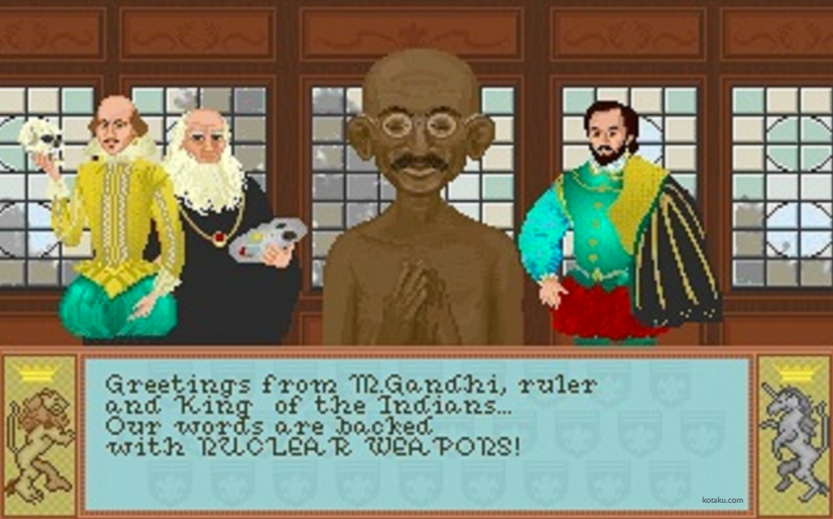
TClark
Civilization
Notes:
In the original Civilization game, each world leader was assigned an aggressiveness score, and Gandhi was given the lowest score of 1. If a nation transitioned to democracy in the game, the leader’s aggressiveness score was decreased by 2. However, the aggressiveness scores were stored in unsigned 8-bit integers
(meaning they couldn’t be negative) - so decreasing Gandhi’s aggressiveness score to -1 had the effect of looping around to 255 (so Gandhi became the most aggressive leader in the game!)

Slide 19

TClark
Ariane5
Notes:
On June 4th, 1996, the Ariane5 rocket self-destructed after 37 seconds of flight. The catastrophe was a result of a chain of events that began when a 64 bit number was stuffed into a 16 bit integer causing overflow. This snafu reportedly cost $370 million.

Slide 20
Real Data Types
TClark

Slide 21
TClark
Round-off Errors
float and double use 32 and 64 bits respectively. Often times calculations with real numbers result in an amount that is impossible to represent in a finite number of bits.
System.out.println(2.1*3);
double d = 1.;
d += .0000000000000001;
System.out.println(d);
6.300000000000001
1.0
Notes:
Round off errors are inherent to all computer systems that use floating point arithmetic. This problem is not just Java related. We can fix this by using the java.lang.Math.round() method to round off the errors or use the BigDecimal class which is designed to give more accuracy.
To check for equality, verify the two numbers are within some sigma or threshold.
Math.abs(x - y) < 0.001

Slide 22
Output with printf
TClark

Slide 23
TClark
printf
printf uses the specified format string and arguments to write a string.
System.out.printf( “format-string” [, arg1, arg2, ... ] );
out.printf("Money $ %.2f\n", 45.0/5);
out.printf("Year: %d, Day: %d", 1955, 3);
Money $ 9.00
Year: 1955, Day: 3
Notes:
printf is a method used to print values on the console window. printf can be used to set the number of decimal when printing a decimal number. printf can be used to print any type of data.

Slide 24
TClark
printf
Argument specifier(‘$’) - in the expression “%2$d”, the portion 2$ specifies that the 2nd listed argument is to be used.
Notice in this scheme that the indices do not start numbering with 0, rather with 1.
out.printf("Second %2$d, First %1$.2f", 3.149, 8);
Second 8, First 3.15
Notes:
2$ specifies the second argument after the string
1$ specifies the first argument after the string
d stands for decimal number (meaning an int)
f represents floating point numbers (real numbers) and the .2f species to round the number to 2 decimal places

Slide 25
Reference Variables
TClark

Slide 26
TClark
References
A reference variable is used to store the location of an Object.
All objects of the same class contain the same methods and types of data, but the values will be different from object to object.
// empty class
class Student{}
Student a = new Student();
Student b = new Student();
Call Stack
Heap
a
Object a with its own data
b
Object b with its own data

Slide 27
TClark
Reference Variables
Student beth = new Student();
3 things happen:
A new Student object is created.
A reference variable named beth is created in the call stack with an empty(null) value.
The variable beth is assigned the memory address where the object is located.

Slide 28
Primitive Types and Strings
Overflow/Underflow/Round-off
printf
Reference Variables

