Slide 1
Strings
Notes:
This PowerPoint will provide an introduction to Java’s String class.

Slide 2
Student Learning Objectives
TClark

Slide 3
TClark
Student Learning Objectives
By the end of this lesson, you should be able to:
Look up the API for the String class
Instantiate Strings
Slice/extract sections from a String
Compare Strings
Search Strings

Slide 4
Array of Characters
TClark

Slide 5
What is a String
Strings are an immutable data type.
Strings are objects and represent a sequence of characters.
The characters may consist of letters, numbers, symbols, spaces, etc.
In Java, the String class uses an array of characters where the first index is 0 and the last is one less than the length.
String str = “CS is Fun”;
0 1 2 3 4 5 6 7 8
str
C | S |  | i | s |  | F | u | n

Slide 6
Constructors
The String class has about a dozen constructors. The most common one is:
String str = new String(“CS is Fun”);
More commonly we can explicitly create a String literal by using quotations.
String str = “Strings are used prolifically”;
In either case, str is a reference variable to a String object in memory. There is a difference which will be discussed later.
str = new String(“Hi”);
out.println(str.length();
out.println(“abc”.length());
2
3

Slide 7
TClark
String Methods
Name | Purpose
substring(x) | returns a section starting at x going to the end
substring(x,y) | returns a section from [x, y)
length() | returns the # of characters
charAt(x) | returns the char at index x
indexOf(c) | returns the index of the first String/char c
lastIndexOf(c) | same as above but starts searching from end
replace(a,b) | returns a new String with all occurrences of a replaced with b
toUpperCase(a) | returns a new String capitalized
toString() | returns the String itself
Notes:
The table in this slide lists the most frequently used methods from the String class. However, there are many useful methods available.
It is important to note that a String object is immutable (i.e. it cannot be changed). All of the String methods are return methods, whether they return a property or a modified string. None of the methods modify the original String.

Slide 8
substring
TClark

Slide 9
substring
The String instance method substring is overloaded. First version:
public String substring(int x){}
str = “CS is Fun”;
out.println(str.substring(3));
out.println(str.length());
The second version is inclusive/exclusive:
public String substring(int x, int y){}
str = “Strings”;
out.println(str.substring(3, 5);
out.println(str.length());
0 | 1 | 2 | 3 | 4 | 5 | 6 | 7 | 8
C | S |  | i | s |  | f | u | n
is Fun
9
in
7
0 | 1 | 2 | 3 | 4 | 5 | 6
S | t | r | i | n | g | s
Notes:
We use the substring method to break strings into pieces. The are two version of substring in Java. The first version has one parameter and returns the string from the index specified (x) to the end of the string. The second version has two parameters.
In Java it is possible to define two or more methods within the same class that share the same name, as long as their parameter declarations are different (their signature is different). When this is the case, the methods are said to be overloaded, and the process is referred to as method overloading. Method overloading is one of the ways that Java implements polymorphism.

Slide 10
Immutability
Once you create a String it cannot be changed
You’re allowed to bind or reassign a reference variable to a new String.
Keep this in mind when you use String methods that return Strings, the original String is unchanged.
String word = "minus";
out.println(word.toUpperCase());
out.println(word.replace('m', 'l’));
out.println(word);
word = word.toUpperCase();
out.println(word);
MINUS
linus
minus
MINUS

Slide 11
OOP
public static void main(String[] args) {
String s = new String(“Hello CS!”); // creates a String and binds to s
s = s.toLowerCase(); // returns a new String and binds to s
}
Call Stack
Heap
s
Hello CS!
hello cs!
Notes:
Java’s garbage collection will reallocate the memory for objects that no longer have a reference to them at an indeterminate time.

Slide 12
length()
length() returns the number of characters in the string.
naturally begin counting at 1
Strings w/ length of zero are called empty Strings.
String str1 = "hello";
String str2 = “goodbye";
String str3 = "";
out.printf(“%d”, str1.length());
out.printf(“%d”, str2.length());
out.printf(“%d”, str3.length());
out.printf(“%b”, str3.isEmpty());
5
7
0
true

Slide 13
characters
TClark

Slide 14
Characters
char is a primitive data type and has no methods available and uses single quotes or the ASCII value to create:
char letter = ‘A’; // or 65
One useful String method is the charAt(int index) method which returns the character in the String at the specified index.
The index must be valid or a StringIndexOutOfBoundsException will occur at run-time
String word = "minus";
char let = word.charAt(2); // the char 'n’
String str = word.substring(2,3); // the String "n"

Slide 15
Characters
The last index of a string is always (empty String is the exception) one less than the entire length, because the first index is zero.
String s = "Comp Sci 1k";
char first = word.charAt(0);
char last = s.charAt(s.length() - 1);
out.printf(“%c\n”, first);
out.printf(“%c\n”, last);
s = “Hello!”
out.printf(“%c”, s.charAt(s.length() - 1));
C
k
!

Slide 16
indexOf(char c) indexOf(String s)
TClark

Slide 17
indexOf
The indexOf method returns the index (location) in the string of the first occurrence of the character specified (c) or string specified (s).
String s = “when nothing is going right, go left";
int spot = s.indexOf(“no”);
int loc = s.indexOf(‘i’);
int index = s.indexOf(‘Z');
out.printf(“%d\n”, spot);
out.printf(“%d\n”, loc);
out.printf(“%d\n”, index);
out.printf(“%d\n”, s.indexOf(‘i’, loc + 1);
5
9
-1
13

Slide 18
indexOf
The lastIndexOf method returns the index (location) in the string of the last occurrence of the character specified (c) or string specified (s).
String s = “when nothing is going right, go left";
out.printf(“%d\n”, s.indexOf(“go”));
out.printf(“%d\n”, s.lastIndexOf(‘go’));
out.printf(“%d\n”, s.lastIndexOf(‘Q’));
out.printf(“%b\n”, s.indexOf(“in”) > -1);
int spot = “aeiou”.indexOf(s.charAt(2));
out.printf(“%b”, spot > -1);
16
29
-1
true
true

Slide 19
compareTo
TClark

Slide 20
compareTo
Compares Strings lexicographically based on the Unicode values. The result is negative if the String object precedes the argument string, positive if it follows the argument string and zero if they are equal.
public int compareTo(String anotherString)
The positive and negative values are the differences in the first unequal Unicode characters.
this.charAt(k) – anotherString.charAt(k)
If there is no index position where the strings differ the shorter string precedes the longer.
this.length() – anotherString.length()

Slide 21
compareTo
Remember the rules: return a negative if the object precedes the argument; return a positive if it follows; and zero if they are equal
out.printf(“%d\n”, “at”.compareTo(“dog”);
out.printf(“%d\n”, “dog”.compareTo(“apple”));
out.printf(“%d\n”, “ardent”.compareTo(“arduous”));
out.printf(“%d\n”, “dog”.compareTo(“dogmatic”));
out.printf(“%d\n”, “Zealous”.compareTo(“austere”));
out.printf(“%d\n”, “apple”.compareTo(“carrot”));
-3
3
-16
-5
-7
-2

Slide 22
toString
TClark

Slide 23
toString()
Every class has a toString() method inherited from a parent class called Object.
public String toString()
The implicit version of the toString method returns a string containing the object’s class name, followed by an @, followed by the memory address for the object (where the object is located in memory).
class Person{}
An objects toString method gets invoked automatically when you print out a reference variable
Person bob = new Person();
out.println(bob);
Person@3e25a5
Notes:
As stated in this slide the object’s toString gets invoked automatically when you print an object (e.g. out.prinln(bob)). It is permissible to implicitly invoke toString (e.g. out.println(bob.toString( )); however, this is very poor practice and shows the programmers ignorance of the toString method. So, rule number 1 is: Don’t invoke toString implicitly.
Every class has an implicitly defined toString method because every class is derived from the Object class, and the Object class provides a toString method that prints: Class Name, "@", and the hex version of the object’s hashcode concatenated into a string. The default hashCode method in Object is typically implemented by converting the memory address of the object into an integer. Thus, if you do not override toString (provide a toString method in your class), and you print an object out, you will see the object’s class name followed by an @, followed by the object’s memory address (where the object begins in memory). For example: MyClass@3e25a5.
The Object class is a special class, it is the mother/father of all classes. That is, Object is the root of the class hierarchy. Every class has Object as a superclass, and all objects implement the methods of this class. One of the methods defined by Object is toString, and its version of toString is the implicit version described in this slide. If you do not define a toString method (override toString) in your class and none of your parent classes do so, then Object’s implicit toString method will be used.
We typically override the toString method to proved a customized output (usually the values of some or all of the instance variables). Even though it is possible for the toString method to print output, it should return a string, NOT print a string. The user of your class, may not want to print your toString output, they may want to store the result in a string and use it as data in their program. So, rule number 2 is: Don’t print from toString.
Two rules to remember about toString:
Rule number 1: Don’t invoke toString implicitly
Rule number 2: Don’t print from toString

Slide 24
toString()
The toString() method returns a string representation of an object that “textually represents” this particular object. It should be succinct, informative and easy to read.
out.println(“You should never”);
out.println(“print from the”);
out.println(“toString(). Return”);
out.println(“a String”.toString());
out.println(“representation of”);
out.println(“the object”);
You should never print from the
toString(). Return a String representation of the object.

Slide 25
equals
TClark

Slide 26
equals()
Every class has an equals(Object other) method inherited from a parent class called Object.
public boolean equals(Object other)
The implicit version of the equals method returns true if and only the object and parameter refer to the same object (x == y)
class Person{}
Person bob = new Person();
Person alias = bob;
out.println(bob == alias);
out.println(bob.equals(alias));
true
true
Notes:
As stated in this slide the object’s toString gets invoked automatically when you print an object (e.g. out.prinln(bob)). It is permissible to implicitly invoke toString (e.g. out.println(bob.toString( )); however, this is very poor practice and shows the programmers ignorance of the toString method. So, rule number 1 is: Don’t invoke toString implicitly.
Every class has an implicitly defined toString method because every class is derived from the Object class, and the Object class provides a toString method that prints: Class Name, "@", and the hex version of the object’s hashcode concatenated into a string. The default hashCode method in Object is typically implemented by converting the memory address of the object into an integer. Thus, if you do not override toString (provide a toString method in your class), and you print an object out, you will see the object’s class name followed by an @, followed by the object’s memory address (where the object begins in memory). For example: MyClass@3e25a5.
The Object class is a special class, it is the mother/father of all classes. That is, Object is the root of the class hierarchy. Every class has Object as a superclass, and all objects implement the methods of this class. One of the methods defined by Object is toString, and its version of toString is the implicit version described in this slide. If you do not define a toString method (override toString) in your class and none of your parent classes do so, then Object’s implicit toString method will be used.
We typically override the toString method to proved a customized output (usually the values of some or all of the instance variables). Even though it is possible for the toString method to print output, it should return a string, NOT print a string. The user of your class, may not want to print your toString output, they may want to store the result in a string and use it as data in their program. So, rule number 2 is: Don’t print from toString.
Two rules to remember about toString:
Rule number 1: Don’t invoke toString implicitly
Rule number 2: Don’t print from toString

Slide 27
OOP
public static void main(String[] args) {
String s = new String(“Hello CS!”); // creates a String and binds to s
String x = s; // creates an alias
String y = new String(“Hello CS!”); // creates a new Object
out.println(s==x);
out.println(s==y);
out.println(s.equals(y));
}
Call Stack
Heap
s
Hello CS!
x
true
false
true
Hello CS!
y

Slide 28
equals()
Always check equality for objects by invoking methods (i.e. equals/compareTo).
Check equality for primitive data types with == (watch out for doubles and round-off error)
out.println(“a”.equals(“a”));
boolean b = false;
out.println(b == true);
int x = 5;
out.println(x == 5);
char c = ‘a’;
out.println(c == 97);
true
false
true
true

Slide 29
tips
TClark

Slide 30
Debugging Tips
Steep learning curve
Goal is to have a bug free program
Tools are built into the IDE but you must use your brain and be systematic in your approach.
Utilize print statements – a good way to test hypothesis.
Print when entering/exiting a method and after calculations.
Print to insure your parameters/variables are correct

Slide 31
Types of Bugs
Error messages should be getting easy
Demo. java:6: error: ';' expected
Run-time Exceptions – follow stack trace
Exception in thread "main“ java.lang.StringIndexOutOfBoundsException: String index out of range: -3 at java.lang.String.substring(String.java:1931) at Demo.main(Demo.java:6)
Logic Errors are harder - think before writing new code; comment out old code (don’t delete); draw pictures; take a break; explain the code to:

Slide 32
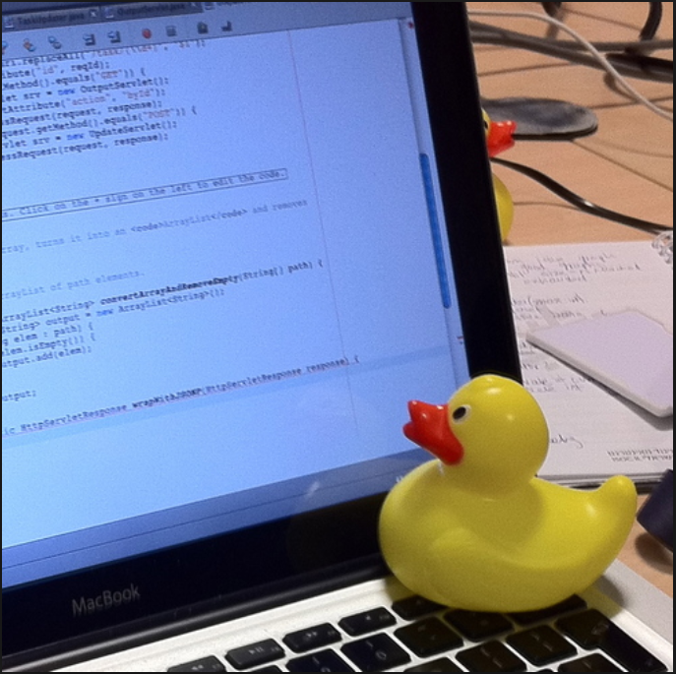

Slide 33
substring
indexOf
compareTo
toString/equals
Notes:
Slides adapted from Tim Clark, John Cargill and Stacey Armstrong

