Slide 1
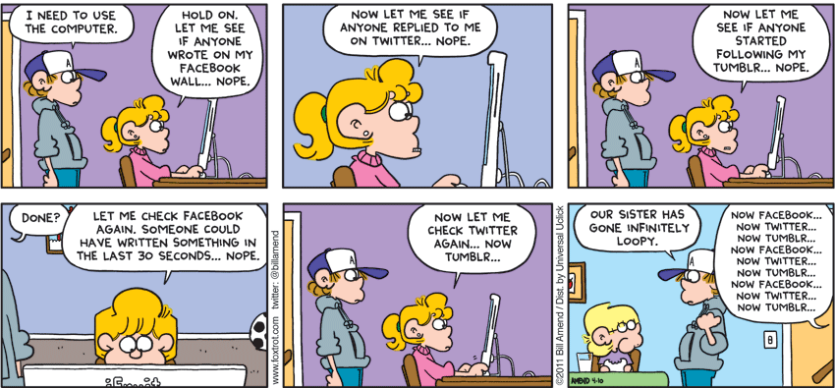
Iteration/Repetition
Notes:
Students learn how to use for loops, use while loops, add iterative processes to their programs, and use Boolean conditions and variables. Students learn the different parts of a loop and when to use a particular type of loop.

Slide 2
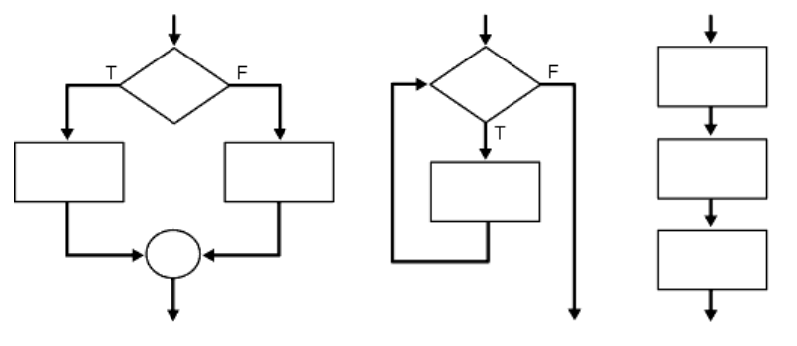
Iteration/Repetition
Selection
Iteration
Sequence
Notes:
Control structures specify the flow of control in your programs. The three fundamental types are sequential, selection and iteration.

Slide 3
While loop
Indefinite iteration
Condition controlled loop
Format
  while condition:
  statements
false
true
Notes:
The while loop is used to iterate a block of code until the checking of the condition expression becomes false.
This type of loop should be used when you don’t know how many iterations are to occur – think indeterminate or indefinite.

Slide 4
While loop – factors
factor.py
1 2 3 4 5 6 7 | n = 91 div = 2 while n % div != 0: print(div, end = " ") div += 1 print("\n" + str(div))
C:\Windows\py.exe
2 3 4 5 6
7

Slide 5
While loop – digits
digits.py
1 2 3 4 5 6 | n = abs(135798642) while n != 0: digit = n % 10 print(digit, end = " ") n //= 10 print("\n" + str(n))
C:\Windows\py.exe
2 4 6 8 9 7 5 3 1
0

Slide 6
While loop – user input
while_avg.py
 | def print_average(): total, cnt = 0, 0 done = False while not done: val = int(input("Type a number: ")) if val >= 0: total += val cnt += 1 else: done = True if cnt > 0: print("Average is", total/cnt) print_average()
C:\Windows\py.exe
Type a number:
Type a number:
Type a number:
Type a number:
Average is 10.0
13
11
6
-1
Notes:
This indefinite loop asks for positive numbers and calculates the average. The loop stops when the user inputs a negative number.

Slide 7
While loop - validating input
It’s important to design your programs such that invalid data is never accepted
Repeatedly prompt the user for data until it’s valid
done = False
ans = ""
while not done:
ans = input("Please enter age: ")
if ans.isdigit():
done = True
else:
print("Invalid response.")
age = int(ans) # now safe to cast

Slide 8
While loop - validating input
It’s important to design your programs such that invalid data is never accepted
Repeatedly prompt the user for data until it’s valid
answer = input("Please enter your weight: ")
while not answer.isdigit():
print("Invalid. Input must be an integer.")
answer = input("Enter your weight: ")
wt = int(answer) # now safe to cast

Slide 9
The for loop
The range function returns an iterable object
Format:
  for var_name in range([min, ] max [, step]):
  statements
  Repeats for values min (inclusive) to max (exclusive)
    min and step are optional (default min 0, step 1)
>>> for i in range(4):
... print(i, end = " ")
0 1 2 3
>>> for i in range(2, 5):
... print(i, end = " ")
2 3 4
Notes:
[ ] – the brackets indicate optional. [min, ] and [, step] are both optional in the range function. By default, they are zero and one respectively.

Slide 10
The for loop
>>> for i in range(15, 0, -5):
... print(i, end = " ")
15 10 5
>>> for i in range(2, 11, 2):
... print(i, end = " ")
2 4 6 8 10

Slide 11
The for loop
>>>s = "I love strings"
# forwards
>>>for i in range(len(s)):
... print(s[i], end = " ")
I l o v e s t r i n g s
# now backwards
>>>for i in range(len(s) -1, -1, -1):
... print(s[i], end = " ")
s g n i r t s e v o l I
Notes:
Be sure to go thru loops_with_strings.py

Slide 12
The for loop
definite iteration
a count-controlled loop
Format
    for var in <iterable/sequence>
    statements
Where iterable is a collection of objects (List, Tuple, String)
The loop variable (named var here) takes on every value in the collection. One at a time for each iteration.
for name in ["raf", "leo", "don", "mike"]:
print(name)

Slide 13
The for loop
1st iteration for name in ["raf", "leo", "don", "mike"]:
print(name)
2nd iteration for name in ["raf", "leo", "don", "mike"]:
print(name)
3rd iteration for name in ["raf", "leo", "don", "mike"]:
print(name)
4th iteration for name in ["raf", "leo", "don", "mike"]:
print(name)

Slide 14
The for loop
>>> list = ["raf", "leo", "don", "mike"]
>>> for name in list:
... print(name, end = " ")
raf leo don mike
>>> for ch in "paradigm":
... print(ch, end = " ")
p a r a d i g m

Slide 15
The for loop
>>> list = ["raf", "leo", "don", "mike"]
>>> for name in list:
... name = "joe"
>>> print(list)
['raf', 'leo', 'don', 'mike']
# changing a copy doesn't change the
# item in the list

Slide 16
split
# breaking up a string with split
>>>s = "I love strings"
>>> for word in s.split(" "):
... print(word)
I
love
strings
Notes:
Syntax
string.split(separator, maxsplit)
Parameter Values
separator is optional and is any whitespace by default. Otherwise, it specifies the separator to use when splitting the string.
maxsplit is optional and is all occurrences (-1) by default. Otherwise, it specifies how many splits to do.

Slide 17
The nested for loop
nested_break_continue.py
1 2 3 4 5 | for i in range(6): for j in range(6): print("*", end=" ") print()
C:\Windows\py.exe
* * * * * *
* * * * * *
* * * * * *
* * * * * *
* * * * * *
* * * * * *
Notes:
A nested loop is a loop inside a loop.
The inner loop must execute a full cycle for each iteration of the outer loop.

Slide 18
The nested for loop
nested_break_continue.py
1 2 3 4 5 | for i in range(6): for j in range(6): print("(", i, ",", j,")", end="", sep="") print()
C:\Windows\py.exe
(0,0)(0,1)(0,2)(0,3)(0,4)(0,5)
(1,0)(1,1)(1,2)(1,3)(1,4)(1,5)
(2,0)(2,1)(2,2)(2,3)(2,4)(2,5)
(3,0)(3,1)(3,2)(3,3)(3,4)(3,5)
(4,0)(4,1)(4,2)(4,3)(4,4)(4,5)
(5,0)(5,1)(5,2)(5,3)(5,4)(5,5)
Notes:
A nested loop is a loop inside a loop.
The inner loop must execute a full cycle for each iteration of the outer loop.

Slide 19
The nested for loop
nested_break_continue.py
1 2 3 4 | for i in range(1, 6): for j in range(i): print("$", end=" ") print()
C:\Windows\py.exe
$
$$
$$$
$$$$
$$$$$
Notes:
The number of iterations of the inner loop is based on the variable from the outer loop.

Slide 20
The nested for loop
nested_break_continue.py
1 2 3 4 | for i in range(5, 0, -1): for j in range(i): print("$", end=" ") print()
C:\Windows\py.exe
$$$$$
$$$$
$$$
$$
$
Notes:
The number of iterations of the inner loop is based on the variable from the outer loop.

Slide 21
continue/break
>>> for i in range(5):
if i==3:
continue
print(i, end = " ")
0 1 2 4
>>> for i in range(5):
if i==3:
break
print(i, end = " ")
0 1 2
while <expr>:
<statement>
<statement>
break
<statement>
<statement>
continue
<statement>
<statement>
<statement>
Notes:
Break exits out of the loop and precedes to the next statement below the block of code the loop resides.
Continue immediately goes to the next iteration of the loop.

Slide 22

Summary
while loop
  - Think indefinite or indeterminate
  - Useful for processes that you don’t know the number of iterations
for loop
  - Think definite or determinate
  - Useful for processes that iterate a fixed number of times
nested loops
  -Just a loop inside of a loop – for each iteration of the outer loop the inner loop goes thru a full cycle

