Slide 1
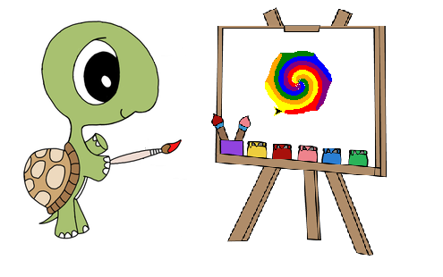
Turtle Graphics
Notes:
Turtle graphics are fun and provide and immediate visual response.
Students will learn to utilize Python’s turtle module to draw an assortment of shapes and pictures. In doing so, students will be practicing all the skills they’ve learned thus far.

Slide 2
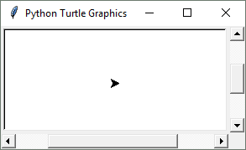
Turtle Module
Turtle graphics is based on a simple metaphor.
It will display a small cursor known as a turtle.
3 basic steps:
Import the turtle module
Create a turtle
Draw using the turtle methods
Notes:
The turtle is facing right (zero degrees or east), with an initial position of (0, 0).

Slide 3
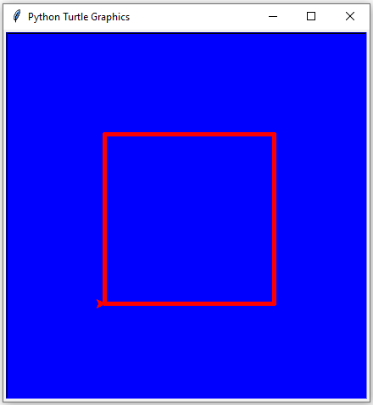
Move and Draw
box.py
1 2 3 4 5 6 | import turtle tortuga = turtle.Turtle() for i in range(4): tortuga.forward(100) tortuga.left(90)
Notes:
import turtle -> loads the module into memory
tortuga = turtle.Turtle() -> creating an object of type turtle and binding to our variable ‘tortuga’
tortuga.forward(100) -> move the turtle in the direction it was pointing 100 pixels
tortuga.left(90) -> turns the turtle counterclockwise 90 degrees

Slide 4
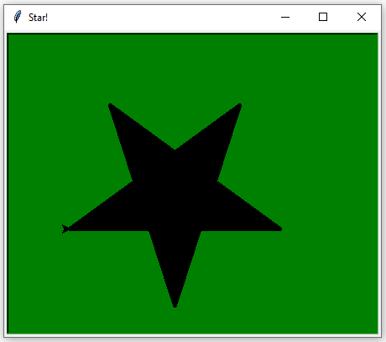
Filling
star.py
1 2 3 4 5 6 | def make_star(emma): emma.begin_fill() for i in range(5): emma.forward(250) emma.left(144) emma.end_fill()
2 4 6 8 9 7 5 3 1
0
Notes:
When running a turtle graphics program not using IDLE, the graphics window will close immediately when the program is done executing.
add turtle.done() to the very end of your program to keep the window open.

Slide 5
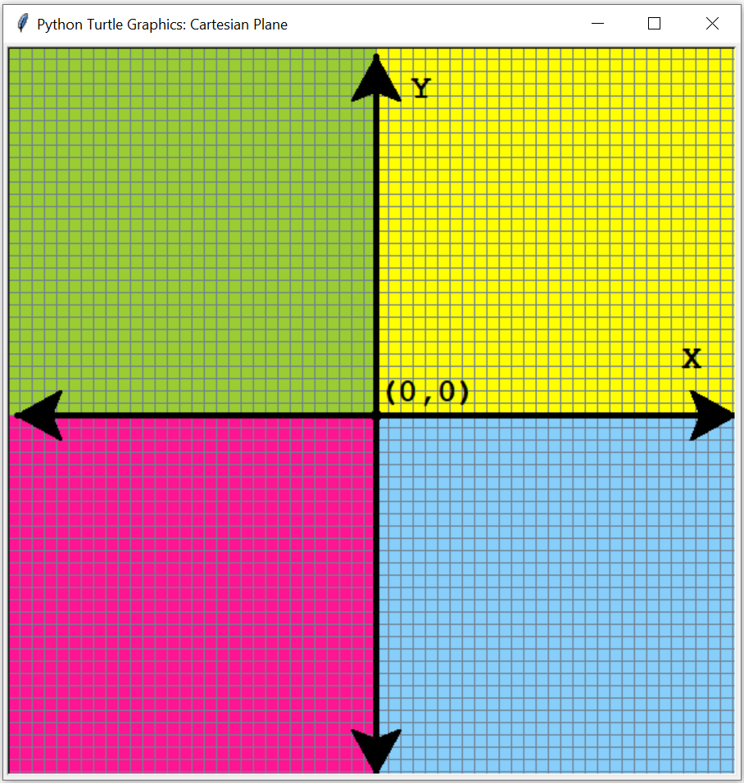
Cartesian Plane
goto(x, y)
setpos(x, y)
pos()
xcor()
ycor()
setx(x)
sety(y)
home()
* invoke on an
instance of Turtle

Slide 6
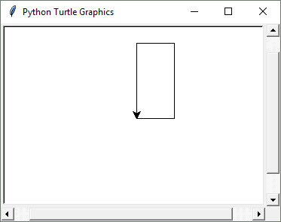
Tell Turtle’s state
>>> import turtle
>>> t = turtle.Turtle()
>>> t.forward(50)
>>> t.setheading(90)
>>> t.forward(100)
>>> t.setheading(180)
>>> t.forward(50)
>>> ang = t.towards(0,0)
>>> t.setheading(ang)
>>> t.fd(100)
Notes:
towards calculates the heading using trigonometry
0 degrees is facing right or east
90 degrees is facing up or north
180 degrees is facing left or west
270 degrees is facing down or south
home() -> sends the turtle to the origin facing east
setx(int or float)
sety(int or float)

Slide 7
Determine Turtle’s state
>>> t = turtle.Turtle()
>>> # some code
>>> if t.isdown():
>>> t.penup()
>>> if t.ycor() < 50:
>>> t.home()
>>> if t.isvisible():
>>> t.hideturtle()
>>> if t.pencolor() == 'red':
>>> t.pencolor('white')
Notes:
isdown() returns True if the pen is down and False otherwise.
xcor() and ycor() return the turtle's X and Y coordinates.
heading() returns the turtle's heading in degrees.
isvisible() returns True if the turtle is visible and False otherwise.
pencolor() without passing an argument returns the pen's color as a string.
fillcolor() without passing an argument returns the pen’s fill color as a string.
pensize() without passing an argument returns the pen’s size as an integer.
speed() without passing an argument returns the current animation speed as an integer.

Slide 8
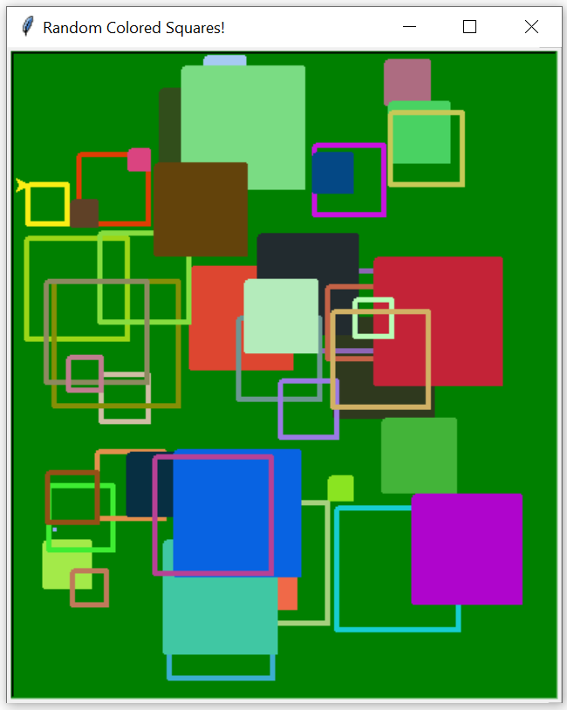
Drawing State
random_squares.py
 | def square(bob, x, y, steps, fill): bob.penup() bob.setpos(x, y) bob.pendown() if fill: bob.begin_fill() for i in range(4): bob.forward(steps) bob.right(90) if fill: bob.end_fill()
13
11
6
-1
Notes:
setpos(x, y) and goto(x, y) do the same thing.
By default, the turtle’s pen is down. When the pen is up, the turtle does not draw as it moves.

Slide 9
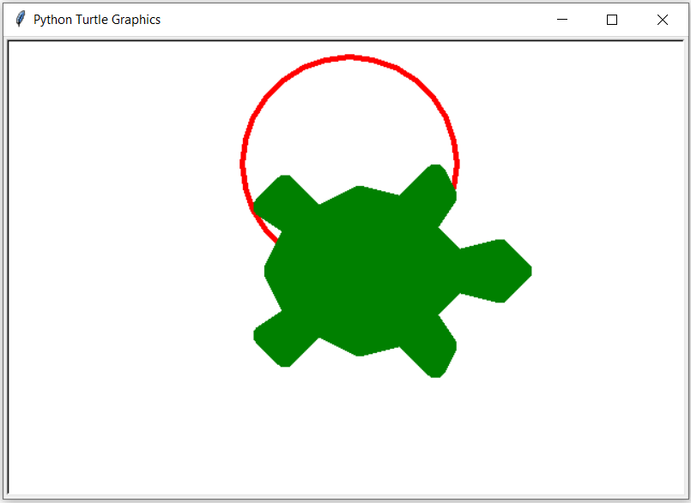
Color and Appearance
>>> import turtle
>>> t = turtle.Turtle()
>>> t.pensize(5)
>>> t.pencolor('red')
>>> t.circle(100)
>>> t.color('green')
>>> t.resizemode('user')
>>> t.shapesize(10,10,20)
>>> t.shape('turtle')
Notes:
“arrow”, “turtle”, “circle”, “square”, “triangle”, “classic” are the valid shapes(you can create your own too)

Slide 10
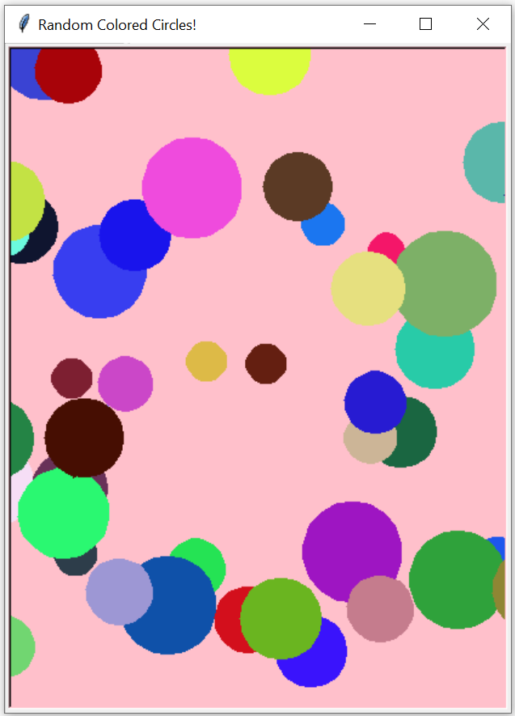
RGB - Red, Green, Blue
circles.py
 | for i in range(100): r = randrange(256) g = randrange(256) b = randrange(256) joe.color(r, g, b) joe.penup() x_pos = randrange(-250, 250) y_pos = randrange(-500, 500) joe.goto(x_pos, y_pos) joe.pendown() joe.begin_fill() joe.circle(randrange(10,40)) joe.end_fill()
13
11
6
-1
Notes:
You must set the color mode to use the RGB color system.
turtle.colormode(255)

Slide 11
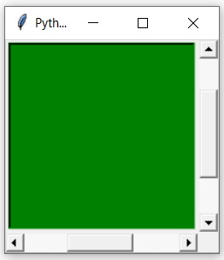
Window Control
>>> import turtle
>>> wn = turtle.Screen()
>>> wn.setup(200, 200)
>>> wn.bgcolor('green')
>>> wn.clearscreen()
>>> wn.resetscreen()
>>> wn.delay(0)
Notes:
turtle.clearscreen() - Delete all drawings and all turtles from the TurtleScreen. Reset the now empty TurtleScreen to its initial state: white background, no background image, no event bindings and tracing on.
turtle.resetscreen() - Reset all Turtles on the Screen to their initial state.
There’s also a reset() and clear() for individual turtles.
When running a turtle graphics program outside IDLE, the graphics window closes immediately when the program is done. Add turtle.done() at the very end of the program so the window will remain open.

Slide 12
Speed and Visibility
turtle.speed(speed=None)
Speeds from 1 to 10 enforce increasingly faster animation of line drawing and turtle turning. 0 means no animation.
bob = turtle.Turtle()
bob.speed(6) # normal speed
bob.speed(10) # fastest speed
bob.speed(1) # slowest speed
bob.speed(0) # ludicrous speed
bob.hideturtle() # makes the turtle invisible
bob.showturtle() # makes the turtle visible
bob.isvisible() # boolean
Notes:
Making the turtle invisible is a good idea to do this while you’re in the middle of doing some complex drawing, because hiding the turtle speeds up the drawing observably.
wn = turtle.Screen()
wn.delay(0) # sets the refresh rate of redrawing the canvas(in milliseconds); animation is slightly perceptable at this rate

Slide 13
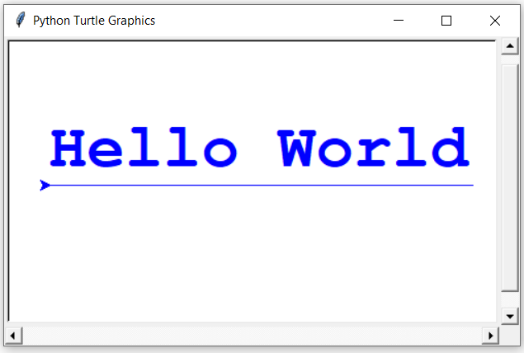
Displaying Text
turtle.write(arg, move=False, align='left', font='Arial', 8, 'normal')
text.py
1 2 3 4 5 6 | import turtle tex = turtle.Turtle() tex.color('blue') tex.fd(210) tex.fd(-410) tex.write('Hello World', font = ('Courier', 46, 'bold'))

Slide 14
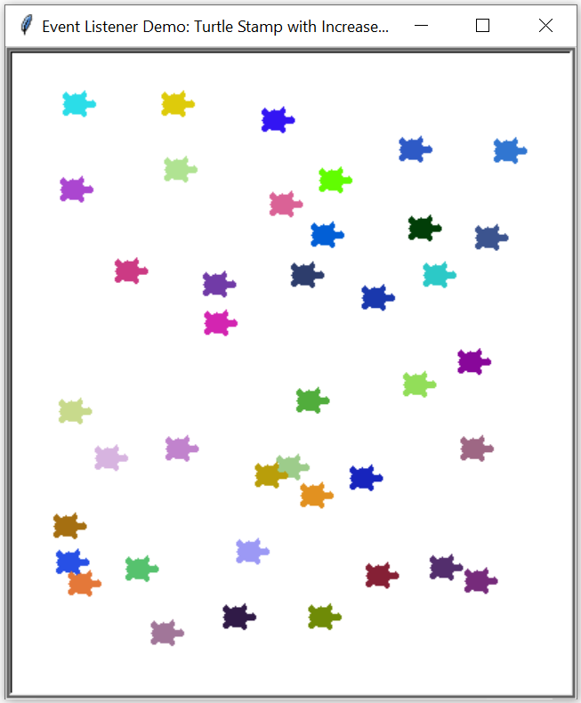
Using Events
turtle.onclick(fun, btn=1)
stamp.py
1 2 3 4 5 6 7 8 | bob = turtle.Turtle() def stamp(x, y): bob.penup() bob.goto(x,y) bob.stamp() wn = turtle.Screen() wn.onclick(stamp)
Notes:
An event is created when the user presses a key, moves the mouse or presses the mouse. The turtle module allows us to listen to events and trigger a function when they occur. For mouse events the function must take two arguments which represent the position(x and y) of the mouse.
turtle.onclick(fun, btn=1)
Parameters
fun – a function with two arguments which will be called with the coordinates of the clicked point on the canvas
btn – number of the mouse-button, defaults to 1 (left mouse button=1, middle mouse button=2, right mouse button=3)
Bind fun to mouse-click events on this screen.
Example for a TurtleScreen instance named screen and a Turtle instance named turtle:
>>> screen.onclick(turtle.goto) # Subsequently clicking into the TurtleScreen will make the turtle move to the clicked point.

Slide 15
Using Events
stamp.py
 | def clear(): bob.clearstamps() def larger(): data = bob.shapesize() # returns a tuple bob.shapesize(data[0] + 1, data[1] + 1, 2) wn = turtle.Screen() wn.onkey(clear, 'c') wn.onkey(larger, 'l') wn.listen()
Notes:
turtle.onkey(fun, key) # on key release; there’s also a onkeypress
Parameters
fun – a function with no arguments
key – a string: key (“a”) or key-symbol (“space”)
You must listen call listen to collect key events, or the functions won’t be triggered.
And shapesize() # returns a tuple(stretch_wid, stretch_len, outline ex (1.0, 1.0, 2)

Slide 16
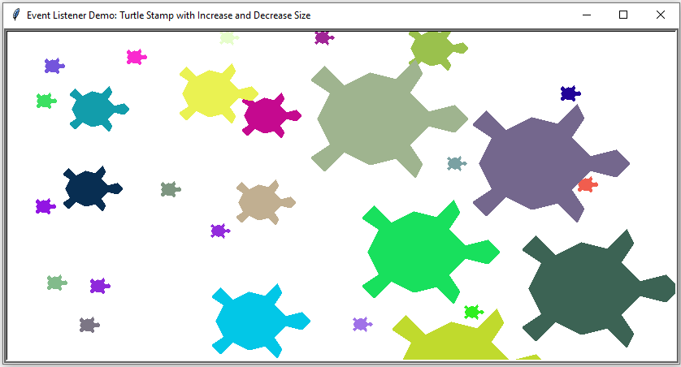
Using Events

Slide 17
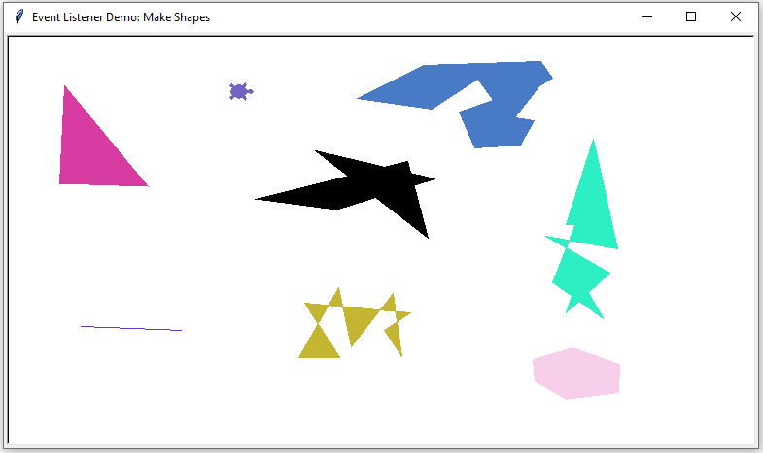
Using Events

Slide 18
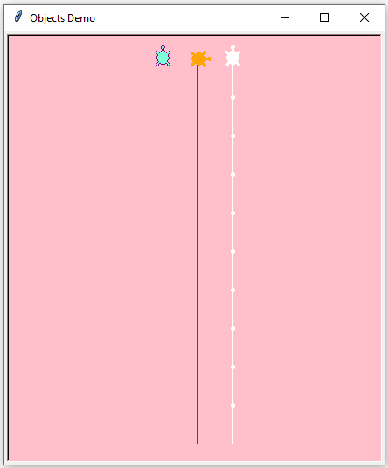
Turtles are Objects
>>> bob = turtle.Turtle()
>>> bob.gender = 'male'
>>>
>>> ann = turtle.Turtle()
>>> ann.gender = 'female'
>>>
>>> sue = turtle.Turtle()
>>> sue.gender = 'female'
Notes:
We added a new attribute to each turtle called gender. We can access it thru dot notation(print(sue.gender)). A better way would be to use inheritance which won’t be covered. Here’s an example if you’re interested:
class FatTurtle(turtle.Turtle):
def __init__(self,age):
super(FatTurtle,self).__init__()
self.age = age
self.shape('turtle')
self.resizemode('user')
self.shapesize(4,4,2)
leatherback = FatTurtle(22) # has all the attributes and behaviors of a turtle with the addition of an age(22). It also starts out with a larger shape.
mudturtle = FatTurtle(40) # age = 40

Slide 19

Summary
Turtle Graphics System
Checking the state of the turtle
Using loops to draw designs
Modularizing your graphics code (use functions)
Events
Objects

