Slide 1
Graphical User Interfaces (GUI)
Notes:
This PowerPoint will provide an introduction to the use of Graphics methods from java.swing and java.awt. Typically, GUI’s are event-driven meaning they respond to events triggered by something (pressing a button, clicking the mouse, typing, etc.). We’ll just be drawing shapes by invoking methods from classes that are a part of java.

Slide 2
Student Learning Objectives
TClark

Slide 3
TClark
Student Learning Objectives
By the end of this lesson, you should be able to:
Create Graphical Applications
Code using package members from awt and swing
Invoke instance methods from the Graphics class
Instantiate Colors and Fonts
Understand the parts of a method signature in Java

Slide 4
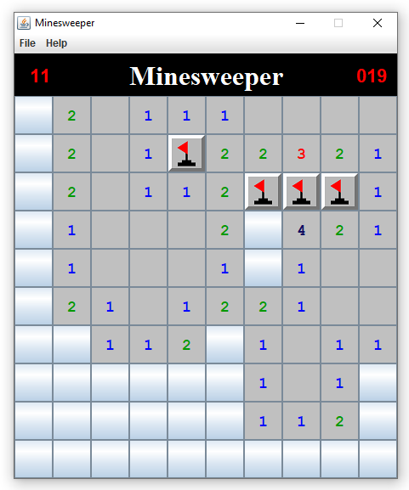
Graphical Applications
Executing a graphical application creates a window on you screen.
Inside that window you can add a multitude of components that can interact with the user.
GUI’s are typically event-driven.
We’ll just be displaying simple shapes.
Rectangles, Ovals, Lines, etc.
Notes:
Minesweeper is a graphical application showing information inside the Frame.
GUI’s are typically event-driven, meaning they respond to events triggered by the user (clicking a button, moving the mouse, pressing a key, etc.).

Slide 5
TClark
Packages
A package is a grouping of related types providing access protection and name space protection – like a folder to organize classes.
2 types: user-defined packages and
Java provides a rich set of built-in packages.
java
lang
util
io
awt

Slide 6
TClark
importing
To import a specific package or package member into the file, put an import statement at the start of the file
Importing an entire package:
import java.awt.*; // place before your class statement
Importing a specific package member:
import java.awt.Color;
import javax.swing.JFrame;
import javax.swing.JPanel;

Slide 7
JFrame Window
TClark

Slide 8
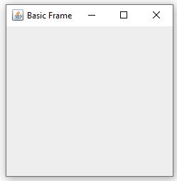
JFrame
To create an instance of the JFrame class.
JFrame frame = new JFrame();
Set the title(optional).
frame.setTitle(“Basic Frame”);
Set the size.
frame.setSize(200, 200);
Stop the program when exiting.
frame.setDefaultCloseOperation(JFrame.EXIT_ON_CLOSE);
Make it visible.
frame.setVisible(true);
Notes:
The code is just missing an import, a class and a main method. Below is the full version.
import javax.swing.JFrame;
public class BasicFrame {
public static void main(String[] args) {
JFrame frame = new JFrame();
frame.setTitle("Basic Frame");
frame.setSize(250, 250);
frame.setDefaultCloseOperation(JFrame.EXIT_ON_CLOSE);
frame.setVisible(true);
}
}

Slide 9
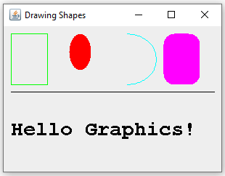
TClark
Drawing on a Component
A computer screen is made up of pixels and
the coordinate system is very similar to that of mathematics.
0
w
x
0
y
h

Slide 10
TClark
Drawing on a Component
A computer screen is made up of pixels – think tiny squares.
the oval below would be smaller than your fingernail.
0
10
x
0
y
7

Slide 11
JPanel,Canvas, JComponent
TClark

Slide 12
Components
Frame / JFrame
Canvas / JPanel /
JComponent
The Frame is used to hold up / display a Canvas , Panel or Component.
Notes:
Frame / JFrame Objects are used to hold up / display Canvas and JPanel Objects. All drawing occurs on the Canvas / JPanel. The JFrame simply provides a place to show Canvas / JPanel after the drawing has occurred.

Slide 13
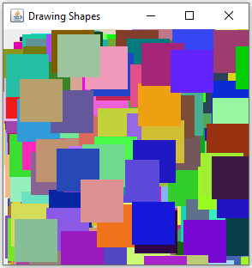
JPanel
Drawing template:
public class RectanglesPanel extends JPanel {
public void paintComponent(Graphics g) {
// your drawing instructions here
}
}
Create a component object:
RectanglesPanel component = new RectanglesPanel();
Add the component to the frame
frame.add(component);
Notes:
You can’t draw on a frame. The drawing happens in a component object. And since we don’t want a blank picture, we’ll need to modify the component class.
JPanel is a fundamental class in Swing and is just a blank container. It’s extremely useful in two ways:
To draw stuff on it
To add other containers inside of it (buttons, text, labels, sliders, even JPanels and much more)

Slide 14
Colors
TClark

Slide 15

Color
The java.awt.Color class has 13 predefined colors.
BLACK, BLUE, CYAN, DARK_GRAY, GRAY, GREEN, LIGHT_GRAY, MAGENTA,
ORANGE, PINK, RED, WHITE, YELLOW
You may use any of the predefined colors by accessing these public static fields.
Color.GREEN
The Color class has seven constructors that may be used to create Color objects. The most common one is
Color myColor = new Color(red, green, blue);
Where the red, green and blue are values in the range of [0, 255].
Color fuschia = new Color(236, 0, 140);
Notes:
The Java.awt Color class has thirteen predefined colors. You can also create your own color using a statement of the form: Color myColor = new Color(r.g,b); where r, g, and b are the red, green, blue values for your color (ranging from 0 to 255). You can then use your newly created color anywhere you can use the predefined colors. For example:
Color brown = new Color(128, 70, 27);
window.setColor(brown);

Slide 16
Shapes
TClark

Slide 17
Graphics
The java.awt.Graphics class has many instance methods for drawing various shapes such as lines, rectangles, ovals and polygons.
The shapes are drawn using the (x, y)
coordinate system as described earlier.
The shapes are drawn using the current
color of the graphics context.
The methods are invoked thru an object
of type Graphics.

Slide 18
TClark
Graphic Instance Methods
Method Name | Purpose
setColor(c) | sets the current drawing color to c
drawRect(x,y,w,h) | draws an unfilled rectangle at (x, y) w wide and h tall
fillRect(x,y,w,h) | draws a filled rectangle at (x, y) w wide and h tall
drawOval(x,y,w,h) | draws an unfilled oval at (x, y) w wide and h tall
fillOval(x,y,w,h) | fills an oval at (x, y) w wide and h tall
drawLine(x1,y1,x2,y2) | draws a line from (x1, y1) to (x2, y2)
drawArc(x,y,w,h,s,d) | draws an elliptical arc covering the specified rectangle
fillArc(x,y,w,h,s,d) | fills an elliptical arc covering the specified rectangle
drawString(s,x,y) | draws String s at spot x, y

Slide 19
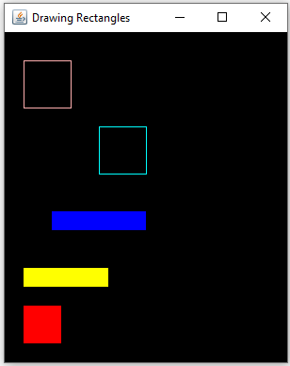
TClark
Rectangles
x
g.setColor(Color.PINK);
g.drawRect(20, 30, 50, 50); // x,y,w,h
g.setColor(Color.CYAN);
g.drawRect(100, 100, 50, 50);
g.setColor(Color.BLUE);
g.fillRect(50, 190, 100, 20);
g.setColor(Color.YELLOW);
g.fillRect(20, 250, 90, 20);
g.setColor(Color.RED);
g.fillRect(20, 290, 40, 40);
y

Slide 20
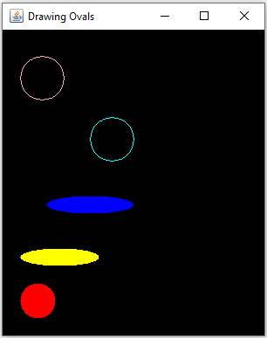
TClark
Ovals
x
g.setColor(Color.PINK);
g.drawOval(20, 30, 50, 50); // x,y,w,h
g.setColor(Color.CYAN);
g.drawOval(100, 100, 50, 50);
g.setColor(Color.BLUE);
g.fillOval(50, 190, 100, 20);
g.setColor(Color.YELLOW);
g.fillOval(20, 250, 90, 20);
g.setColor(Color.RED);
g.fillOval(20, 290, 40, 40);
y

Slide 21
TClark
Arcs
Method Name | Purpose
drawArc(x,y,w,h,startAngle,arcAngle) | draws an elliptical arc covering the specified rectangle at (x,y) with with w and height h
fillArc(x,y,w,h,startAngle,arcAngle) | fills an elliptical arc covering the specified rectangle at (x,y) with with w and height h
startAngle specifies the start of the arc going from 0 to 360 with 0 being the leftmost point of the oval (dead east or 3 o’clock) and going counter-clockwise arcAngle specifies the degrees of the arc w/ positive degrees going counter-clockwise and negative degrees clockwise

Slide 22
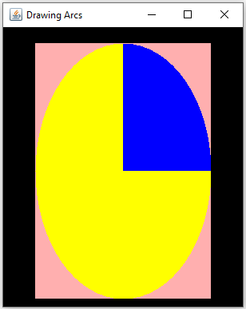
TClark
Arcs
x
g.setColor(Color.PINK);
g.fillRect(x, y, w, h);
g.setColor(Color.YELLOW);
g.fillOval(x, y, w, h);
g.setColor(Color.BLUE);
g.fillArc(x, y, w, h, 0, 90);
The startAngle is at 0
The arcAngle is 90 degrees counter-clockwise
y

Slide 23
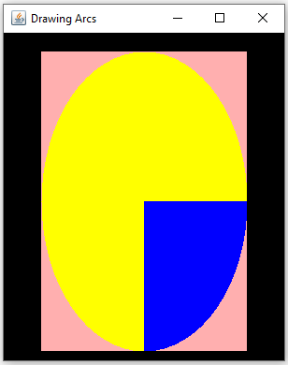
TClark
Arcs
x
g.setColor(Color.PINK);
g.fillRect(x, y, w, h);
g.setColor(Color.YELLOW);
g.fillOval(x, y, w, h);
g.setColor(Color.BLUE);
g.fillArc(x, y, w, h, 0, -90);
The startAngle is at 0
The arcAngle is 90 degrees clockwise
y

Slide 24
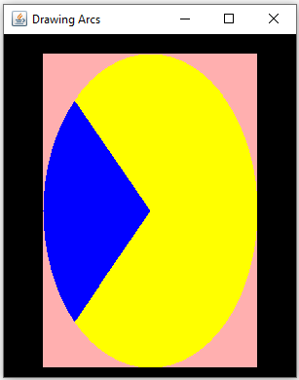
TClark
Arcs
x
g.setColor(Color.PINK);
g.fillRect(x, y, w, h);
g.setColor(Color.YELLOW);
g.fillOval(x, y, w, h);
g.setColor(Color.BLUE);
g.fillArc(x, y, w, h, 135, 90);
The startAngle is at 135
The arcAngle is 90 degrees counter-clockwise
y

Slide 25
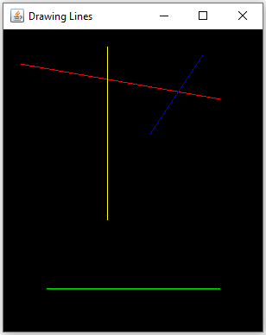
TClark
Lines
x
//drawLine(int x1, int y1, int x2, int y2)
g.setColor(Color.RED);
g.drawLine(20, 40, 250, 80);
g.setColor(Color.YELLOW);
g.drawLine(120, 20, 120, 220);
g.setColor(Color.BLUE);
g.drawLine(230, 30, 170, 120);
g.setColor(Color.GREEN);
g.drawLine(50, 300, 250, 300);
y

Slide 26
Fonts
The java.awt.Font class has 5 logical font families that must be supported by any JRE: Serif, SansSerif, Monospaced, Dialog and DialogInput.
The class also supports physical fonts and much more.
1 contructor:
public Font(String name, int style, int size)
String name – the name of the font.
int style – represented by the class constants, BOLD, ITALIC, PLAIN
size – the size of the font
Font serif = new Font(Font.SERIF, Font.PLAIN, 22);
Font sansSerif = new Font(Font.SANS_SERIF, Font.BOLD, 14);

Slide 27
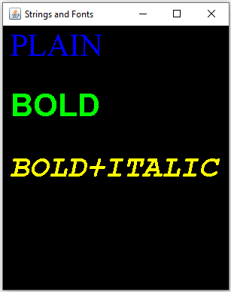
TClark
Strings
drawString(s, x, y) draws String s at spot x, y
x, y is at the bottom left of the text
g.setColor(Color.BLUE);
Font serif = new Font(Font.SERIF, Font.PLAIN, 22);
g.setFont(serif);
g.drawString("PLAIN", 10, 40);
g.setColor(Color.GREEN);
Font sansSerif = new Font(Font.SANS_SERIF, Font.BOLD, 22);
g.setFont(sansSerif);
g.drawString("BOLD", 10, 120);
g.setColor(Color.YELLOW);
Font mono = new Font(Font.MONOSPACED, Font.BOLD + Font.ITALIC, 22);
g.setFont(mono);
g.drawString("BOLD+ITALIC", 10, 200);

Slide 28
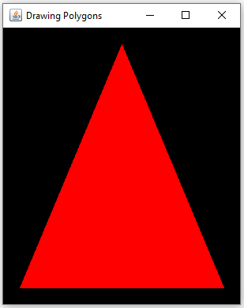
TClark
Polygons
The java.awt.Polygon class represents a two-dimension region bounded by an arbitrary number of line segments. It consists of a list of x, y pairs where each pair is a vertex and successive pairs are endpoints of a line segment.
g.setColor(Color.RED);
int[] xPts = {20, 150, 280};
int[] yPts = {330, 20, 330};
Polygon triangle = new Polygon(xPts, yPts, 3);
g.fillPolygon(triangle);
x
y

Slide 29
Methods
TClark

Slide 30
Method Signature
We define a method by specifying an access modifier (public, private, protected), followed by non-access modifiers (optional), followed by a method’s return type, followed by an identifier (name), followed by an open parenthesis, followed by a method’s parameters (optional) and lastly a closed parenthesis.
[access modifier]
[non-access modifiers]
return type
identifier
([parameters])
{
// your code
}

Slide 31
Method Signature
[access modifier] [non-access modifiers] return type identifier ( [parameters] )
public void printHelloWorld()
{
System.out.println(“Hello World!”);
}
public void printName(String name) {
System.out.printf(“My name is %s.”, name);
}

Slide 32
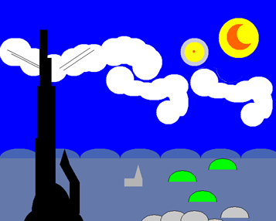
Decomposition
the process of breaking down a large or complex problem into more manageable units (objects/methods) that are easier to comprehend, code/program, maintain and debug.
public void paintComponent(Graphics g) {
tower(g);
cloud(g, 300, 200);
cloud(g, 500, 200);
}
private void cloud(Graphics g, int x, int y)
{ // add your code}

Slide 33
GUI
JPanel
Shapes/Colors/Fonts
Methods()/Decomposition
Notes:
Slides adapted from Tim Clark, John Cargill and Stacey Armstrong

