Slide 1
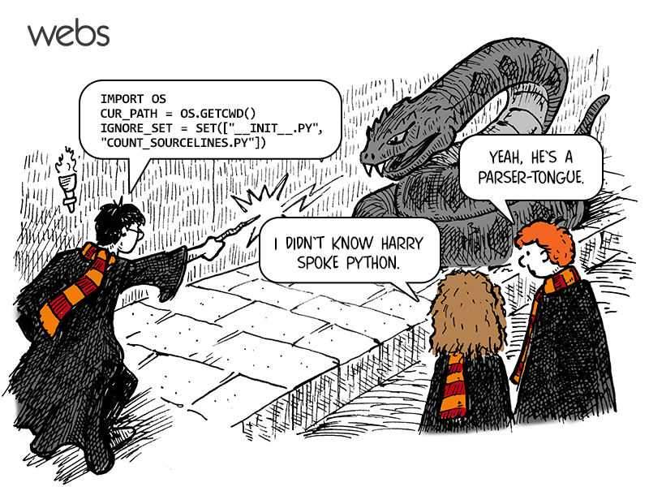
Python!
Notes:
Welcome to programming in Python! You’ll be learning how to code computer programs to solve various problems this semester.

Slide 2
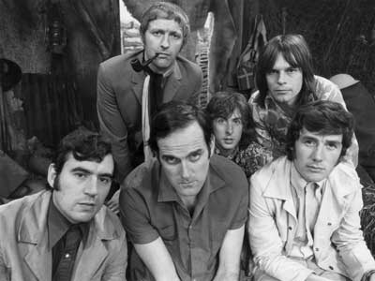
Python!
Created in 1991 by Guido van Rossum
Named for Monty Python
Useful as a scripting language
script: A small program meant for one-time use
Relatively simple and widely used
Used by:
Google, Yahoo!, Youtube
Many Linux distributions
Games and apps
Notes:
From the man himself:
"Over six years ago, in December 1989, I was looking for a "hobby" programming project that would keep me occupied during the week around Christmas. My office (a government-run research lab in Amsterdam) would be closed, but I had a home computer, and not much else on my hands. I decided to write an interpreter for the new scripting language I had been thinking about lately... I chose Python as a working title for the project, being in a slightly irreverent mood (and a big fan of Monty Python's Flying Circus).“
From the forward of "Programming Python" (1st ed.) by Mark Lutz, published by O'Reilly
It has evolved over the years but remains a simple language that appeals to a wide audience.
And it supports multiple programming paradigms including procedural, object-oriented and functional programming.

Slide 3
Installing Python
Windows:
Download Python from http://www.python.org
Install Python.
Run Idle from the Start Menu.
Mac OS X:
Python is already installed.
Open a terminal and run python or run Idle from Finder.
Linux:
Chances are you already have Python installed. To check, run python from the terminal.
If not, install from your distribution's package system.
Notes:
Python is cross-platform (runs of multiple platforms), open-source and free to download.
Python underwent a major release in 2008 with Python 3 which we’ll be using in this course. Python 3 is not backwards compatible and will not work with earlier versions. And code in Python 2 (and earlier) will not work in 3.0 and beyond.
Python is maintained by the Python Software Foundation. Please go to https://www.python.org/ and roam the site.

Slide 4
Introduction
Computers can be programmed
Designed to do any job that a program tells them to
Program: set of instructions that a computer follows to perform a task
Commonly referred to as Software
CS I K is a computer programming course!
Programmer: person who can design, create, and test computer programs
Aka software developer
Everyone in this course

Slide 5
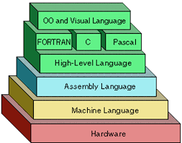
High-Level Languages
Low-level language: close in nature to machine language
Example: assembly language, machine code
High-Level language: allows simple creation of powerful and complex programs
No need to know how CPU works or write large number of instructions
More intuitive to understand
Notes:
"High-level language" refers to the higher level of abstraction from machine language. Rather than dealing with registers, memory addresses and call stacks, high-level languages deal with variables, arrays, objects, complex arithmetic or boolean expressions, subroutines and functions, loops, threads, locks, and other abstract computer science concepts, with a focus on usability over optimal program efficiency. Unlike low-level assembly languages, high-level languages have few, if any, language elements that translate directly into a machine's native opcodes.” - Wikipedia

Slide 6
Instruction Cycle
Program must be copied from secondary memory to RAM each time CPU executes it
CPU executes program in cycle:
Fetch: read the next instruction from memory into CPU
Decode: CPU decodes fetched instruction to determine which operation to perform
Execute: perform the operation
Notes:
Major Hardware Components that make up a Computer
Central processing unit (CPU): the part of the computer that actually runs programs
Main memory: where computer stores a program while program is running, and data used by the program
Known as Random Access Memory or RAM
CPU is able to quickly access data in RAM
Volatile memory used for temporary storage while program is running
Contents are erased when computer is off
Secondary storage: can hold data for long periods of time
Programs normally stored here and loaded to main memory when needed
Disk drive: magnetically encodes data onto a spinning circular disk
Solid state drive: faster than disk drive, no moving parts, stores data in solid state memory
Flash memory: portable, no physical disk
Optical devices: data encoded optically
Input device: component that collect data
keyboard, mouse, touchscreen, scanner, camera
Output device: formats and presents output
- video display, printer

Slide 7
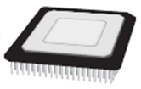
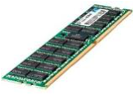
Instruction Cycle
Fetch the next instruction in the program.
Decode the instruction to determine which operation to perform.
Execute the instruction (perform the operation).
10100001
00011010
10010111
11110011
…
Main memory (RAM)
All data in a computer is stored in sequences of 0s and 1s. A binary digit or bit is an electrical component that can hold positive or negative charge, like on/off switch. The on/off pattern of bits are used to represent everything!

Slide 8
Interpreted Languages
Interpreter: translates and executes instructions in high-level language program
Used by Python language
Interprets one instruction at a time
Type commands into interpreter and see immediate results
Or code is written and then directly executed by an interpreter
No separate machine language program
Python:
Code
Interpreter
Machine Instruction
CPU
Notes:
Python programs start as source code in files that typically end in “.py”. The source code contains the code that makes up the program. To run or execute the program, Python uses an interpreter program to read the source files and convert it to machine commands. This happens on the fly or as the program is running.

Slide 9
Strings
A sequence of characters. "hello" 'Here is "another" with quotes in'
Restrictions:
Strings surrounded by " " or ' ' may not span multiple lines
"This is not a legal String."
Strings surrounded by " " may not contain a " character.
"This is not a "legal" String either."
Strings surrounded by ' ' may not contain a ' character. 'This is not a 'legal' String either.'
Notes:
Strings store sequences of characters and can hold 1 character like “y”, short phrases like “look”, very long sentences or paragraphs, and can be empty like “”. In Python a String is always enclosed or surrounded by a matched set of single quotes ‘example’ or double quotes “example”.
Python supports many operators and operands for joining objects. This is just like math! 3 * 5 is legal, but 3 5 is not.
You must have an operator between two operands. Python supports adding String objects (called concatenation) with the + operator.
“This is a ” + “legal” + “ String.”

Slide 10
The print Statement
print.py
1 2 3 4 | print("Hello, world!") print() print("This program produces") print('four lines of output')
C:\Windows\py.exe
Hello, world!
This program produces
four lines of output
Notes:
Python programs are coded as a sequence of statements (lines of code).
Each statement is on one line of code.
Python knows this because you hit the enter key at the end of a line.
The program will run one statement at a time starting at the top by default and moving down.
print() is a function that is built into Python.
A function is a block of code that performs some task.
We’ll be coding our own functions soon but for now we’ll be calling or invoking functions that are a part of the Python language.
print() lets you send output to the console window.

Slide 11
Comments
Syntax:
# comment text (one line)
comments.py
1 2 3 4 5 6 | # Joe Bob Student, Computer Programming K # This program prints a message about python print("Python is an interpreted, high level,") print("general-purpose programming language.") print('First released in 1991.') # single quote works
Notes:
Comments are completely ignored when the program executes.
Comments should make the code more understandable to someone reading the code.
Add comments where you feel an explanation would be helpful.

Slide 12
Comments
Syntax:
””” Multiline comments start and end with 3
quotation marks ”””
comments2.py
1 2 3 4 5 6 | ””” This is a comment And so is this And so is this ””” print("this is not a comment")

Slide 13
Escape Sequences
A special sequence of characters used to represent certain special characters in a string.
\t tab character
\n new line character
\" quotation mark character
\' quotation mark character
\\ backslash character
>>> print("\\hello\nhow\tare \"you\"?\\\\")
\hello
how are "you"?\\
>>>

Slide 14
Escape Sequences
What is the output of the following print statements?
print("\ta\tb\tc")
print("\\\\")
print("'")
print("\"\"\"")
print("C:\nin\the downward spiral")
Write a print statement to produce this output:
/ \ // \\ /// \\\

Slide 15
Escape Sequences
Output of each print statement:
a b c
\\
'
"""
C:
in he downward spiral
print statement to produce the line of output:
print("/ \\ // \\\\ /// \\\\\\")

Slide 16
print function
Accepts a variable number of positional arguments.
Items are separated by commas when passed as arguments
Arguments displayed in the order they are passed to the function
Items are automatically separated by a space when displayed
print("This","prints","on","one","line.")
print("And", "so", "does",
"this", "even", "though", "it's",
"on", "three", "lines.")
>>>
This prints on one line.
And so does this even though it's on three lines.
>>>
Notes:
From PEP 8
The preferred way of wrapping long lines is by using Python's implied line continuation inside parentheses, brackets and braces. If necessary, you can add an extra pair of parentheses around an expression, but sometimes using a backslash looks better. Make sure to indent the continued line appropriately. The preferred place to break around a binary operator is after the operator, not before it.
When you use print() with multiple parameters, it will automatically insert a space between each string value.

Slide 17
print function
print function uses space as item separator
Special argument sep='delimiter' causes print to use delimiter as item separator
>>> print("Y","O","L","O", sep = '-')
Y-O-L-O
>>> print("Y","O","L","O", sep = '')
YOLO
Notes:
If you don't want any separator at all, use sep="" or ‘’ with nothing between the quotes.
“” is an empty string.

Slide 18
print function
print function displays line of output
Newline character at end of printed data
Special argument end='delimiter' causes print to place delimiter at end of data instead of newline character
>>> print("Hi", end = '!')
>>> print("There", end = '.')
Hi!There.
# The delimiter/cursor is currently after the period
Notes:
The empty String in Python has no characters and two quotation marks next to each other like “”.
You can set end = “” to the empty string so stay on the same line.
print(“1+”, end = “”)
print(“2 == 3”)
Outputs
1+2 == 3

Slide 19
print function
blastoff.py
1 2 3 4 | print("5", end = " ") print("4", end = " ") print("3", end = " ") print(2, 1) print("Blast", "off!", sep = "-")
C:\Windows\py.exe
5 4 3 2 1
Blast-off!
Notes:
You can pass in multiple arguments to the print() function, and it will automatically convert them to strings and join them together with a separator and end-of-line character.

Slide 20
Line Continuation \
Multiline continuation character (\): Allows to break a statement into multiple lines – use sparingly
>>> print("This will\
>>> continue on the same\
>>> line.")
This will continue the same line.
>>> x = 1 + 2 + 3 + 4 + \
>>> 5 + 6 + 7 + 8 + 9 + 10
>>> print(x)
55
Notes:
The line continuation character \ is a backslash at the end of a line which indicates to continue the statement to the next line ignoring the new line character (\n when you hit “Enter”).
It may be used to explicitly join 2 or more lines.
Python documentation: https://docs.python.org/3/reference/lexical_analysis.html#explicit-line-joining

Slide 21
Interactive Mode
When you start Python in interactive mode, you will see a prompt
Indicates the interpreter is waiting for a Python statement to be typed
Prompt reappears after previous statement is executed
Error message displayed If you incorrectly type a statement
Allows you to type commands one-at-a-time and see results
A great way to explore Python's syntax
Repeat previous command: Alt+P

Slide 22
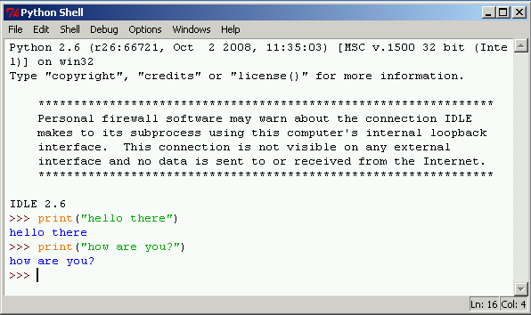
Interactive Mode
Allows you to type commands one-at-a-time and see results
A great way to explore Python's syntax
Statements entered in interactive mode are not saved as a program

Slide 23
Script Mode
Script mode: save statements in Python script
Must use script mode to have a program
Save a set of Python statements in a file
The filename should have the .py extension
To run the file, or script, type
filename.py
at the operating system command line
- Or run the script from an IDE (IDLE/Wing/Atom/Spyder)

Slide 24
Command Prompt
Here’s a one-line source file named first.py that prints a message to the screen.
print("CS I K Python Programming")
To run from the Windows Command Prompt or Mac OS terminal type "python" followed by the file name.
Often your program will reside in a different directory in which you’ll need to specify the absolute path to the file.
C:\users\s123456\desktop\CSI\> python first.py
CS I K Python Programming
C:\users\student\> python "C:\users\student\docs\project\first.py"
CS I K Python Programming

Slide 25
IDLE
Fortunately, many tools and software applications have been developed for you to write code (you don’t have to use the command prompt ☺).
IDLE (Integrated DeveLopment Environment): single program that provides tools to write, execute and test a program all inside a graphical interface
Automatically installed when Python language is installed
Runs in interactive mode
Has built-in text editor with features designed to help write Python programs
hello.py
1 | print("Hello, world!")
Notes:
An IDE or Integrated Development Environment is an application that lets you code inside a graphical interface. You don’t have to use the command line and a separate text editor.
Python comes with an easy-to-use IDE called IDLE and there are many more that can be downloaded. Try searching best Python IDE.

Slide 26
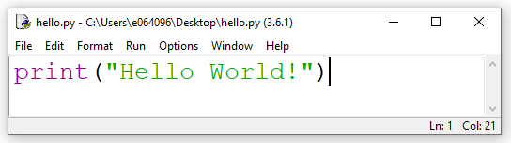
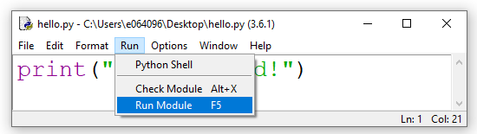
Hello World Program

Slide 27
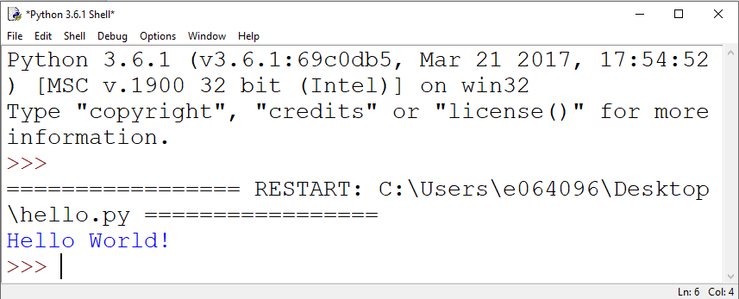
Hello World Program

Slide 28
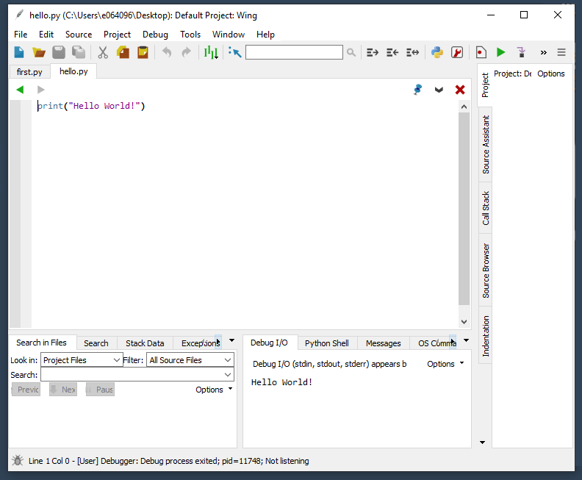
Wing IDE
Notes:
There are many text editors and IDE’s for Python. Both allow you to write code. A text editor allows you, as the name suggests, to edit text.
An IDE will have a text editor with a set of tools that all work together. An IDE allows programmers to run/execute the code, debug, and much more.
A few text editors:
Sublime Text
Notepad++
Vim
Emacs
Atom (lightweight IDE)
IDE’s:
Sypder
Wing
PyDev
PyCharm
Thonny

Slide 29
Summary
Installing Python and the Python interpreter modes
Fetch-decode-execute cycle
Use of comments in programs
Strings
Escape Sequences
Ways in which programs can present and format output

