Slide 1
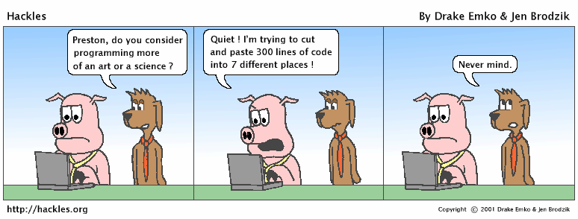

Variables/Expressions/Input

Slide 2
Data Types
Internally, computers store everything as 1s and 0s
104 → 01101000
'hi' → 0110100001101001
'h' → 01101000
How are h and 104 differentiated?
type: A category or set of data values.
Constrains the operations that can be performed on data
Many languages ask the programmer to specify types
Examples: integer, real number, string
Notes:
A data type has a set of values and operations on those values.

Slide 3
Data Types
Data types: categorize value in memory
e.g., int for integer, float for real number, str used for storing strings in memory
Numeric literal: number written in a program
No decimal point considered int, otherwise, considered float
Some operations behave differently depending on data type
Notes:
The amount of memory used to store a data type depends on the type of data.
Python has two main numeric literals: integers, and floating-point numbers.
Integers are positive or negative whole numbers (includes zero). Do not add commas or spaces in your code.
Floating-Point Numbers are real numbers. The fractional part could be zero such as 1.000 but they are composed of an integer part and a fractional part separated by a decimal point.

Slide 4
Data Types
Type | Example
int | -4, 0, 3
float | 4.5, 3.14
complex | 2 + 3j
boolean | True, False
string | "Hello"
list | ["apple", "banana", "cherry"]
tuple | ("kiwi", "mango")
NoneType | None (special has 1 value)
# Can use type() to see the type of object
>>> type(3.5)
<class 'float'>
Notes:
Python has a variety of data types. You can also make your own. The table here lists some of Python’s basic data types.

Slide 5
Expressions
expression: A value or operation that computes a value.
Examples: 1 + 4 * 5
(7 + 2) * 6 / 3
42.0
The simplest expression is a literal value.
combine objects and operators to form expressions
an expression has a value, which has a type
syntax for a simple expression
<object> <operator> <object>
Notes:
How and if the operator works depends on the data type. Math with numeric values works the same as you would expect. Can you multiply, divide, add or subtract strings? The answer is yes, and no. Try it out yourself.
Python examines the data types of your operands and produces a result of the correct data type.
1 + 1 # type integer
1 + 2.2 # type floating point number
4 / 2 # type floating point number; division always results in a real number

Slide 6
Expressions
operator: Combines multiple values or expressions.
+ addition
- subtraction (or negation)
* multiplication
/ division
// integer division (a.k.a. leave off any remainder)
% modulus (a.k.a. remainder)
** exponent

Slide 7
Expressions
Python operator precedence:
Operations enclosed in parentheses
Force's operations to be performed before others
Exponentiation (**)
Multiplication (*), division (/ and //), and remainder (%)
Addition (+) and subtraction (-)
Higher precedence performed first
Same precedence operators execute from left to right

Slide 8
Expressions
Exponent operator (**): Raises a number to a power
3 ** 5 == 3⁵
Integer division operator(//): Performs division and rounds down
37 // 10 == 3
Remainder operator (%): Performs division and returns the remainder
a.k.a. modulus operator
e.g., 7 % 5 == 2, 3 % 5 == 3
Useful for converting times/distances and odd/even numbers

Slide 9
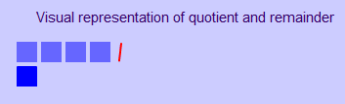


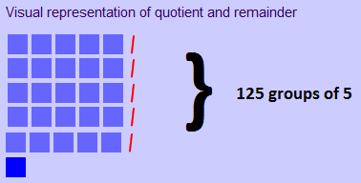
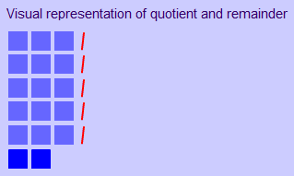


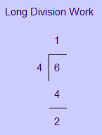
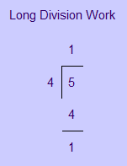
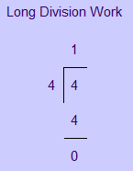
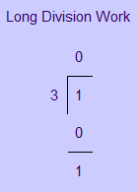
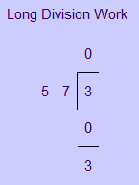
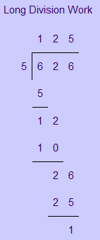
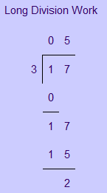
Modulus Operator
5 % 4 ==
1
1 % 3 ==
1
3 % 57 ==
3
4 % 4 ==
0
6 % 4 ==
2
17 % 3 ==
2
626 % 5 ==
1

Slide 10
Variables
Variable: name that represents a value stored in the computer memory
Used to access and manipulate data stored in memory
A variable references the value it represents
Assignment statement: used to create a variable and make it reference data
General format is variable = expression
Example: age = 29
Assignment operator: the equal sign (=)
An assignment binds a name to a value
Notes:
age = 29
Some languages require you to specify a type, but Python knows the type based on the data you store in it. This happens automatically based on the type of the expression.
Assignment statements have 3 parts.
age is the variable name is on the left-hand side of the assignment operator (=)
29 is an expression and is on the right-hand side of the assignment operator (=)

Slide 11
Variables
Rules for naming variables in Python:
Variable name cannot be a Python key word
Variable name cannot contain spaces
First character must be a letter or an underscore
After first character may use letters, digits, or underscores
Variable names are case sensitive
Variable name should reflect its use
python convention is to separate words with _ ‘s
my_age = 5
Notes:
Variable names should be meaningful and descriptive.
Don’t make names too long where they are hard to read or conversely too short where they become ambiguous.
Avoid misleading names.

Slide 12
Variables
Rules for naming variables in Python:
[_a-zA-Z][_0-9a-zA-Z]*
names.py
1 2 3 4 5 6 7 | comp_sci_1_k_grade = 100 # preferred convention in Python compSci1KGrade = "ninety" # camel-case COMPSCI1KGRADE = 80.7 # in all caps - hard to read cOmPsCi1kGrAdE = "seventy" # alternating - hard to read # never use a singular l (el), O (oh) or I (eye) # always use meaningful names
Notes:
From PEP 8 -- Style Guide for Python Code - https://www.python.org/dev/peps/pep-0008/
Descriptive: Naming Styles
There are a lot of different naming styles. It helps to be able to recognize what naming style is being used, independently from what they are used for.
The following naming styles are commonly distinguished:
b (single lowercase letter)
B (single uppercase letter)
lowercase
lower_case_with_underscores
UPPERCASE
UPPER_CASE_WITH_UNDERSCORES
CapitalizedWords (or CapWords, or CamelCase -- so named because of the bumpy look of its letters ). This is also sometimes known as StudlyCaps.
Note: When using acronyms in CapWords, capitalize all the letters of the acronym. Thus HTTPServerError is better than HttpServerError.
mixedCase (differs from CapitalizedWords by initial lowercase character!)
Capitalized_Words_With_Underscores (ugly!)

Slide 13
Variables
Compute the rhs (right hand side) -> value
Store it (aka bind it) to the lhs (left hand side) -> variable
lhs will be replaced with new value
= is called assignment
Assignment uses = , but it is not an algebraic equation.
The right-side expression is evaluated first, and then its result is stored in the variable at left.
x = 3 * 5
x = x + 2

Slide 14
Variable Binding
A variable in Python can refer to any type of item
x refers to an integer
x = 9
x 9
x refers to a string
x = "Hello"
x 9
"Hello"

Slide 15
String Variables
A string variable stores a sequence of characters.
Combine 2 or more strings using the plus (+) operator.
strings.py
1 2 3 4 | empty_str = "" one_char = "K" phrase = "CS 1" concatenation = phrase + one_char
Notes:
A string variable stores a sequence of characters. A string can hold zero characters like "", one character like “y” or “no”, a short phrase like “CS I K”, and very long sentences.
Adding Strings together is called concatenation. Python will not add spaces between. The strings are merged or glued together.

Slide 16
Variable Casting
Built-in functions convert between data types
str(item) converts item to a string
Python will only concatenate string objects or a TypeError will occur
casting.py
1 2 3 4 | gpa = 4.0 print("Your GPA is " + str(gpa)) print("Your GPA is", gpa)
Notes:
gpa = 4.0
str_gpa = str(gpa) # “4.0”

Slide 17
Variable Casting
Built-in functions convert between data types
int(item) converts item to an int
float(item) converts item to a float
Type conversion only works if item is valid numeric value, otherwise, throws exception
cast.py
1 2 3 4 | num_str = "1234" num = int(num_str) dec = 3.4 x = int(dec) # truncates or rounds down

Slide 18
Variables
>>> type(3)
<class 'int'>
>>> type(3.5)
<class 'float'>
>>> type(int(3.5))
<class 'int'>
>>> int("123")
123
>>> int("1ZA")
ValueError
>>> type(True)
<class 'bool'>
>>> bool("what")
True
>>> bool("")
False
>>> int(False)
0
>>> int(True)
1
>>> float(5)
5.0

Slide 19
Input
Many programs need to read input from the user
Built-in input function reads input from keyboard
Returns the data as a string
Format: variable = input(prompt)
prompt is typically a string instructing user to enter a value
Does not automatically display a space after the prompt
Notes:
The input function allows us to build interactive programs. When you invoke the input() function it pauses your program until the user presses the “enter” key.
The input function always returns a string.

Slide 20
Input
input function always returns a string
input.py
1 2 3 4 | name = input("Enter your name: ") print(name, "type", type(name)) age = int(input("Enter your age: ")) print(age, "type", type(age))
C:\Windows\py.exe
Enter your name:
Bryce Hulett type <class 'str’>
Enter your age:
41 type <class 'int'>
Bryce Hulett
41
Nested function call: general format:
function1(function2(argument))
value returned by function2 is passed to function1
Notes:
It is acceptable to pass the results of one function directly into another function.

Slide 21
Input
input2.py
1 2 3 4 5 6 7 8 | name_1 = input("Enter first name: ") name_2 = input("Enter second name: ") earnings_1 = int(input("Enter " + name_1 + "'s earnings: ")) earnings_2 = int(input("Enter " + name_2 + "'s earnings: ")) print(name_1 + " \t\t= $" + str(earnings_1) + " million") print(name_2 + " = $" + str(earnings_2) + " million")
C:\Windows\py.exe
Enter first name:
Enter second name:
Enter Ninja's earnings:
Enter PewDiePie's earnings:
Ninja = $17 million
PewDiePie = $15 million
Ninja
PewDiePie
17
15
Notes:
It is acceptable to pass the results of one function directly into another function.

Slide 22
PEP 8 Style Guidelines
Use Whitespace Appropriately but Avoid Extraneous Whitespace
*One space around an assignment operator to align it with another:
# Correct:
x = 1
y = 2
long_variable = 3
# Wrong:
x = 1
y = 2
long_variable = 3
z=3
*Immediately before the open parenthesis that starts the argument list of a function call:
# Correct:
int(1.9)
input("Name: ")
# Wrong:
int (1.9)
input ("Name: ")
input ( "Name: " )
Notes:
From https://peps.python.org/pep-0008/

Slide 23
Reserved Words
The following identifiers are used as reserved words, or keywords of the language, and cannot be used as ordinary identifiers. They must be spelled exactly as written here:
False class from or
None continue global pass
True def if raise
and del import return
as elif in try
assert else is while
async except lambda with
await finally nonlocal yield
break for not

Slide 24
Summary
Data types(int, float, str, etc.)
Expressions, arithmetic operations, and precedence
Use of variables (rules and binding via assignment)
Casting
Strings
Input from the keyboard
Ways in which programs can present and format output

