Slide 1
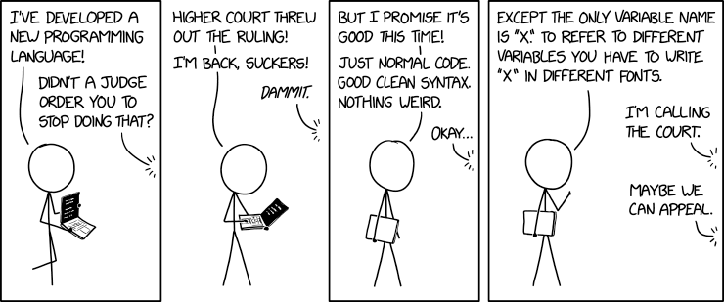

String Formatting
Notes:
There are multiple ways of formatting strings. These slides cover the most recent and versatile way.
For more advanced options please visit:
https://docs.python.org/3/library/string.html#formatstrings

Slide 2
Strings
Sequence of characters
Concatenation is the process of adding strings together
Often, we want to build strings with specific spacing and formatting
String.format() function is very useful and versatile
  Format: string.format(value1, value2...)
  values can be of any type
  values may be a key=value pair
  values are formatted and inserted into placeholders {}
  function returns a string
  string is the format string and is very powerful with lots of options
Notes:
string .format() function was introduced in version 3

Slide 3
Place Holders {}
format_1.py
1 2 3 4 5 6 7 8 9 | print("{} {} {}".format("A","B","C")) str = "Coding in Python is {}" print(str.format("fun")) print("Python {}".format(3.9)) str = "Count to {} {} {}" print(str.format("one", 2, "three"))
C:\Windows\py.exe
A B C
Coding in Python is fun
Python 3.9
Count to one 2 three
Notes:
Any characters inside the format string but not a part of a place holder are outputted exactly as they appear.
The function will return a new string that has been built from the format string and input values.
A simple format string will include sets of curly braces {} wherever you want to insert values.
By default, the first value will go to the first set of curly braces, the second value will go to the second set, and so forth.

Slide 4
Positions
format_2.py
1 2 3 4 5 6 7 8 9 | s = "{0}/{1}/{2}" print(s.format("a","b","c")) s = "{2}/{1}/{0}" print(s.format("a","b","c")) s = "{0}/{0}/{0}" print(s.format("a","b","c"))
C:\Windows\py.exe
a/b/c
c/b/a
a/a/a
Notes:
The numbers are zero-indexed based. That is {0} represents the first value, {1} matches the second value, and so forth. You can think of the values as being in a “list” where the list starts at zero.
You can reuse a value as many times as you like and not all values have to be used.

Slide 5
Key and Values
format_3.py
1 2 3 4 5 6 7 8 9 | s = "Hello {name}" print(s.format(name="Bob")) s = "My name is {f_name}, I'm {age}" output = s.format(f_name = "Bryce", age = 42) print(output) s = "My name is {}, I'm {age}" print(s.format("Bryce", age = 42))
C:\Windows\py.exe
Hello Bob
My name is Bryce, I'm 42
My name is Bryce, I'm 42
Notes:
# you can choose values, key=value pairs or a mix of both
# if you use both, key=values must be after the positional arguments (positional arguments can't follow key=values)

Slide 6
Format Specification
So far, we haven’t done anything except insert which we could have done with concatenation
the guts of format are in the format_spec
the grammar for the replacement field {} is
  replacement_field ::= "{" [field_name] ["!" conversion] [":" format_spec] "}"
  format starts to shine with the format_spec
formatting options are added to the right of a colon "{0:}"
fill, align, sign, width, precision and type provide a wide range of formatting options

Slide 7
Width
format_4.py
1 2 3 4 5 6 7 8 9 | s = "{:5}{:5}{:5}" print(s.format(1, 2, 3) , end ="|\n") print(s.format("a","b","c") , end ="|\n") print(s.format("abcdefg","b","c") , end ="|\n") s = "{:5.5}{:5}{:5}" print(s.format("abcdefg","b","c") , end ="|\n")
C:\Windows\py.exe
1 2 3|
a b c |
abcdefgb c |
abcdeb c |
Notes:
# the grammar is
# format_spec ::= [[fill]align][sign][#][0][width][grouping_option][.precision][type]
# sets the width to a minimum of 5 and is left aligned by default for most objects but right aligned for numbers
s = "{:5}{:5}{:5}"
# width won't truncate longer strings
# add a dot . to set the maximum
s = "{:5.5}{:5}{:5}"

Slide 8
Alignment
Option | Meaning
< | Forces the field to be left-aligned.
> | Forces the field to be right-aligned.
^ | Forces the field to be centered.
format_5.py
1 2 3 4 | print("{:<12}".format("left")) print("{:>12}".format("right")) print("{:^12}".format("center")) print("{:*^12}".format("center"))
C:\Windows\py.exe
left
right
center
***center***

Slide 9
Numbers
Option | Meaning
d | Decimal Integer. Outputs the number in base 10.
e | Scientific notation.
f | Fixed-point notation for floating point number.
g | General format.
+ | Indicates that a sign should be used for both positive as well as negative numbers.
- | Indicates that a sign should be used only for negative numbers (this is the default behavior).
, | Thousands separator with commas.
% | Converts to a percentage.

Slide 10
Numbers
format_6.py
1 2 3 4 5 6 7 8 9 | print("'d': {:12d}".format(100)) print("'e': {:12.3e}".format(299792458)) print("'f': {:12.3f}".format(3.1415)) print("'f': {:12.4f}".format(3.14159)) print("'g': {:12g}".format(3.14159)) print("'+': {:+12d}".format(1000000)) print("'-': {:-12d}".format(-1000000)) print("',': {:12,}".format(1000000)) print("'%': {:12.1%}".format(3.9 / 4))
C:\Windows\py.exe
'd': 100
'e': 2.998e+08
'f': 3.142
'f': 3.1416
'g': 3.14159
'+': +1000000
'-': -1000000
',': 1,000,000
'%': 97.5%
Notes:
For more advanced options please visit:
https://docs.python.org/3/library/string.html#formatstrings
Try testing these out yourself or go to https://www.w3schools.com/python/ref_string_format.asp.

Slide 11
Summary
String data type
string.format()
Positions
Keys and Values
Width
Alignment
Argument Specifiers/Formatting Type

