Slide 1
Ch 2: Sets Whole Numbers & Numeration
2.1 Sets as a Basis for Whole numbers
2.2 Whole Numbers & Numeration
2.3 Hindu-Arabic Numeration System
By
Dr. Sally A. Robison

Slide 2
Understanding Sets

Slide 3
Preview 2.1
Sets - Definitions
Operations on Sets
Finite and Infinite Sets

Slide 4
Sets
A collection of objects is a set
Objects are called elements
  Defined in three ways
    A) a verbal description
    B) a list of members separated by commas inside brackets {3, 4, 6}
    C) Set-builder notation {x / x < 1}

Slide 5

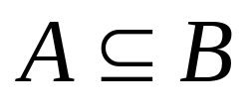

Set definitions & rules
Empty set (null set) { }
A=B - equal sets possess exactly the same elements
Same element is never listed more than once
Order of elements is not important
One-to-One correspondence: each element of A corresponds to only one element in B
A is a subset of B if all elements of A are in B
Proper subset if B has one element not in A

Slide 6
More definitions
Venn Diagrams: circles used to illustrate relationships
Universal set: set that consists of all elements being considered in a situation
Disjoint sets: two sets that no elements in common
Finite sets: set that is either empty or where the number of elements ends
Infinite sets: set that goes on forever
Research: Students feel that the set of odd numbers is about as large as the set of even numbers, but feel the set of whole numbers is larger….. not true.

Slide 7
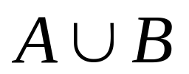
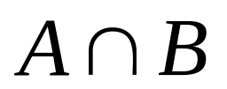

Operations on Sets
A union B: the set consisting of all elements in either A or B (or both)
A intersect B: the set consisting of all common elements in both A & B
Compliment of A: the set of elements in U not in A A’
Difference of two sets: Set of elements in A not in B A-B
Cartesian Product: Set of all ordered pairs (a,b) a from A and b from B A x B

Slide 8
Understanding Whole Numbers & Numeration

Slide 9
Preview 2.2
Numbers and Numerals
Ordering Whole Numbers
Numeration Systems

Slide 10
Number definitions
Number: Represents a quantity
Numerals: Symbols we see write and touch that represent a number
Representations of numbers
  Cardinal: quantity of items in a finite set
    n(A) is used to identify the number of elements in a set
  Ordinal: indicates the position or order of an object
    First place, third
  Nominal (identification): numbers used with out reference to quantity or position to identify something that name an object
    Phone numbers, social security numbers, zip codes

Slide 11
Ordering Whole Numbers
Whole numbers include the counting (natural numbers) plus 0 {0, 1, 2, 3, 4, …}
a = n(A), b = n(B); a<b means a is a proper subset of b (less than)
a = n(A), b = n(B); a>b means b is a proper subset of a (greater than)
Whole number line: Begins at 0 and continues upward in equal intervals
Natural number line: Begins at 1

Slide 12
Numeration Systems
Tally system uses tallies to make groups of 5
Egyptian system using symbols to represent quantities (numerals) ~3400 BC
Babylonian system used place value and placeholders where symbols represented different values depending on their location ~2000 BC
Mayan system used a vertical place value system of dots, lines and oval shapes and represented zero ~ 300 AD
  Look at textbook for samples of each pg 50-54

Slide 13
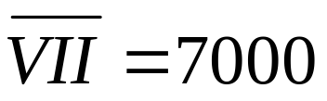
Numeration Systems cont
Roman numeration system uses the roman numeral system ~500BC
No place value concept or a zero
I=1, V=5, X=10, L=50, C=100, D=500, M=1000 so MMIV = 2004
A positional system: MDCLXVI = 2666
Subtractive principle : MMDVIII – MVI = MDII
Multiplicative system : bar on top means 1000 times

Slide 14
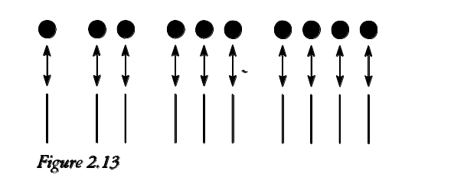

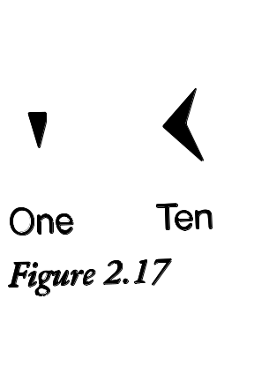
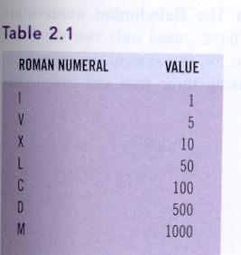
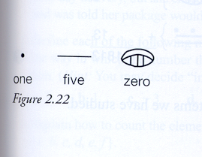
Tally, Egyptian, Roman, Babylonian, Mayan
Summative Table 2.3

Slide 15
2.3 Hindu-Arabic Numeration System
Used today includes 10 symbols (digits) and groups of 10 ~800AD
Digits 0, 1, 2, 3, 4, 5, 6, 7, 8, 9
Groupings of 10 (Decimal system): Base 10
Place value system (positional): digit position matters
Abacus, Base 10 blocks (Dienes blocks), hundreds charts

Slide 16
Modeling Numbers
  Abacus, Base 10 blocks (Dienes blocks), unifix cubes, hundreds charts, bear counters, etc
  Proportional models: Base 10 blocks, groupings of 10 sticks, unifix cubes connected
  Non-proportional models: coins, chips, abacus
  Concrete – semi-concrete – abstract representations

Slide 17
ARKANSAS STANDARDS
Number Sense, Properties & Operations

Slide 18
NCTM/ ARK Standards
1) TSW communicate an understanding of the properties of number and operations (+,-,X,/)
Demonstrate number sense (concepts of counting, grouping, and place value) using manipulatives
Develop meaning for the operations (+,-,X,/) by modeling and discussing a variety of problem situations
Apply and master counting, grouping, place value, and estimation
Solve problems using terminology and symbols of operations (+,-,X,/)

Slide 19
NCTM/ ARK Standards
1) TSW communicate an understanding of the properties of number and operations (+,-,X,/)
Demonstrate competency of operations (+,-,X,/) using mental math and technology
Use manipulatives to demonstrate and compare rational numbers/fractions (parts of a whole)
Communicate understanding of number sense, properties, and operations through journal writing, creating problems, constructing mathematical sentences, etc.

Slide 20
NCTM/ ARK Standards
2) Demonstrate and apply knowledge of numbers & numerical relationships to real world situations.
Represent number and operations (+, -, X, /) in a variety of forms using manipulatives, symbols, and graphs (pictographs, etc)
Apply elementary number theory (skip counting, patterns, number series, odd and even numbers, multiples, fractions, etc)
Apply computation (+, -, X, /) and estimation to real work problems
Use mental math, manipulatives, and technology to solve problems
Describe and compare quantities by using concrete and real world models of fractions.

Slide 21
Number Sense Indicators
Intuitive sense of numbers & understanding of number meanings & relationships among numbers
Multiple strategies for solving problems
Multiple representation of numbers
Flexible with numbers
Operational sense
Relative magnitude of numbers
Referents for measuring (benchmarks)
Error detection and reasonableness of answers
Estimates, rounds and mentally computes

