Slide 1
Whole Number Operations & Properties
3.1 - Addition & Subtraction
By
Dr. Sally Robison

Slide 2
Introduce operations with word problems
Real world problems give relevance making analysis of problem more easy (connects life & language to math language & symbols)
Follow real world problem by translating into some model and make different materials available to use in modeling
Provide ample opportunities to discuss and interpret real situations
Write number sentences to represent the real situation
Don’t delay real problems as they learn the basic facts
Key word strategy for operations is not effective
Have students decode and encode their translations using number sentences before using symbols (translation from horizontal to vertical formats)

Slide 3

Definition of Addition
Let a and b be any two whole numbers. If A and B are disjoint sets with a = n(A) and b = n(B), then a + b = n(A U B)
  A + B = sum, reads a plus b, a & b are called addends (summands)
  A binary operation since 2 (bi) numbers are combined to produce a unique (one and only one) number.

Slide 4
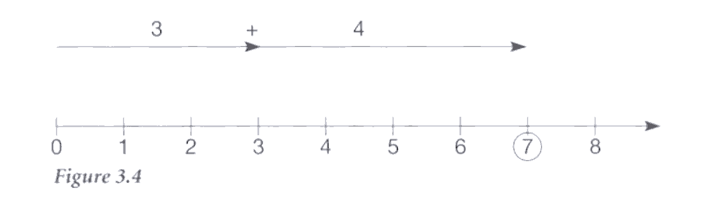

Models for Addition
Set: two disjoint sets that form a union
Measurement: arrows used on a number line

Slide 5
Guidelines for Modeling + / -
Direct modeling: use of concrete materials to represent problem as written
Easier to model with actual objects (counters)
Pictorial models are more difficult for separate models: do before and after pictures or circle set taken away
Measurement models: lengths rather than countable, discrete objects (unifix cubes, cuisenaire rods, number lines (more advanced model))
Write number sentences – but be flexible

Slide 6
Types of Problems
  Join
  Separate
  Part-part whole
  Compare

Slide 7

Addition & Subtraction (11 problems)
Start / change / result unknown
Action taken
Join: elements added/joined to a set
  [ ]+2=5 3+[ ]=10 4+7=[ ]
Separate: elements being removed from a set
  [ ]-5=8 4-[ ]=1 12-6=[ ]

Slide 8
Addition & Subtraction
No Action taken
Part part whole: relationship between a set and 2 subsets (whole/part unknown)
  3+7=[ ] 3+[ ]=10 or [ ] +7=10
Compare: comparison between 2 sets (difference/larger/smaller unknown)
  12-5=[ ]more 17=4more+[ ] 12=8+[ ] more

Slide 9
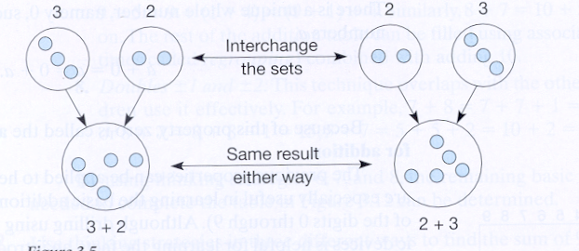
Properties of Addition
Commutative (commute)
a + b = b + a
Associative (unite)
a+(b+c) = (a+b)+c

Slide 10
Properties of Addition
Closure: The sum of two whole numbers is a whole number
Identity: There is a unique whole number, namely 0 – the additive identity element, such that all whole numbers a, a + 0 = 0 + a = a

Slide 11
Basic Facts
Addends or factors that are between 0 and 9, inclusive (390 total facts)
100 facts for + & x & -
90 facts for division
NCTM emphasizes importance for developing proficiency but warns against overemphasizing memorization before understanding is developed or at the exclusion of other important topics

Slide 12
Thinking Strategies for +
Commutativity: symmetry in table
  a + b = b + a
  Eliminates 45 facts
  55 facts remain

Slide 13
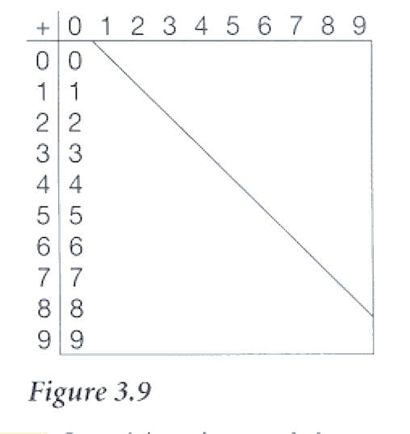
Thinking Strategies for +
Adding with zero
  a + 0 = a
  fills in 10
  45 facts remain

Slide 14
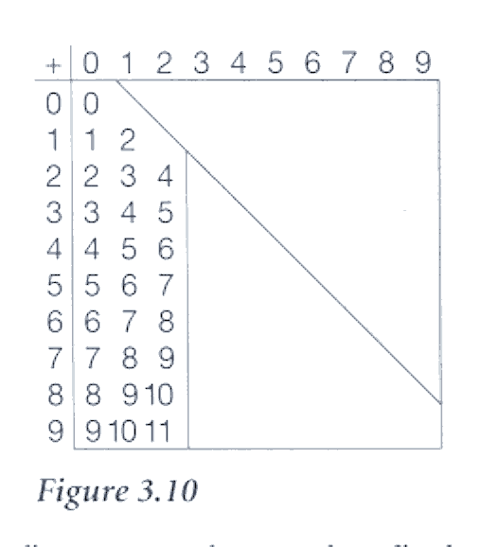
Thinking Strategies for +
Counting on with 1 or 2:
  7 + 1 –> 7 & 1 more
  6 + 2 – 6 → 7, 8
  Fills in 17 facts
  28 facts remain

Slide 15
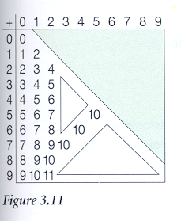
Thinking Strategies for +
Combinations to 10:
  (Compensation)
  Ten buddies: (1,9) (2,8) (3,7) (4,6) (5,5)
  Fills in 3 more facts
  25 facts remain

Slide 16
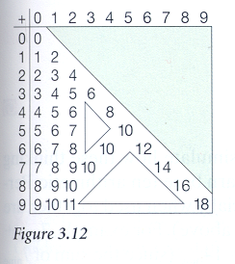
Thinking Strategies for +
Doubles: 1 + 1, 2 + 2, etc.
  Appear in diagonal;
  Fills in 6 facts – 19 facts remain

Slide 17
Thinking Strategies for +
Adding ten:
  3 + 10 = 13 (one long + 3 units)
Associativity
  9 + 5 = 9 + (1 + 4) = (9 + 1) + 4 = 14
Near Doubles +1, + 2:
  7 + 8 = 7 + 7 + 1 more
  5 + 7 = 5 + 5 + 2 more
Ten frame facts
  5 + 2 = 7

Slide 18
Subtraction Methods

Slide 19
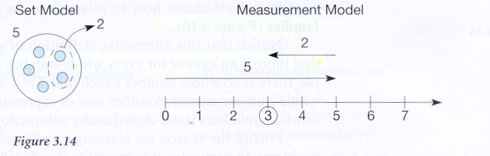
Models for Take Away

Slide 20
Take Away Approach
Let a and b be any whole numbers and A and B be sets such that a = n(A), b = n(B), and B is a subset of A. Then a – b = n(A – B)
  a – b = difference, read “a minus b”, a is the minuend, b is the subtrahend
  Used to introduce subtraction
  Use counting back methods 5 – 2 = 5, 4, 3

Slide 21
Missing Addend Approach
Let a and b be whole numbers. Then a – b = c if and only if a = b + c for some whole number c
Often used when making change (sort of counting forward)

Slide 22
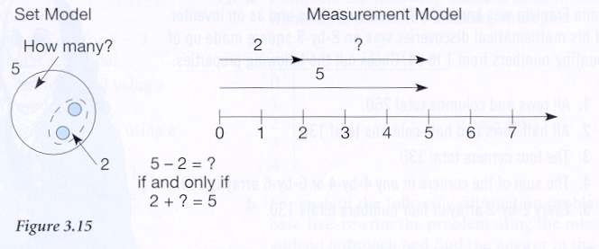
Model for Missing Addends

Slide 23
Comparison Approach
Begin with two sets that are compared with the take away or missing addend approach to find the difference

Slide 24
Mastering Basic Facts
Basic Facts
  Three step approach to mastery
  Fact families
  Thinking strategies

Slide 25
3 Step Approach to Fact Mastery
Understand the meaning of the operation
Use thinking strategies to retrieve facts
Consolidate activities for drill and practice

Slide 26
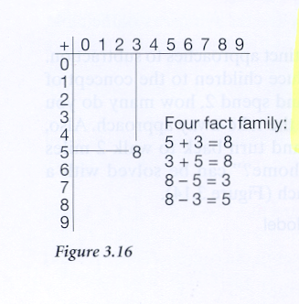
Fact Families in the table

Slide 27
Basic Fact Issues to consider
Begin with concrete experiences for sums up to 5
Use a variety of problems, models & manipulatives
Encourage alternative algorithms
Use drill to learn the basic facts
Consider concepts
  Teach Fact families
  Place value & regrouping
  Counting on, back and step counting
  Inverse properties (+ -) (x /)
  Repetition (x +) (/ -)
  Properties, commutative, associative, distributive
  Identity elements for x and +

Slide 28
Principles of drilling facts
Memorize only after understanding
Participate with the intent to memorize not for conceptual understanding
Focus on importance of drill and flexibility with numbers
Keep drill short (5-10 mins) almost daily & self checking
Memorize a few new facts in a given lesson
Review previously memorized facts (equal mix)
Vary & individualize interesting activities: games, puzzles, riddles, software
Organize around sets of facts based on thinking strategies & fact families
Help students gain confidence

Slide 29
Fact Remediation - Upper Grades
Recognize that more drill will not work
Inventory known and unknown facts
Diagnose strengths/weaknesses (15 min interview)
Provide hope (new ideas and help)
Build on success (easier & few facts at beginning)
Never let lack of mastery be a barrier
FUN, INTERESTING, RELEVANT ACTIVITIES

