Slide 1
Whole Number Operations & Properties
3.3 Ordering & Exponents
By
Dr. Sally Robison

Slide 2

“Less Than”
For any two whole number a and b, a < b (or b > a) if and only if there is a nonzero whole number c such that a + n = b

Slide 3
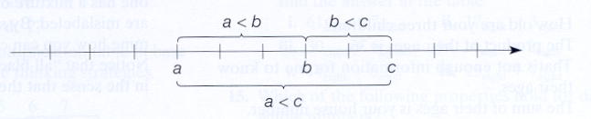

Properties of Less Than
Transitive Property
  For all whole numbers a, b, and c, if a < b and b < c, then a < c

Slide 4
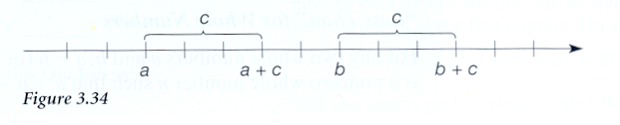
Properties of Less Than
Less than and Addition Property
  If a < b, then a + c < b + c

Slide 5
Properties of Less Than
Less than and Multiplication Property
  If a < b, then for c not equal to 0 a * c < b * c

Slide 6
Exponents
Let a and m be any two whole numbers where m not equal to 0, then
a^{m} = a * a * a * a ….. a
(m factors)

Slide 7
Exponent Theorems
a^{m} * a^{n} = a ^{n+m} 3² * 3⁴ = 3*3*3*3*3*3=3⁷
a^{m} * b^{m} = (ab)^{m} 3² * 2² = (3*2) ² = 6²
(a^{m} )^{n} = a^{mn} (3²)⁴ = 3⁸
a^{m} / b^{m} = a ^{n-m} 3⁴ * 3² = 3*3*3*3/(3*3)= 3²
a⁰ =1 3² / 3² ⁼ 3²⁻² = 3⁰ = 1
a¹=a 3³ / 3² ⁼ 3³⁻² = 3¹ = 3

