Slide 1
Fraction Concepts &
Fraction Computation
by
Dr. Sally Robison

Slide 2
Starting Point
A child has a set of 10 cubical blocks. The lengths of the edges are 1 cm, 2 cm, 3 cm., … 10 cm. Using all the cubes, can the child build two towers of the same height by stacking upon another? Why or why not?
1, 2, 3, 4, 5, 6, 7, 8, 9, 10

Slide 3
NCTM Standards
1. Understand and model fractions
2. Relate models to language and symbols
3. Order and compare fractions
4. Equivalence of fractions
5. Operations on and number sense of fraction
6. Mixed and Improper fractions
7. Relate to decimals and percents when appropriate

Slide 4
Fraction Concepts
• Partitioning (equal shares)
    →Each part must be an equal share of the same size
• Words: Two quarters or one half
    →denominator, numerator, proper, improper)
• Counting: 4 x ½ = ½ + ½ + ½+ ½ = 1 + 1
• Symbols used after concrete representation
      Concrete (informal) then words then symbols (Piaget)
• Non-congruent parts can be equal
• Carefully draw models: ½
• Extend models (Equivalences): 2/4 or 3/6
    →SIMPLIFY -→avoid using the word reduce
    →many different ways to represent the same quantity

Slide 5
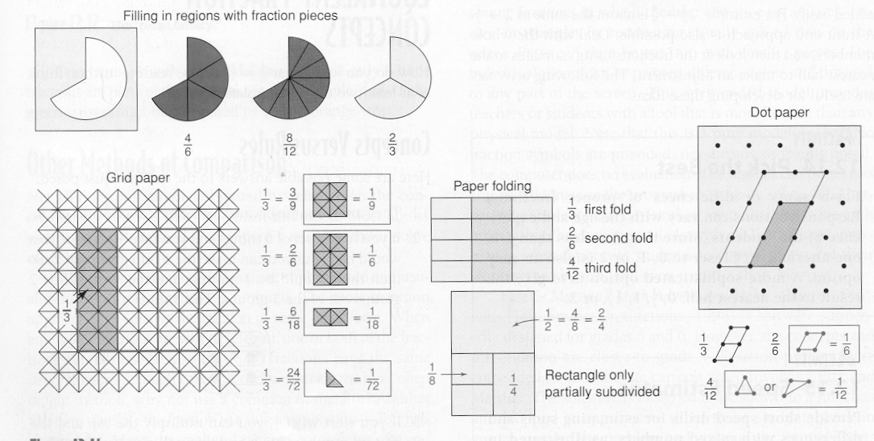
Equivalences for fractions

Slide 6
Meanings of a fraction
Part of a whole
  ( 1 piece out of 3)
Quotient
  (1 pizza divided by 3 people)
Ratio between two quantities
  (10 red hearts to 5 pink hearts)
Operator
  (24 cookies in 3 bags becomes 8 in 1bag)

Slide 7
Models for fractions
Region models
→learned before part of a set model
→(circles, fraction squares)
Length/Measurement model
→(fraction tiles, bars, towers, cuisenaire rods)
Part of a Set models
→(counters, color tiles, color tiles/cubes)
Area models
→ Possess same area, but not same shape

Slide 8
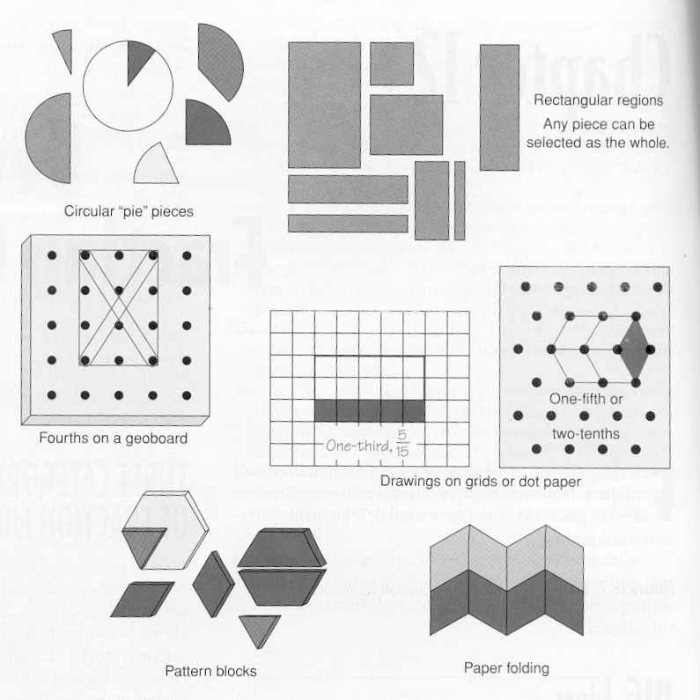

Slide 9
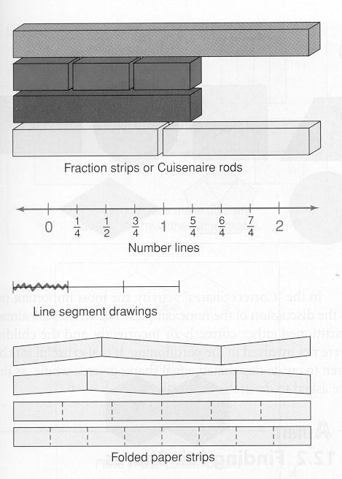

Slide 10
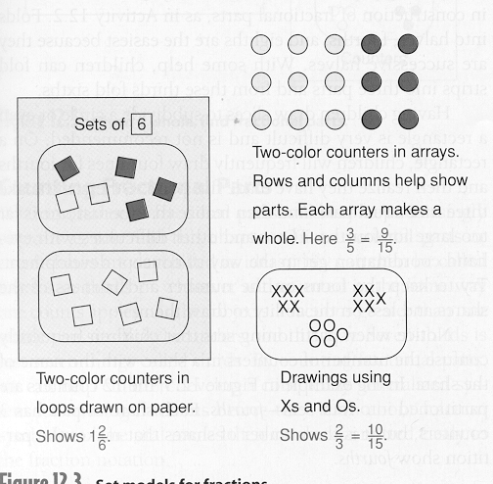

Slide 11
Number Sense with Fractions
Representing: words, models, diagrams, symbols
Flexibility (equivalencies) mastered in upper eled
  Renaming and simplifying
Ordering fractions
Operational sense
Relative size(magnitude) of a fraction
  Comparison Schemes
  • More of the same size parts 3/8 versus 5/8
  • Same number but different size parts 3/7 versus 3/9
  • More or less than or closer to 0 or ½ or 1

Slide 12
Some concepts that are taught
Terminology of fractions
Ordering fractions
Simplifying and equivalences
All rational # can be represented as fractions ( 4 = 4/1)
4/4 is equal to 1 so ½ of 4/4 = 4/8 = ½
Changing mixed to improper & vise versa
Connecting fraction operations to whole number operations
  Correct answer doesn’t have to be simplest form (teacher preferences)
Estimation skills for computation sense (number sense)

