Slide 1
7.1 : Decimals
By
Dr. Sally Robison

Slide 2
Starting Point
The numbers 0.1, 0.10, and 0.100 are all equal but can be represented differently. Using base 10 blocks, think how you will show that the fractions are equal.

Slide 3
Misconceptions & error factors
50% of 7th graders could not identify the largest number: 0.36, 0.058, 0.375, and 0.4
50% of 8th graders could identify fraction closes to 0.52
Decimal is not significant or is viewed as simply separating two whole numbers ***
Zeros do not change the value of the decimal
Reading incorrectly (0 pt 5 for 0.5 vs 5 tenths)
Ordering decimals
  Longer number is bigger 0.123 vs 0.3 ***
  Shorter is better 0.3 vs 0.41 since 3 is 10th
Operational errors
  x -> bigger value in answer
  ÷ / -> smaller value in answer
Reasonableness of answer (number sense)
  Decimal goes where ? 0.24 x 39.5 = 948
Lack of concrete & semi-concrete models

Slide 4
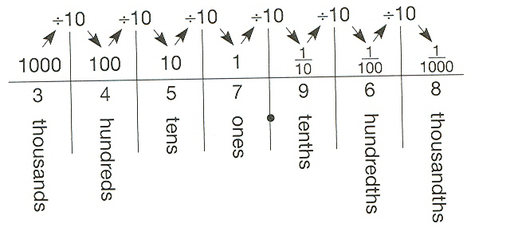
Teach decimals by…
Identify the importance of the decimal point
Expanding on place value knowledge
  Encourages lining up the decimal for +/-
Expanded form ***
  Multiplicative Property: 3457.968 = 3(1000) + 4 (100) + 5(10) + 7(1) + 9(1/10) + 6(1/100) + 8(1/1000)
  Additive property: 0.45 = 0.4 + 0.05

Slide 5
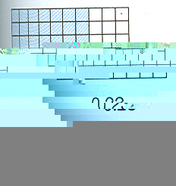
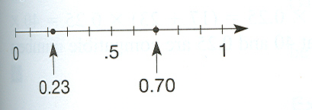
Teach decimals by…
Building on fraction knowledge
  Understanding of decimal
  Accentuate the difference between 10s and 10ths, 100s and 100ths.

Slide 6
Extending the Base 10 system
Use concrete models
  Base 10 blocks, meter stick, decimal squares, decimal wheel, 10x10 grid – Hundreds squares, metric charts, number lines, money, abacus, fraction towers
Connect the models, words and symbols slowly
Read and interpret decimal numbers
  avoid digit stating---decimal should be read as “and”
Fraction number connections in ordering decimals
  first as fractions (fraction methods) 5/100, 5/ 1000, 51/100, 5/10
  then as place value methods 0.05, 0.005, 0.051, 0.5
Rounding (estimating) decimals
Various representations for decimal notation (cultural)
  3.142, 3 142, 3 | 142, 3,142 3.142

Slide 7
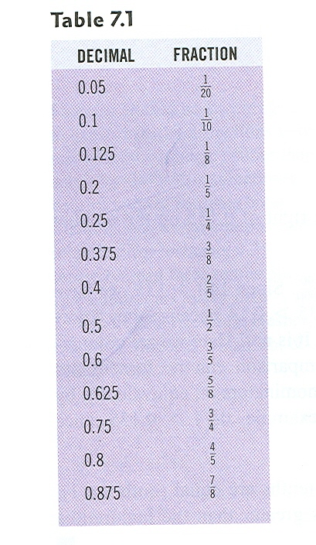
Connect equivalences between a decimal fraction and common fractions ***

Slide 8
More complex topics
Converting unfamiliar fractions to decimals (approximate with nice fractions)
Link to operations of whole numbers
Convert decimals to fractions and percents
Scientific notation 0.0007 = 7 x 10^-4
Terminating Decimals: Let 1/b be a fraction in simplest form. Then 1/b has a terminating decimal representation if and only if b contains only 2s and/or 5s in its prime factorization.

Slide 9
Multiplying/Dividing Decimals by Powers of 10 (L-R number line)
Let n be any decimal number and m represent any nonzero whole number.
  Multiplying a number n by 10^{n} is equivalent to forming a new number by moving the decimal point of n to the right m places.
    EX 2.34 x 100 = 2.34 x 10² = 234
  Dividing a number n by 10^{n} is equivalent to forming a new number by moving the decimal point of n to the left m places.
    EX 2.34 ÷ 100 = 2.34 ÷ 10² = 0.0234

