Slide 1
7.2 : Decimal Operations
By
Dr. Sally Robison

Slide 2
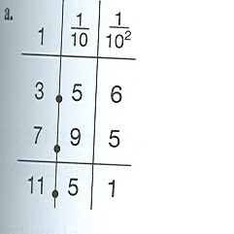
Algorithms for +
Fraction Approach
  3.5 + 2.4 = 35/10 + 24/10
Decimal Approach
  Line up decimals
  3.5
  + 2.4
  5.9
  --Add as if whole numbers

Slide 3
Algorithms for -
Fraction Approach
  3.5 - 2.4 = 35/10 - 24/10
Decimal Approach
  Line up decimals (most appropriate)
  Supplement with 0 as needed
  Subtract as if whole numbers
    Do 14.793 – 8.95
    Do 7.5 – 1.007

Slide 4
Algorithms for x
Fraction Approach
  3.5 +x2.4 = 35/10 x 24/10 = 35x24/100
Decimal Approach
  Multiply as if whole numbers
  Count decimal points in problem to place into answer
  Do 57.5 x 1.4 in calculator

Slide 5
Reflection from Research
Students tend to assume that adding a zero to the end of a decimal fraction is the same as adding a zero to the end of a whole number. The most common error on a test item for which students were to write the number 10 times bigger than 437.56 was 437.560
    (Hiebert & Wearne, 1986)

Slide 6
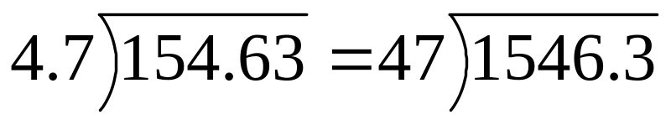
Algorithms for ÷
Fraction Approach
  3.52 ÷ 2.4 =
    352/100 ÷ 24/10 =
    352/100 ÷ 240/100 =
    352/240
Decimal Approach
  Replace problem where divisor is a whole number

Slide 7
Reflection from Research
Division of decimals tends to be quite difficult for students, especially when the division problem requires students to add zeros as place holders in either the dividend or the quotient
    (Trafton & Zawojewski, 1984)
    EX 4.5 ÷ 0.05
    EX 10.02 ÷ .5

Slide 8
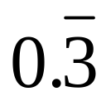
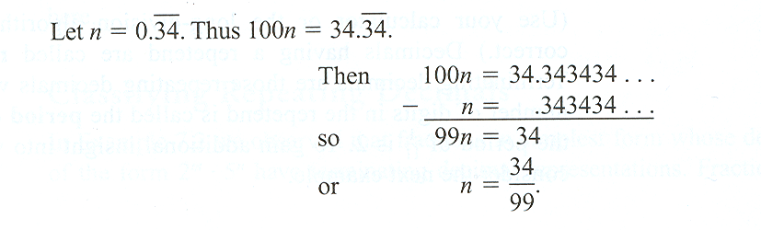
Repeating Decimals
1/3 = 0.3333… =
  Instead of writing dots, we place a horizontal bar above the repetend, (the first string of repeating decimals)
  The number of digits in the repetend is called the period of the decimal
Repeating, non-terminating decimals can be expressed in the form of a/b

