Slide 1
11.2 Probability & Complex Experiments
By Dr. Sally A. Robison

Slide 2

Starting Point
Two red cubes, one white cube, and one blue cube are placed in a box. One cube is randomly drawn, its color is recorded, and it is returned to the box. What is the probability of drawing a blue and red cube?
  (hint, order is not specified so BR or RB are possible events)

Slide 3
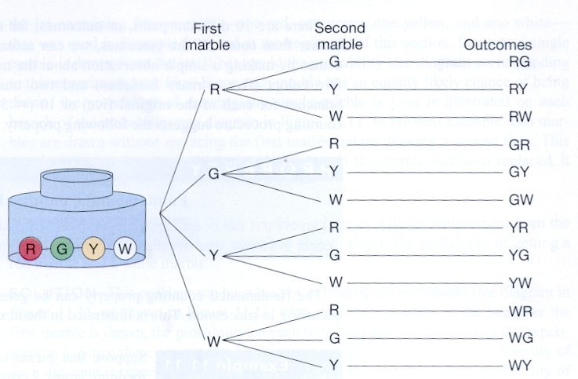
Tree Diagrams
Used to represent all possible outcomes of an experiment

Slide 4
Fundamental Counting Property
If an event A can occur in r ways, and for each of these r ways, an Event B can occur in s ways, then events A and B can occur , in succession in r x s ways

Slide 5
Example 11.11
Pizza can be orders in 3 sizes (small, medium, large), 2 crusts (thick, thin), 4 choices of toppings (sausage, pepperoni, ham, hamburger), and 2 cheese toppings (regular or double cheese). How many different ways can a pizza be ordered?
(Make a tree diagram)

Slide 6

Example 11.13
A local hamburger outlet offers patrons a choice of four condiments: catsup, mustard, pickles, and onions. If the condiments are added or omitted in a random fashion, what is the probability that you will get one of the following types:
  Catsup and onion
  Mustard, onions, and pickles
  One of everything
    (hint… use binary numbers to explain the number of events is 2^4)

Slide 7
catsup mustard pickles onions
0 0 0 0
0 0 0 1
0 0 1 0
0 0 1 1
0 1 0 0
0 1 0 1
0 1 1 0
0 1 1 1
1 0 0 0
1 0 0 1
1 0 1 0
1 0 1 1
1 1 0 0
1 1 0 1
1 1 1 0
1 1 1 1

Slide 8
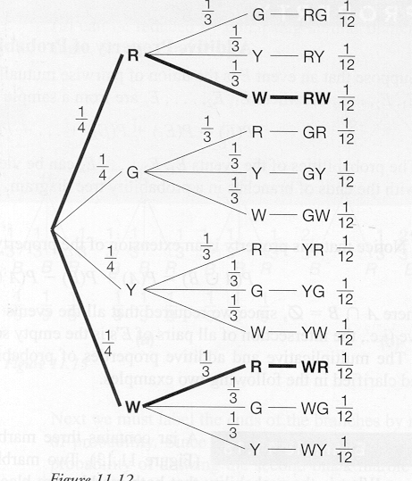
Probability tree diagram
Weighting the branches of a tree diagram with the appropriate probabilities
EX: Two marbles drawn without replacement from a jar. What is the probability of drawing out a red and a white marble?

Slide 9
Solution
P(event) = the number of objects or outcomes of interest divided by the total number of objects or outcomes under consideration
P(RW) + P(WR) = 1/12 + 1/12 = 2/12 = 1/6

Slide 10
Multiplicative Property
Suppose an experiment consists of a sequence of simpler experiments (order matters). Then the probability of the final outcome is equal to the product of the probabilities of the simpler experiments that make up the sequence.
EX: Roll a dice twice. Probability of getting a 1 followed by a 3 = (1/6) x (1/6) = (1/36)
EX: Roll a dice twice. Probability of getting a 1 or 2 followed by a 3 = (2/6) x (1/6) = 2/36 = 1/18

Slide 11

Additive Property
Suppose that an event E is the union of pair wise mutually exclusive simpler events E₁, E₂, E₃, E₄, E₅, … E_{n} Where E₁, E₂, E₃, E₄, E₅, … E_{n} are from a sample space S. Then P(E) = P(E₁)+P(E₂) +P(E₃)+ P(E₄) + P(E₅) + … P(E_{n}). The probabilities of the events E₁, E₂, E₃, E₄, E₅, … E_{n} can be viewed as those associated with the ends of branches in a probability tree diagram
  NOTICE: This property is an extension of P(AUB) = P(A) + P(B) – P(A∩B) where A∩B = Ф since all events must be pairwise mutually exclusive

Slide 12
Example 11:15
A jar contains 3 marbles, two black and one red. Two marbles are drawn with replacement. What is the probability that both marbles are black? (assume the marbles are equally likely to be drawn).
Solution: 4/9

Slide 13
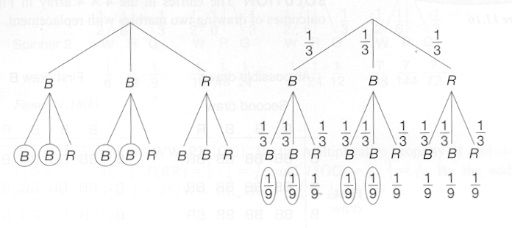
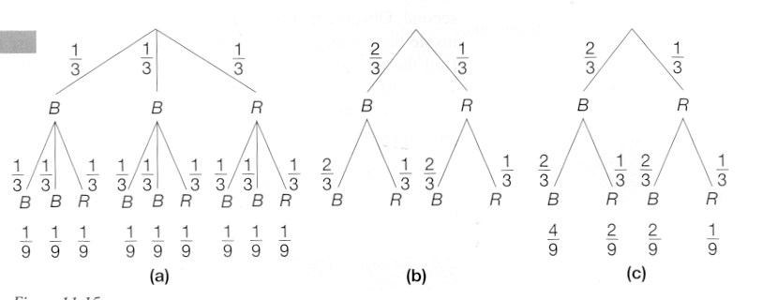

Slide 14
Example 11:16
Consider a jar with 3 black marbles and one red marble. For the experiment for drawing two marbles with replacement, what is the probability of drawing a black marble and then a red marble in that order?
Solution: 3/16

Slide 15
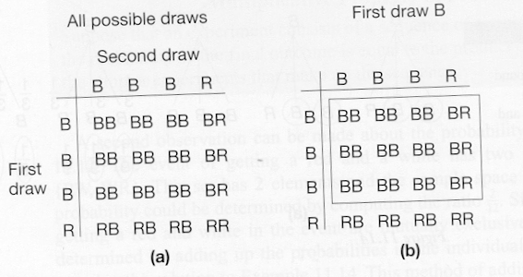

Solution

Slide 16
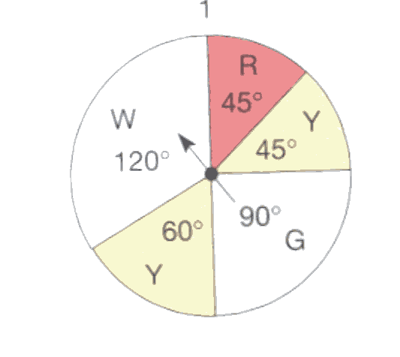
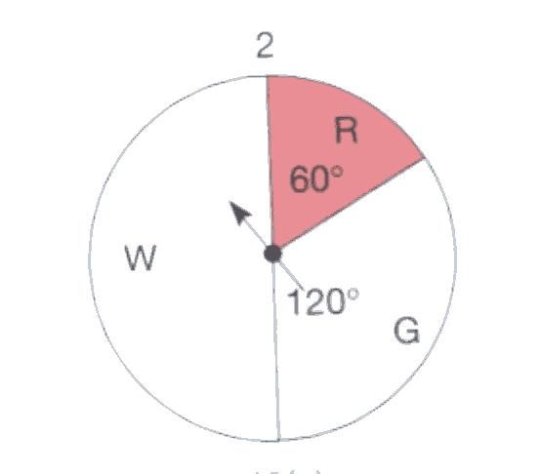
Example 11:17
Both spinners shown are spun. Find the probability that they stop on the same color

Slide 17
Solution
P(W) = 120/360 = 1/3 Spinner 1
P(G) = 90/360 = 1/4
P(R) = 45/360 = 1/8
P(W) = 180/360 = ½ Spinner 2
P(G) = 120/360 = 1/3
P(R) = 60/360 = 1/6
P(WW) = 1/3 * 1/2 = 1/6 Probability of two colors
P(GG) = 1/4 * 1/3 = 1/12
P(RR) = 1/8 * 1/6 = 1/48
P(WW, GG, RR) = 1/6 + 1/12 + 1/48 = 13/48

Slide 18
Example 11:18
A jar contains 3 red gumballs and 2 green gumballs. An experiment consists of drawing a gumballs one at a time from the jar, without replacement, until a red one is obtained. Find the probability of the following
A) only one draw is needed
B) exactly two draws are needed
C) exactly three draws are needed

Slide 19
Solution (Fig 11.19)
Solution
RED 3/5
(3/5)
GREEN 2/5
R 3/4
(6/20)
G 1/4
R (3/3) = 1
(2/20)

Slide 20
Example 11:20
Six fair coins are tossed. Find the probability of getting exactly 3 heads (This is a combination problem where you have six items taken 3 at a time)
Solution – look at row six in Pascal’s triangle
2^6 outcomes = 64
C(6,0) = (6H) = 1 1/64
C(6,1) = (5H) = 6 6/64
C(6,2) = (4H) = 15 15/64
C(6,3) = (3H) = 20 20/64
C(6,4) = (2H) = 15 15/64
C(6,5) = (1H) = 6 6/64
C(6,6) = (0H) = 1 1/64
C(n,r) = n!/ (n-r)!r! C(6,2) = 6! / 4! 2!

Slide 21
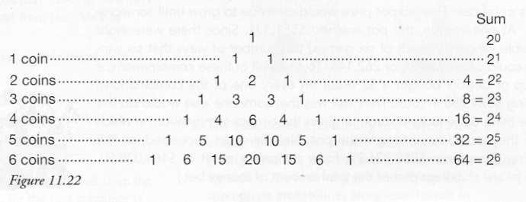
Ext: 11.21 At least four heads tossing 7 coins… C(7,4)

