Slide 1
11.3 Additional Counting Techniques
By Dr. Sally A. Robison

Slide 2

Starting Point
Roberto and Rafael were having a contest to see who could make the most towers out of combinations of red and green blocks. Each tower must be exactly four blocks high and look different from all of the rest of the four-block towers. How many towers can you make?
  RGRG, GRGG, GGGG are 3 examples

Slide 3
Permutations
An ordered arrangement of objects is called a permutation.
For example: For 3 different letters, there are 6 different three-level permutations or “words” that we can make. JIM - JIM, JMI, MIJ, MJI, IMJ, IJM
Notice the method for finding the number of permutations is 3x2x1 = 6. This is also denoted at 3! (3 factorial)
Try it with 4 colored cubes

Slide 4
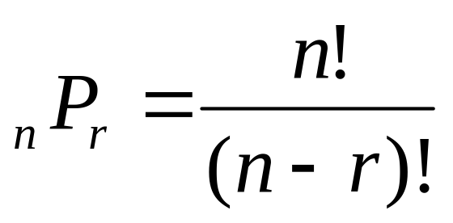
THEOREMS
The number of permutations of n distinct objects, taken all together, is n! (0! = 1)
The number of permutations of r objects chosen from n objects, where 0 <= r <= n, is

Slide 5
Example 11.23
Miss Murphy wants to seat 12 of her students in a row for a picture. How many different seating arrangements are there?
Answer: 12!

Slide 6
Example 11.24
Using the digits 1, 3, 5, 7, and 9, with no repetitions of digits, how many
  A one digit number can be made?
  B two digit numbers can be made?
  C three digit numbers can be made?
  D four digit numbers can be made?
  E five digit numbers can be made?

Slide 7

Example 11.24 answers
Using the digits 1, 3, 5, 7, and 9, with no repetitions of digits, how many
  A one digit number can be made?
    5! / (5-1)! = 5
  B two digit numbers can be made?
    5! / (5-2)! = 20
  C three digit numbers can be made?
    5! / (5-3)! = 60
  D four digit numbers can be made?
    5! / (5-4)! = 120
  E five digit numbers can be made?
    5! / (5-5)! = 120

Slide 8


Combinations
A collection of objects, in no particular order, is called a combination.
  EX: Choosing three people from a set of 5 people to ride in a car with you.
    Bill, Harry, Larry, Mary, Teri
    (BHL), (BHM), (BHT), (BLM), (BLT), (BMT)
    (HLM), (HLT), (HMT),
    (LMT)
To compute the number of combinations, find the number of permutations 5!/(5-3)! = 60 and divide out the repetitions (in this example 3!) or 5! / [(5-3)! 3!] = 60/6 = 10

Slide 9
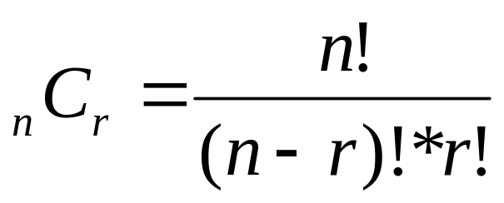
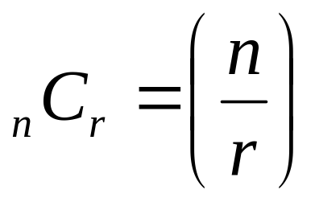
THEOREM
The number of combinations of r objects chosen from n objects, where o <= r <= n, is
Occasionally

Slide 10
EX 11.26
A fair coin is tossed 5 times. Find the number of ways that 2 heads and 3 tails can appear.
EX: HHTTT or HTHTT are possibilities
Solution: order doesn’t matter, 5 choose 3 = 10 ways. Can you find them?

Slide 11
Ex 11:27
On a 30 item true/false test, in how many ways can 27 or more answers be correct?
Solution:
  30 choose 27 = 4060
  30 choose 28 = 435
  30 choose 29 = 30
  30 choose 30 = 1
  Total: 4526

Slide 12
Ex 11:28
At Frederico’s Pizza they offer 10 different choices of toppings other than cheese. How many different combinations of toppings are available at Frederico’s?
Solution:
  10 choose 0 = 1, 10 choose 1 = 10, 10 choose 2 = 45
  10 choose 3 = 120, 10 choose 4 = 210, 10 choose 5 = 252
  10 choose 6 = 210, 10 choose 7 = 120, 10 choose 8 = 45
  10 choose 9 = 10, 10 choose 10 = 1
  1+10+45+120+210+252+210+120+45+10+1
  Or think of each item as one or off and recognize that 2^10 is the total number. (binary concept)
  Total: 1024

