Slide 1
11.4 Simulation,
Expected Value,
Odds, and
Conditional Probability
By Dr. Sally A. Robison

Slide 2
Starting Point
For Sterling’s weekly lawn-mowing job, his parents have given him two choices for his method of payment
Choice 1: He receives $10
Choice 2: His parents place 4 $1 bills, one $5 bill, and two $10 bills in a bag and Sterling draws two bills from the bag.
? In the long run, which is the better deal for Sterling? Justify your answer with mathematical reasoning.

Slide 3
Simulation
A representation of an experiment like using dice, coins, objects in a bag, or random-number generators to “simulate” or “model” the actual experiment.
A) There is a 1-1 correspondence between the outcomes in the original experiment and the outcomes in the simulated experiment.
B) The probability that an outcome in the original experiment occurs is estimated to be the experimental probability of its corresponding outcome in the simulated experiment.

Slide 4

Example 11.30
When planning for a family, a husband and wife plan to stop having children after they have either two girls or four children. Since they want to begin saving for their childrens’ college education, they want to predict how many children they should expect to have. If the chances are equally likely of having a girl or a boy, what is the probability that they will have four children?
  Can use the flip of a coin, a spinner in two equal parts, drawing two pieces of paper from a bag (one marked G, the other marked B), or a random-number table.

Slide 5
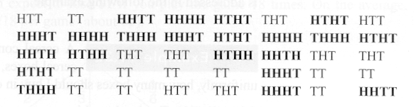
Example 11.30 solution
H = boys T = girls
SIMULATION: Out of 40 sets, 21 have 4 children. Thus the probability the they have 4 children is 21/40 or 52.5%
Let’s do a number tree to find solution

Slide 6

Example 11.31
A cereal company has put six types of toys cars in its cereal boxes, one car per box. If the cars are distributed uniformly, what is the probability that you will get all six types of cards if you buy 10 boxes?
  Use a number dice from 1 to 6, use a random number table, use 6 slips of paper or chips drawn randomly from a hat, or use a spinner with 6 equal segments

Slide 7
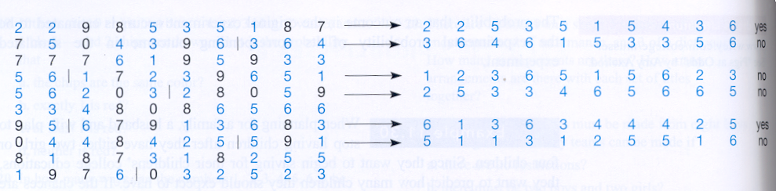
Example 11.31 solution
Simulation using a random number generator table. Read 10 numbers (ignore 0, 7, 8, and 9)
P = 2/6 or 0.333…
A computer simulator would find P = 0.257

Slide 8
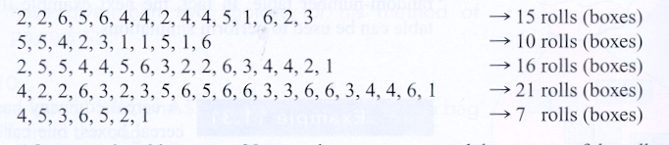
Example 11.32
EXT: If the cars are distributed uniformly, how many boxes should I buy in order to get all six types of cars?
  5 of 25 solutions simulated by a roll of a dice where each number = a different car are given below
  Solution: Ave: = 15.12 in 25 trials so 15 to 16 boxes is the expected number

Slide 9
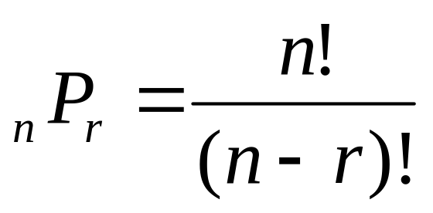
Def: Expected Value
Suppose that the outcomes of an experiment are real numbers (values) called v1, v2, v3… vn, and suppose that the outcomes have probabilities p1, p2, p3…. Pn respectively. The expected value, E, of the experiment is the sum
E = v1*p1 + v2*p2…. + vn*pn
The expected value of an experiment is the average value of the outcomes over many repetitions.

Slide 10
Example 11.33
A cube had 3 red faces, 2 green faces, and 1 blue face. A game consists of rolling the cube twice. You pay $2 to play.
If both faces are the same color you earn $5 (so you win $3)
If not, you lose the $2 it costs to play

Slide 11
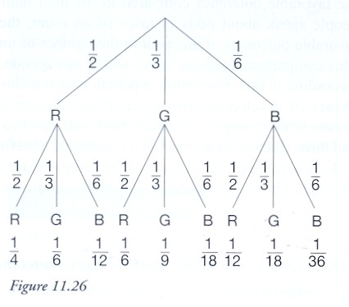
11.33 Solution in Prob tree

Slide 12
Expected Value cube solution
W= {RR, GG, BB} P(W) = ¼ + 1/9 + 1/36
You win 7/18 or 39%
You lose 11/18 or 61% or 1-P(W)
So if you play 18 times, you will win 7 and lose 11
Dollars = (5-2)*7 + (-2)*11 = -1
Expected value = 3 *(7/18) + (-2) *(11/18) = -1/18

Slide 13
ODDS
In probability we speak of the number of favorable outcomes compared to the total number of possible outcomes of the event.
  EX 7/10
In odds, we speak of the number of favorable outcomes compared to the number of unfavorable outcomes of the event.
  EX 7:3

Slide 14

ODDS
Odds of Events with Equally Likely Outcomes
  Odds in favor of event E
    n(E):n(E’)
    P(E): 1-P(E)
    P(E): P(E’)
  Odds against event E
    n(E’):n(E)
    1-P(E): P(E)
    P(E’):P(E)

Slide 15
Ex 11:38
When tossing three fair coins, what is the probability of getting two tails given that the first coin came up heads?
Solution
  { HHH, HHT, HTH, THH, HTT, THT, TTH, TTT} are the 8 total outcomes possible
  Yet with the condition 1st is heads {HHH, HHT, HTH, HTT} reduced to 4 outcomes
  Therefore, only HTT it only one so ¼
  Can be found by P(A П B) / P(B) = 1/8 / 4/8 where A = {HTT, THT, TTH} represents the events that exactly two tails occur and B = {HHH, HHT, HTH, HTT} represents the event of the first coin comes up heads

Slide 16
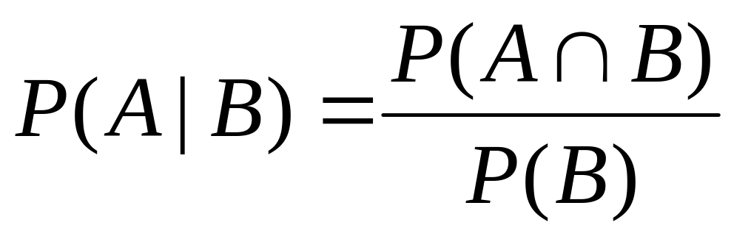
Conditional Probability
Let A and B be events in a sample space S where P(B) is not empty. The conditional probability that event A occurs, given that event B occurs first, denoted P(A|B) is

Slide 17
Ex 11:28
Suppose a 20 sided die has the following numerals on its faces: 1,1, 2, 2, 2, 3, 3, 4, 5, 6, 7, 8, 9, 10, 11, 12, 13, 14, 15, 16. The die is folled once and the number on the top face is recorded. Let A be the event the number is prime, and B be the event the number is off. Find P(A|B) and P(B|A).
Use Venn Diagram to represent
Solution:
  P(A|B) = P(A int B)/P(B) 6/20 / 10/20 = 3/5
  P(B|A) = P (A int B)/P(A) 6/20 / 9/20 = 2/3

