Slide 1
12.4 Regular Polygons and Tessellations
By
Dr. Sally Robison

Slide 2
Starting Point
Known Facts
The sum of the interior angles of a triangle is 180 degrees
The sum of the angles around a single point is 360 degrees
Using both
Find a + b + c + d + e where a, b, c, d, and e represent the marked interior angles of a pentagon
Describe at least two methods for finding the above sum

Slide 3
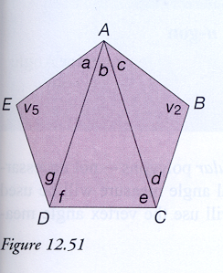
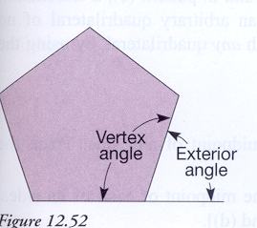
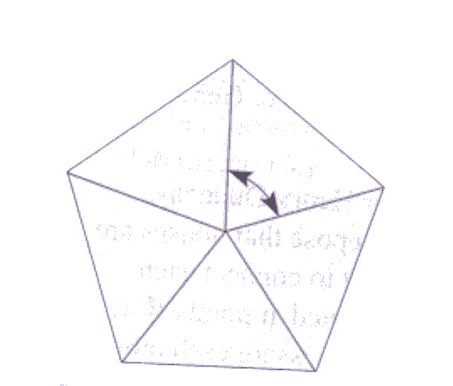
Angle Measures in Regular Polygons
Regular polygon: A polygon that is both equilateral and equiangular
Number of triangles: Polygon can be subdivided into n-2 triangles
Sum of exterior and interior angle: 180
Measure of each central angle: 360/n
Vertex angle: [(n-2) * 180] / n

Slide 4
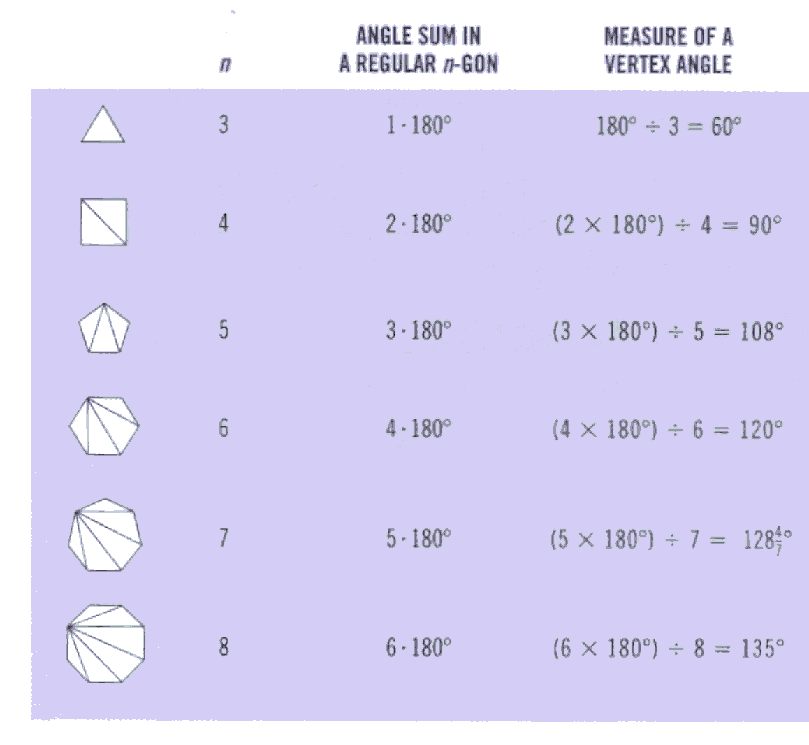
Table 12.3 Angle sums and vertex angles

Slide 5
THEOREM
Angle measures of a regular n-gon
Vertex angle (n-2)*180 / n
Central angle 360 / n
Exterior angle 360 / n

Slide 6
Tessellations
Polygon Regions: a polygon together with its interior
Tessellation: an arrangement of polygonal regions having only sides in common that completely cover the plane (no gaps….no overlaps)
Regular Tessellations: composed of copies of one regular polygon
  Theorem: only 3-gons, 4-gons, 6-gons form tessellations
Vertex Arrangement: configuration of regular polygons meeting at a vertex

Slide 7
Let’s do some mathematics
Triangle sum
Tessellations with pattern blocks
Tessellations with any quadratic
Problem for writing/discussion #1
Problem set B # 15
GSP explorations
eManipulative on web page

