Slide 1
12.5 Describing Three Dimensional Shapes
By
Dr. Sally Robison

Slide 2
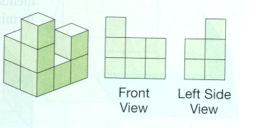
Starting Point
The stack of blocks below would have the front view and side view shown. Build two other block stacks that have the same front and side views.
  A Sketch all four views (front, back, two sides) of the two stacks that you have constructed.
  B How do the views for these two stacks compare to each other?
  C How do they compare to the views of the original stack?

Slide 3
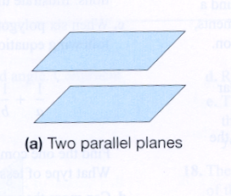
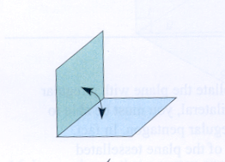
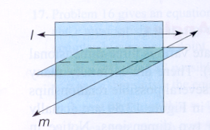
Planes, Skew Lines, and Dihedral Angles
Parallel Planes: Two plans that do not intersect
Dihedral angle: formed by the union of polygonal regions in space that share an edge
Faces: The polygonal regions formed the dihedral angle
Skew Lines: lines in three dimensional space that do not intersect and are not parallel

Slide 4

Polyhedra
Polyhedron (polyhedra): The union of polygonal regions, any two of which have at most a side in common, such that the connected finite region in space is enclosed without holes.

Slide 5
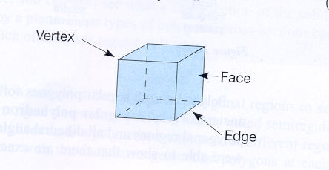
Polyhedra
Convex: A polyhedron is convex if every line segment joining two of its points is contained inside or on the polyhedron
Faces: Polygon regions
Edges: line segments common to a pair of faces
Vertices: point of intersection of the edges

Slide 6
Polyhedra
Prism: Two opposite sides (called bases) that are identical polygons
The vertices of the bases are jointed to form Lateral faces that must be parallelograms
Right Prism: the lateral faces are rectangles and the dihedral angle formed by the base and lateral face is a right angle
Oblique Prism: all non right prisms

Slide 7
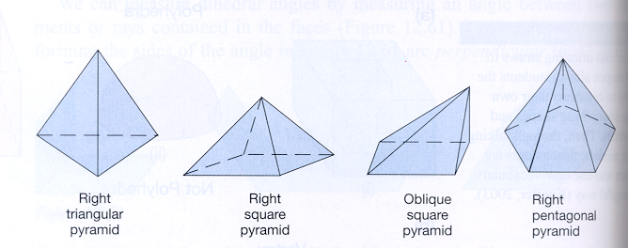
Polyhedra
Pyramid: Polyhedron that uses a polygon for the base and a point not on the plane of the base (called the APEX) to connect the line segments of each vertex of the base. The pyramids are usually named for their bases.
Right Regular Pyramid: the lateral faces are isosceles triangles
Oblique Pyramid: all non right pyramids

Slide 8
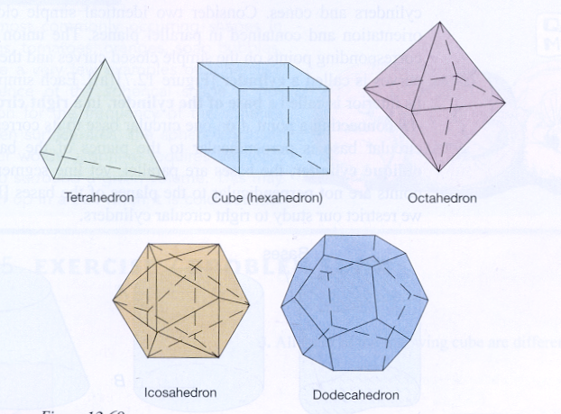
Platonic Solids
Regular Polyhedron: All faces are identical regular polygonal regions and all dihedral angles have the same measure.

Slide 9
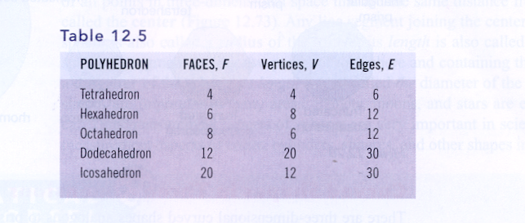
Platonic Solids
Euler’s Formula: Can you see the relationship between the faces, vertices, and edges?

Slide 10
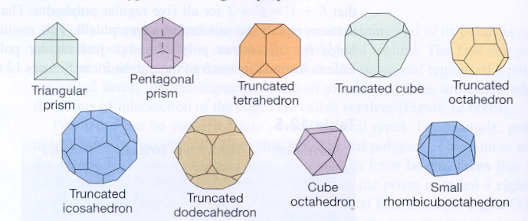
Semi-regular polyhedron
A polyhedron with several different regular polygonal regions for faces but with the same arrangement of polygons at each vertex

Slide 11
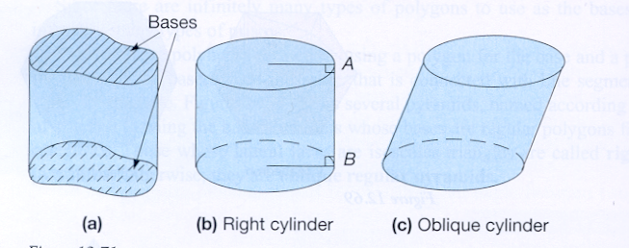
Curved Spaces in 3 -dimension
Cylinder: The union of line segments joining corresponding points on two identical simple closed curves (called bases) existing on two parallel planes
Right Circular Cylinder: a cylinder whose bases are circles and whose corresponding points on the base form perpendicular line to the bases.
Oblique: Bases are parallel, but connecting lines are not perpendicular to the base

Slide 12
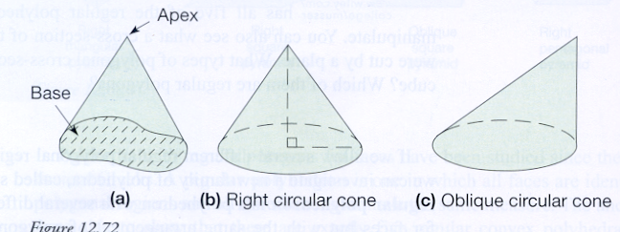
Curved Spaces in 3 -dimension
Cone: The union of the interior of a simple closed curve (called the base) and all line segments joining points of the curve to a point (called the apex)
Right Circular Cone: a cylinder that has a line segment joining the apex and the center of the circular base is perpendicular to the plane of the base.
Oblique Circular Cone: The line connecting the center of the base to the apex is not a perpendicular line

Slide 13
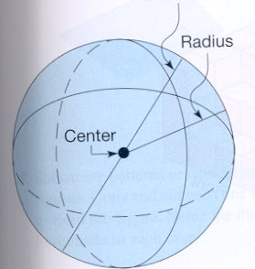
Curved Spaces in 3 -dimension
Sphere: Three dimensional analog of a circle. Set of all points in 3-d space that are the same distance from a fixed point called the center.
Radius: any line segment connecting the center to the sphere
Diameter: any line segment connecting two sides of the sphere passing through the center

Slide 14
Let’s do some mathematics
Polydron Frames
Platonic Solids folding & Euler’s formula
Problem set B # 13
Problem set A # 11 & B # 11
eManipulative on web page

