Slide 1
Measurement
  13.1 Measurement with Nonstandard and Standards units
  Elementary Math Methodology

Slide 2
Measurement Attributes
Nonstandard units
Holistic
hands
feet (paces)
pencils
paper clips
Standard
English system
  Length
  Area
  Volume
  Capacity
  Weight
  Temperature

Slide 3
Measurement Process
Select an object and identify the attribute to measure
  length, area, volume, weight, or temperature
Choose a unit (non standard or standard)
Determine the number of units
  counting, using instruments, or using formulas
Report the number of units

Slide 4
Measurement Attributes
English system (standards)
Length (Table 13.1)
  Inch, Foot, Yard, Rod, Fathom, Furlong, Mile
Area (Table 13.2)
  Square units, acre
Volume (Table 13.3)
  Cubic - inches, foot, yard
Capacity (Table 13.4)
  Teaspoon, tablespoon, ounce, cup, pint, quart, gallon, barrel
Weight (Table 13.5)
  Grain, dram, ounce, pounds, tons
Temperature
  Farenheit

Slide 5
Metric System:
An ideal system of units
The fundamental unit can be accurately reproduced without reference to a prototype (portability)
There3 are simple ratios (decimals) among units of the same type (convertibility)
Different types (such as length, area, and volume) are defined in terms of each other using simple relationships (interrelatedness)

Slide 6
Stair Steps for value system
Table 13.6
Kilo 1000 units
Hecto 100 unit
Deka 10 units
Unit 1 unit
Deci 0.1 unit
Centi 0.01 unit
Milli 0.001 unit

Slide 7
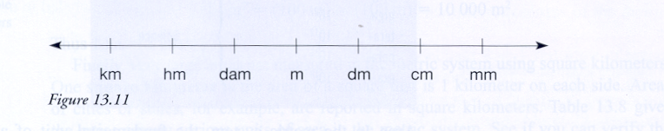
The number line for conversions

Slide 8
Metric measurement
Length – kilometer, decimeter, centimeter, milimeter, dekameter, hectometer (table 13.6)
Area - Square meter, square centimeter, square millimeter, square kilometer (table 13.8)
Volume – cubic decimeter, cubic centimeter, cubit milliliter (table 13.9 & 13.10)
Mass – kilogram, gram, metric ton (table 13.10)
Temperature – celsius
  Points (C,F) - (0,32) & (100,212) & slope intercept form

Slide 9
Dimensional Analysis
Use ratios that are equal to 1 to convert
See examples
  17 ft into inches
  4286 g into liters
  25,375 cubic feet into acres
  19 feet 4.5 inches into meters
  200 mph to feet per second

Slide 10
Common Metric equivalences
1 in = 2.540 cm 1 ft = 30.48 cm
1 yd = 91.44 cm 1 m = 39.37 in
1 kg = 2.2046 lb 1 lb = 453.59 gr
1 l = 1000 cc = 1.05671 qt
1 gr/cm^3 = 62.4 lb/ft^3

Slide 11
Temperature Conversion
  Metric poem for temperature
  30 is hot,
  20 is nice,
  10 is chilly,
  0 is ice

