Slide 1
Measurement
  13.2 Length & Area
  Elementary Math Methodology

Slide 2
Starting Point
Discuss
What is area?
Why are squares used to measure area?
What are some other possible units that could be used to measure area?

Slide 3
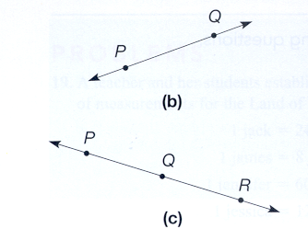
Length
Distance from P to Q
  Nonnegative difference of p and q
Distance on a line
  The distance from 0 to 1 on the number line is 1 and is called the unit distance
  For all points P and Q, PQ = QP
  If P, Q, & R are points on a line and Q is between P and R, then PQ + QR = PR

Slide 4
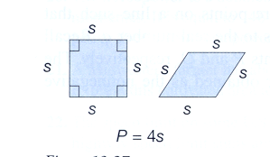
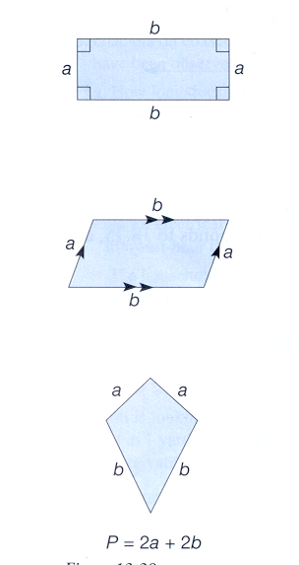
Perimeter
The sum of the lengths of a polygon’s sides
Square: 4s
Rhombus: 4s
Rectangles with sides a, b: 2a + 2b
Parallelogram with sides a, b: 2a + 2b
Kite with sides a, b: 2a + 2b

Slide 5
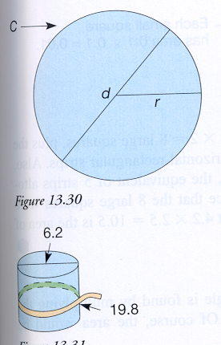
Circumference
“perimeter” of a circle
Let r, d, and C be the radius, diameter, Circumference of a circle, then d = 2r and C = πd = 2 π r

Slide 6
Reflections from research
Some students have difficulty using a ruler. They often begin measuring at a point other than zero (such as 1)
Students who make connections between geometric forms and numerical ideas in length problems have more powerful and flexible solution strategies for solving spatial problems. The lack of connection appears to limit growth in number sense, geometric knowledge, and problem solving ability.

Slide 7
Reflections from research
Both primary and upper grade students have difficulty distinguishing between area and perimeter
The construction and coordination of units is a fundamental component of children’s construction of area
Seeing the connection between the lengths of the sides and the area of a rectangle may seem natural to adults, but is not obvious to children

Slide 8
Areas of special shapes
Rectangles filled with square units
  Perpendicular sides a, b = a*b
Square of side a = a²
Triangles
  ½ a rectangle of height h and side b = ½ bh
Parallelograms
  Sides a, b = a*b
Trapezoids
  Bases a, b = ½ (a+b)h
Circles
  Radius r = πr²

Slide 9
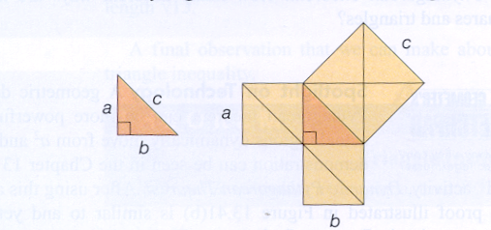
Pythagorean Theorem
A right triangle with two sides, a & b, and a hypotenuse, c

Slide 10
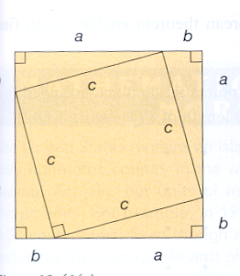
Algebraic Explanation
  From algebra:
  (a+b)² = (a+b)(a+b)
  = (a+b)a + (a+b)b
  = a² + ba + ab + b²
  = a² + ab + ab + b²
  = a² + 2ab + b²
  From Picture:
  4 (1/2 ab) + c² = 2ab + c²
  so (a+b) ² = 2ab + c²
  Therefore:
  a² + 2ab + b² = 2ab + c²
  ^{Or} a² + b² = c²

Slide 11
Technology
  A) eManipulatives www.wiley.com/college/musser
  Geoboard
  Pythagorean theorem
  B) Geometer’s Sketchpad explorations
  Rectangle Areas: Is the area and perimeter related?
  Same Base, Same Height: Do two different triangles have the same area if the height and base remain the same?
  Parallelogram areas: Do two parallelograms with the same area have the same perimeter?
  Dynamic Pythagorean
  Triangle Inequality

