Slide 1
Measurement
  13.3 Surface Area
  Elementary Math Methodology

Slide 2
Starting Point
At Bobbi’s Baby Bargain, they make and sell baby blocks in sets of 24 blocks. Bobbi has asked you to design a box to package these blocks that will require the least amount of cardboard. What is your recommendation? Provide a justification as to why your design is the most efficient.

Slide 3
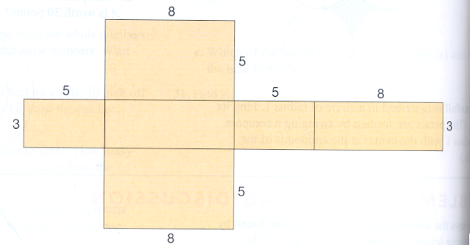
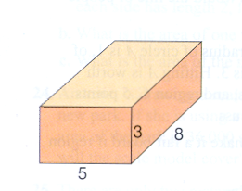
Surface Area
The total area of a 3D figure’s exterior surfaces.
Research: It is easier for students to connect a three dimensional object with its two dimensional pattern (or net) if each lateral face in the pattern is attached to the base.

Slide 4
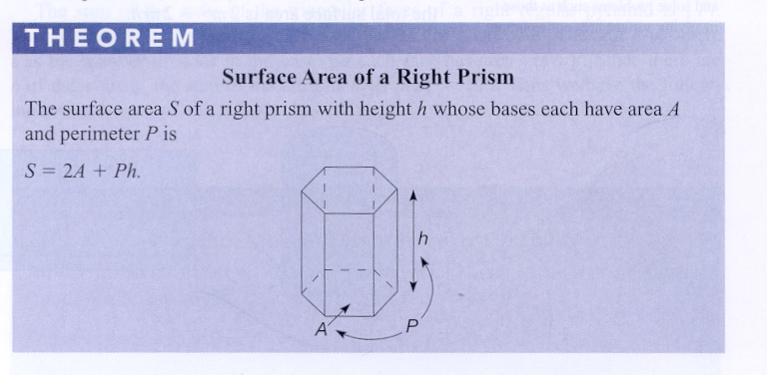
SA of a Right Prism

Slide 5
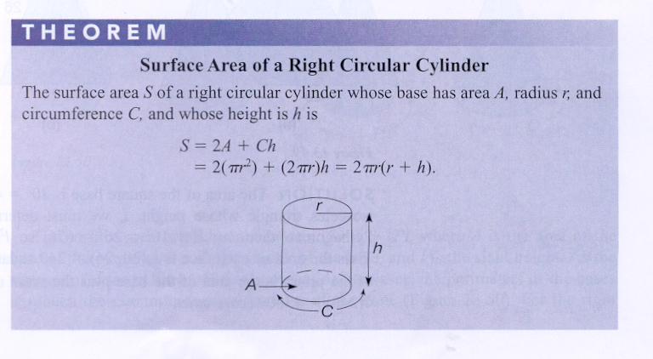
SA of a Right Circular Cylinder

Slide 6
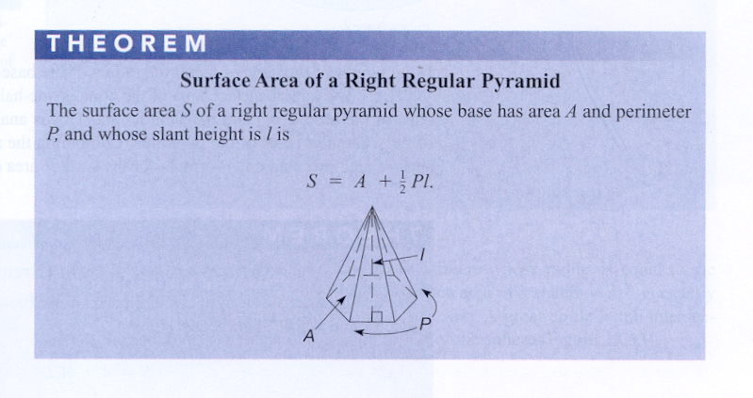
SA of a Right Regular Pyramid

Slide 7
SA of a Right Circular Cone

Slide 8
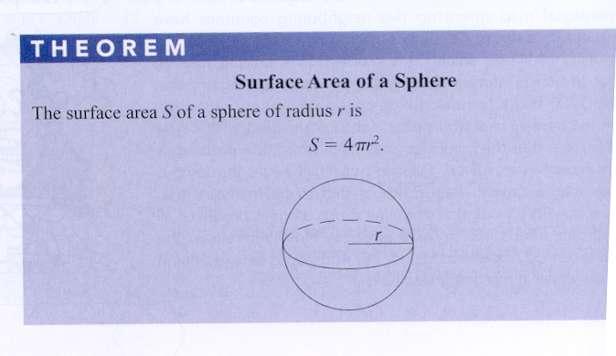
SA of a Sphere

