Slide 4
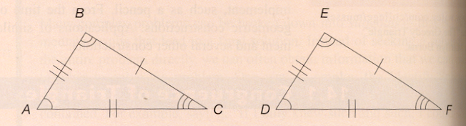
Congruent Triangles
∆ABC is CONGRUENT to ∆DEF if under the correspondence of A↔D. B↔E, C↔F all corresponding sides are congruent and all corresponding vertex angles are congruent.

Slide 5
Facts to know
If two ∆ are congruent, they have the same size and shape, but may not always be positioned in the same way.
The dominant strategy in young children for verifying congruence is edge matching.

Slide 6
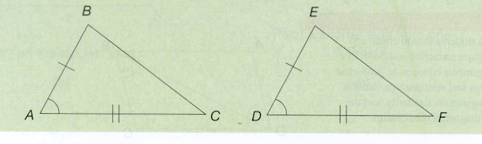
Side – Angle – Side Congruence
(SAS)
If two sides and the included angle of a triangle are congruent, respectively, to two sides and the including angle of another triangle, then the triangles are congruent.

Slide 7
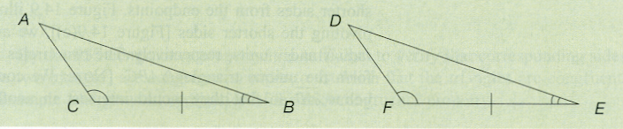
Angle – Side – Angle Congruence
(ASA)
If two angles and the included side of a triangle are congruent, respectively, to two angles and the included side of another triangle, then the triangles are congruent.

Slide 8
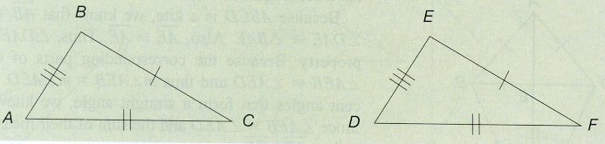
Side – Side – Side Congruence
(SSS)
If all three side of a triangle are congruent, respectively, to three side of another triangle, then the triangles are congruent.

Slide 9
Examples from text
14.1 The diagonal of a rectangle divides it into two congruent triangles (uses dot paper)

Slide 10
Examples from text
14.2 Given an isosceles triangle show that the median line forms two congruent triangles

Slide 11
Examples from text
14.3 The diagonal of a parallelogram cuts it into two congruent triangles.

Slide 12
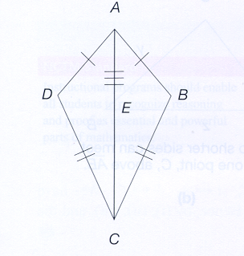
Examples from text
14.4 A Kite can be divided into two congruent triangles

Slide 13
Examples from text
14.5 The diagonals of a kite are perpendicular to each other

