Slide 1

14.2 Similarity of Triangles
By
Dr. Sally Robison

Slide 2
Starting Point
Write a description of what is meant by “this object is similar to that object.” Use your description to determine whether the following pairs of objects are similar.
  A volleyball and a basketball
  A father and his son
  Two squares
  You and your picture
  A small soda cup and a medium soda cup from a fast food restaurant
  A piece of paper with writing on it and a clean piece of paper

Slide 3
Definition of similarity
Two geometric figures that have the same shape, but not necessarily the same size

Slide 4
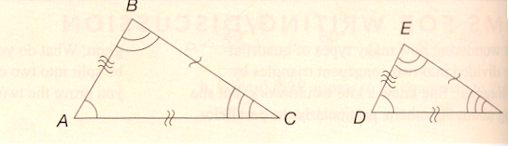
Similar Triangles
∆ABC is SIMILAR to ∆DEF if under the correspondence of A↔D. B↔E, C↔F all corresponding sides proportional and all corresponding vertex angles are congruent.

Slide 5
Research
Because the term “similar” is used in mathematical and non-mathematical context, students often have difficulty with it’s meaning. For instance, in life, triangles are similar because they all have 3 sides and 3 angles.

Slide 6
Wiley Site
http://www.wiley.com/college/musser
  CH 14: GSP: TREE HEIGHT

Slide 7
Similarity Properties of Triangles
Two triangles are similar if and only if they posses at least one of the following three statements
  2 pairs of corresponding sides are proportional and their including angles are congruent (SAS similarity)
  2 pairs of corresponding angles are congruent (AA similarity)
  All 3 pairs of corresponding sides are proportional (SSS Similarity)

Slide 8
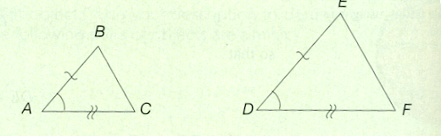
SAS similarity
2 pairs of corresponding sides are proportional and their including angles are congruent

Slide 9
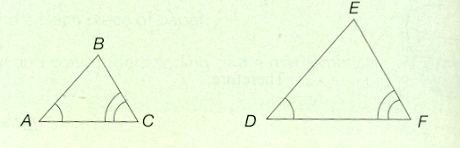
AA Similarity
  2 pairs of corresponding angles are congruent

Slide 10
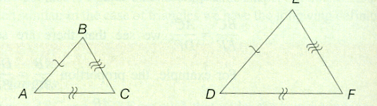
SSS Similarity
All 3 pairs of corresponding sides are proportional

Slide 11
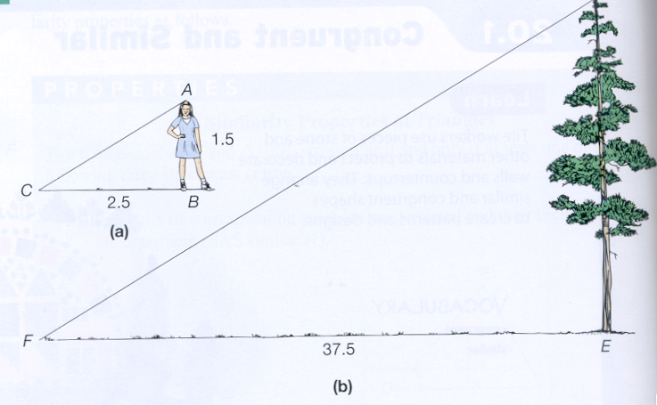
Indirect Measurements
Proportionality used to solve
2.5 / 37.5 is equal to 3.5 / tree height (DE)

Slide 12
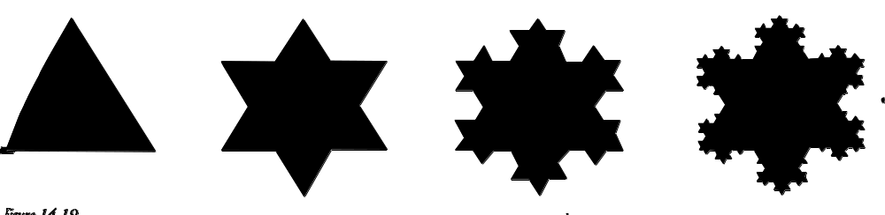
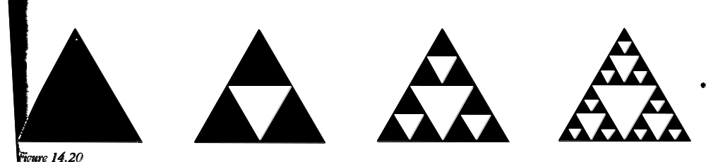
Fractals and Self Similarity
Self similar: shape looks the same when part of it is magnified.
  May have finite area but infinite perimeter

