Slide 1

14.3 Basic Euclidean Constructions
By
Dr. Sally Robison

Slide 2
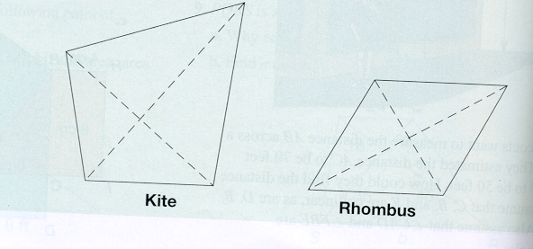
Starting Point
Identify all the properties you can think of regarding the diagonals of a kite and a rhombus.
  Are there any properties that a rhombus has that a kite does not?
  Are there any properties that a kite has that a rhombus does not?

Slide 3
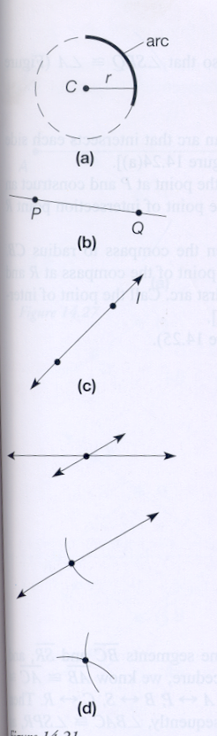
Compass and Straightedge Properties
For every positive number r and for every point C, we can construct a circle of radius r and center C.
Every pair of points P and Q can be connected by a straightedge to construct line PQ, ray PQ, and segment PQ
A line l can be constructed if and only if we have located two points that are on l. Points are located only by the intersection of lines, rays, segments, or arcs.

Slide 4
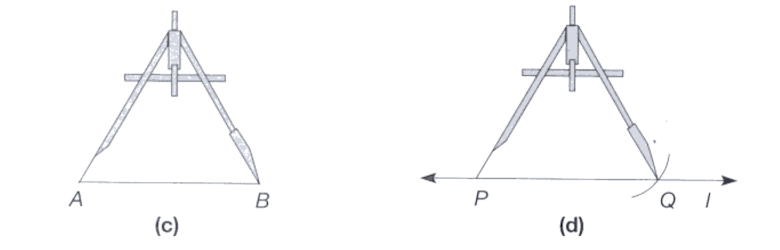
Construction 1
Copy a line segment

Slide 5
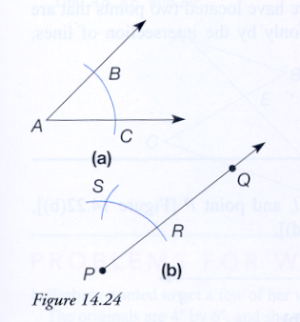
Construction 2
Copy an angle

Slide 6
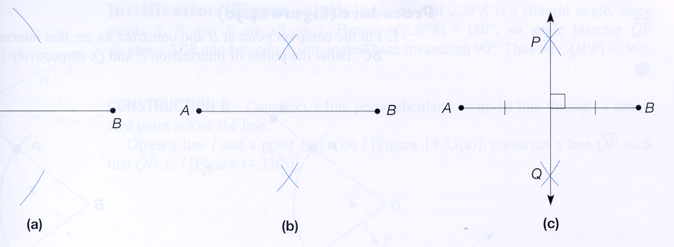
Construction 3
Construct a perpendicular bisector of a line segment

Slide 7
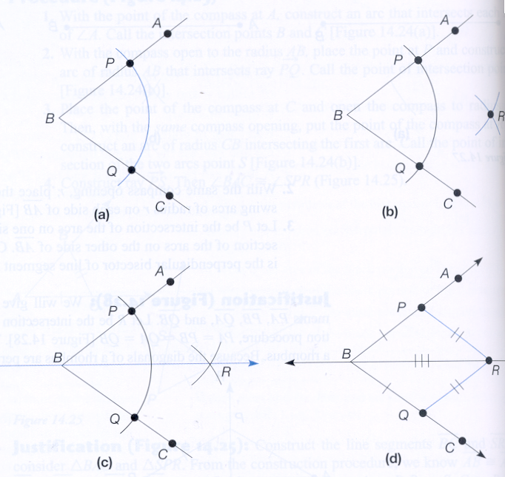
Construction 4
Bisect an angle

Slide 8
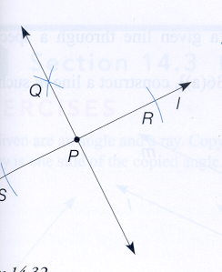
Construction 5
Construct a line perpendicular to another line passing through a point on the line

Slide 9
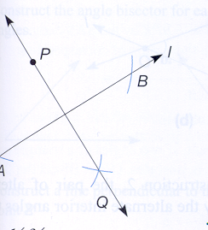
Construction 6
Construct a line perpendicular to another line passing through a point not on the line

Slide 10
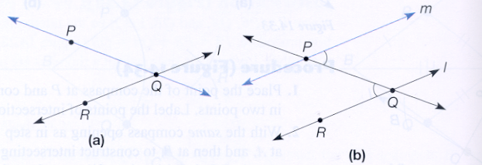
Construction 7
Construct a line parallel to another line passing through a point not on the line

Slide 11
Research
Because many computer drawing programs enable the user to move geometric figures after they have been drawn, the sequence in which steps of a construction are done becomes important. Constructing a point on a line may not be the same as constructing a line through a point. If a line is drawn through a point and then the line is moved, the point would need to be constructed on the line to ensure the movement.

