Slide 1
6.3 Fractions:
Multiplication and Division
By
Dr. Sally Robison

Slide 2
Starting Point
Give a word problem for each of the following expressions.
  4 x 2/3
  3 ÷ 1/2

Slide 3
Reflections from Research
Until students understand operations with fractions, they often have misconceptions that multiplication always results in a larger answer and division in a smaller answer.

Slide 4
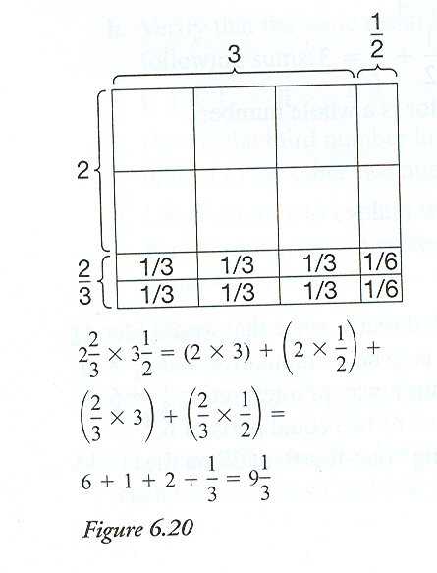
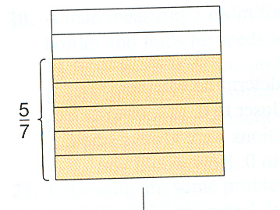
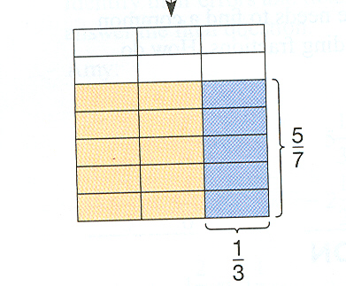
Multiplying fractions
a/b and c/d are any two fractions, then a/b * c/d = ac/ bd
(think---what is a/b of c/d?)

Slide 5
Reflections from Research
Students who only view fractions like ¾ as “three out of 4 parts” struggle to handle fraction multiplication problems such as 2/3 of 9/10. Students who can more flexibly view ¾ as “three fourth of one whole or three units of one fourth” can better solve multiplication of two proper fractions.

Slide 6
Multiplicative Properties (reworded)
Closure: The produce of two fractions is a fraction
Commutative: Order doesn’t matter
Associative: grouping doesn’t matter
Multiplicative Identity: 1 (a/a) can be multiplied to a fraction with no affect.
Inverse: a/b * b/a = 1 (identity)
Distributive (Multiplication over Addition)
  a/b(c/d + e/f) = a/b x (c/d) + a/b x (e/f)

Slide 7
Division of fractions
Recognize that a ÷ b = a/b, b ≠0
Think how many sets of the divisor are in the dividend. ½ ÷ ¼ = How many ¼ in ½? Answer is 2.
Like Denominators
  a/b and c/b are any two fractions
  a/b ÷ c/b = a/ c
Unlike Denominators
  a/b and c/d are any fractions with c ≠ 0
  a/b ÷ c/d = a/b * d/c = a*d / b*c (complex)

Slide 8
Reflections from Research
Teachers are better at interpreting student incorrect responses to division of fractions if they understand “students’ tendencies to attribute observed properties of division with natural numbers to fractions or properties of other operations on fractions to division of fractions” (Tirosh, 2000)

