Slide 1
8.1 Adding and Subtracting Integers
By Dr. Sally Robison

Slide 2
Starting Point
Write a word problem for each of the following expressions
a -30 + 14
b -30 – 14
c -30 + (-14)

Slide 3
Integers
The set of integers is the set
I = {…., -3, -2, -1, 0, 1, 2, 3, ….}
The numbers 1, 2, 3, … are positive integers
The numbers -1, -2, -3, … are negative integers
The zero is neither positive or negative

Slide 4
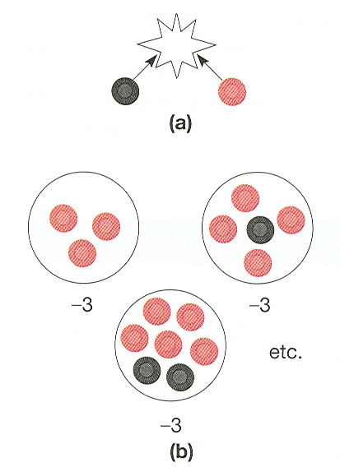
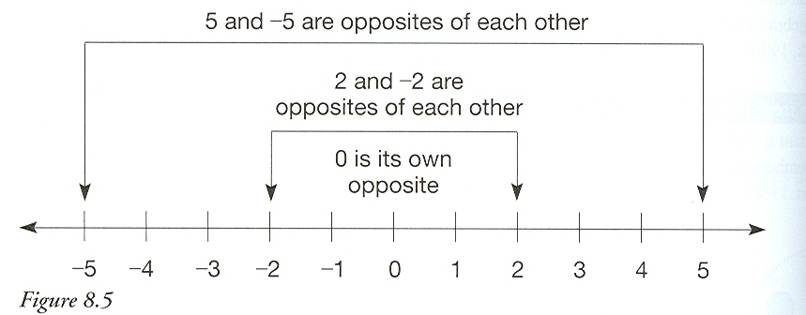
Integer Models
Set Model
Measurement

Slide 5
Reflections from research
An understanding of integers is crucial to an understanding of future work in algebra
It is important to introduce children to negative numbers using manipulatives
Students should be able to make generalizations to integers from their experience with arithmetic

Slide 6
Modeling
Addition of Integers

Slide 7
Zero My Hero

Slide 8
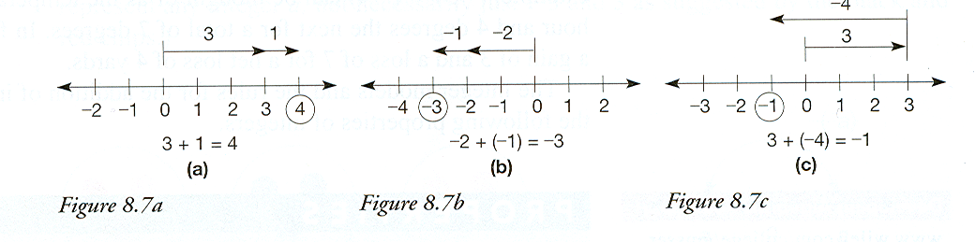
Number Line Model

Slide 9
Adding Integers
Adding zero
  a + 0 = 0 + a = a
Adding two positives
  a + b = a positive number
Adding two negatives
  (-a) + (-b) = a negative number

Slide 10
Adding Integers
Adding a positive and a negative
  If a and b are positive and a > b, then a + (-b) = a-b where a – b is the whole number difference of a and b and will be positive
  If a and b are positive and a < b, then a + (-b) = - (b-a), where b-a is the whole number difference between a and b and will be negative

Slide 11
Properties of Integer Addition
Closure a + b is an integer
Commutative a + b = b + a
Associative (a+b)+c = a+(b+c)
Identity Property a + 0 = 0 + a = a, 0 is the identity element
Additive Inverse a + (-a) = 0, -a is the additive inverse

Slide 12
Additive cancellation of integers
Let a, b, and c be any integers.
If a + b = b + c, then a = b
When solving an equation, such as x + 4 = 3, the additive inverse of 4, namely -4 , is added to both sides of the equation as follows
X + 4 + (-4) = 3 + (-4)
X = -1

Slide 13
Modeling
Subtraction of Integers

Slide 14
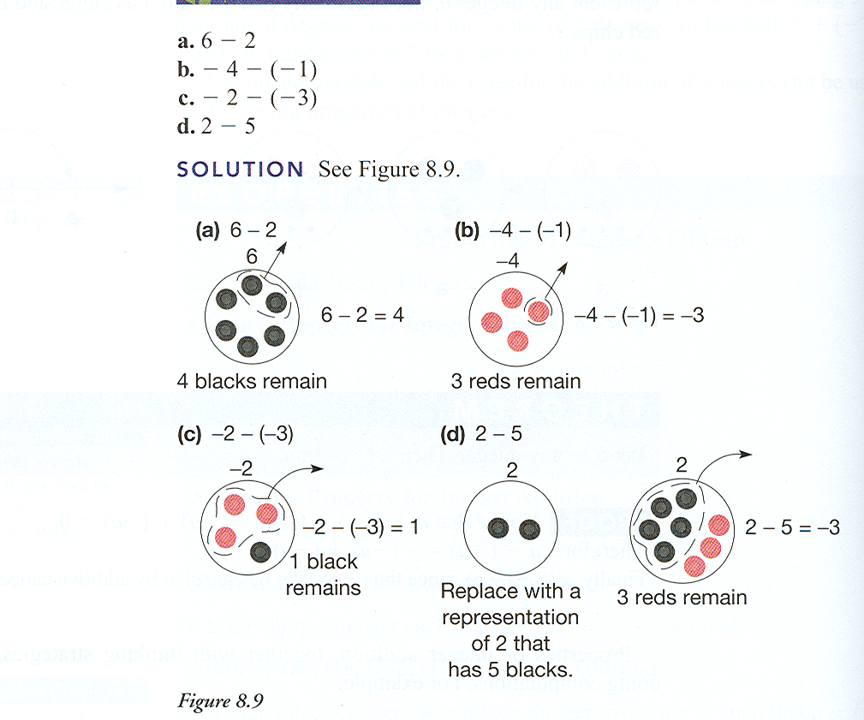
Set Model for Subtraction

Slide 15
Definition of Subtracting Integers
Adding the Opposite
  a –b = a + (-b)
Missing Addend Approach
  Let a, b, and c be any integers, then a – b = c if and only if a = b + c

Slide 16
Chip Minus
http://www.wiley.com/college/musser

