Slide 1
8.2 Multiplication & Division of Integers and Order
By Dr. Sally Robison

Slide 2
Starting Point
Consider the following table
3² = 9
3¹ = 3
3⁰ = 1
What would 3 ⁻¹ equal?

Slide 3
Multiplication of Integers
Multiplying by 0
  0*a = a*0 = 0
Multiplying two positives
  a*b is a whole number
Multiplying a positive and a negative
  a(-b) = - (ab)
Multiplying two negatives
  (-a)(-b) = ab

Slide 4
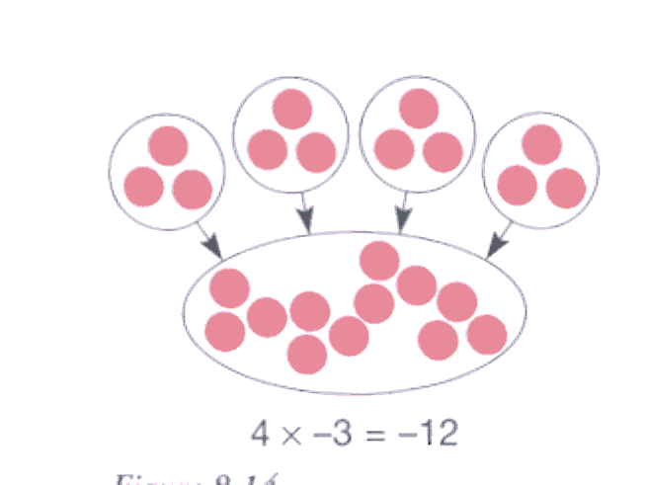
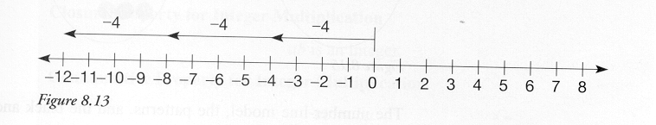
Integer Models
Set Model
Measurement

Slide 5
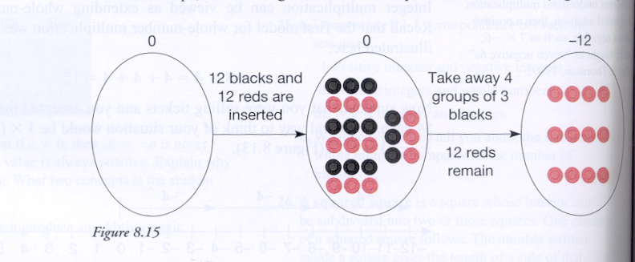
Multiplication of Integers
-4 x 3 = -12

Slide 6
Reflections from research
If students understand multiplication as repeated addition, then a positive times a negative, such as 7 x -6, can be taught as “seven sets of negative 6s”

Slide 7
Properties of Integer Multiplication
Closure a x b is an integer
Commutative a x b = b x a
Associative (ab)c = a(bc)
Identity Property a x 1= 1 x a = a, 1 is the identity element
Distributivity of Multiplication over Addition a(b+c) = ab + ac

Slide 8
Theorems
a (-1) = -a
(-a)b = -(ab)
(-a)(-b)= ab for all integers a,b

Slide 9
Multiplicative cancellation of integers
Let a, b, and c be any integers.
If ac = bc, then a = b
Ex: (x)(2) = (y)(2) so x = y

Slide 10
Zero Divisors Property
Let a, b, and c be any integers.
If ab = 0, then a = 0 or b = 0 or both a and b = 0
When solving an equation, such as
(x -2)(x+3) = 0, then either x-2 = 0 or x+3 = 0

Slide 11
Modeling
Division of Integers

Slide 12
Set Model for Repeated Subtraction
Brainstorm how you will explain and model
a) 15 divided by -3
b) -15 divided by 3
c) -15 divided by -3

Slide 13
Definition of Division of Integers
Let a and b be any integers, where b ≠ 0, then a ÷ b = c if and only if a = b x c

Slide 14
Negative Integer Exponents
Let a be any nonzero number and n be a positive integer. Then
a ^{–n} = 1 / a ^{n}
EX 6 ⁻² = 1/6² = 1/36
EX 1/ 4⁻² = 1 / 1/4² = 4² = 16

Slide 15
Properties of Ordering Integers
Transitive property for less than
  If a < b and b < c then a < c
Property of less than for addition
  If a < b, then a+c < b+c
Property of less than - multiplying positive number
  If a < b, then ap < bp
Property of less than - multiplying negative number
  If a < b then an > bn

Slide 16
Division
http://www.wiley.com/college/musser

