Slide 1

Overview
September 2012

Slide 2
Who We Are
We are a mentoring service catering to Middle and High School students that are interested in pursuing a successful and meaningful career
We are especially focused in empowering students to excel in Science, Technology, Engineering and Math (STEM)

Slide 3

Our Messages To The Students
Careers are NOT accidents or miracles that occur by happenstance
Careers must be planned
Careers must fit one’s personality and bliss in life

Slide 4
The Problem
There are way too many choices (over 4,000 careers/occupations to choose from). There are new jobs invented every year
There are a lot of misperceptions and misunderstandings pertaining to careers and the way one should go about pursuing them

Slide 5

Key Points
The better the career, the better life one will enjoy and the more money one will make
However, careers are NOT about money alone

Slide 6

Students that have the right attitude, knowledge and tools have better careers
Mentoring is a great tool!

Slide 7


The Key To Success

Slide 8

TMM’s Mission
To help youth explore their career options and potential through hands-on interaction in a mentor’s work environment

Slide 9
TMM Current Programs
Job Shadowing --- Visiting a mentor at her/his workplace and learning by observing and asking the right questions
Speed Date Your Career Events --- Meeting 12 or more mentors all in one day (2-3-hrs) and in one location (usually a school or other institution, like Mercy Street or SMU Campus)

Slide 10
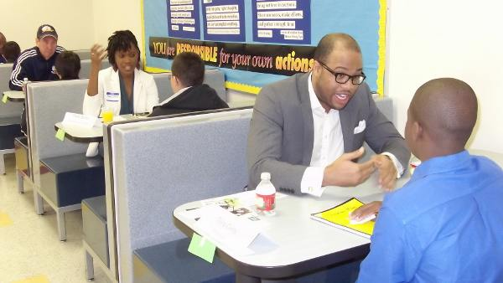
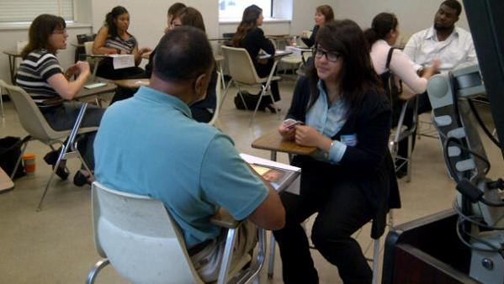
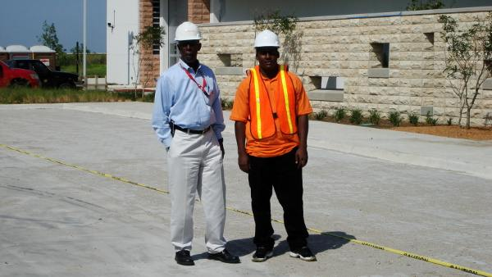

Slide 11
TMM’s Geographic Coverage
Dallas County
Collin County
Note: One of TMM’s goal is to expand its programs to all counties in North Texas and then to all of Texas

Slide 12
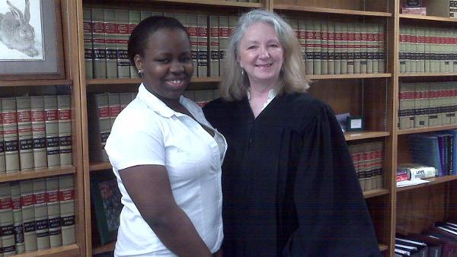
TMM’s Current Status
TMM currently has over 400 students (mentees) and over 70 mentors (professionals and business owners from several industries)

Slide 13

Thank you for joining us today!

