Slide 1
Generating Synthetic Genotypes using Diffusion Models
Philip Kenneweg, Raghuram Dandinasivara, Xiao Luo, Barbara Hammer, Alexander Schönhuth
University Bielefeld
July 21, 2025

Slide 2
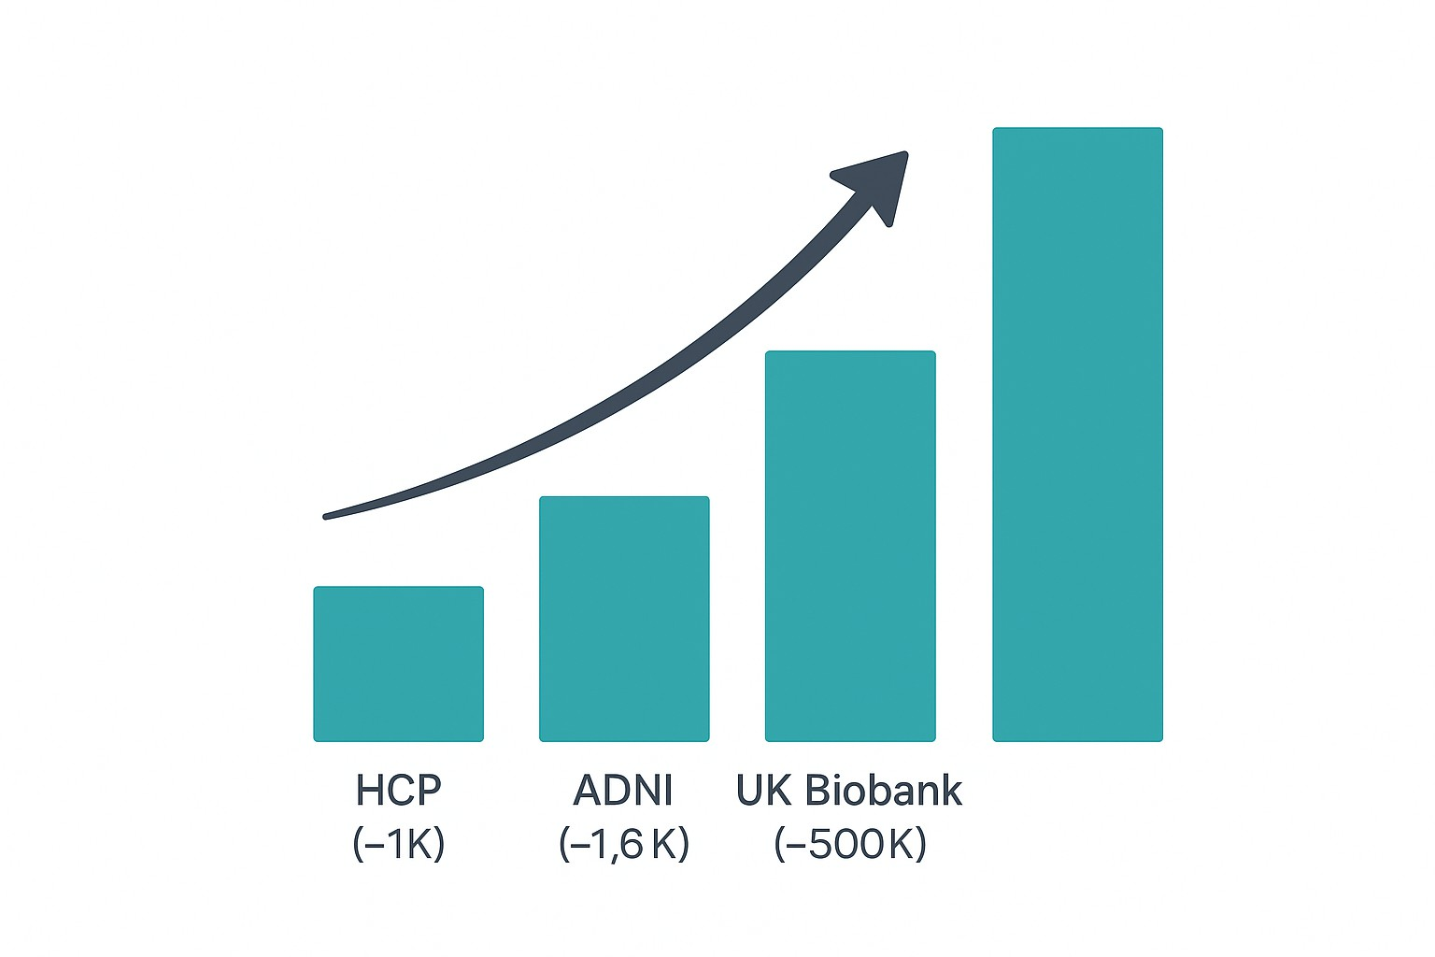
Why do we need Synthetic Data?
Faculty of Technology
Large high quality datasets are becoming available but getting access is a long and costly process (for example UKBB ¹)
High quality synthetic data would allow genomics data to be freely distributed (i.e. Kaggle dataset) without privacy concerns.
Figure: Increasing availability of large scale genomics datasets.
¹UK Biobank – cohort of 500 000 participants with extensive health, genetic and imaging data. “About our data” page, UK Biobank.
https://www.ukbiobank.ac.uk/enable-your-research/about-our-data.
<number> / 18

Slide 3
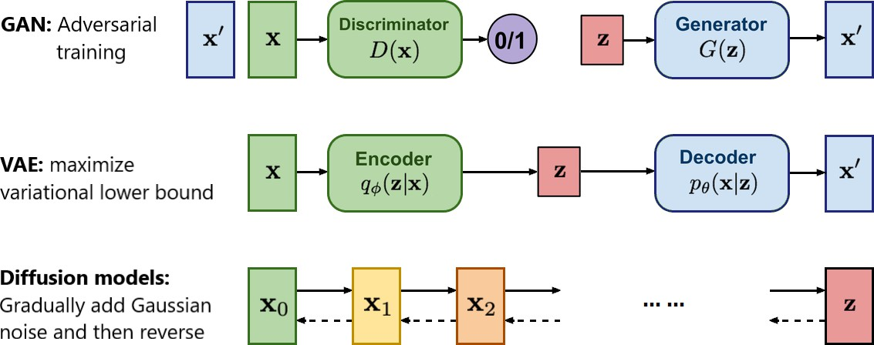
Possible Generative Models
Faculty of Technology
Variational Autoencoder
Generative Adversarial Networks
Generative Markov Models
Diffusion Models
Autoregressive Models (LLM Style)
<number> / 18

Slide 4
Possible Generative Models
Faculty of Technology
Variational Autoencoder - Output quality not state of the art, does not scale well, ...
Generative Adversarial Networks - Unstable, hard to train, ...
Generative Markov Models - Not very powerfull or general, ...
<number> / 18

Slide 5
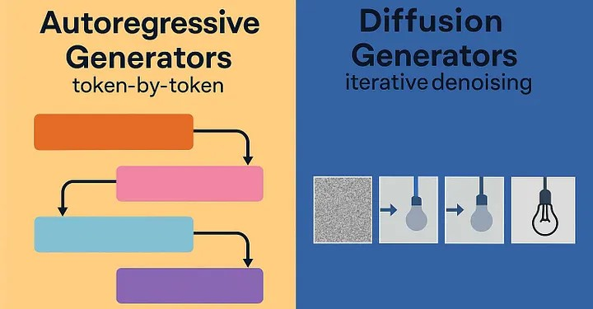
Possible Generative Models
Faculty of Technology
Diffusion Models - best suited for fixed length generation with causal interactions in all directions, can produce very high quality output by refining over multiple passes
Autoregressive Models (LLM Style) - best suited for non-fixed length with causal interactions left to right, produces good output, mostly used for high level tasks
Genome has interactions in all directions, fixed length, high quality needed
-> Diffusion Models
<number> / 18

Slide 6
Related Work
Faculty of Technology
Table: An overview of related work on generating synthetic genomes and its differences / similarities in comparison with our work. Our novelties are highlighted.
Reference | Model | Data Type | Genome Length | Cond.
DNAGPT (Zhang et al., 2023) HyenaDNA (Nguyen et al., 2023) | Autoregressive Autoregressive | Base-Pairs Base-Pairs | 24k BPS 10⁶ BPS | x x
HAPNEST (Wharrie et al., 2023) | LD & Markov | SNPs | 1 Chromosome | x
(Perera et al., 2022) | GMMNs | SNPs | 1 Chromosome | y
(Yelmen et al., 2021) | GAN,RBM | SNPs | 10k SNPs | x
(Yelmen et al., 2023) | WGAN | SNPs | 10k SNPs | x
(Szatkownik et al., 2024) | WGAN | PCA+SNPs | 65k SNPs | x
(Ahronoviz and Gronau, 2024) | GAN | SNPs | 10k SNPs | y
(Burnard et al., 2023) | VAE | SNPs | 1 Chromosome | x
(Dang et al., 2023) | HCLTs | SNPs | 10k SNPs | x
GeneticDiffusion (Ours) | Diffusion | PCA+SNPs | Full Genome | y
<number> / 18

Slide 7
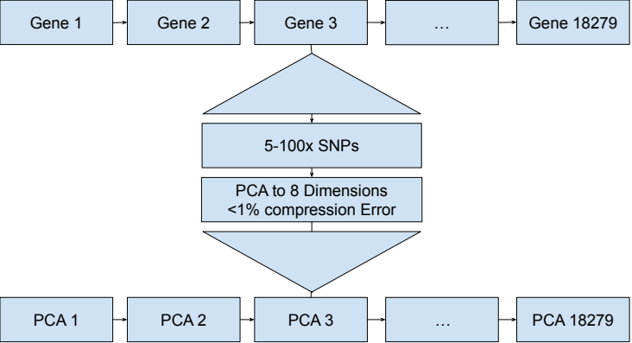
Pre-Processing
Faculty of Technology
Figure: Overview of the Pre-processing pipeline. Genes, which consist of between 5 to 100 SNPs are each processed by a custom PCA. This is done independently for each Gene.
<number> / 18

Slide 8
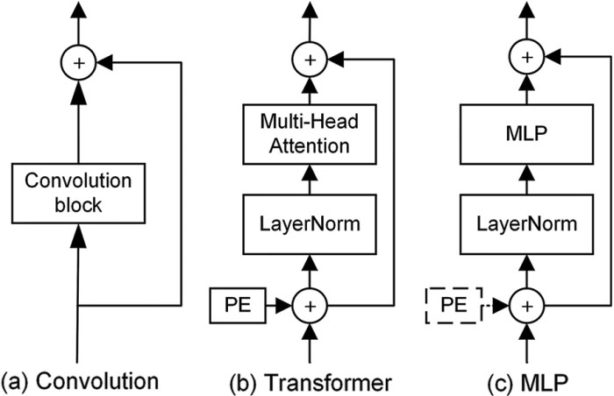
Model Architecture
Faculty of Technology
Possible options:
Transformer - No spatial bias, popular, needs high amount of training data
U-Net CNN - Local spatial bias, few parameters
U-Net MLP - Overfits easily, hard to train
Combinations are also possible
<number> / 18

Slide 9
Model Architecture
y,t
147456
147456
Faculty of Technology
1024
18432x8
18432x8
+
1024 ₁₀₂₄
1024
512
512
512
256
256
up/down block
Input/output y,t input linear layers
Skip connection forward connection
y,t connection
Down Sampling Block
Up Sampling Block
Skip output Skip input
out_size out_size
input
^{in_size} out_size
+
output input
cat
x +
output
out_size in_size _{out_size 2x}
out_size
out_size
y
t
linear layer + activation
Figure: A structural overview of the architecture of the MLP diffusion model.
<number> / 18

Slide 10
Evaluation
Faculty of Technology
We evaluate on 2 different classification tasks:
Train Data
Generative Model
Synthetic Data
ALS classification
1KG region classification
Recovery Rate compares the performance of the syn model a_{s} vs the true model a_{r}:
Trained on
Trained on
Data
Classification Model True
Classification Model Syn
Evaluated on
Val Data
Evaluated on
a_{s} a_{r}
Recovery Rate
R(a_{r}, a_{s}) =
(1)
Figure: A diagram of the evaluation pipeline.
<number> / 18

Slide 11
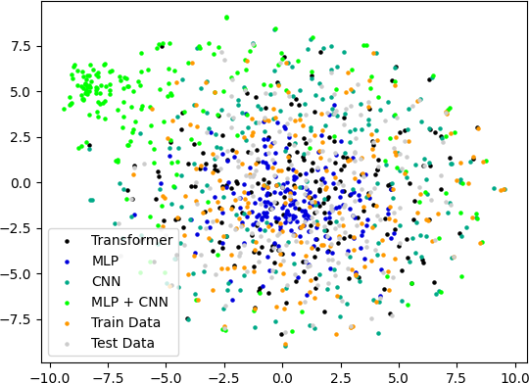
Evaluation
Faculty of Technology
Additional metric:
Nearest Neighbour Adversarial Accuracy (Yale et al., 2019) - relies on distances of generated samples to original samples.
Problem:
Distances/neighbourhood in high dimensional space are not inherently meaningful (Beyer et al., 1999).
<number> / 18

Slide 12
Experiments
Faculty of Technology
We evaluated 4 different generative architectures:
MLP
CNN
MLP + CNN
Transformer
The metrics we used:
Recovery Rate
Nearest Neighbour Adversarial Accuracy
Accuracy improvement with partial synthetic data
<number> / 18

Slide 13
Results Recovery Rate
Table: Recovery rates on a hold out test set of true genotypes after training
population classifiers (MLP, Transformer or CNN) on different synthetically generated data types (generated by: MLP, Transformer, CNN, MLP + CNN). The best synthetic data for each classifier
type is marked in bold.
Faculty of Technology
Classifier | CNN | MLP | MLP+CNN | Transformer
 |  | ALS data
MLP | 71.51 | 96.69 | 94.26 | 73.77
Transformer | 66.06 | 93.44 | 93.89 | 69.30
CNN | 69.88 | 91.72 | 93.17 | 68.72
 |  | 1KG data
MLP | 15.58 | 65.80 | 93.02 | 13.28
Transformer | 16.23 | 62.99 | 84.98 | 8.38
CNN | 19.52 | 56.57 | 77.54 | 21.21
Average (all) | 43.17 | 78.06 | 89.48 | 42.56
<number> / 18

Slide 14
Results NNAA
Table: Result of Nearest Neighbour Adversarial Accuracy for generated
datasets; For AA the closer to 0.5 the better, For Privacy Loss the closer to 0 the better; best performance is highlighted.
Faculty of Technology
 |  |  | CNN | MLP | MLP + CNN | Transformer
ALS data | test data | AAtruth | 0.735 | 0.255 | 0.485 | 0.92
 |  | AAsyn | 0.68 | 1.0 | 0.93 | 0.66
 | train data | AAtruth | 0.81 | 0.005 | 0.405 | 0.93
 |  | AAsyn | 0.67 | 1.0 | 0.92 | 0.69
 |  | Privacy Loss | 0.0325 | 0.125 | 0.0475 | 0.02
1KG data | test data | AAtruth | 0.76 | 0.0 | 0.63 | 0.345
 |  | AAsyn | 0.995 | 1.0 | 0.94 | 0.92
 | train data | AAtruth | 0.765 | 0.0 | 0.385 | 0.285
 |  | AAsyn | 1.0 | 0.99 | 0.74 | 0.82
 |  | Privacy Loss | 0.05 | -0.005 | -0.2225 | 0.08
<number> / 18

Slide 15
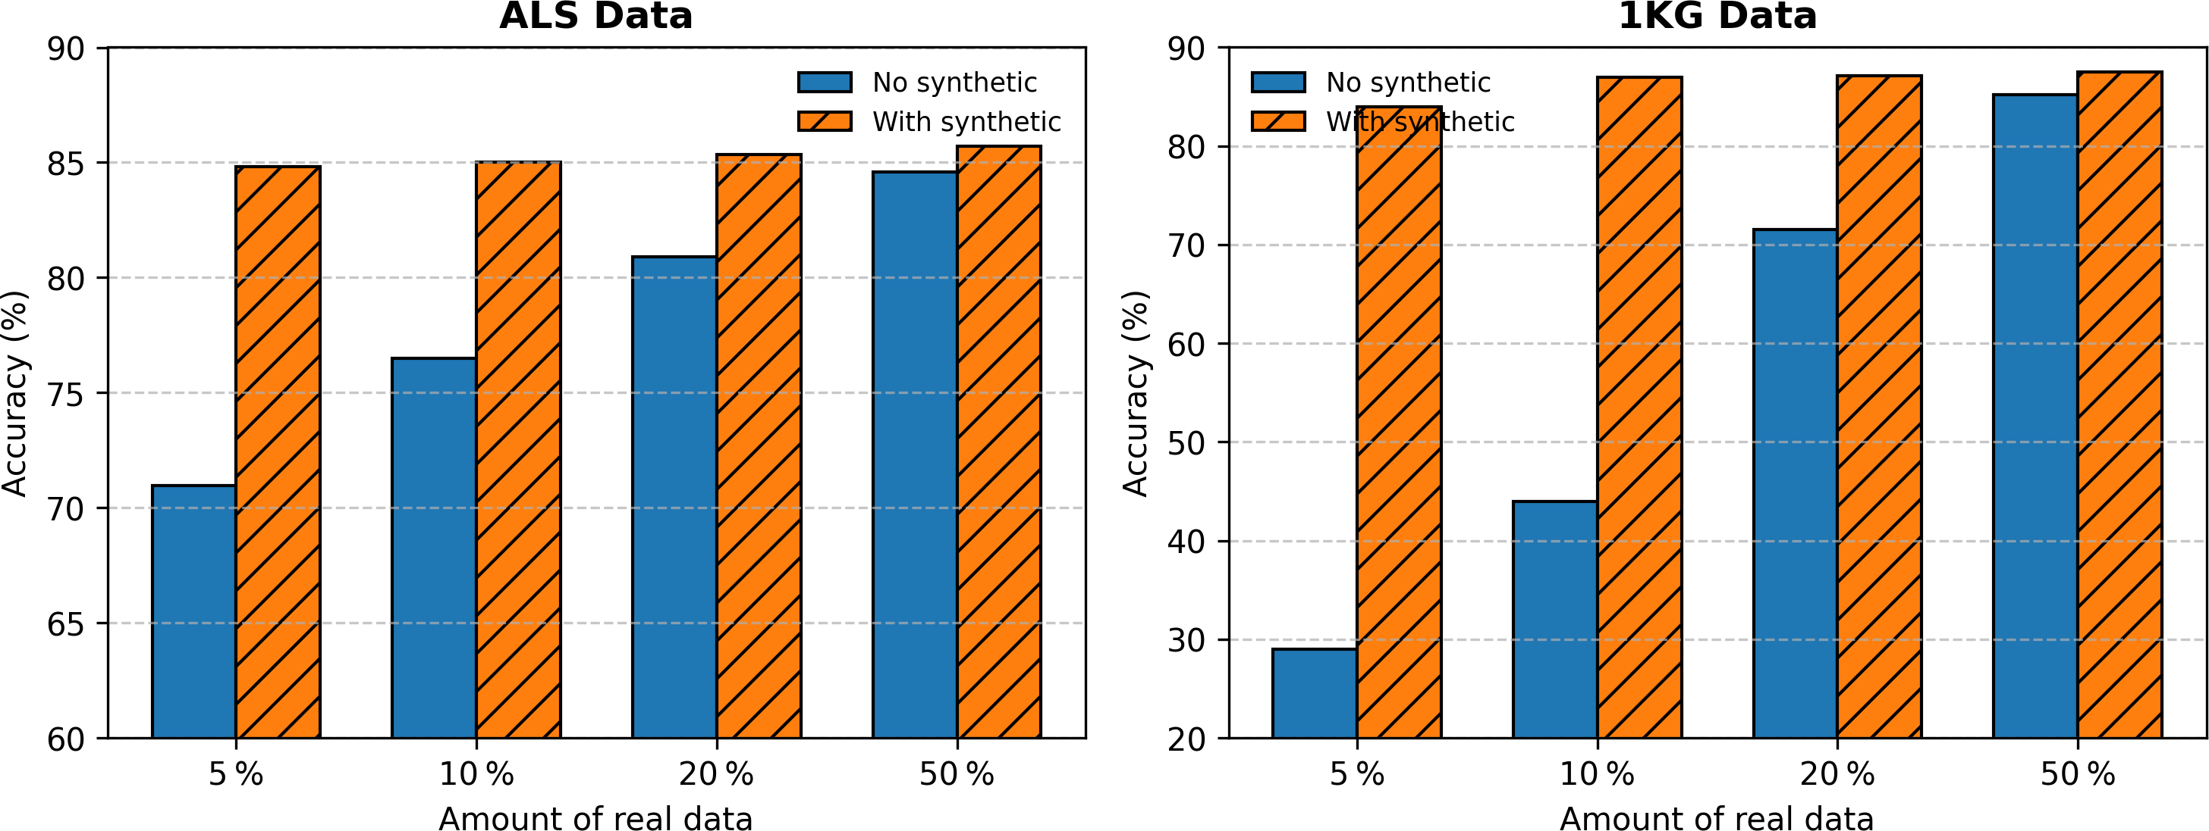
Partial Synthetic and Real
Faculty of Technology
Figure: Accuracy improvements by integration of synthetic data for best performing classification architecture.
<number> / 18

Slide 16
Conclusion
Faculty of Technology
Synthetic data does not just copy real data, while close to real data distribution (see NNAA)
Recovery Rate indicates high fidelity of synthetic data.
Next Steps:
Bigger dataset (for example UK Biobank)
Multimodal data
Publish synthetic dataset
<number> / 18

Slide 17
Q & A
Faculty of Technology
Questions and Discussion
Feel free to ask anything.
<number> / 18

Slide 18
Faculty of Technology
Bibliography
18 / 18

Slide 19
Ahronoviz, S. and Gronau, I. (2024).
Genome-ac-gan: Enhancing synthetic genotype generation through auxiliary classification.
bioRxiv, pages 2024–02.
Beyer, K., Goldstein, J., Ramakrishnan, R., and Shaft, U. (1999).
When is “nearest neighbor” meaningful?
In International conference on database theory, pages 217–235. Springer.
Faculty of Technology
Burnard, C., Mancheron, A., and Ritchie, W. J. (2023).
Generating realistic artificial human genomes using adversarial autoencoders.
bioRxiv, pages 2023–12.
Dang, M., Liu, A., Wei, X., Sankararaman, S., and Van den Broeck, G. (2023). Tractable and expressive generative models of genetic variation data. bioRxiv.
Nguyen, E., Poli, M., Faizi, M., Thomas, A., Birch-Sykes, C., Wornow, M., Patel, A., Rabideau, C., Massaroli, S., Bengio, Y., Ermon, S., Baccus, S. A., and Ré, C. (2023).
Hyenadna: Long-range genomic sequence modeling at single nucleotide resolution.
Perera, M., Montserrat, D. M., Barrabés, M., Geleta, M., Giró-i Nieto, X., and Ioannidis, A. G. (2022).
Generative moment matching networks for genotype simulation.
In 2022 44th Annual International Conference of the IEEE Engineering in Medicine & Biology Society (EMBC), pages 1379–1383. IEEE.
Szatkownik, A., Furtlehner, C., Charpiat, G., Yelmen, B., and Jay, F. (2024).
Towards creating longer genetic sequences with gans: Generation in principal component space. In Machine Learning in Computational Biology, pages 110–122. PMLR.
Wharrie, S., Yang, Z., Raj, V., Monti, R., Gupta, R., Wang, Y., Martin, A., O’Connor, L. J., Kaski, S., Marttinen, P., Palamara, P. F., Lippert, C., and Ganna, A. (2023).
HAPNEST: efficient, large-scale generation and evaluation of synthetic datasets for genotypes and phenotypes.
Bioinformatics, 39(9):btad535.
Yale, A., Dash, S., Dutta, R., Guyon, I., Pavao, A., and Bennett, K. P. (2019).
Privacy preserving synthetic health data.
In ESANN 2019-European Symposium on Artificial Neural Networks, Computational Intelligence and Machine Learning.
18 / 18

Slide 20
Yelmen, B., Decelle, A., Boulos, L. L., Szatkownik, A., Furtlehner, C., Charpiat, G., and Jay, F. (2023). Deep convolutional and conditional neural networks for large-scale genomic data generation. PLoS Computational Biology, 19(10):e1011584.
Yelmen, B., Decelle, A., Ongaro, L., Marnetto, D., Tallec, C., Montinaro, F., Furtlehner, C., Pagani, L., and Jay, F. (2021).
Creating artificial human genomes using generative neural networks.
PLoS genetics, 17(2):e1009303.
Faculty of Technology
Zhang, D., Zhang, W., He, B., Zhang, J., Qin, C., and Yao, J. (2023).
Dnagpt: a generalized pretrained tool for multiple dna sequence analysis tasks.
bioRxiv, pages 2023–07.
18 / 18

