Slide 1
No Learning Rates Needed
Introducing SaLSa – Stable Armijo Line Search
Philip Kenneweg
13 May 2024
University Bielefeld

Slide 2
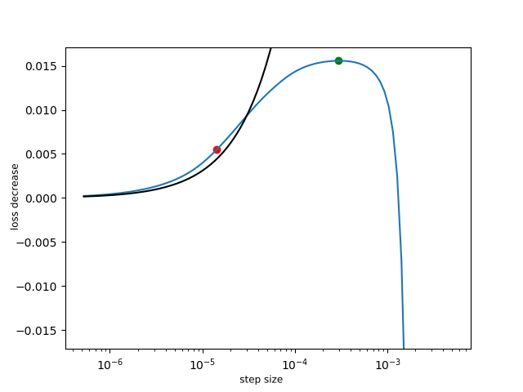
What is a Line Search?
Learning rate is a hyperparameter
We want to find its optimum
Dynamic schedules possible

Slide 3
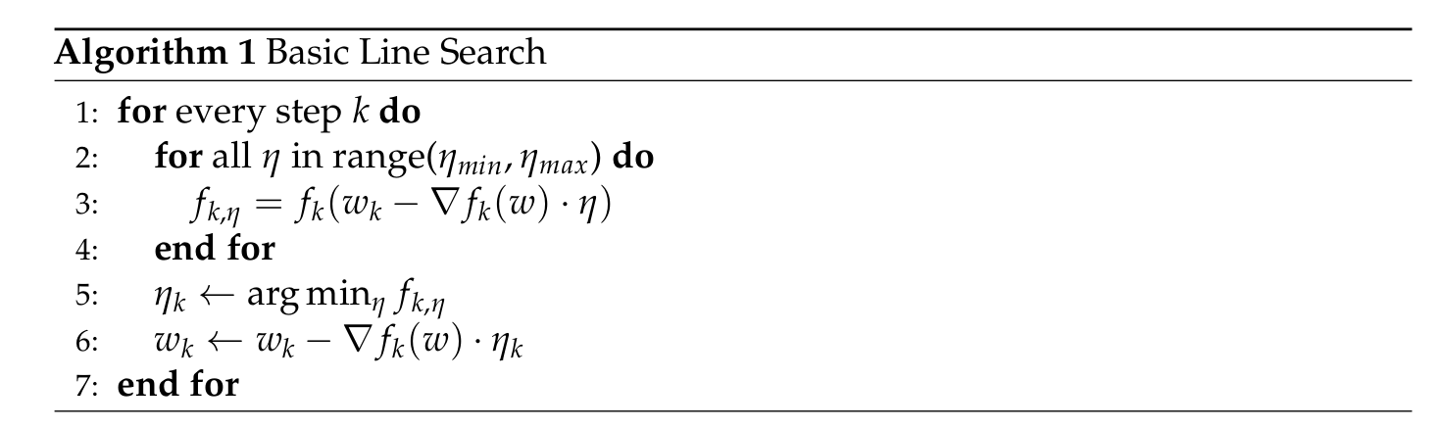
Key Idea

Slide 4
Advantages
Disadvantages
No learning rate tuning needed
Faster convergence
Better generalization
High computational cost
Designed for classical optimization
Can not incorporate other optimizers (ADAM)

Slide 5
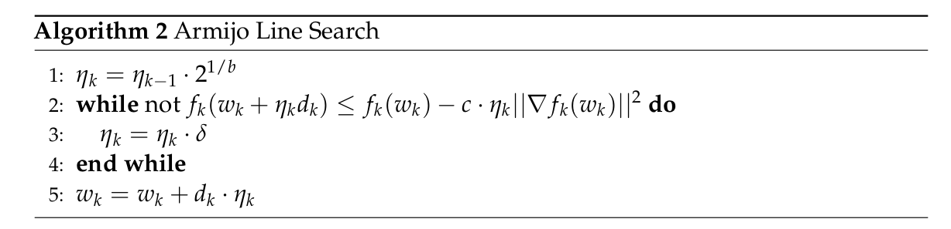
Existing Solutions

Slide 6
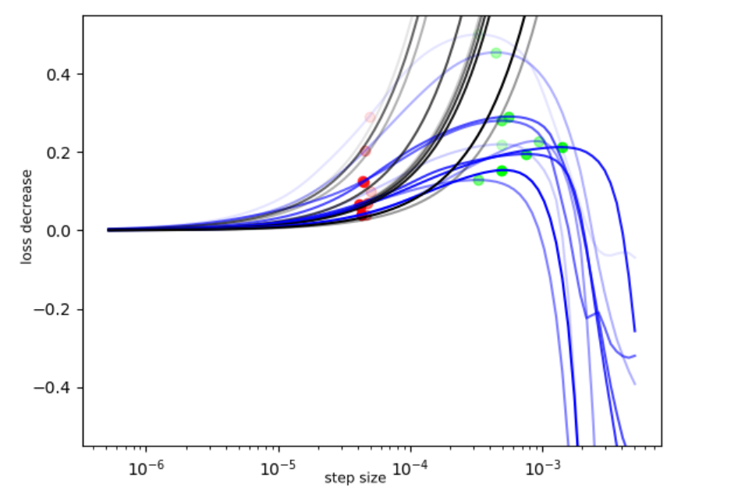

Slide 7
Advantages
Disadvantages
Lower computational cost
Can work with other optimizers
Starting step size is not clear
Has problems for more complex NN
Not computationally stable

Slide 8
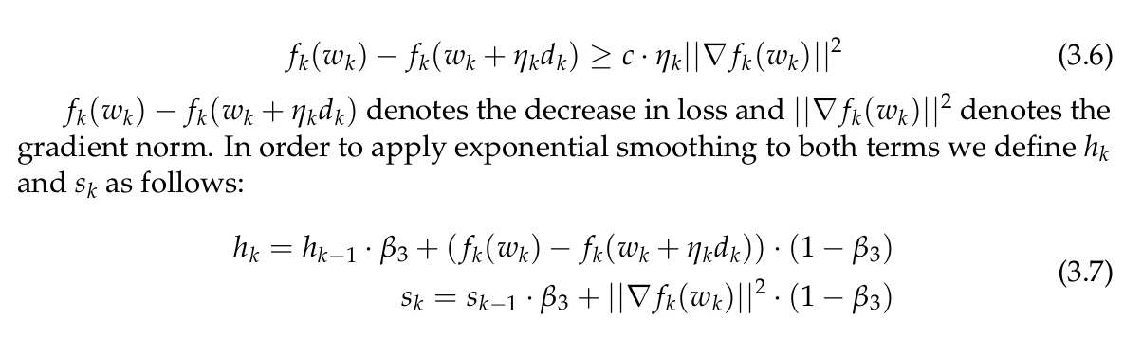
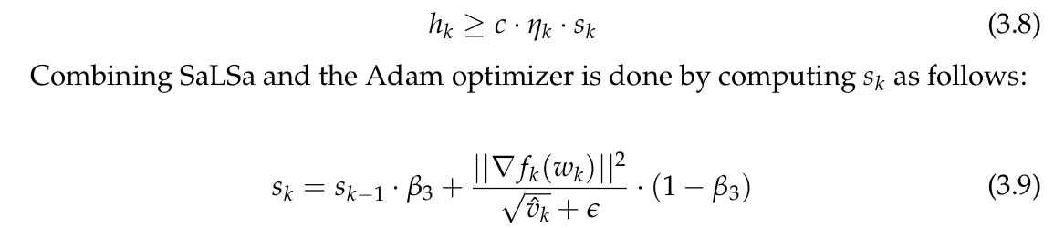
Our Solution

Slide 9
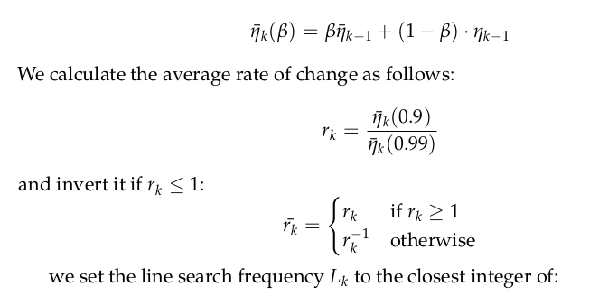
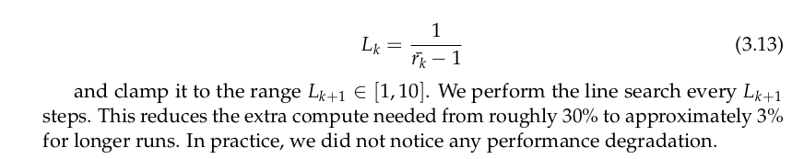
Our Solution

Slide 10
Advantages
Disadvantages
Even lower computational cost
Can work with other optimizers
More computationally stable
Can now train Transformer and other modern architectures
Starting step size is not clear
No general proofs of convergence possible due to momentum term.

Slide 11
01 Theory
We presented the Idea
02 Experiments
We show you some Empirical proof
03 Application
We make our Line Search easy to use

Slide 12
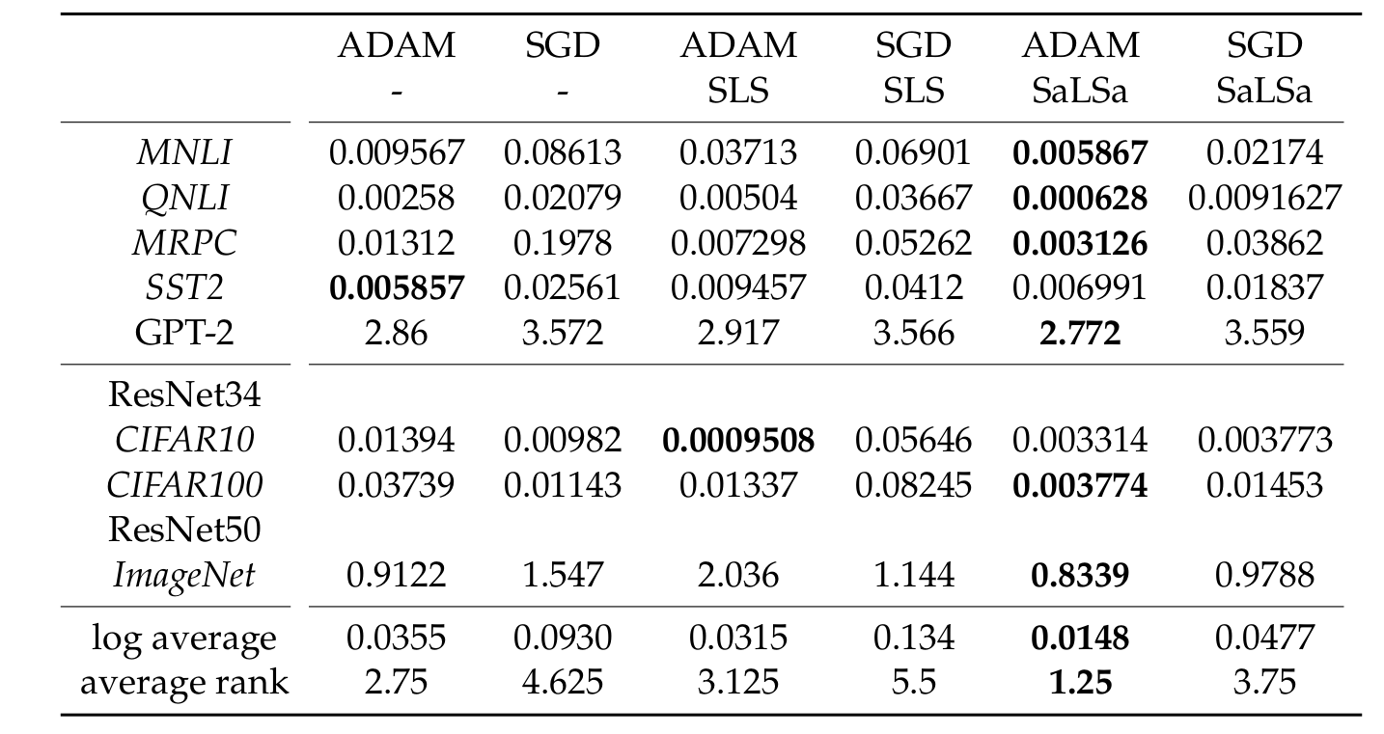
Experiments – more than 50% reduction on final loss

Slide 13
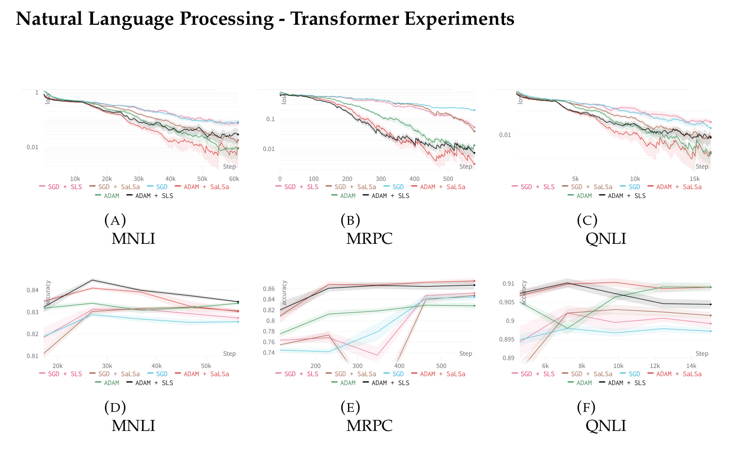
Experiments

Slide 14
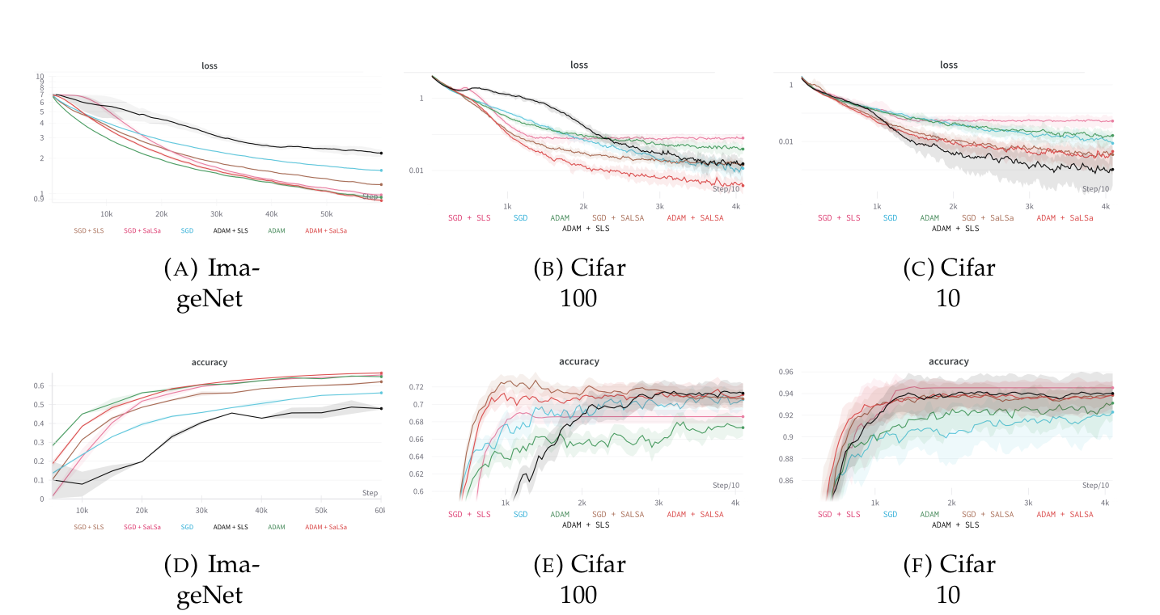
Experiments

Slide 15
Summary
We examined the state of the art
We iterated on the ideas and found improvements
We provide an easy to use framework

Slide 16

Questions & Answers
Thanks for listening!

