Slide 1
Stochastic Line Search
by
Philip Kenneweg, Leonardo Galli, Tristan Kenneweg
and Barbara Hammer

Slide 2
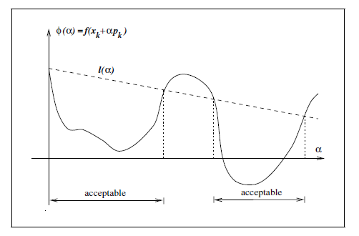
What is Stochastic Line Search
Method to find optimal learning rate
Key idea:
1. Take a step along
the gradient direction
2. compute the loss
3. if loss did not reduce
(enough) try different lr

Slide 3
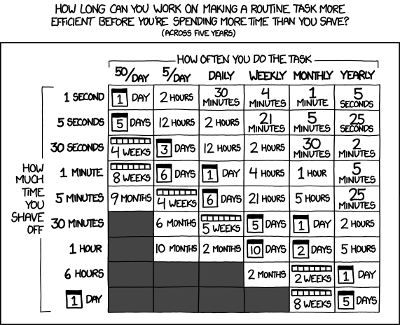
Advantages
No learning rate tuning anymore
Faster convergence
Better generalization
performance
(surprisingly)

Slide 4
Disadvantages
Uses more compute
-a lot more for un-optimized approaches
-about 1 extra forward pass per loss computation/step for our implementation
Can not easily incorporate human expert knowledge

Slide 5
Challenges
Where to start checking for reasonable learning rate?
How much reduction in loss is reasonable?
Many more implementation details

Slide 6

Solutions (existing)
Lipschitz Line Search criterion:
Guaranteed to converge with SGD (under some assumptions) if step size is lowered until this criterion is fullfilled
Can be extended to Armijo Line Search for adaptive optimizers (Adam, Adagrad etc)
Loss reduction
Gradient norm

Slide 7
Solutions (existing)
Initial Step size for the search is the last step size.
To facilitate growing learning rates, double lr every n(in practice 300) steps.

Slide 8
Our Idea
Adapt learning rates per Layer.
Evaluate this and the Armijo approach combined with Adam on modern architectures. (Transformers)

Slide 9
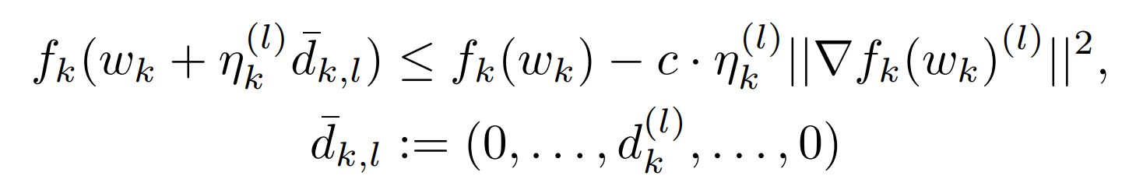
Math
Change:
To:
Actually not quite correct, but correct one would need 2 forward passes per check
→ too expensive

Slide 10
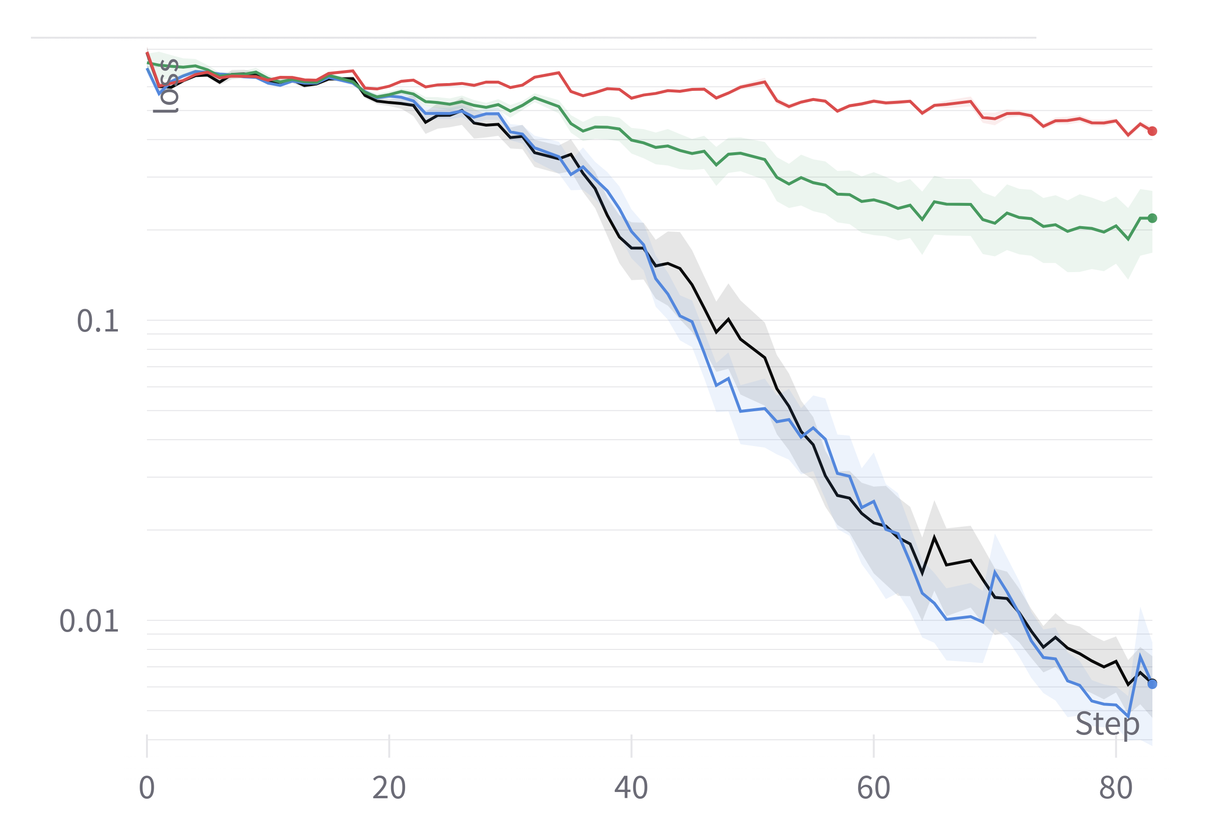
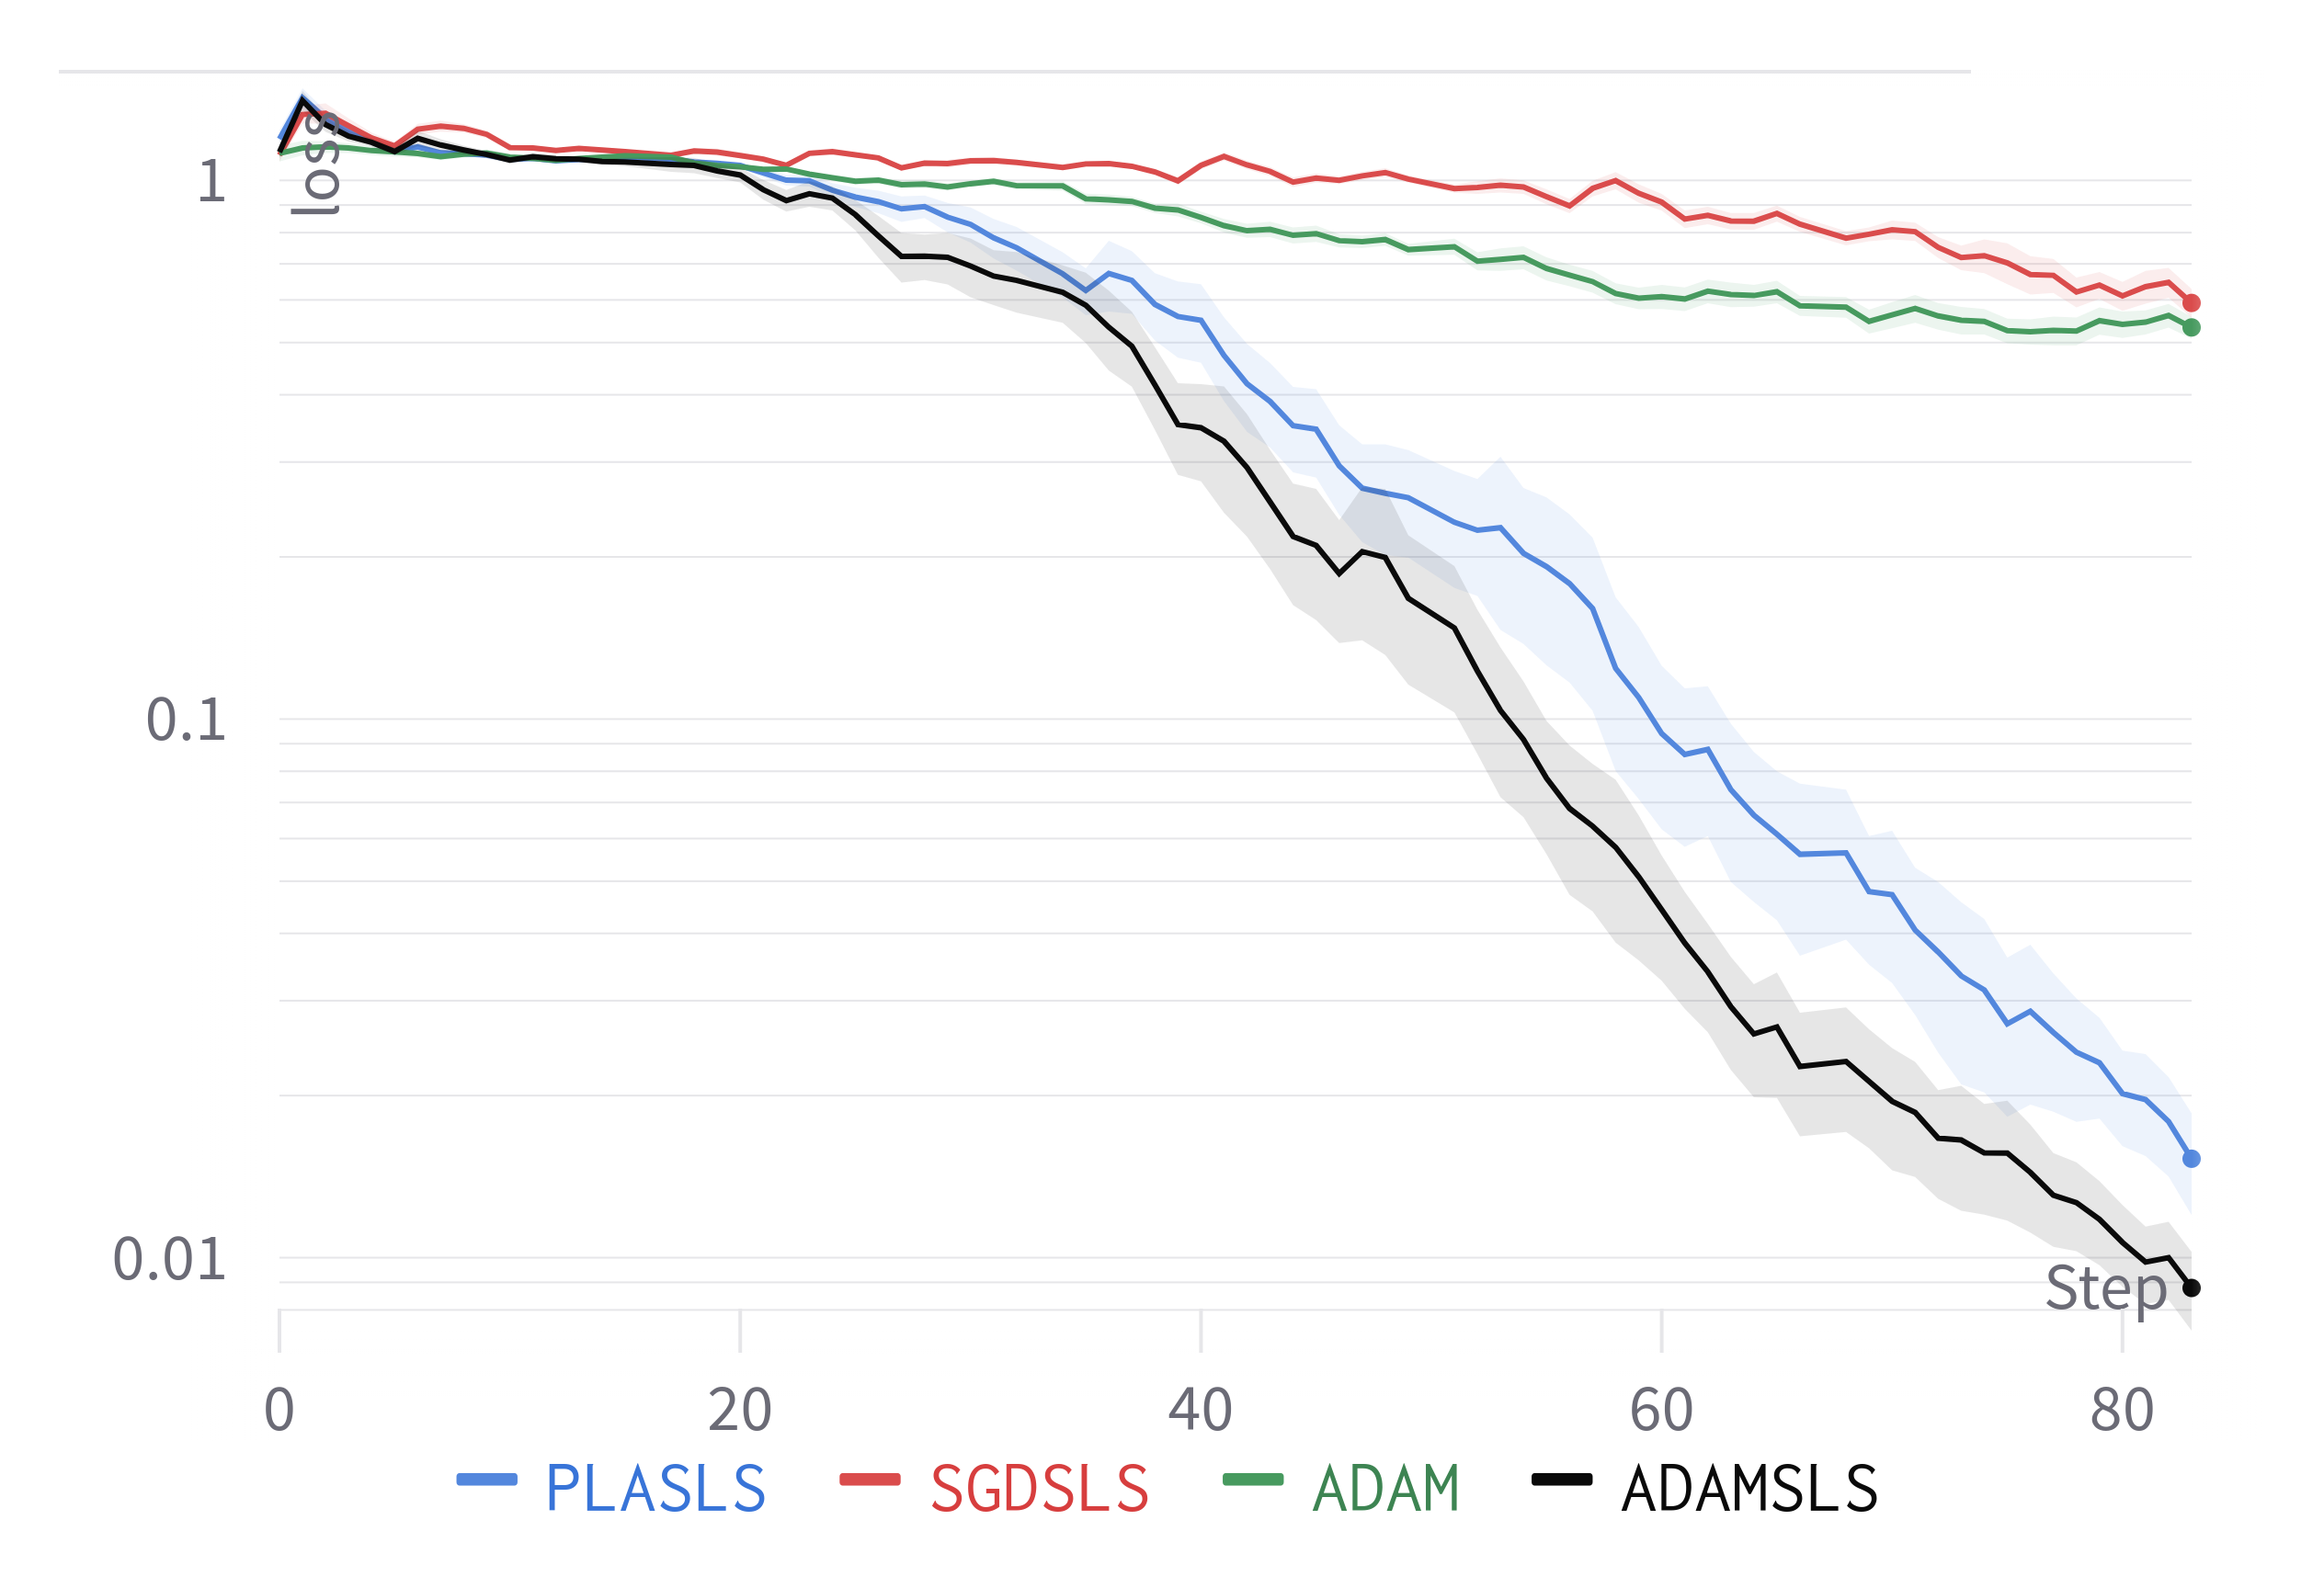
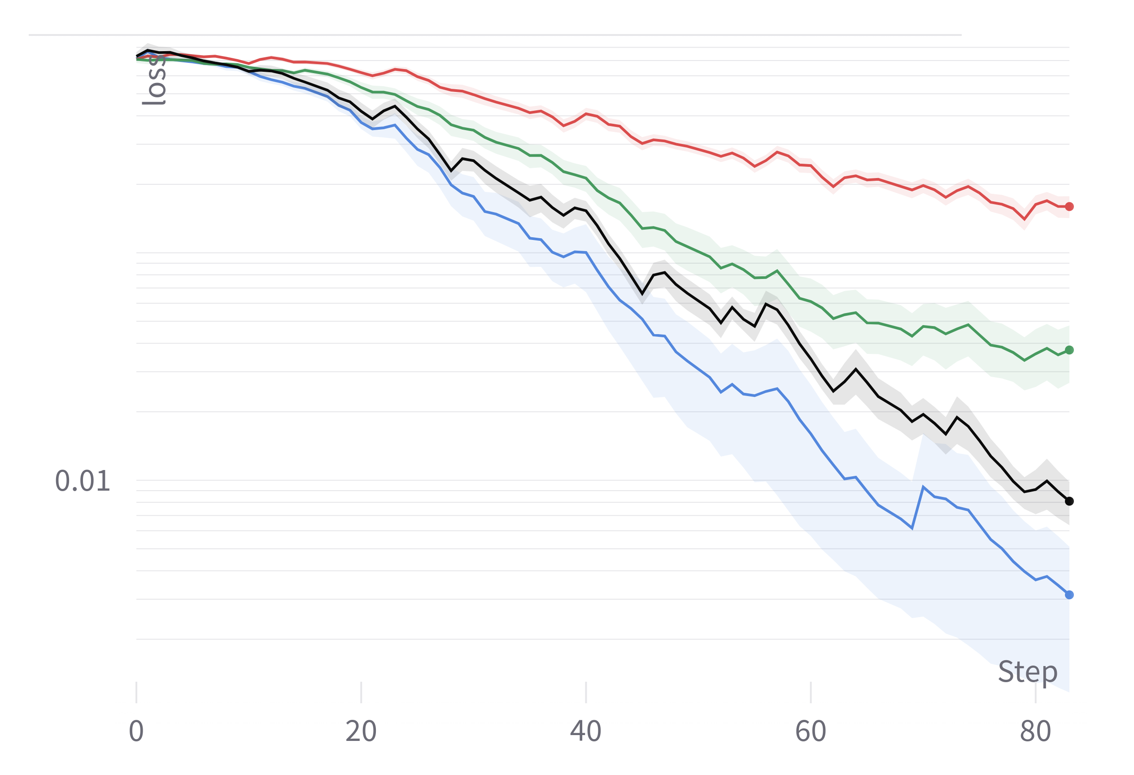
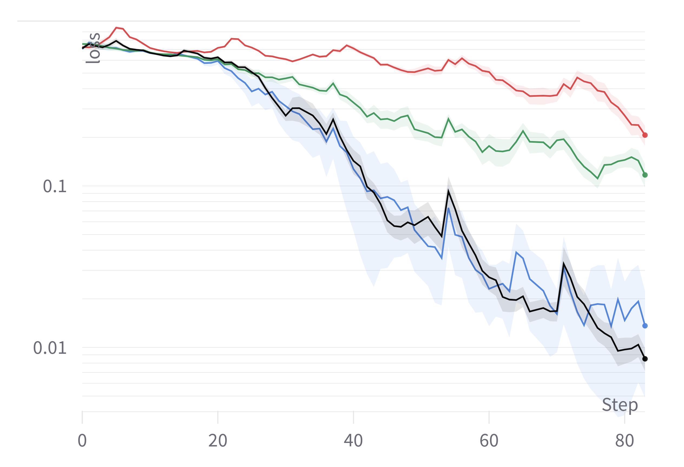
Results small Dataset
MNLI
QNLI
MRPC
SST2

Slide 11
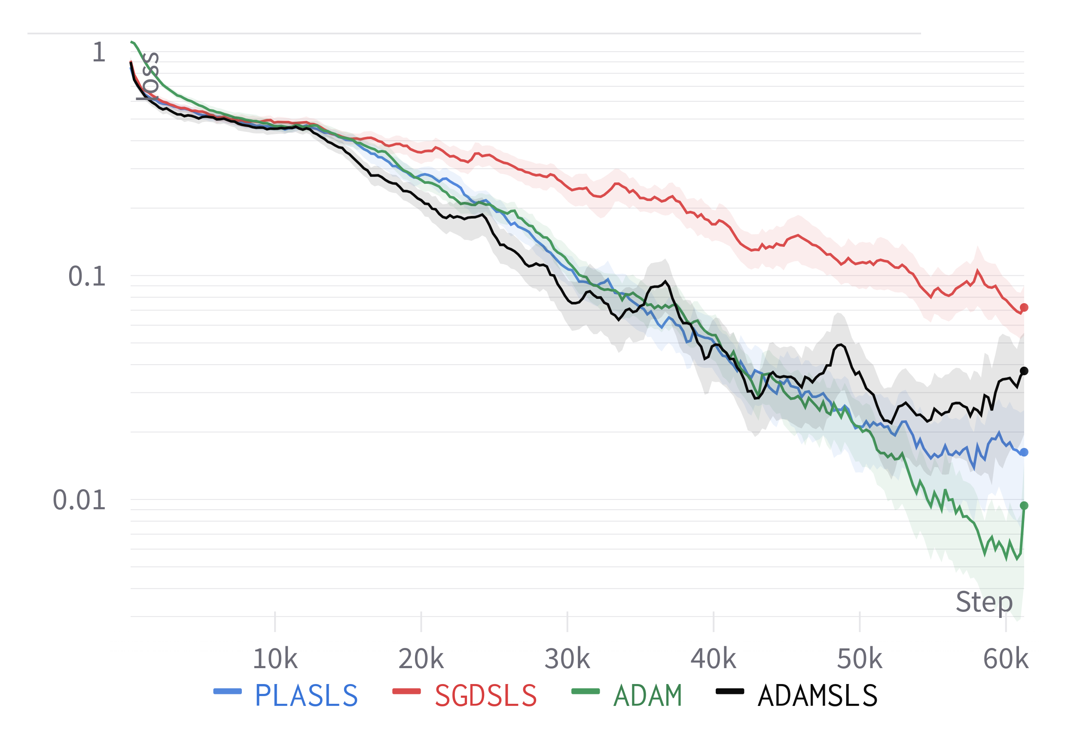
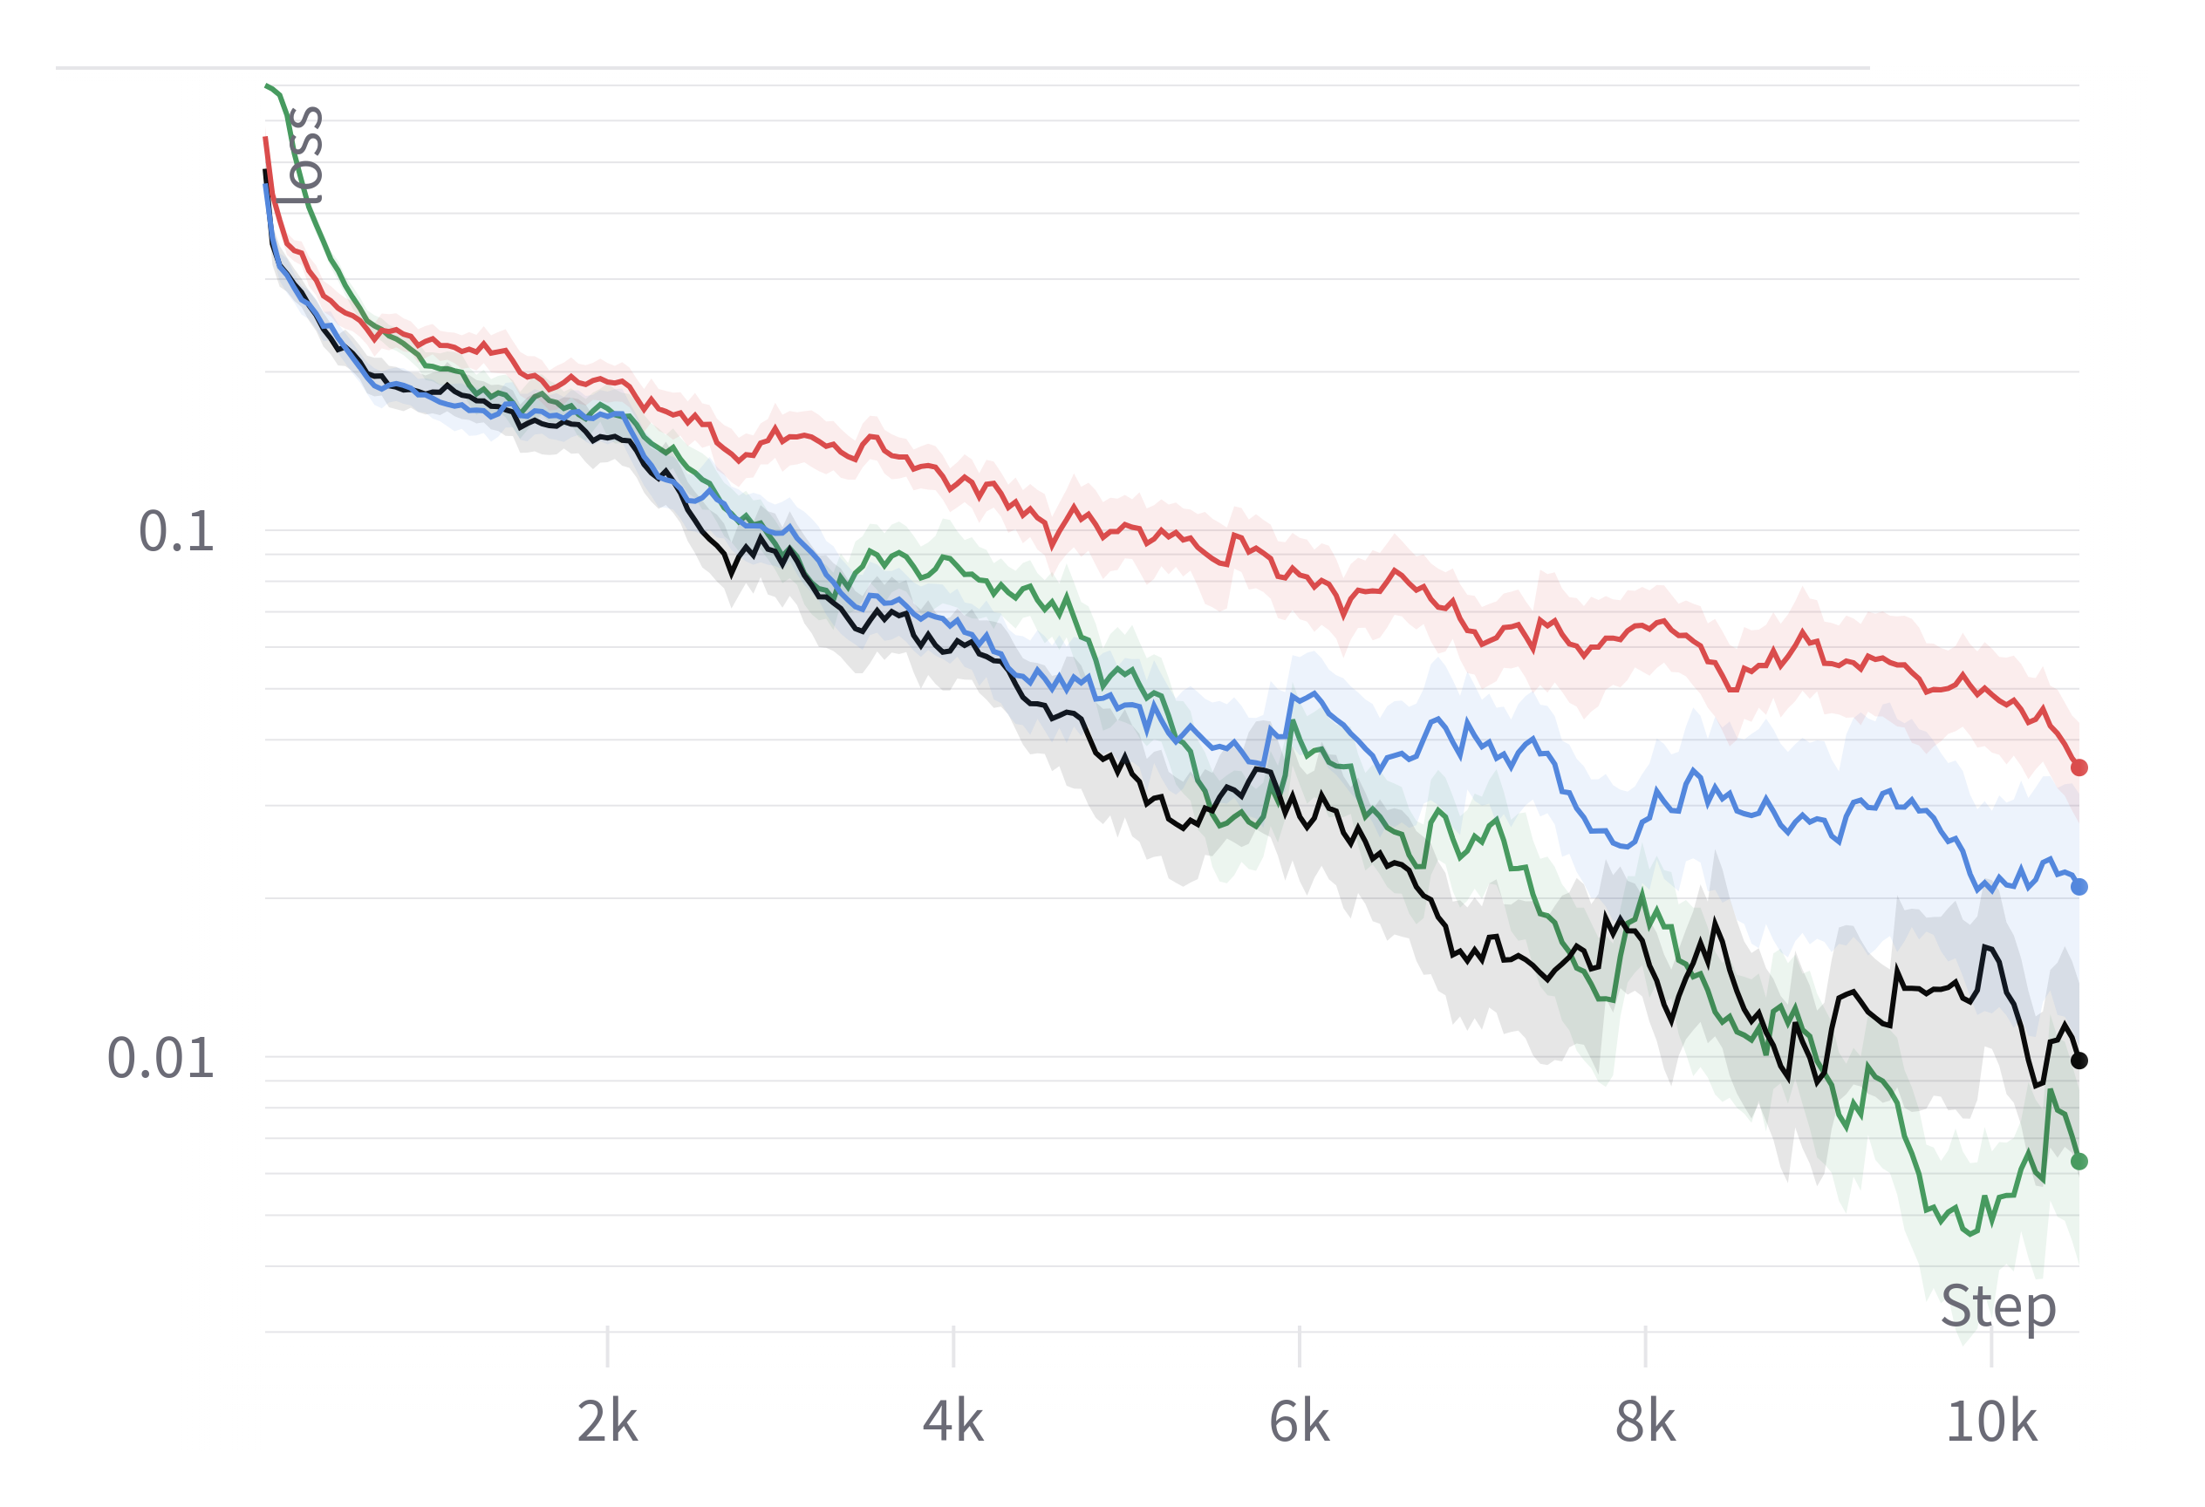
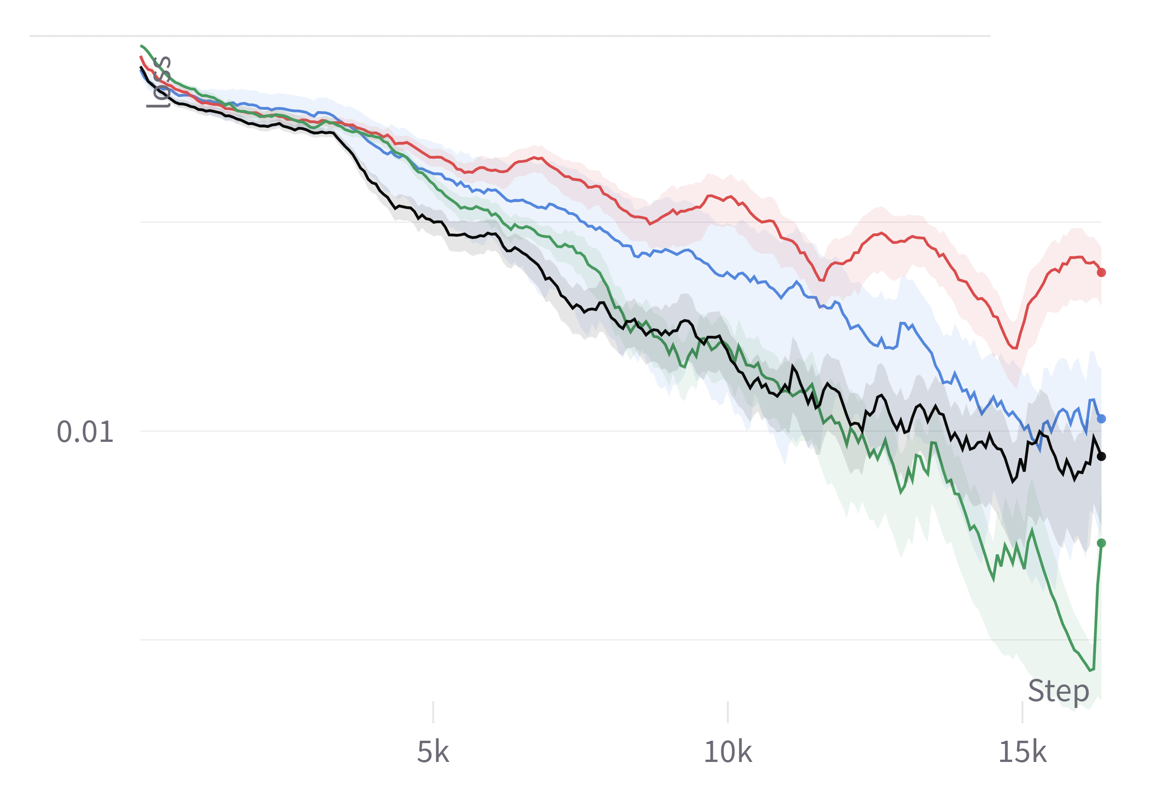
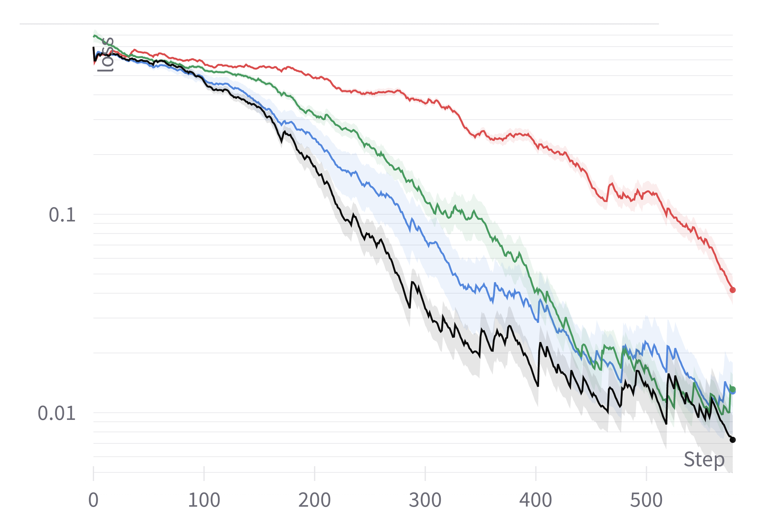
Results
MNLI
SST2
QNLI
MRPC

Slide 12
Results
PLASLS and ADAMSLS perform a lot better than ADAM or SGD even with ADAMs tuned learning rate schedule.
PLASLS does not significantly outperform ADAMSLS
→ this was a very short summary of the IJCNN paper

Slide 13
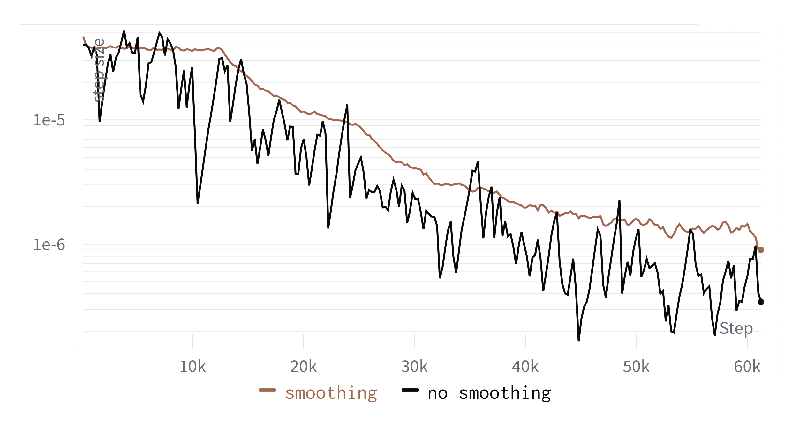
New Idea
We saw during training that the learning rate is mostly determined by a small percentage of batches which lower it significantly.

Slide 14
New Idea
So smoothing seems to make intuitive sense.

Slide 15
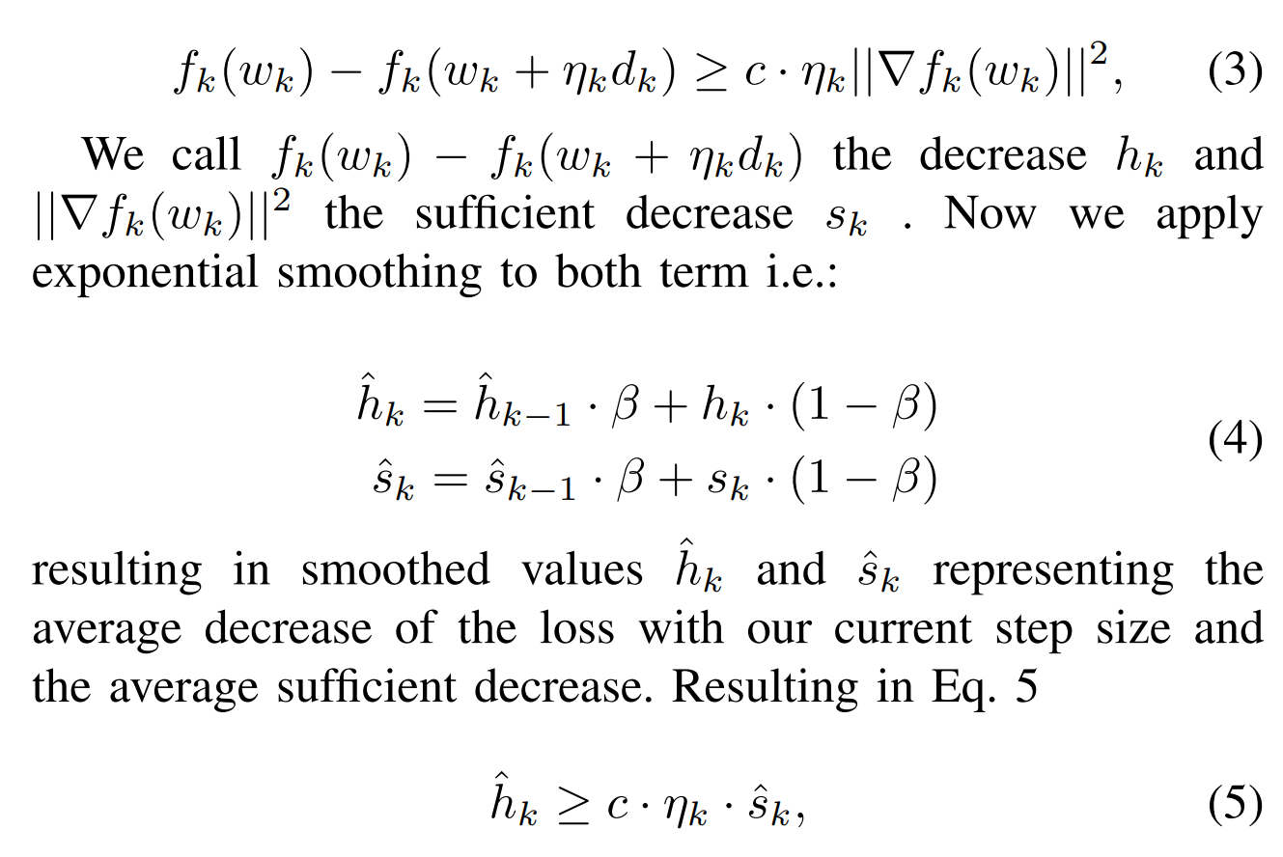
Math

Slide 16
Problem
Lowering step size has no immediate effect on h since f(w_k + n_k*d_k) is dependend on step size n_k. Impractical to recompute.
→ but this is actually not a problem, just makes changes in step size take place over a longer period in time

Slide 17
Experiments
Experiments on a variety of architectures:
CNN ResNet34
Transformers BERT
MLPs 2 hidden layers
? something missing ?

Slide 18
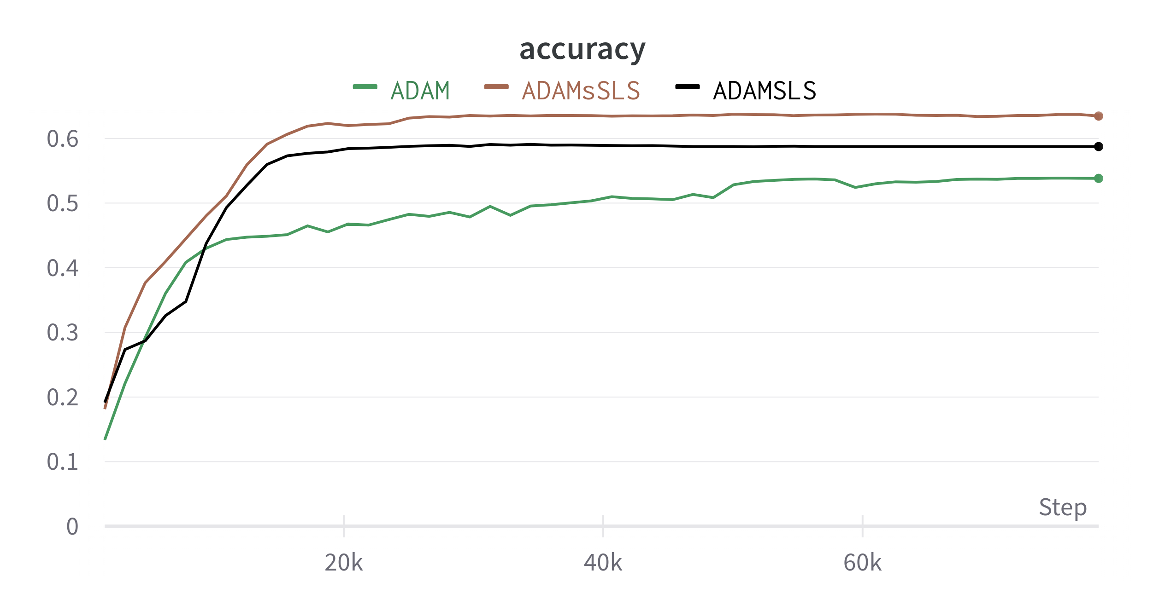
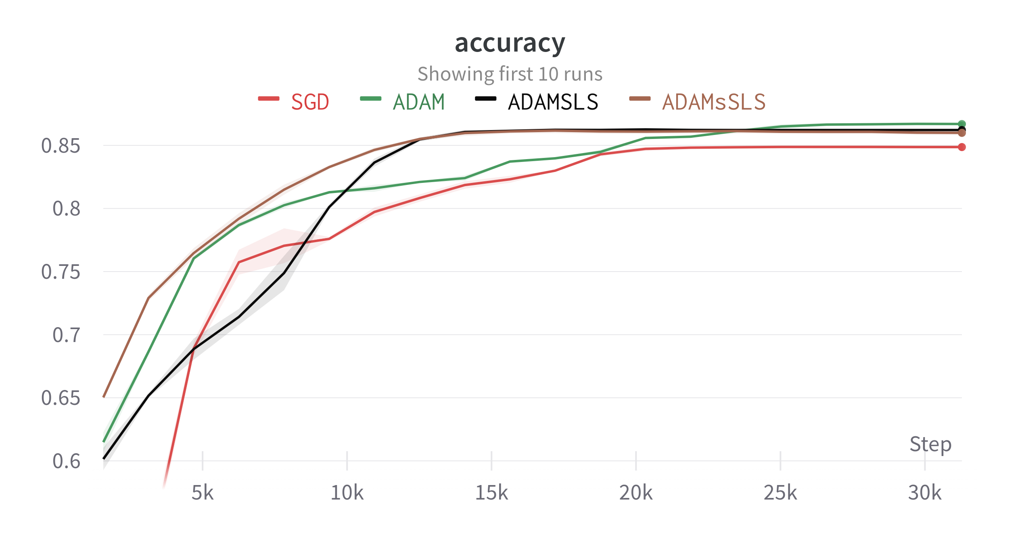
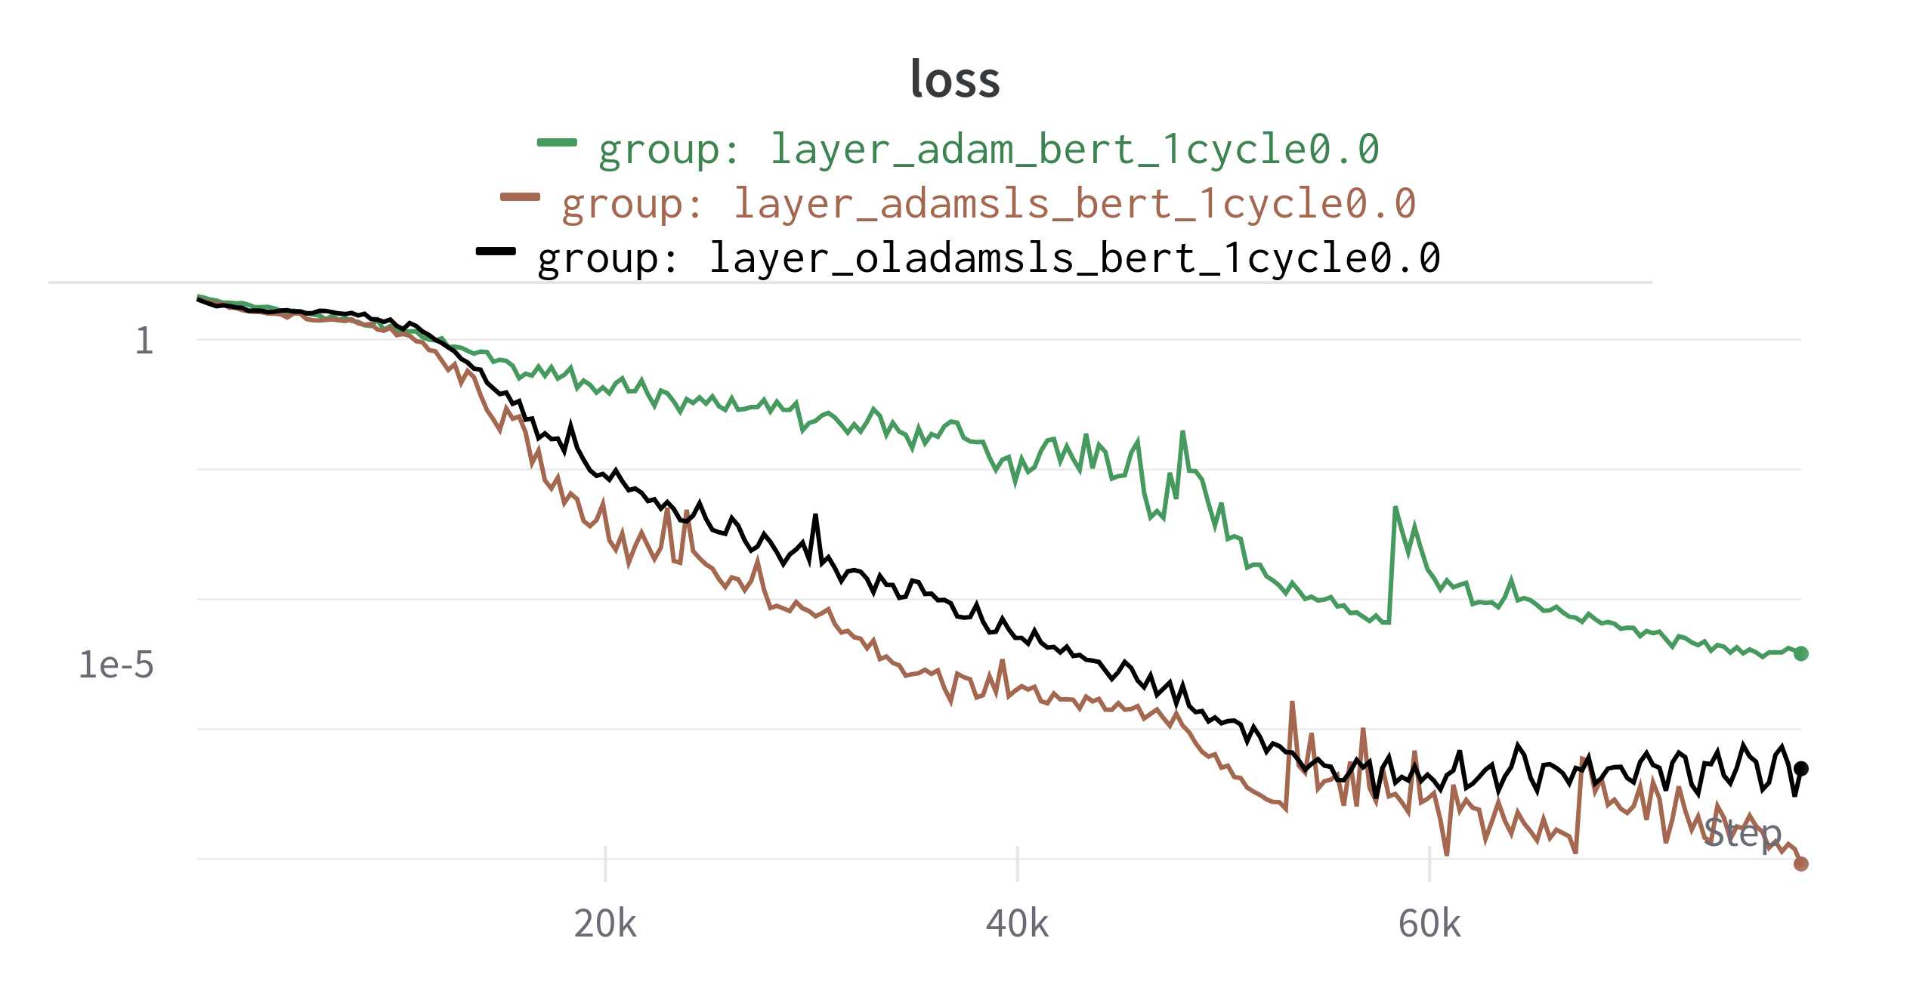
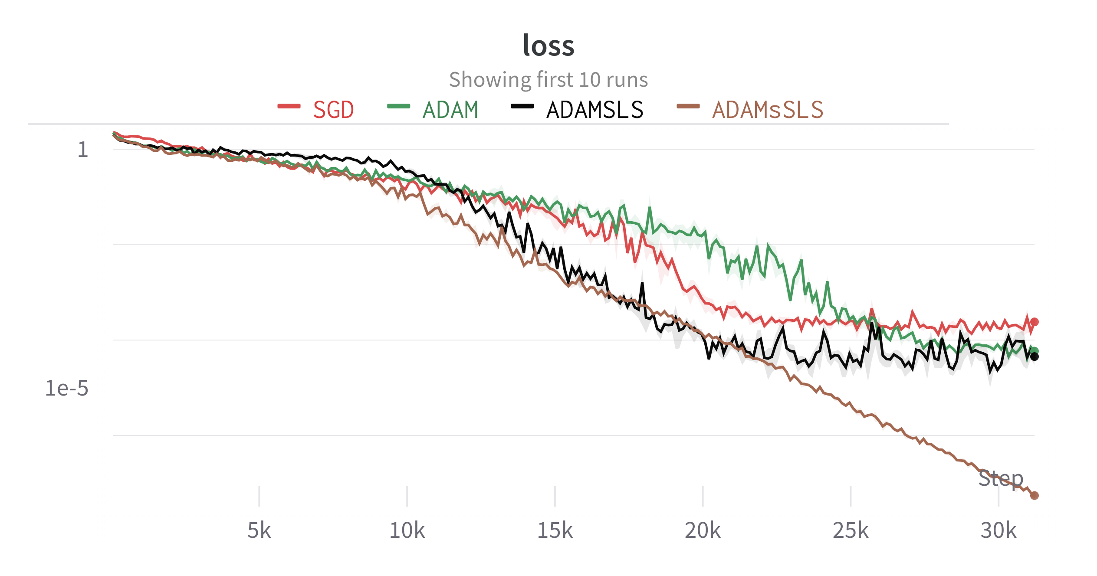
Results CNN
Cifar100
Cifar10

Slide 19
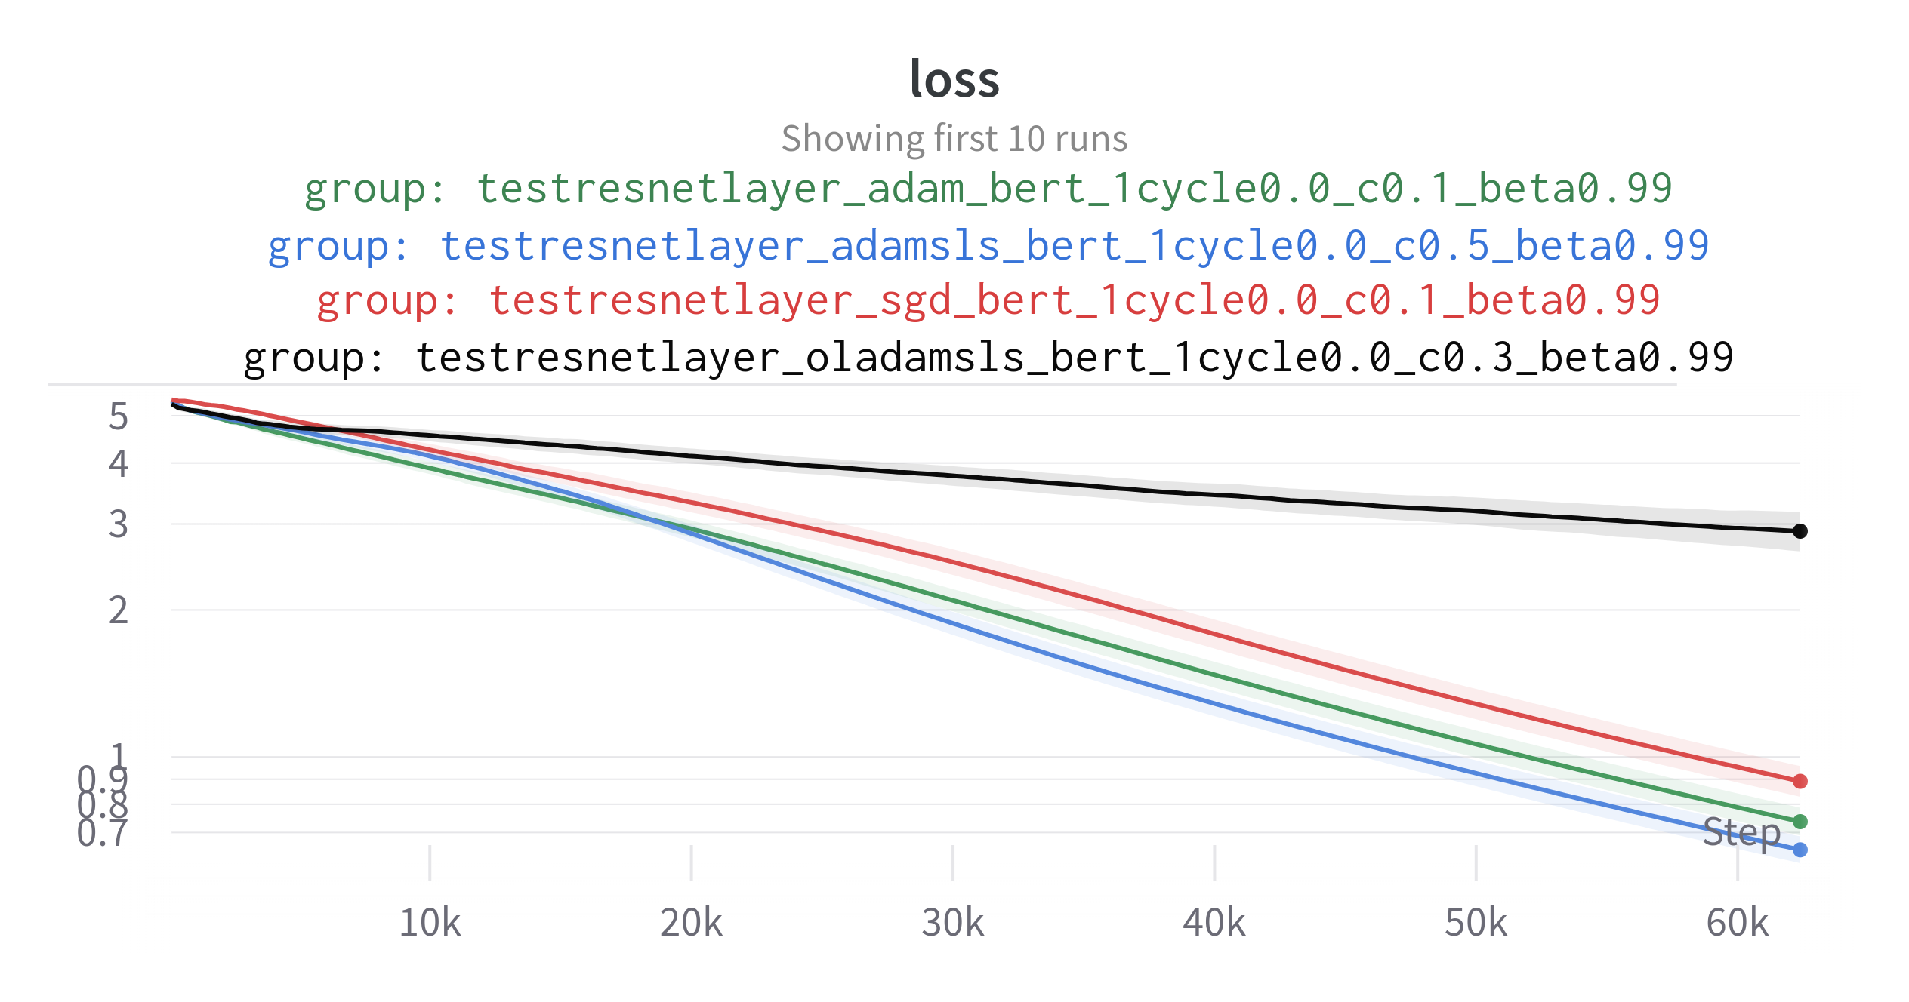
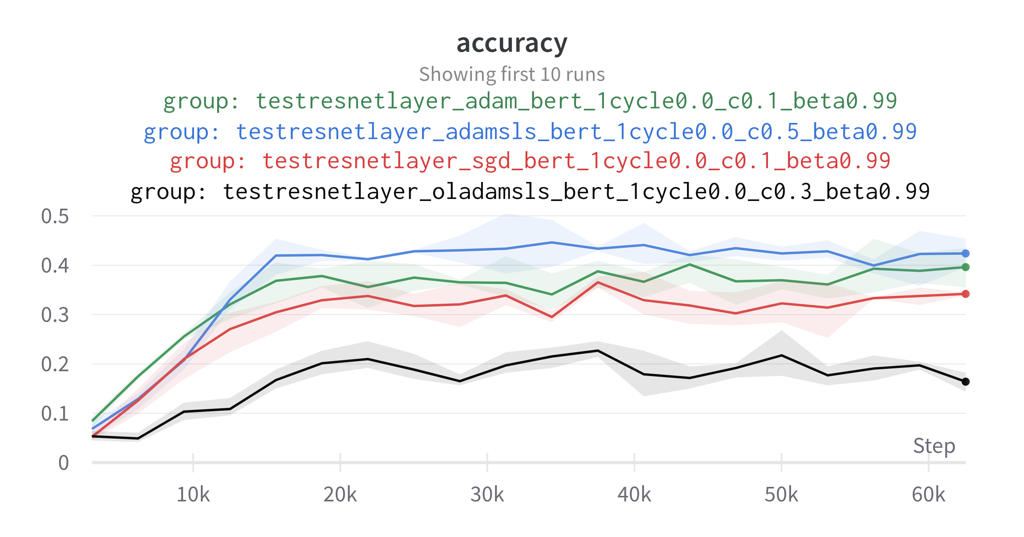
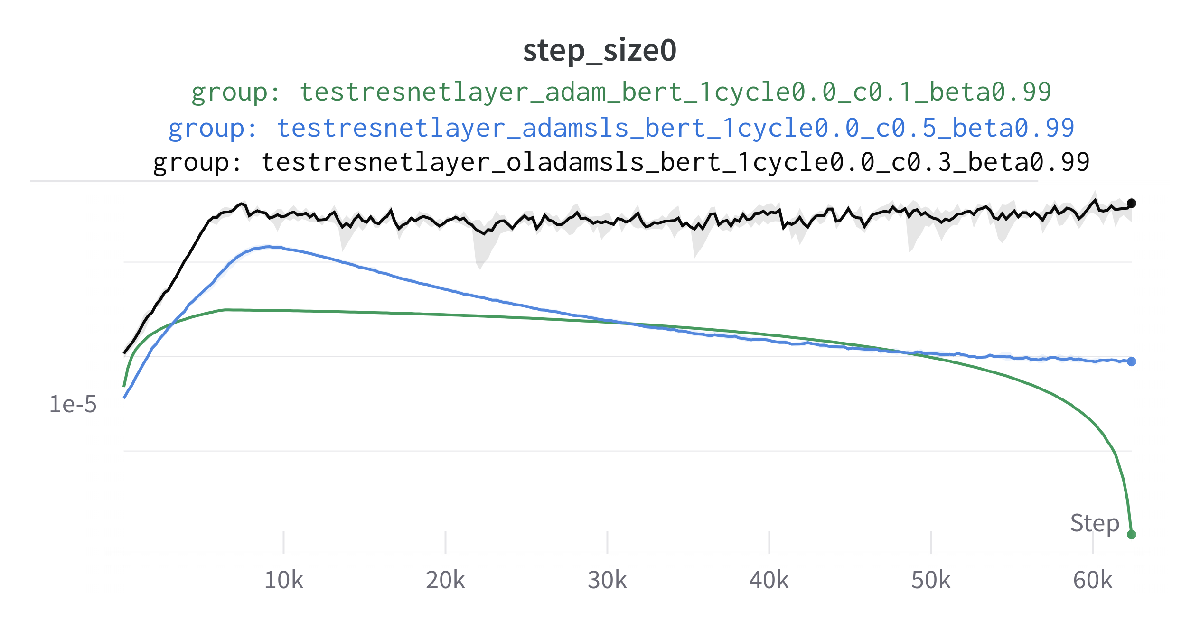
Results CNN
TinyImageNet

Slide 20
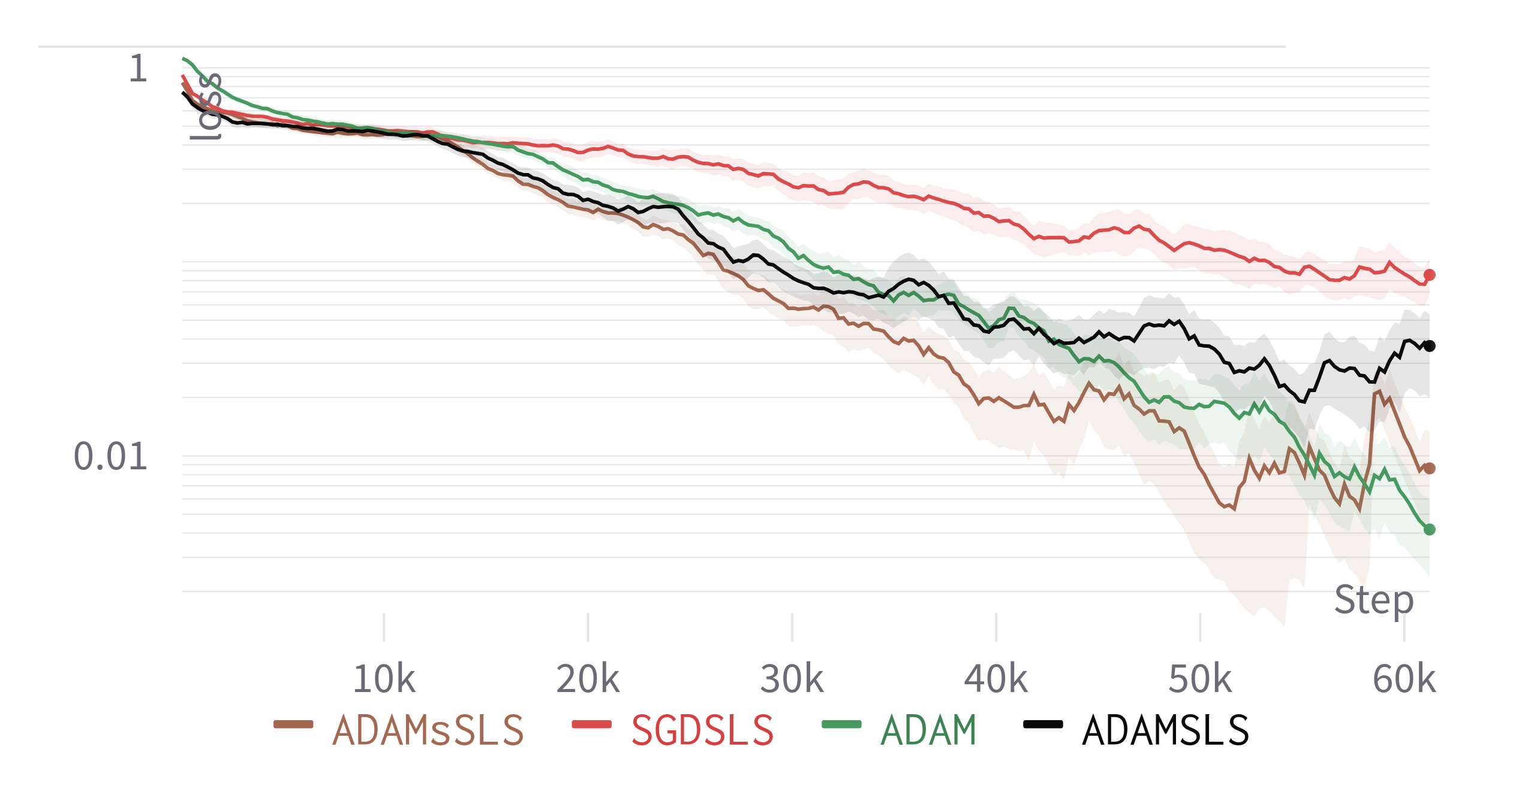
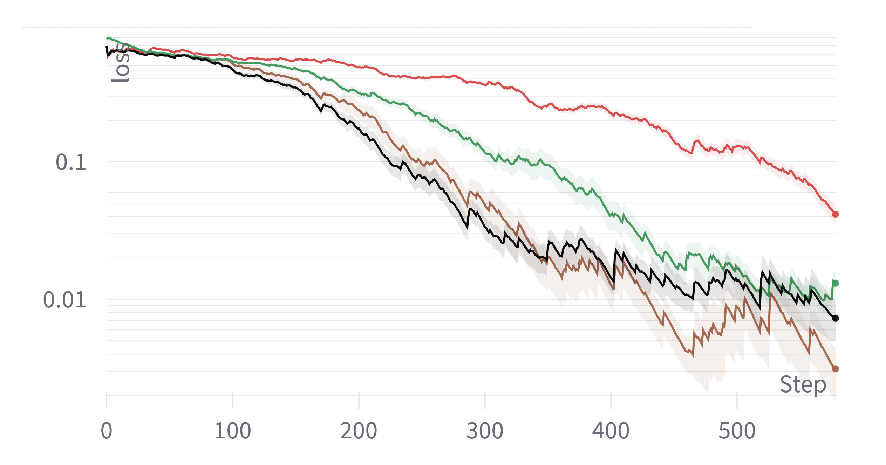
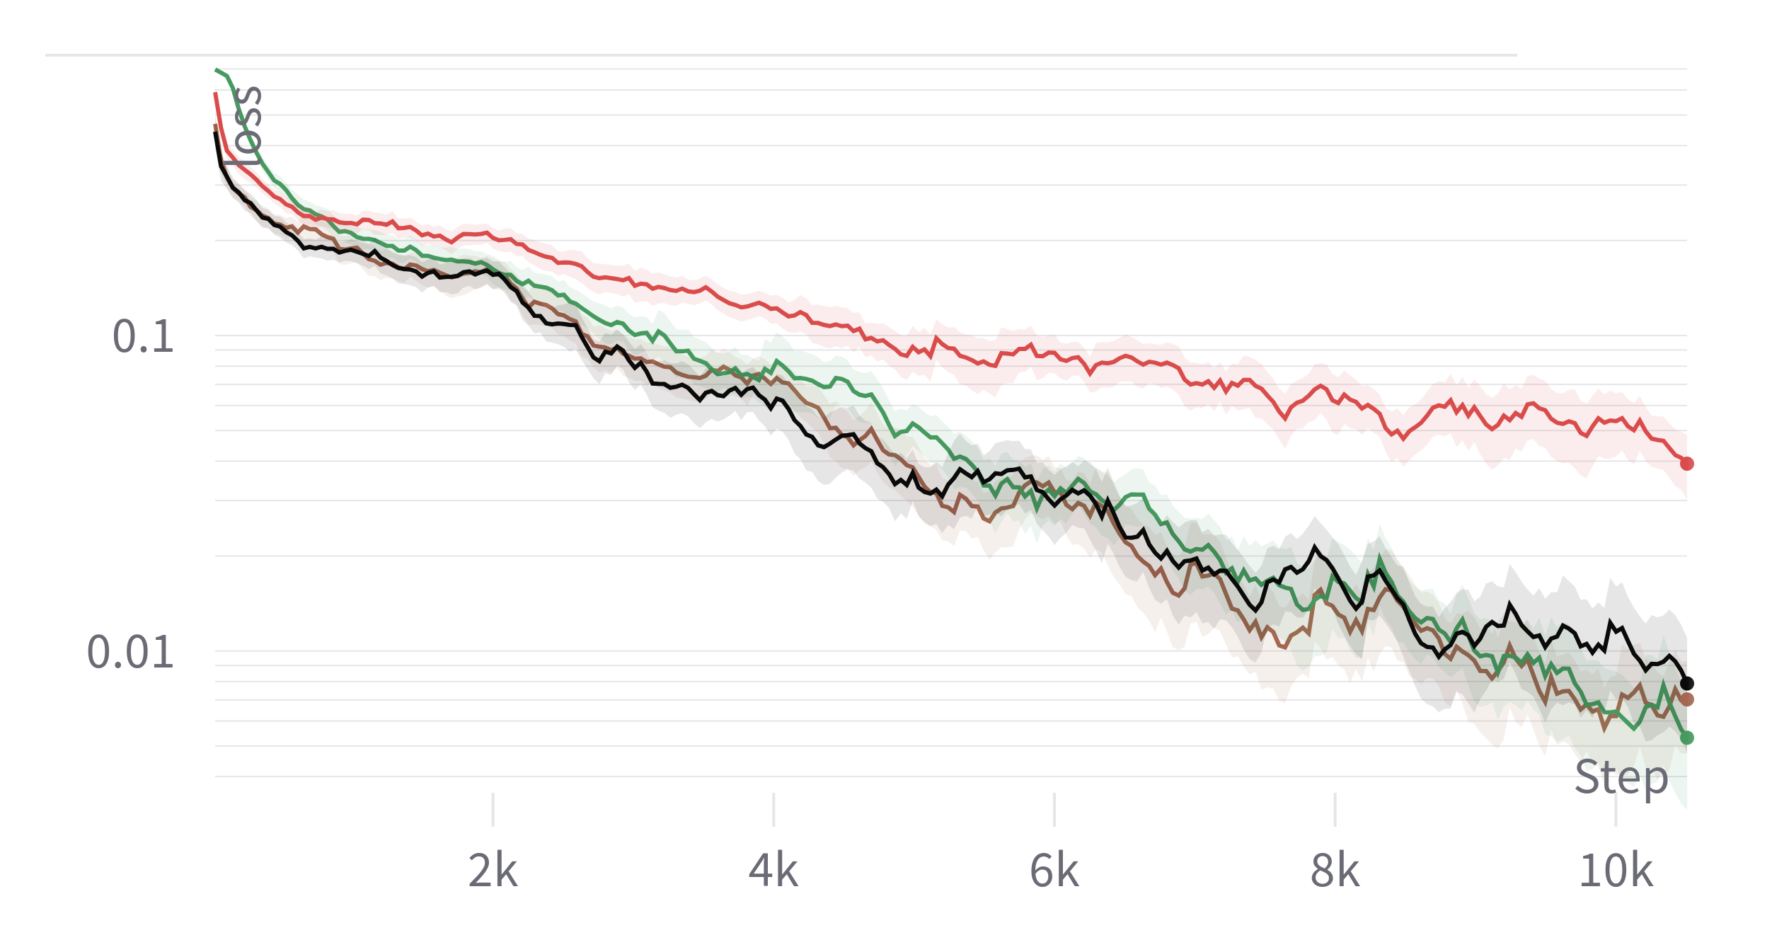
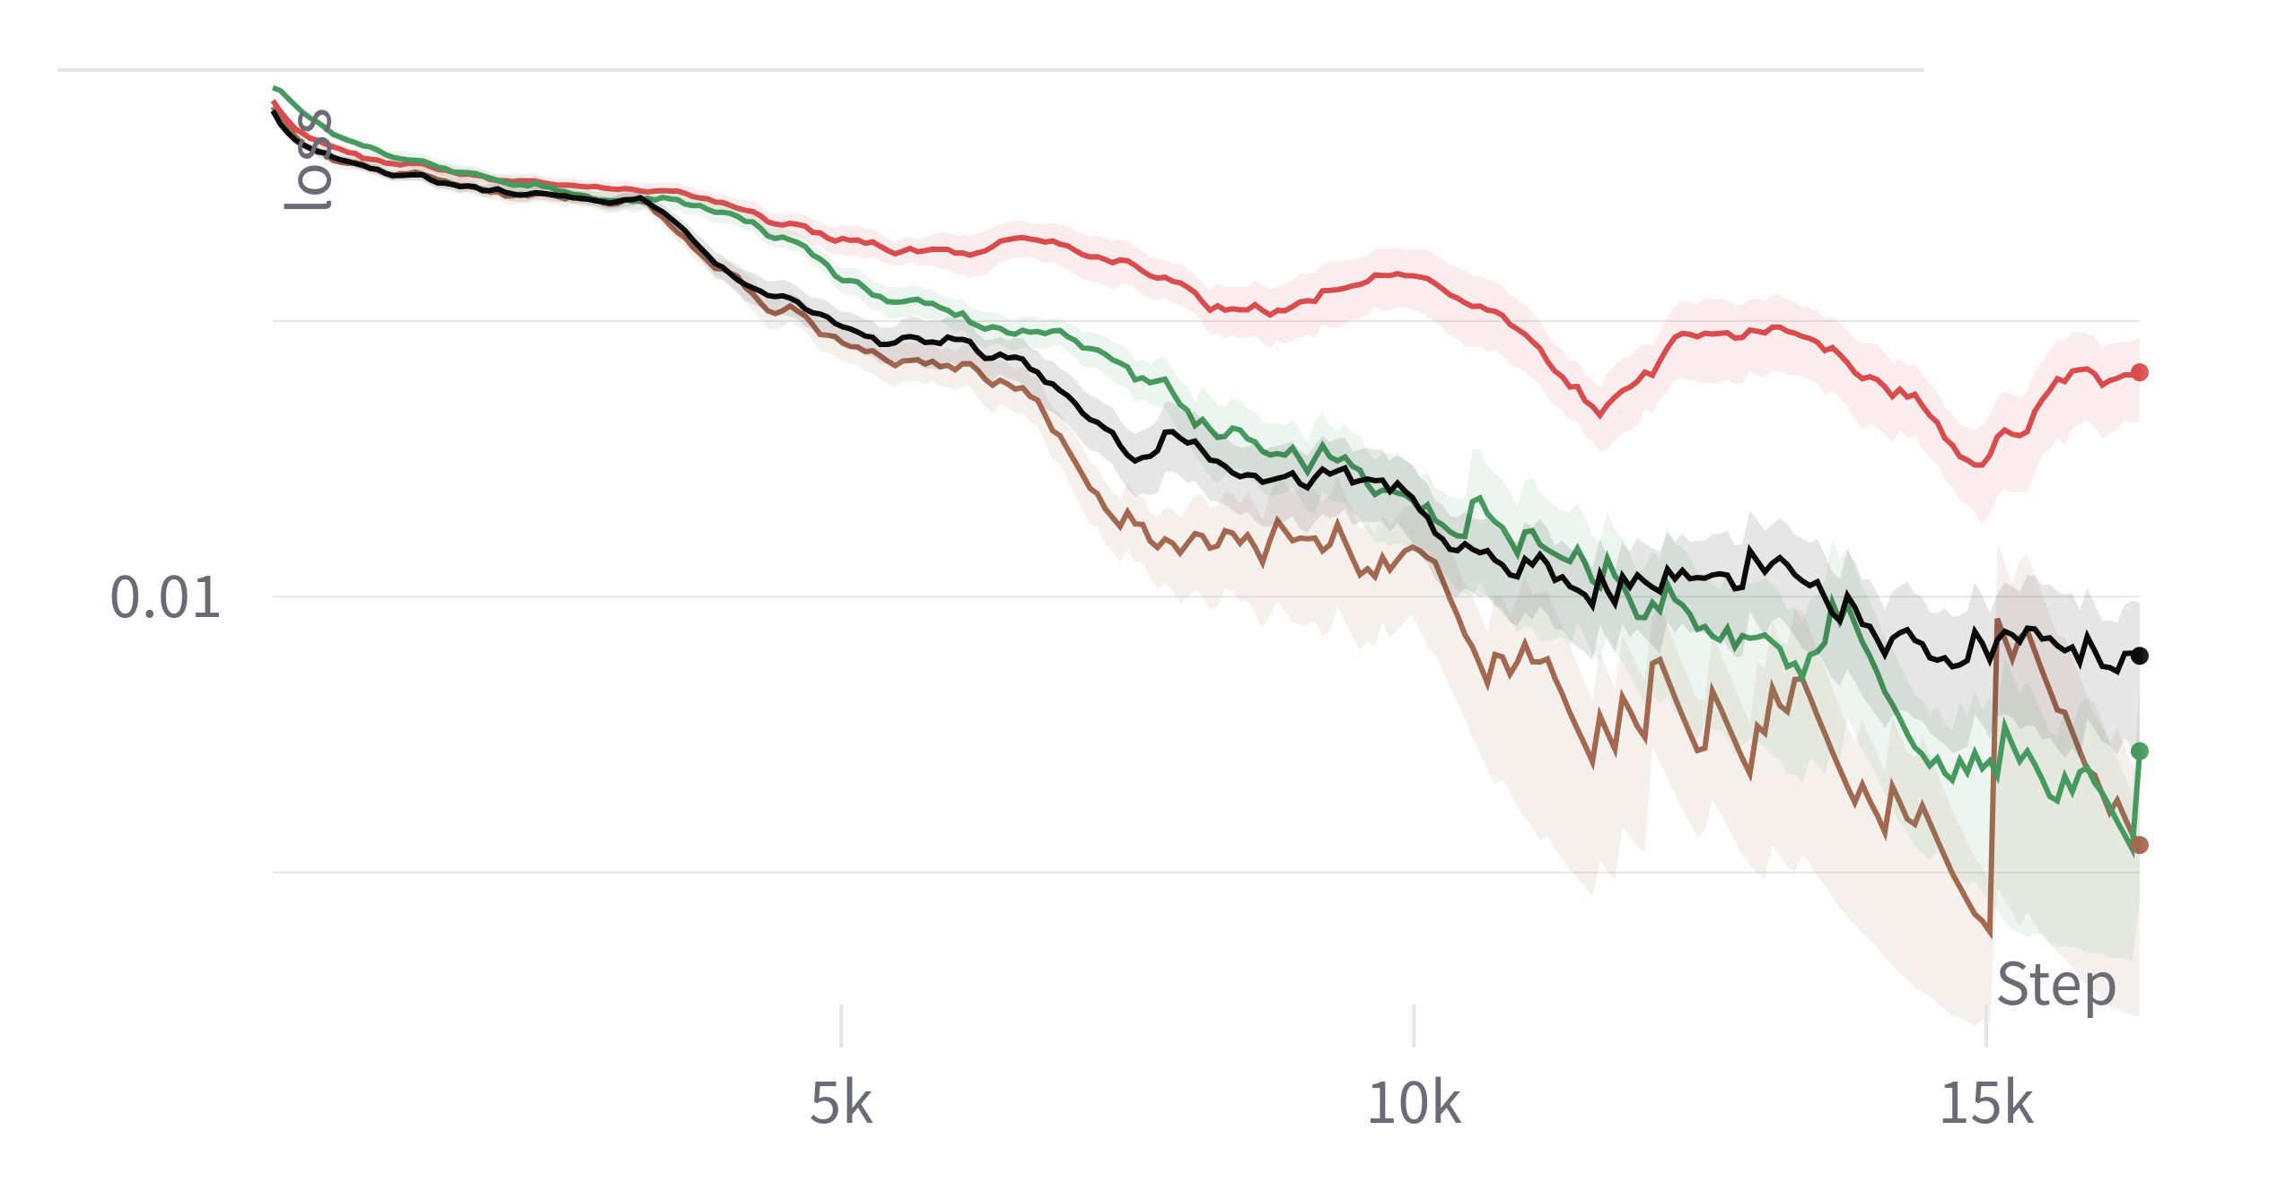
Results Transformer

Slide 21
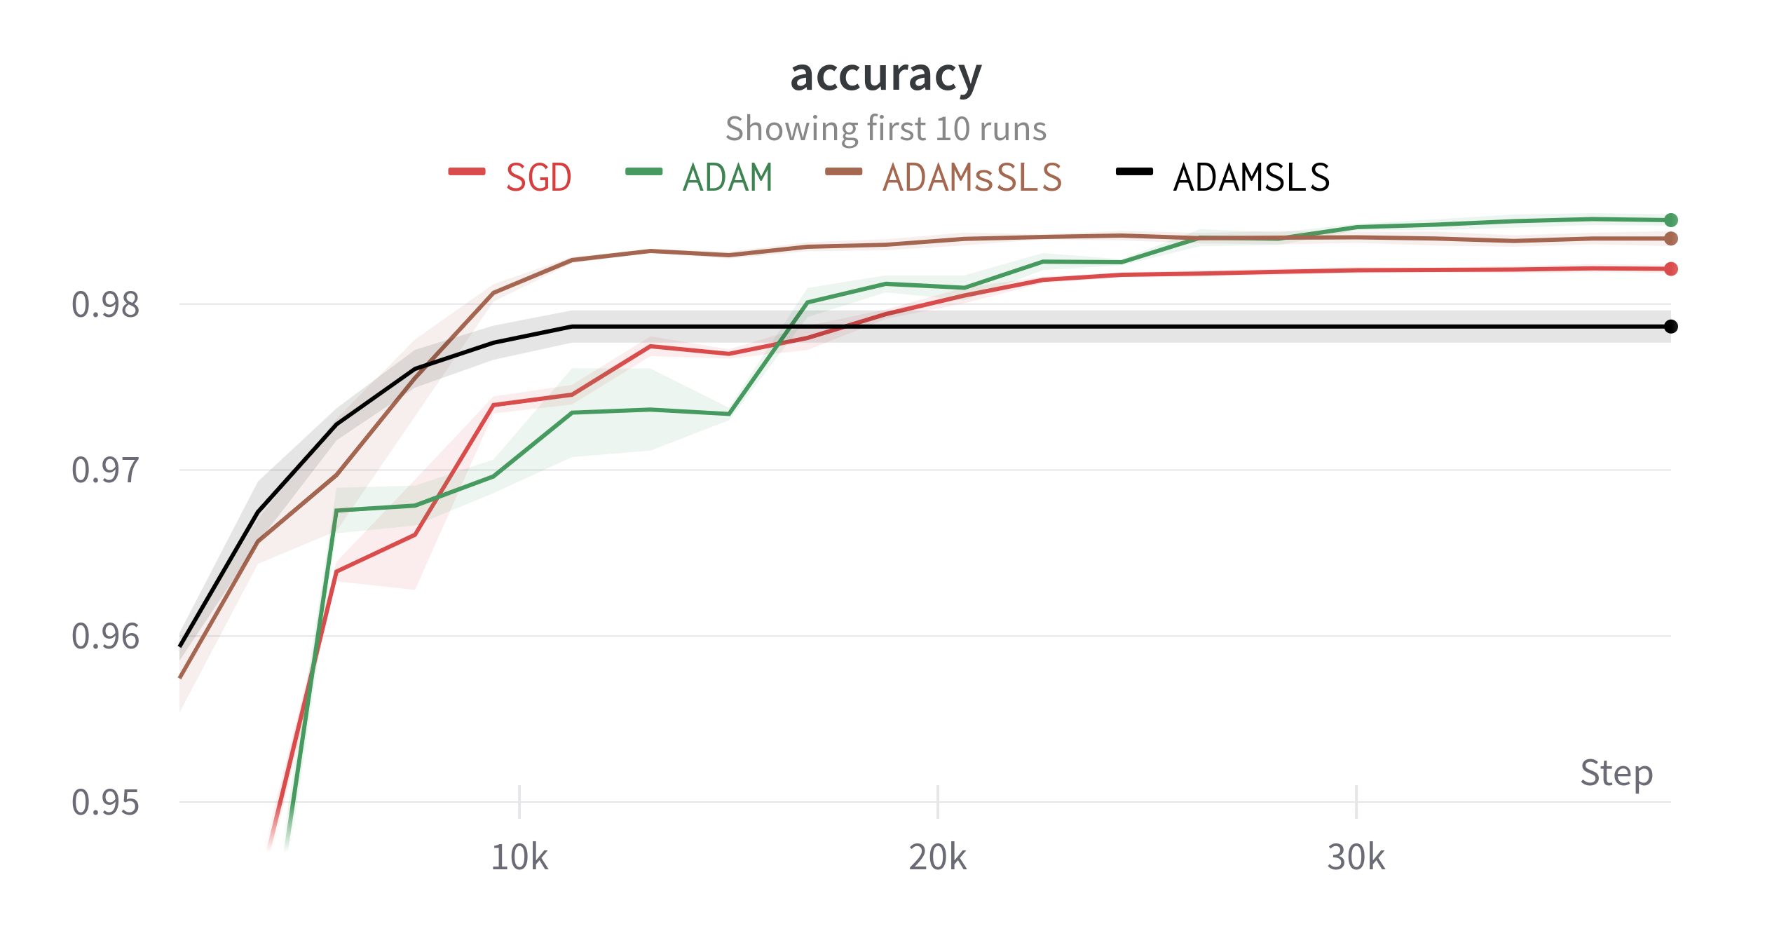
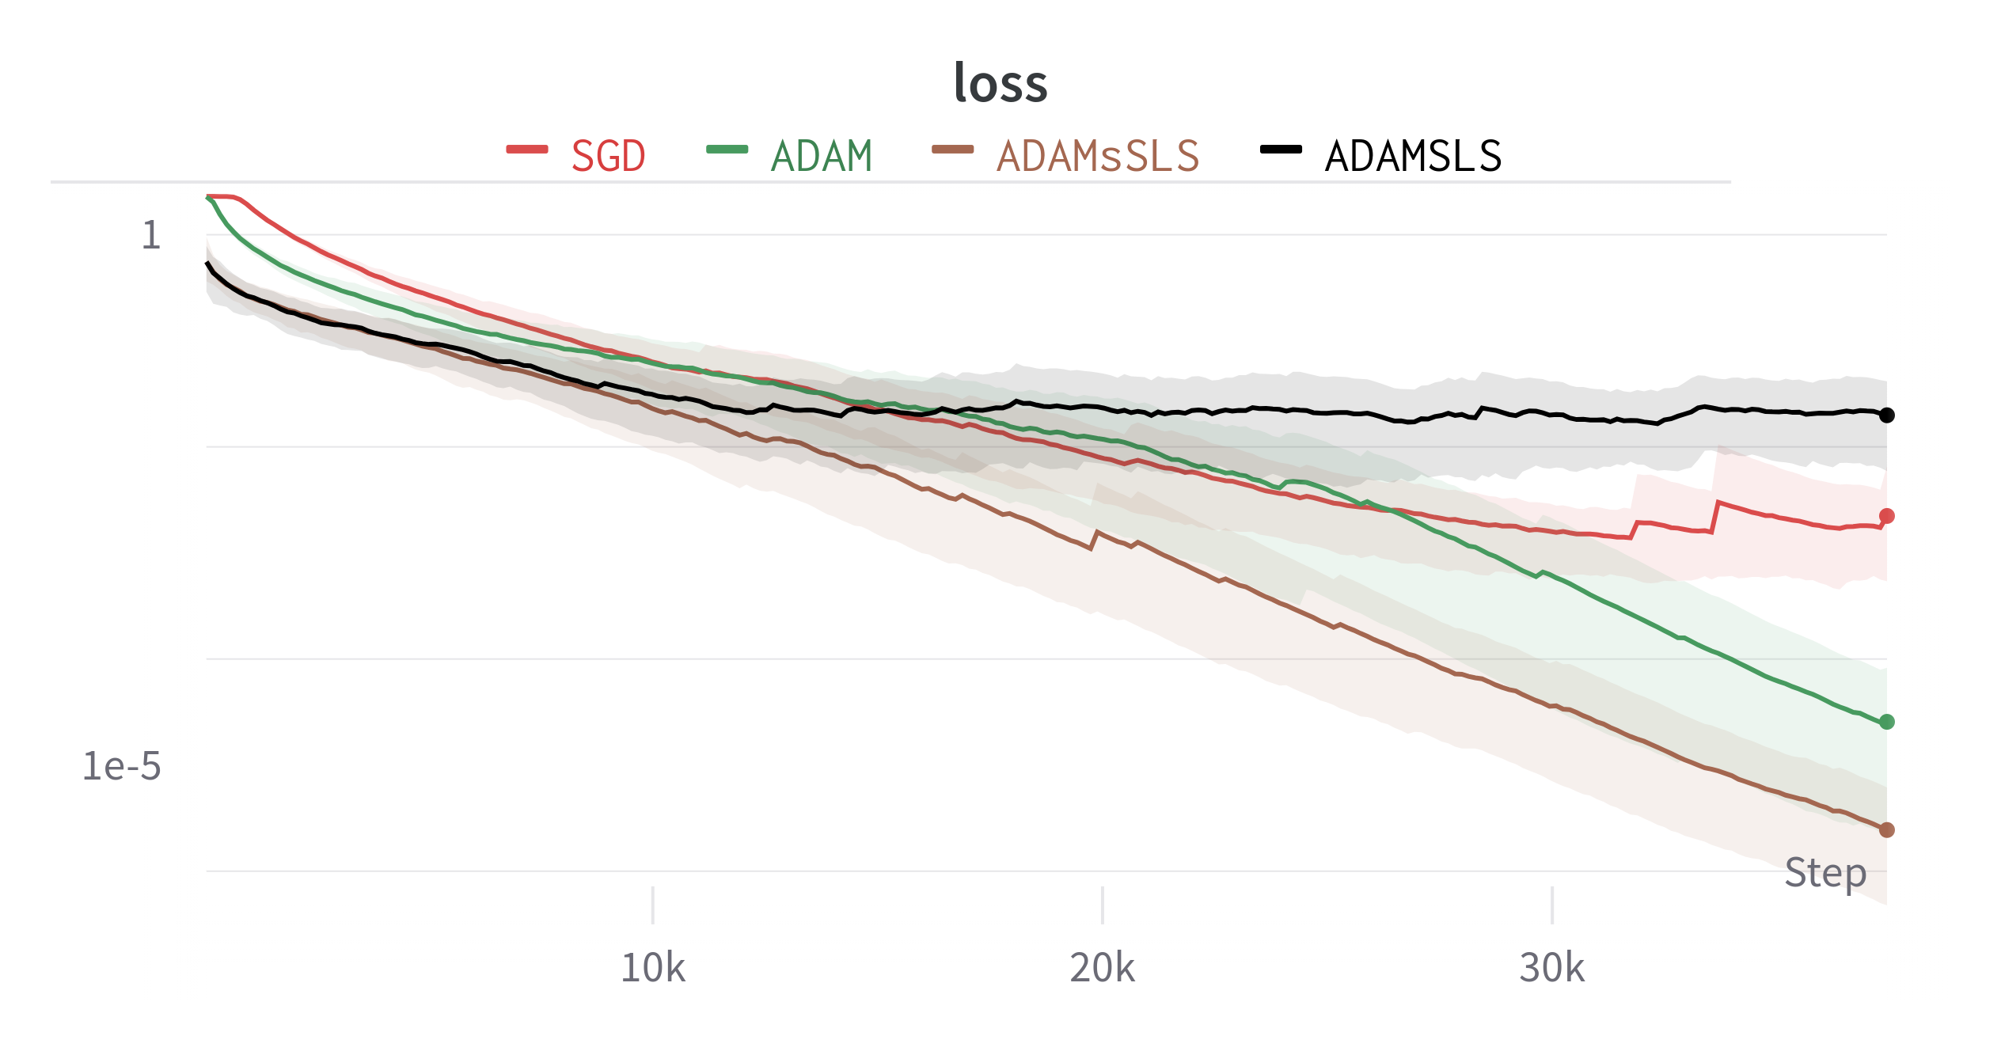
Results MLP
Mnist with 2 hidden layers:

Slide 22
More interesting Ideas &
TODOs:

Slide 23
More interesting Ideas &
TODOs:

Slide 24
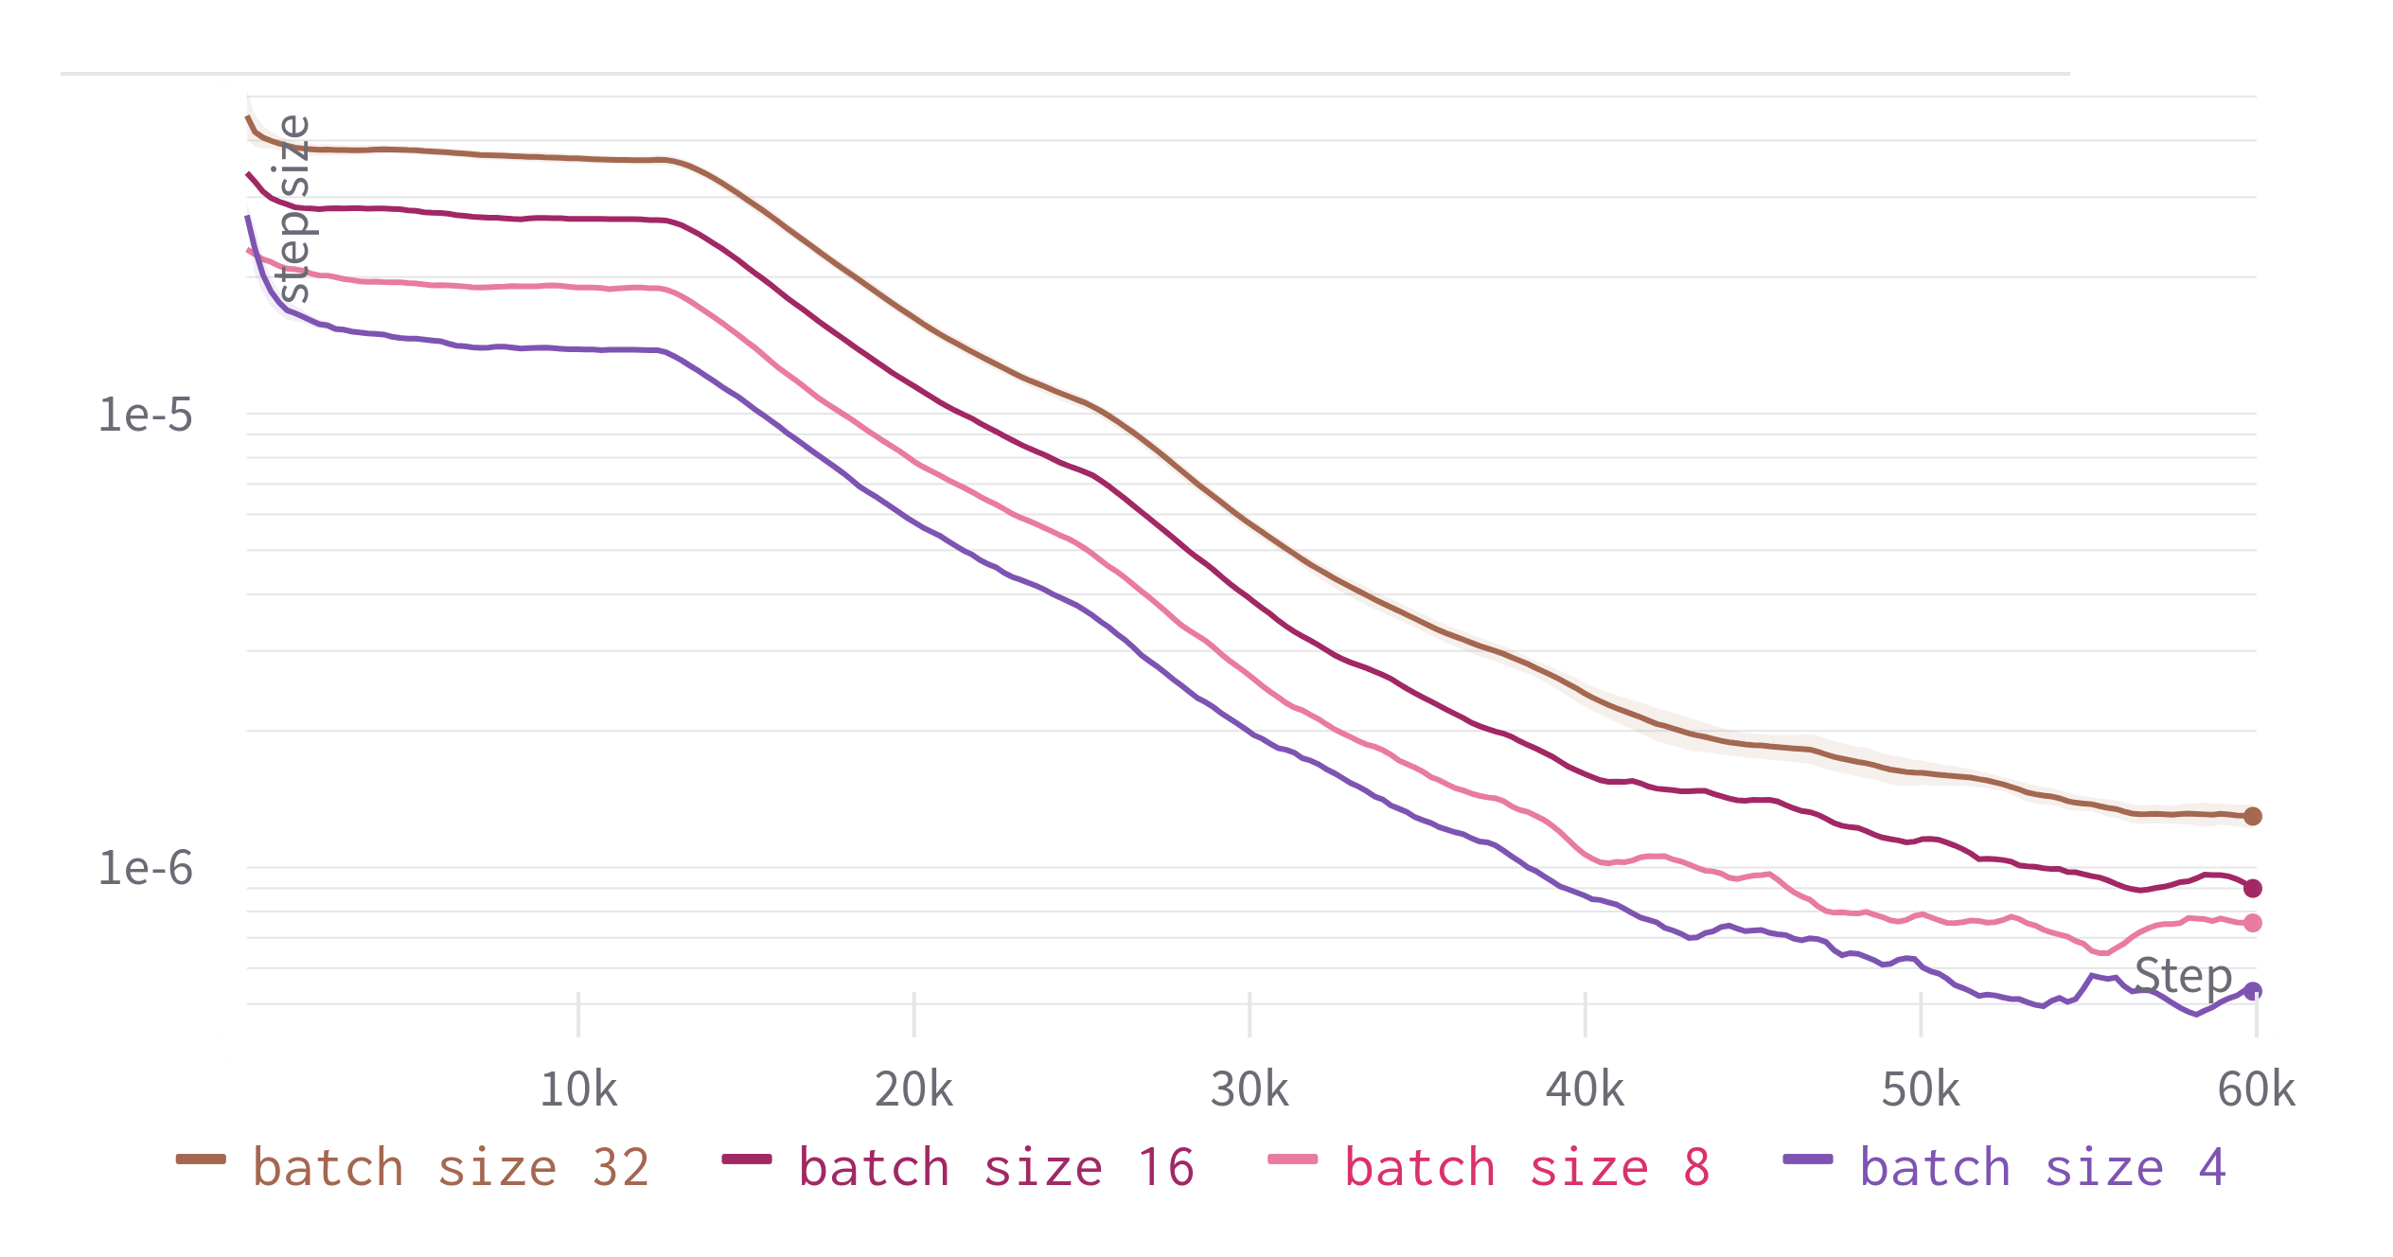
Theory
Some theoretical results: learning rate and batch size should be related. We see the same proportionality as predicted for our implementation: lr ~ sqrt(batch_size) for adaptive optimizers

Slide 25
Theory
Network size to learning rate relation could also easily be looked at.

Slide 26
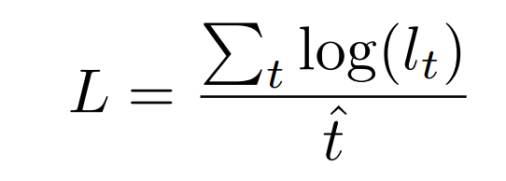
Graphs are fine but metrics are better?
Some metric to evaluate optimizers?
Intuition:
Should be similar to area under the curve just for loss.
Should be logarithmic (i.e. halving of loss is valued the same)

Slide 27
Theory
Some theoretical proofs would be nice for example:
more robustness towards noise induced by the batch size. Will still be limited.
At the moment all proofs for SLS convergence assume no noise induced by batch size.

Slide 28
Thank you for listening
Questions?

