Slide 1

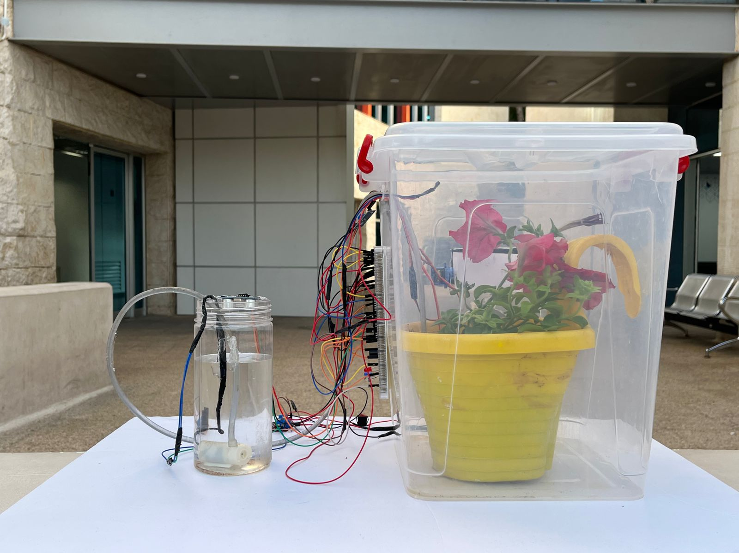
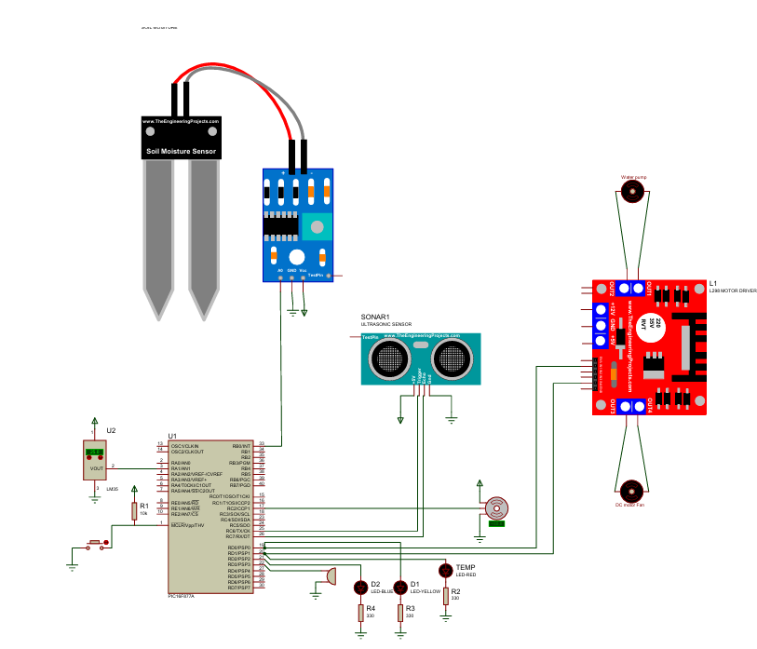
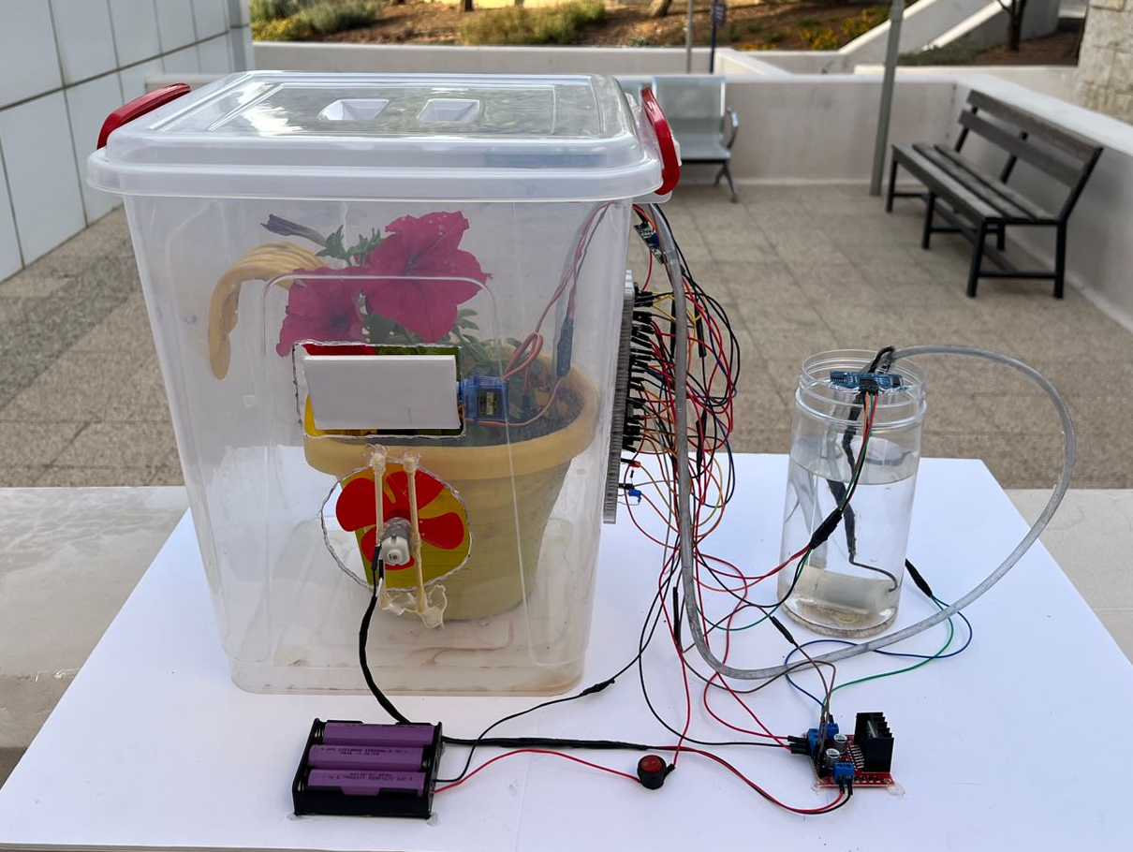
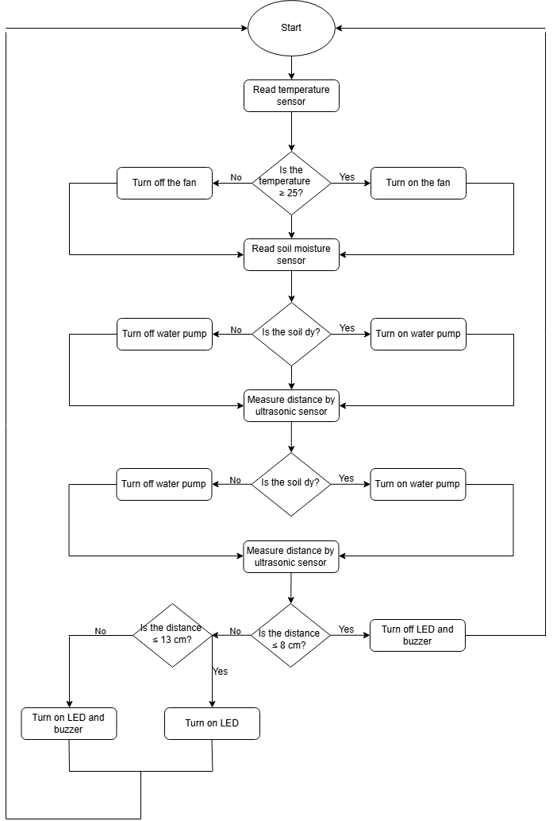
EcoGrow:
Autonomous Greenhouse Control
M. Abualia, J. Quteifan, M. Khalil.
Supervisor: Dr. Belal Sababha
Embedded Systems Final Design Project, Spring 2025
King Abdullah II School of Engineering
Princess Sumaya University for Technology
Introduction
Managing a greenhouse environment requires constant attention to factors like temperature, soil moisture, and safety. This project introduces a smart automation solution using the PIC16F877A microcontroller to minimize manual involvement. It utilizes various sensors — including a temperature sensor (LM35), a soil moisture detector, and an ultrasonic module — to create a self-regulating system. Through the use of automated watering, intelligent fan control, and responsive ventilation, the setup maintains optimal conditions for plant health and growth with improved efficiency and minimal user input.
Results
The system successfully automated core greenhouse functions. When the soil was dry, the water pump was activated to irrigate the plants. The fan responded to rising temperatures to maintain optimal air conditions. Meanwhile, the servo-controlled vent operated intermittently to promote ventilation. Additionally, the ultrasonic sensor effectively detected low water levels, triggering an LED indicator as a visual alert. These integrated features worked together to maintain a balanced environment with minimal manual oversight.
The design emphasizes efficient water use and ensures the plant receives adequate hydration without manual intervention. The modular circuit and wiring are clearly organized to support functionality and easy maintenance. This system is ideal for home gardeners and busy plant enthusiasts who want to maintain healthy plants effortlessly.
Figure 4:Final implementation
Figure 4
Design
The system architecture centers around the PIC16F877A microcontroller, which coordinates the responses of multiple components. Sensor data is collected from the soil moisture input, LM35 temperature sensor, and ultrasonic distance module. Based on this real-time data, the controller manages outputs such as a water pump, fan, and a servo-controlled vent. An LED indicator signals object detection via the ultrasonic sensor. The design ensures that each module operates independently while maintaining overall synchronization to achieve an effective and responsive greenhouse environment.
Figure 1: Electrical Design
Figure 2: Software Design
Figure 3: Final implementation
Conclusion
To conclude the automated greenhouse system developed in this project demonstrates how embedded technology can elevate traditional agriculture to new levels of precision and efficiency. By combining real-time soil moisture monitoring, temperature-controlled fan, and ultrasonic proximity sensing, the system creates optimal growing conditions with minimal need for manual intervention. This approach not only improves plant health and yield, but also illustrates the potential for scalable, intelligent agricultural solutions that support sustainable farming practices.

