Slide 1

Princess Sumaya University for Technology
King Abdullah II School of Engineering
FPGA-Based Transparent
Ethernet Bridge
Design and implementation for firewall development
Sara Abu_Saed | Mohammad Khalil | Bader Basel
Supervised by Eng. Hazem Marrar
Spring 2025-2026

Slide 2
What We Built
Active board result described in the final documentation
ACTIVE BUILD
HARDWARE
PURPOSE
Transparent two-port Ethernet bridge
Terasic DE2-115 between router and laptop
Foundation for future FPGA firewall integration
Receives Ethernet traffic from one PHY interface.
Converts the RGMII receive stream into AXI-Stream frame bytes.
Transfers frames through asynchronous FIFOs.
Transmits frames through the opposite PHY interface.
Current scope
Bridge datapath, FCS handling, clock-domain crossing, transmit framing.
Live packet filtering remains future work.
FPGA-Based Transparent Ethernet Bridge
02

Slide 3
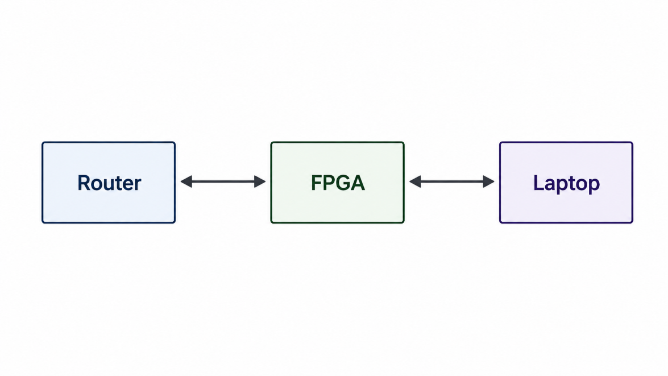
Live Test Setup
Router LAN port to FPGA bridge to laptop Ethernet port
One FPGA Ethernet port connects to the router LAN port.
The other FPGA Ethernet port connects to the laptop.
Frames received from either side are forwarded to the opposite side.
The test verified real Ethernet traffic through FPGA hardware.
Inline transparent bridge
FPGA-Based Transparent Ethernet Bridge
03

Slide 4
Design Requirements
The live system must move real Ethernet frames correctly
RGMII receive
Receive and decode traffic from the PHY interfaces.
AXI-Stream style
Move frame bytes using tdata, tvalid, tready, tlast, and tuser.
Clock crossing
Use asynchronous FIFOs between receive and transmit clock domains.
Frame integrity
Check incoming FCS/bad-frame status and regenerate FCS on transmit.
Transmit framing
Add preamble, pad short frames when needed, and drive the opposite PHY.
Debug status
Provide LED indications for traffic, reset, link speed, and frame status.
FPGA-Based Transparent Ethernet Bridge
04

Slide 5
Selected Design Approach
Stabilize the transparent bridge first, then insert filtering logic later
Software firewall
Flexible, but does not prove the FPGA can sit inline and forward real traffic.
Full FPGA firewall
Important future direction; requires field extraction, rule storage, buffering, and timing validation.
Transparent bridge
Selected current build: validates physical Ethernet path, RGMII handling, clock crossing, and transmit operation.
1
2
3
SELECTED
Current limitation: active allow/drop packet filtering is not yet running on the FPGA board.
FPGA-Based Transparent Ethernet Bridge
05

Slide 6
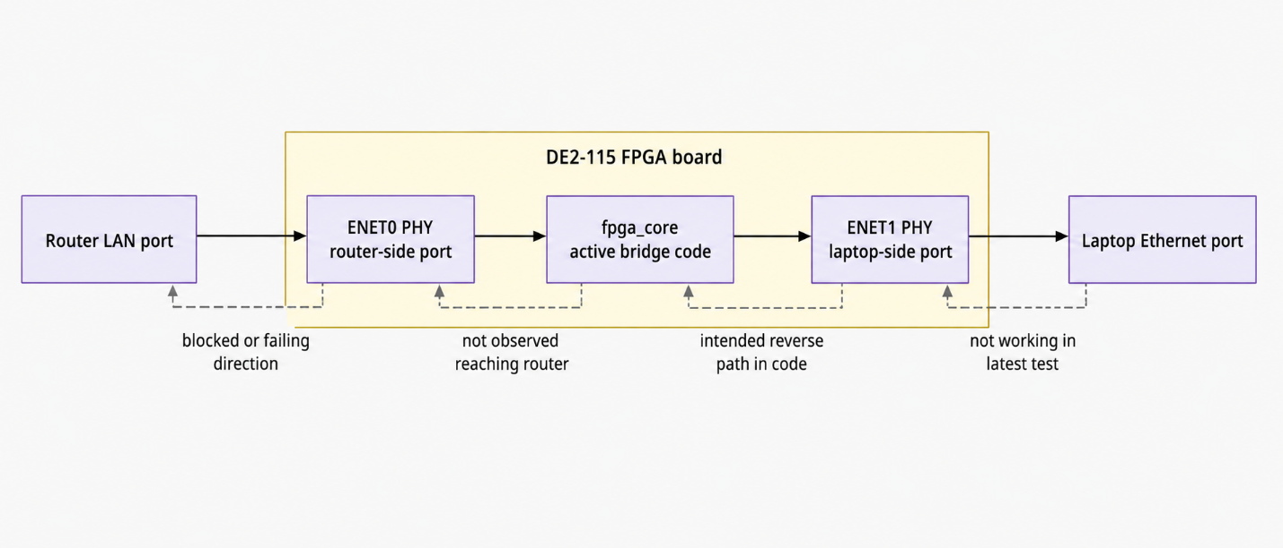
Bridge Architecture
Active modules in the Quartus board build
fpga.v: PLL, reset synchronization, physical pin wiring
fpga_core.v: Main bridge datapath and LED/debug status
de2_rgmii_rx.v: RGMII DDR receive alignment and frame decoding
axis_async_fifo.v: Clock-domain crossing between RX and opposite TX
verilog-ethernet: MAC/RGMII support for transmit framing
FPGA-Based Transparent Ethernet Bridge
06

Slide 7
Receive Path
From RGMII pins to AXI-Stream frame bytes
RGMII RX
Aligned GMII
Frame bytes
tuser status
Samples and aligns RGMII receive data.
Uses GMII receive logic to identify frames.
Checks frame integrity at the MAC receive stage using FCS.
Removes incoming preamble and FCS, then marks bad frames through tuser.
Important boundary
The active bridge treats frame contents as a byte stream. It does not inspect MAC/IP/TCP/UDP fields for filtering in this phase.
FPGA-Based Transparent Ethernet Bridge
07

Slide 8
Transmit Path
The opposite MAC rebuilds valid Ethernet output
Async FIFO
TX MAC
Preamble / pad
New FCS
RGMII TX
FIFO transfers the frame stream into the opposite transmit clock domain.
Transmit MAC adds the required Ethernet preamble.
Short frames are padded when needed.
A new frame check sequence is regenerated before transmission.
Receive checks FCS.
Transmit regenerates FCS.
FPGA-Based Transparent Ethernet Bridge
08

Slide 9
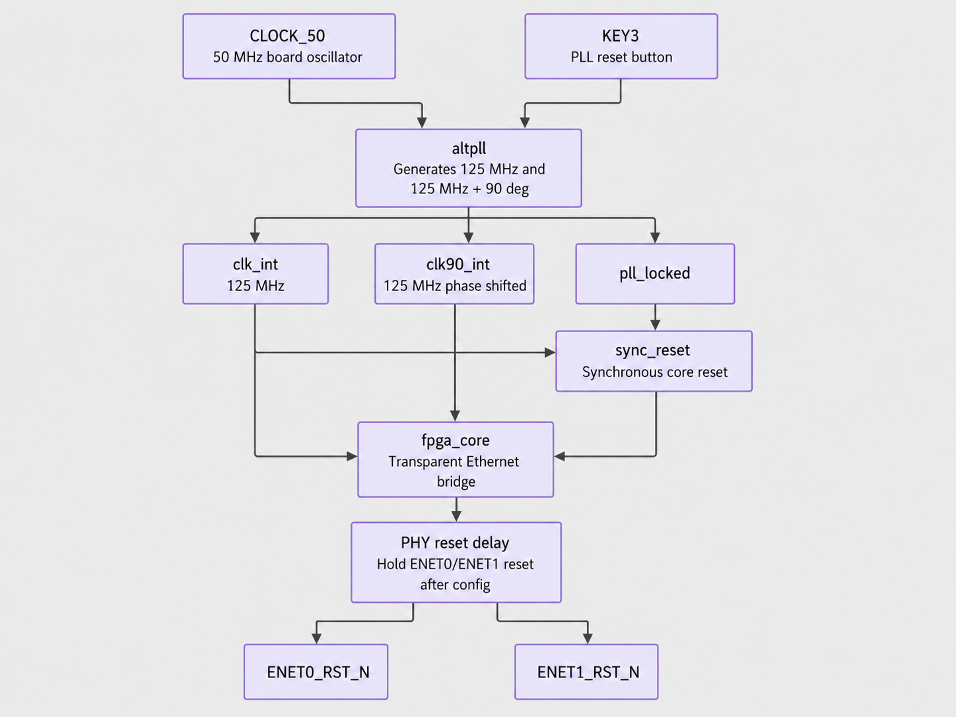
Board Top-Level Logic
Clocking, reset synchronization, PHY reset delay, and bridge core
fpga.v handles PLL, reset synchronization, and physical Ethernet pin wiring.
The 50 MHz board oscillator feeds the PLL for FPGA/interface clocks.
PHY reset delay supports stable startup.
Ethernet PHYs recover timing from the physical Ethernet signal.
FPGA-Based Transparent Ethernet Bridge
09

Slide 10
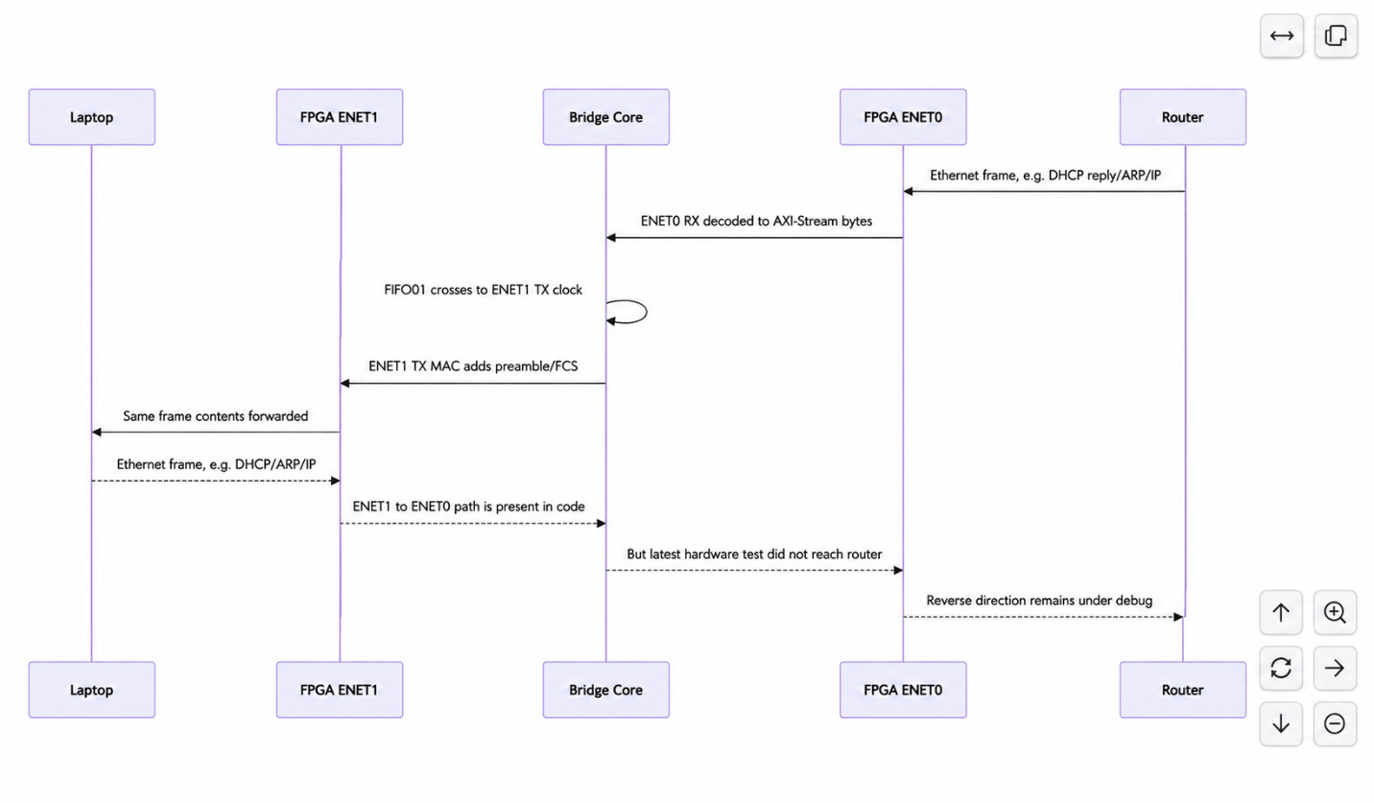
Runtime Packet Flow
Traffic crosses the FPGA bridge in both directions
Laptop traffic can include DHCP, ARP, ICMP, DNS, and normal IP traffic.
Router replies return through the opposite direction of the same bridge.
This verifies inline transparent Ethernet bridge behavior.
Working bridge path
FPGA-Based Transparent Ethernet Bridge
10

Slide 11
Standards and Constraints
Engineering frame for the implementation
IEEE 802.3
Ethernet frame behavior, MAC addressing, and FCS.
RGMII
PHY-to-FPGA MAC-side interface.
Key constraints
Existing DE2-115 board
Timing across clock domains
Valid Ethernet transmit framing
Resource headroom for future filtering
AXI-Stream style
Internal frame movement using tdata, tvalid, tready, tlast, tuser.
Verilog + Quartus
Synthesizable HDL and FPGA design flow.
FPGA-Based Transparent Ethernet Bridge
11

Slide 12
Current Limitations and Future Work
Accuracy matters: the active build is not a live firewall yet
Current board build
No live packet filtering.
No active key-field packet inspection.
No programmable allow/drop rule matching on the FPGA board.
Older firewall-related files remain development material outside the active Quartus build.
Next integration steps
Insert filtering logic into the proven bridge path.
Add header extraction for Ethernet/IP/TCP/UDP fields.
Add rule storage and allow/drop decision logic.
Validate timing and behavior with live traffic.
FPGA-Based Transparent Ethernet Bridge
12

Slide 13
Project Takeaway
Implemented a transparent Ethernet bridge on the DE2-115.
Validated RGMII receive alignment, FIFO clock crossing, MAC transmit framing, and FCS handling.
Established the live inline hardware path needed for future FPGA firewall filtering.
Thank you

Slide 14
References
Sources listed in the final documentation
1
IEEE Computer Society, "IEEE Standard for Ethernet," IEEE Std 802.3.
2
Hewlett-Packard Company and contributors, "Reduced Gigabit Media Independent Interface (RGMII), Version 2.0," 2002.
3
A. Forencich, "verilog-ethernet: Verilog Ethernet components for FPGA implementation," GitHub.
4
Intel Corporation, "Intel Quartus Prime Design Software Documentation."
FPGA-Based Transparent Ethernet Bridge
14

