Slide 1


1
2
3
4
ENERGY CONSUMPTION ACROSS BORDERS
GitHub
Querys
Tables
Git
Explain Git’s basics: version control, branches, commits, and merges. Highlight its role in our workflow.
Present our database tables and their relationships. Highlight how we connected and extended pre-defined tables.
Describe GitHub’s role in our project and its use for collaboration.
Present SQL queries for data analysis. Explain their goals and highlight key results

Slide 2
1
2
3
4
GitHub
Git
Tables
Querys
Describe GitHub’s role in our project and its use for collaboration.
Explain Git’s basics: version control, branches, commits, and merges. Highlight its role in our workflow.
Present our database tables and their relationships. Highlight how we connected and extended pre-defined tables.
Present SQL queries for data analysis. Explain their goals and highlight key results

Slide 3
What is GitHub?
1
Web-based platform:
Version control
Collaboration
2
3
4
GitHub combines these two features to enhance teamwork and code management.

Slide 4
Why GitHub was essential
1
Efficient collaboration
Traceability
Transparency
2
3
4
These features are powered by Git, the version control system.

Slide 5


What is Git?
1
2
Functions:
Tracks changes in files
Allows you to load previous versions
Supports branching and merging
3
4

Slide 6
How did we use Git?
1
2
Clone Repository
Creating Branches
Commit and Push changes
Pull Requests and Merge
3
4

Slide 7
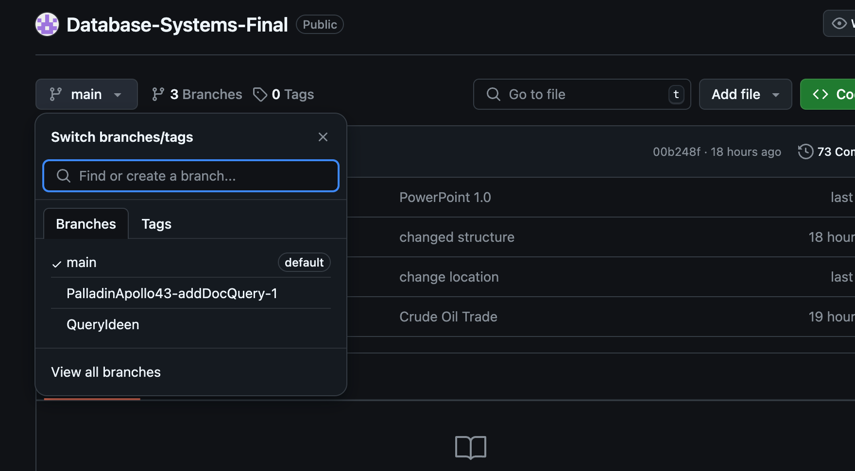
Example for Branches
1
2
3
4

Slide 8
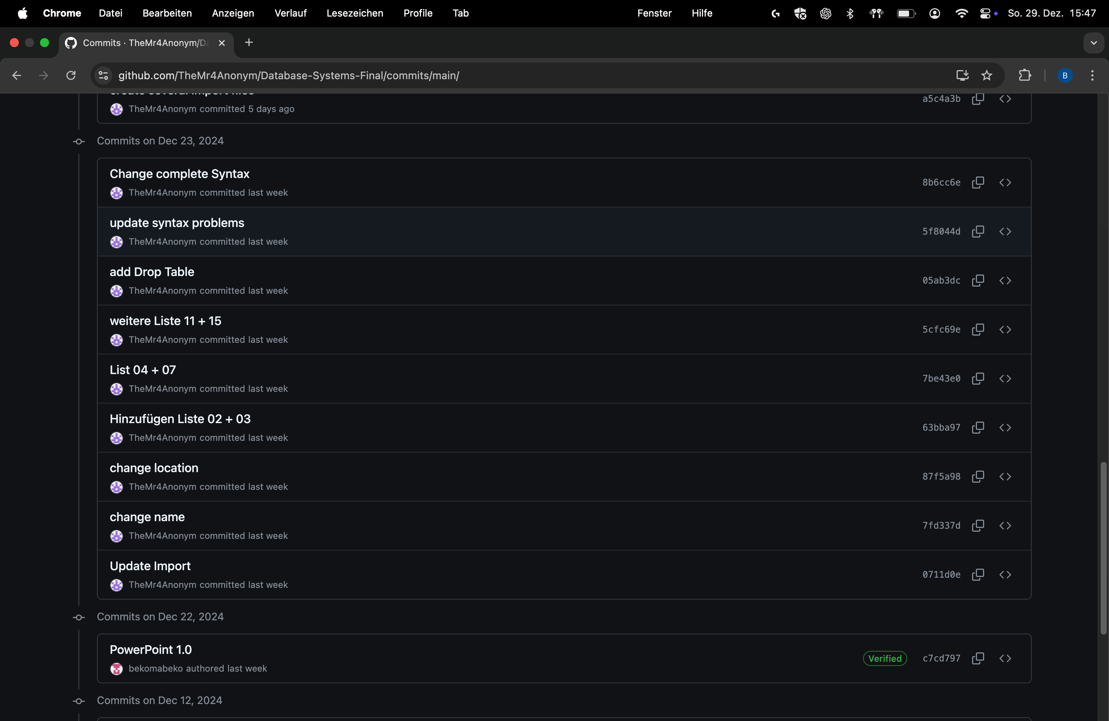
Example for Commits
1
2
3
4

Slide 9
How did we start?
1
2
Data Collection
GitHub Setup
UML Design
Data Import
3
4

Slide 10
Data and GitHub Setup
1
Data Collection
Searched datasets from kaggle.com
Downloaded CSV files matching our project theme
GitHub Setup
Created Repository
Imported CSV files to GitHub
2
3
4

Slide 11
UML Design
1
2
Visualized structure and connection
Planned relationships
Clear overview
3
4

Slide 12
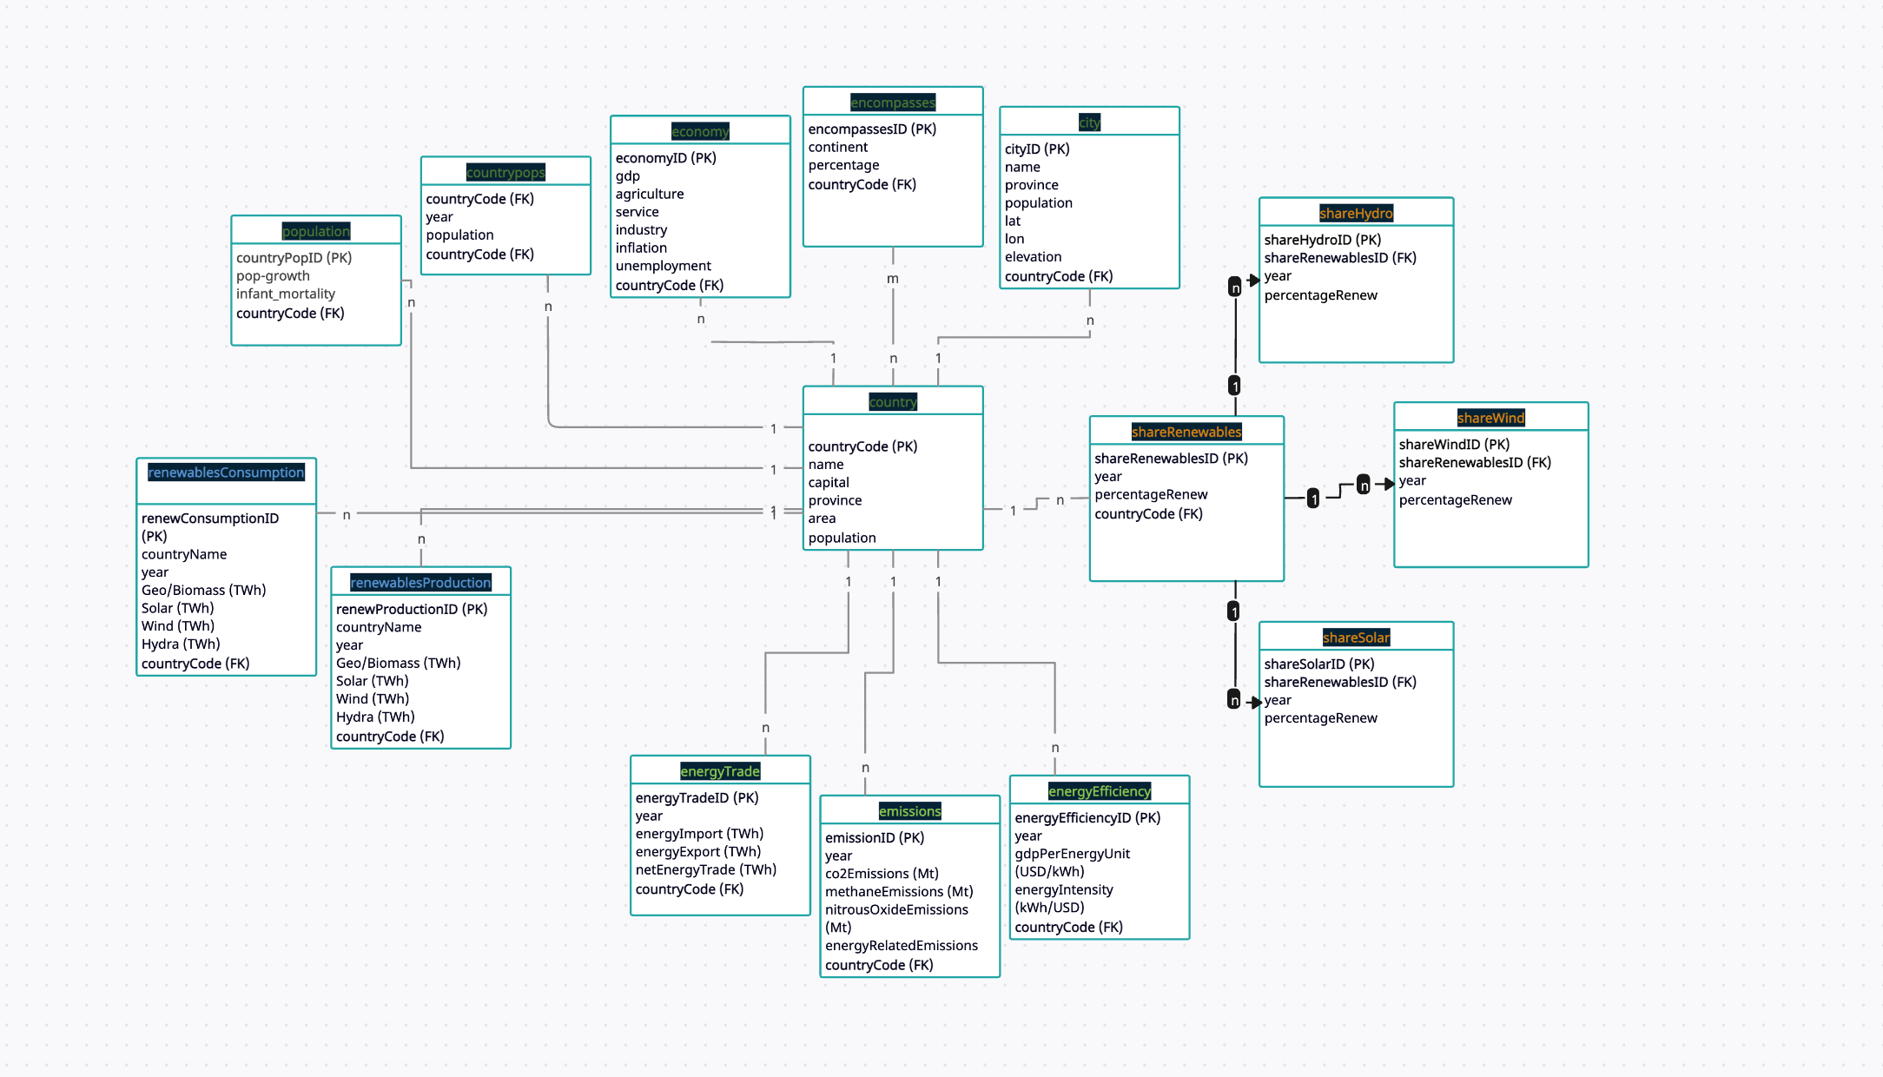
1
2
3
4

Slide 13
Data Import
1
2
Imported CSV files into PostgreSQL
Followed UML design to create and tables
3
4

Slide 14

Querys
1
2
3
4

Slide 15

Thank You!

