Slide 1


1
2
3
4
RENEWABLE ENERGY CONSUMPTION ACROSS BORDERS
GitHub
Queries
Tables
Git
Explain Git’s basics: version control, branches, commits, and merges. Highlight its role in our workflow.
Present our database tables and their relationships. Highlight how we connected and extended pre-defined tables.
Describe GitHub’s role in our project and its use for collaboration.
Present SQL queries for data analysis. Explain their goals and highlight key results

Slide 2
1
2
3
4
GitHub
Git
Tables
Queries
Describe GitHub’s role in our project and its use for collaboration.
Explain Git’s basics: version control, branches, commits, and merges. Highlight its role in our workflow.
Present our database tables and their relationships. Highlight how we connected and extended pre-defined tables.
Present SQL queries for data analysis. Explain their goals and highlight key results

Slide 3
What is GitHub?
Web-based platform:
Version control
Collaboration
GitHub combines these two features to enhance teamwork and code management.

Slide 4
Why GitHub was essential
Efficient collaboration
Traceability
Transparency
These features are powered by Git, the version control system.

Slide 5

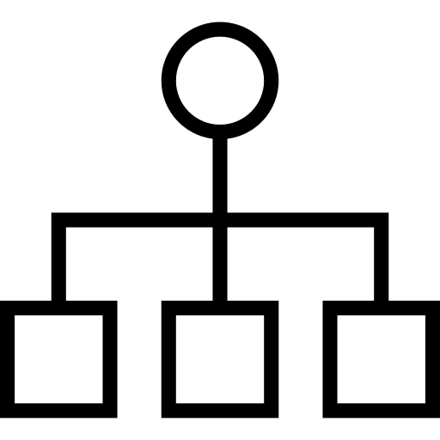
What is Git?
Functions:
Tracks changes in files
Allows you to load previous versions
Supports branching and merging

Slide 6
How did we use Git?
Clone Repository
Creating Branches
Commit and Push changes
Pull Requests and Merge

Slide 7
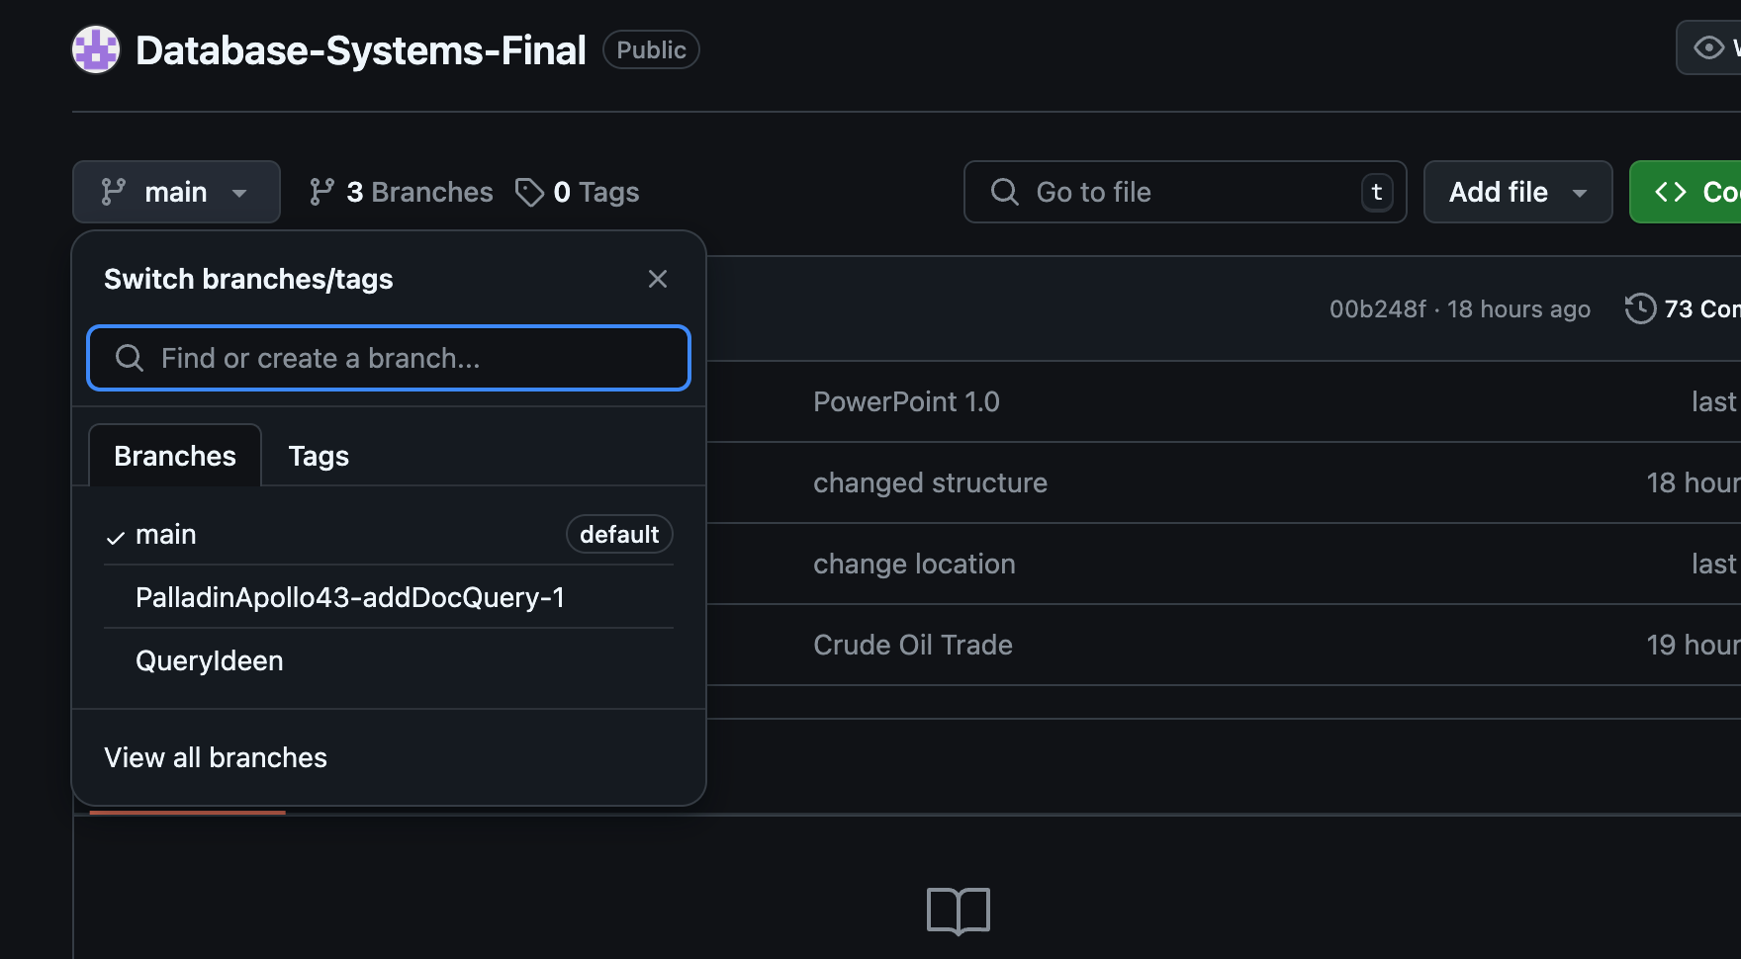
Example for Branches

Slide 8
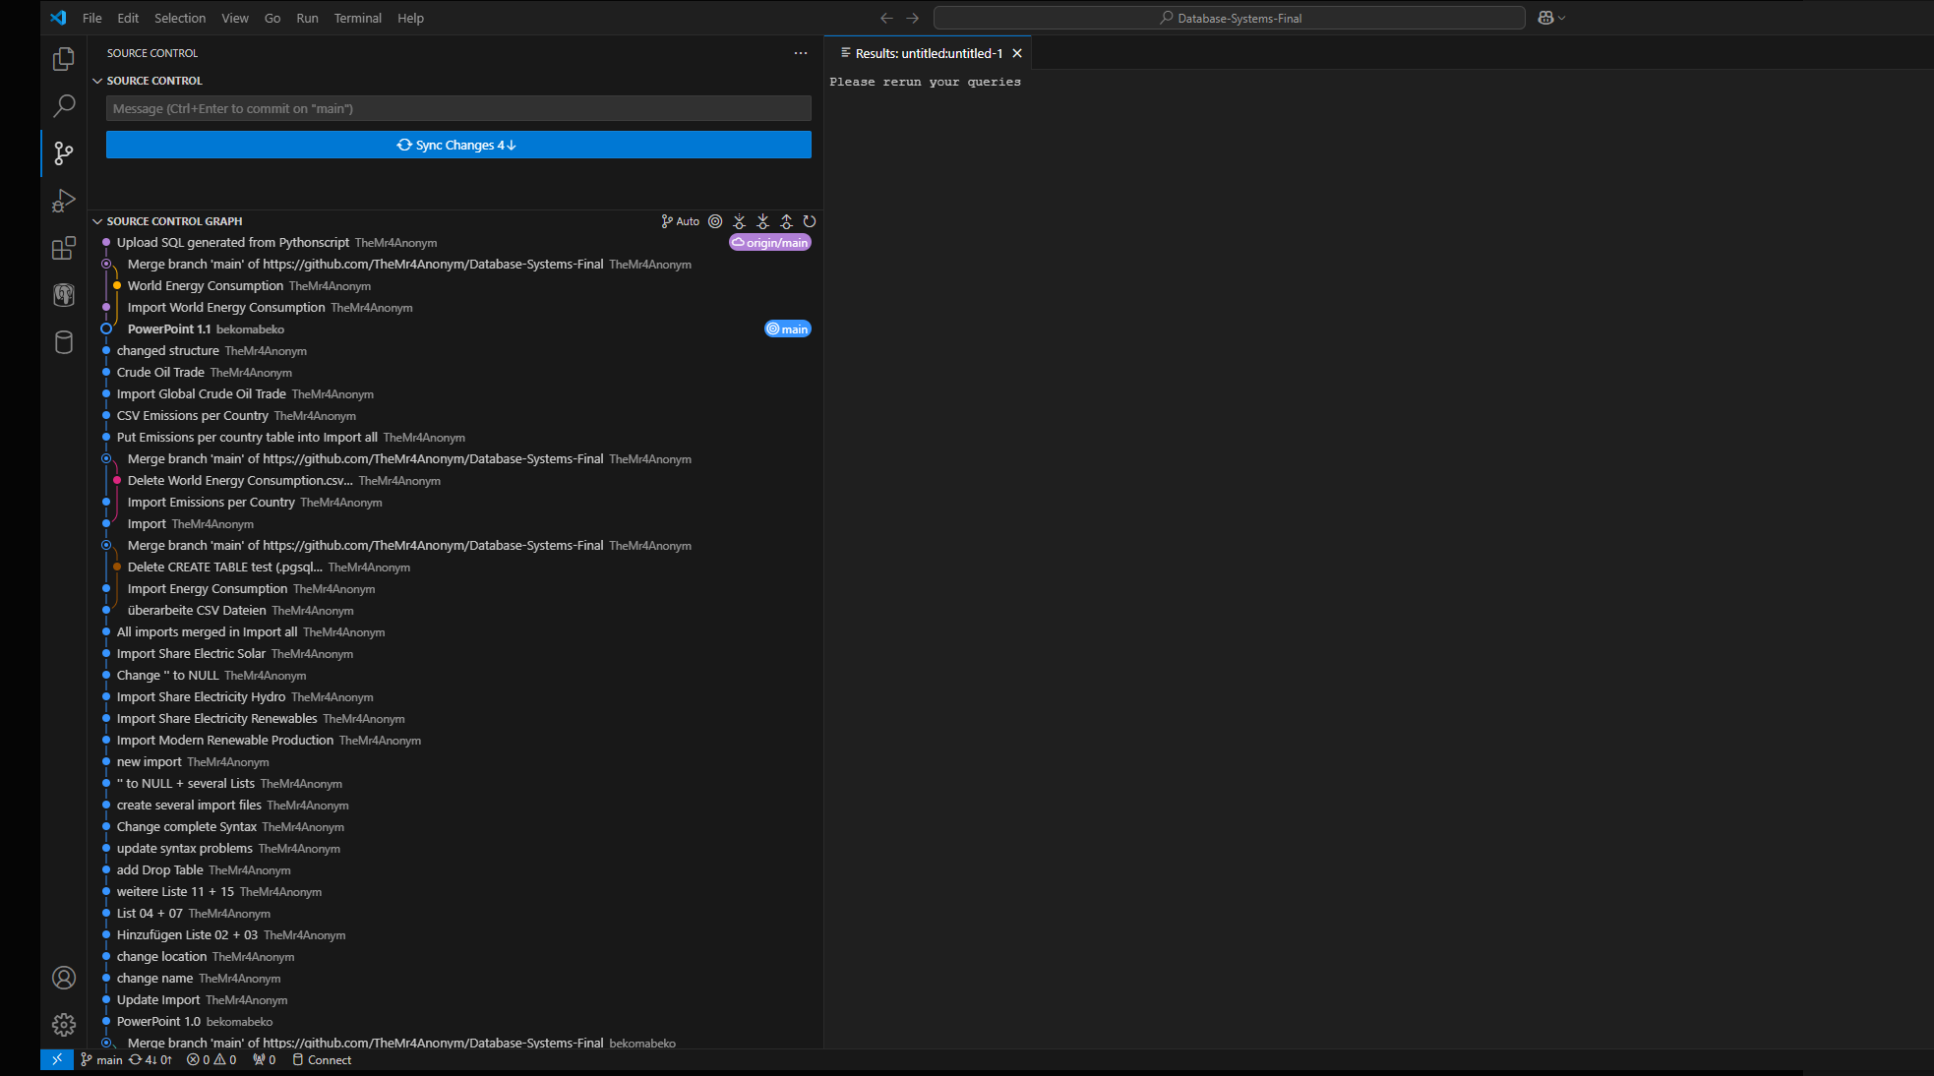
Example for Commits

Slide 9



HOW CAN WE IDENTIFY THE GLOBAL TRENDS IN RENEWABLE ENERGY CONSUMPTION?

Slide 10
Tables

Slide 11
UML Design
Visualized structure and connection
Planned relationships
Clear overview

Slide 12
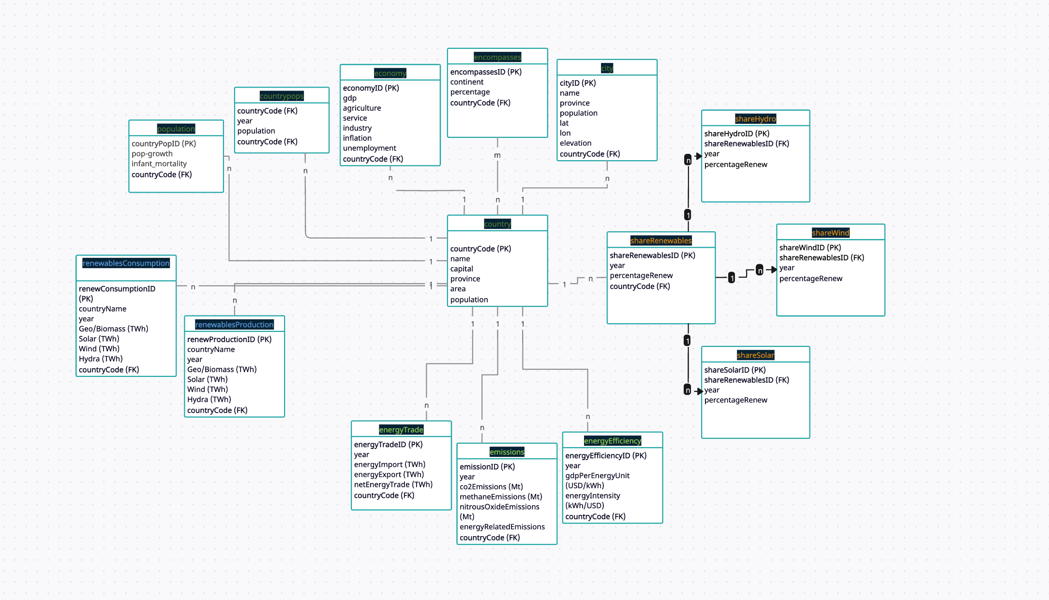
1
2
3
4

Slide 13

Queries

Slide 14

Thank You!

