Slide 1



$$x∗y=a^{\log_{a}\left(x\right)}∗a^{\log_{a}\left(y\right)}$$
$$x∗y=a^{\log_{a}{x}+\log_{a}{y}}$$
$$\log_{a}\left(x∗\frac{1}{z}\right)=\log_{a}{x}+\log_{a}{\frac{1}{z}}$$

Slide 2


$$\log_{a}\left(\frac{x}{z}\right)=\log_{a}{x}+\log_{a}\left(z^{−1}\right)$$
$$\log_{a}\left(\frac{x}{z}\right)=\log_{a}{x}−\log_{a}\left(z\right)$$

Slide 3
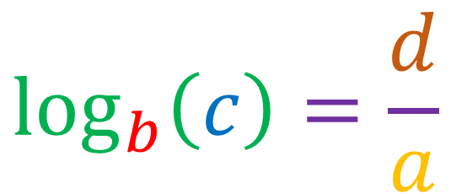



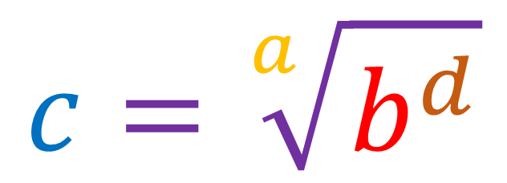
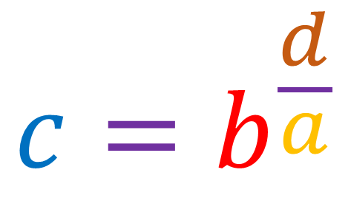
$$a∗\log_{b}\left(c\right)=d$$
$$\log_{b}\left(c\right)=\frac{d}{a}$$
$$c=b^{\frac{d}{a}}$$
$$c^{a}=b^{d}$$
$$c=\sqrt[a]{b^{d}}$$
$$\log_{b}\left(c^{a}\right)=a∗\log_{b}\left(c\right)$$

Slide 4
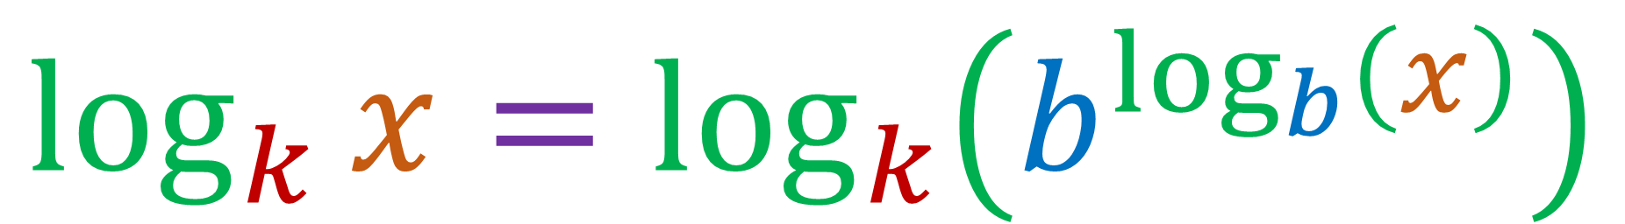
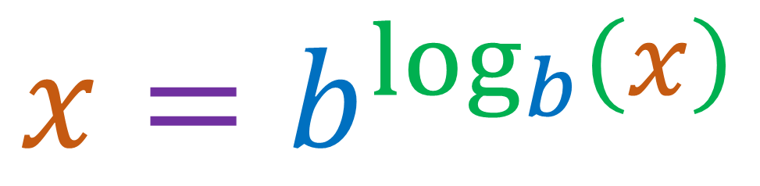
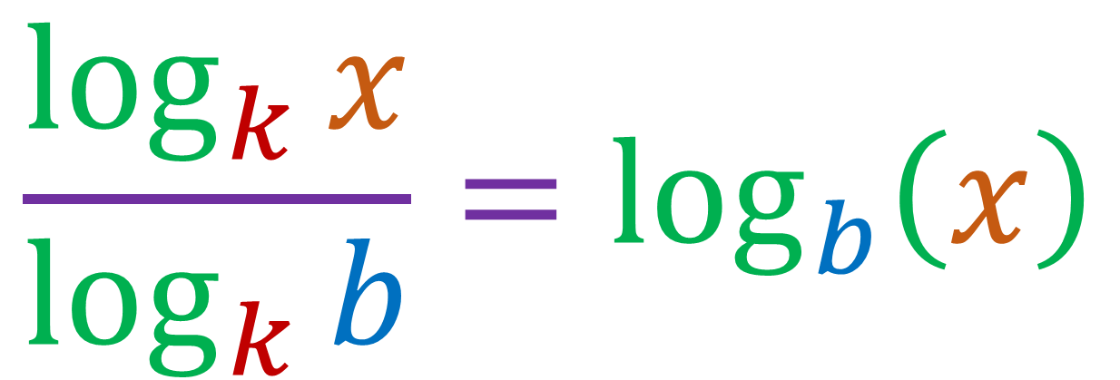
$$x=b^{\log_{b}\left(x\right)}$$
$$\log_{k}{x}=\log_{k}\left(b^{\log_{b}\left(x\right)}\right)$$
$$\frac{\log_{k}{x}}{\log_{k}{b}}=\log_{b}\left(x\right)$$

