Slide 1
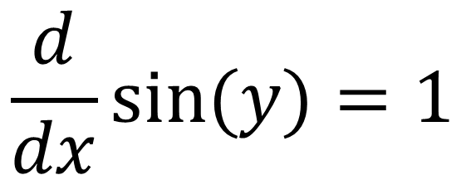



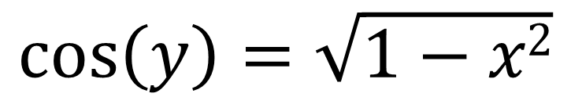
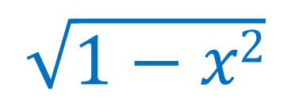
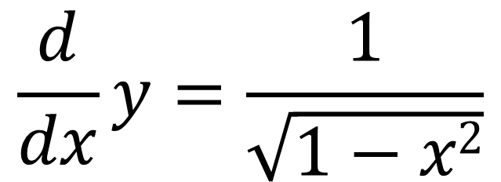
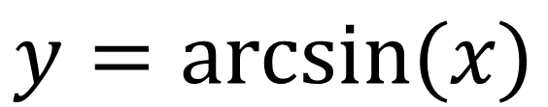
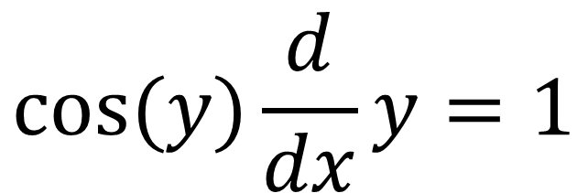
$$\frac{d}{dx}x=1$$
$$1$$
$$\frac{d}{dx}sin⁡(y)=1$$
$$x$$
y
$$cos⁡(y)\frac{d}{dx}y=1$$
$$\sqrt{1−x2}$$
$$y=arcsin⁡(x)$$
$$\frac{d}{dx}y=\frac{1}{\sqrt{1−x2}}$$
$$\cos\left(y\right)=\sqrt{1−x2}$$

Slide 2
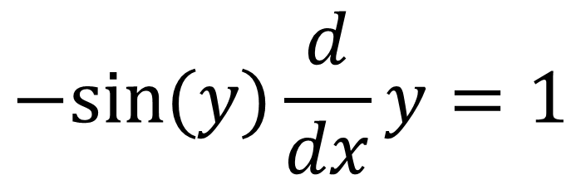


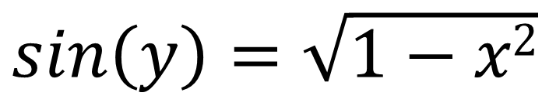
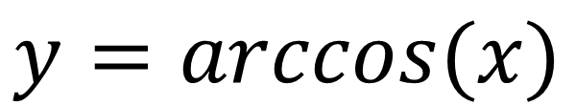
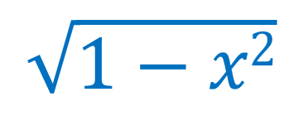
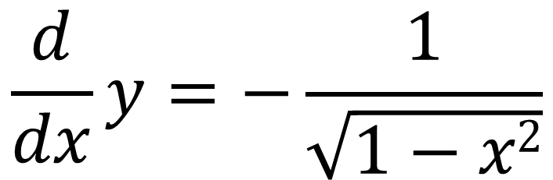
$$1$$
$$\sqrt{1−x2}$$
$$−sin⁡(y)\frac{d}{dx}y=1$$
y
$$x$$
$$\frac{d}{dx}cos⁡(y)=1$$
$$y=arccos(x)$$
$$\frac{d}{dx}y=−\frac{1}{\sqrt{1−x2}}$$
$$sin\left(y\right)=\sqrt{1−x2}$$

Slide 3
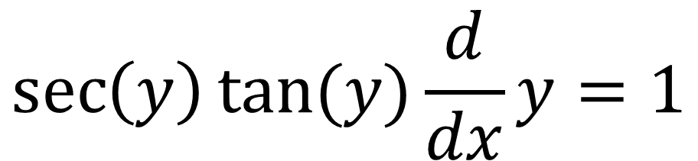

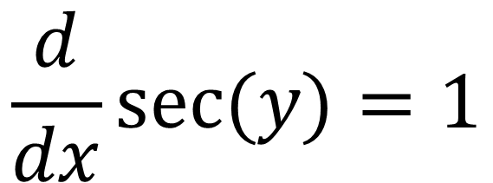

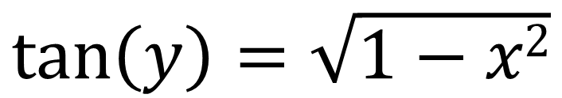
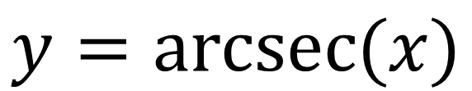
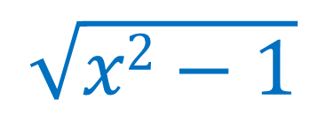
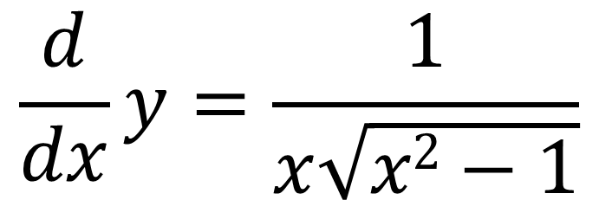
$$x$$
$$\frac{d}{dx}sec⁡(y)=1$$
$$\sqrt{x2−1}$$
y
$$1$$
$$\sec\left(y\right)tan⁡(y)\frac{d}{dx}y=1$$
$$y=arcsec(x)$$
$$\frac{d}{dx}y=\frac{1}{x\sqrt{x2−1}}$$
$$\tan\left(y\right)=\sqrt{1−x2}$$

Slide 4
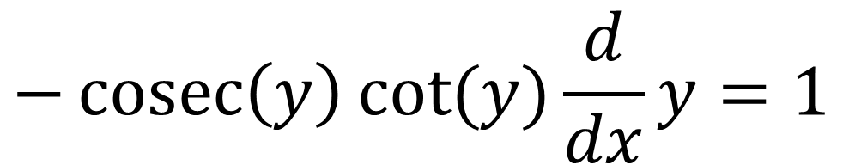

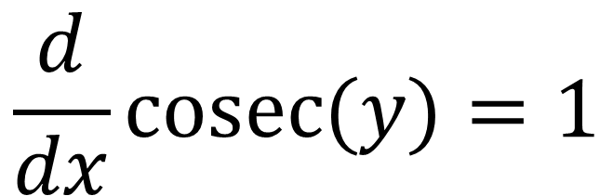
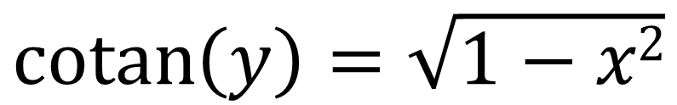
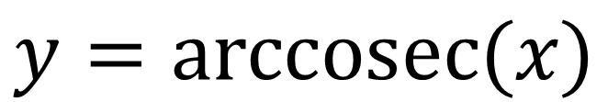

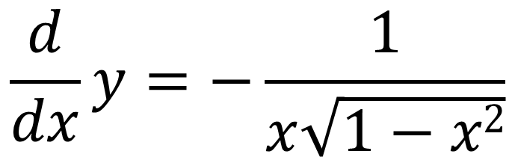
$$x$$
$$\frac{d}{dx}cosec⁡(y)=1$$
$$1$$
y
$$\sqrt{x2−1}$$
$$−\operatorname{cosec}\left(y\right)cot⁡(y)\frac{d}{dx}y=1$$
$$y=arccosec(x)$$
$$\frac{d}{dx}y=−\frac{1}{x\sqrt{1−x2}}$$
$$\operatorname{cotan}\left(y\right)=\sqrt{1−x2}$$

Slide 5
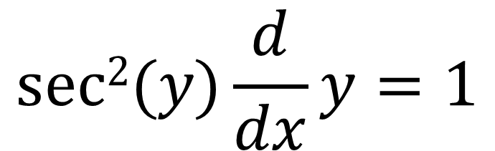

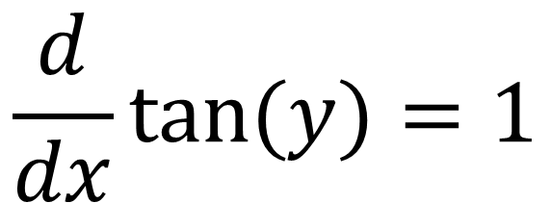

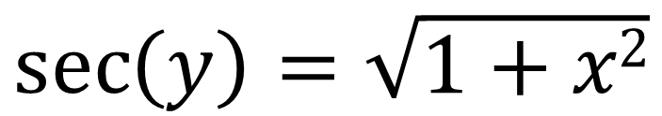
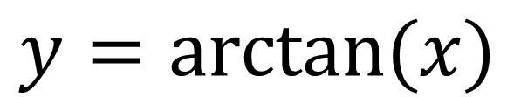
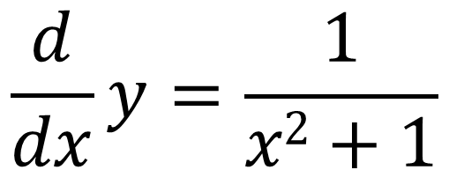
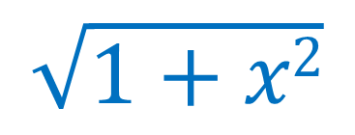
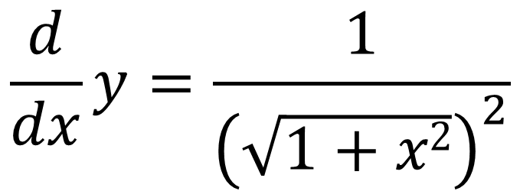
$$\sqrt{1+x2}$$
$$\frac{d}{dx}tan⁡(y)=1$$
$$x$$
$$sec2⁡(y)\frac{d}{dx}y=1$$
y
$$1$$
$$\frac{d}{dx}y=\frac{1}{{\left(\sqrt{1+x2}\right)}^{2}}$$
$$y=arctan(x)$$
$$\frac{d}{dx}y=\frac{1}{x2+1}$$
$$\sec\left(y\right)=\sqrt{1+x2}$$

Slide 6
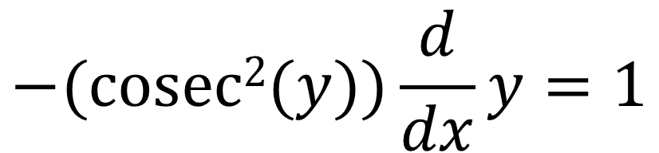

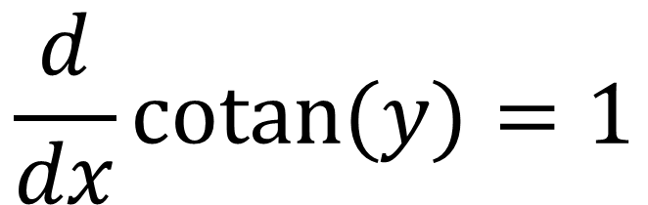

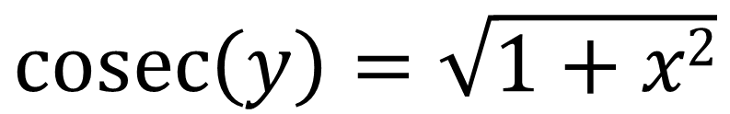
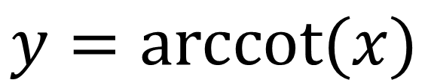
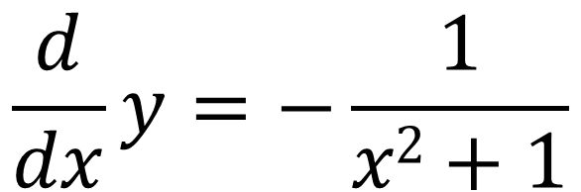

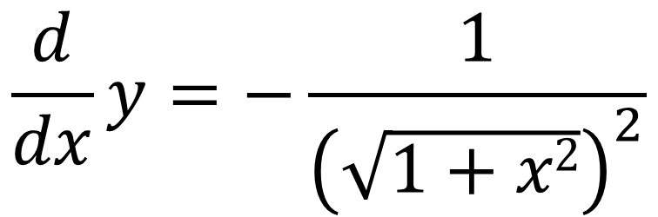
$$\sqrt{1+x2}$$
$$\frac{d}{dx}cotan⁡(y)=1$$
$$1$$
y
$$−(cosec2(y))\frac{d}{dx}y=1$$
$$x$$
$$\frac{d}{dx}y=−\frac{1}{{\left(\sqrt{1+x2}\right)}^{2}}$$
$$y=arccot(x)$$
$$\frac{d}{dx}y=−\frac{1}{x2+1}$$
$$\operatorname{cosec}\left(y\right)=\sqrt{1+x2}$$

