Slide 1
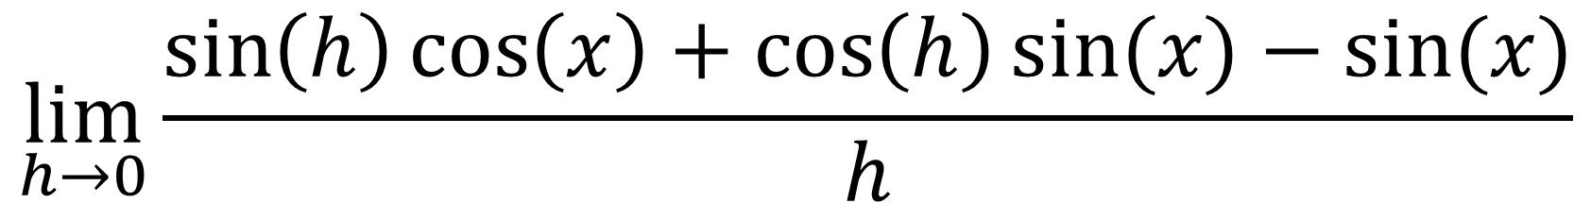
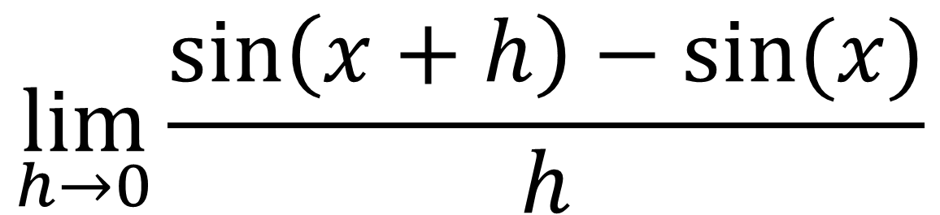
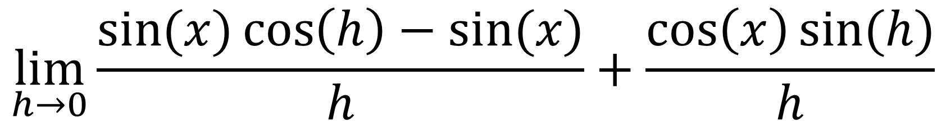
$$\lim_{h→0}{\frac{\sin\left(x+h\right)−sin⁡(x)}{h}}$$
$$\lim_{h→0}{\frac{\sin\left(h\right)\cos\left(x\right)+\cos\left(h\right)sin⁡(x)−sin⁡(x)}{h}}$$
$$\lim_{h→0}{\frac{\sin{(x)}\cos\left(h\right)−sin⁡(x)}{h}+\frac{\cos\left(x\right)sin⁡(h)}{h}}$$

Slide 2
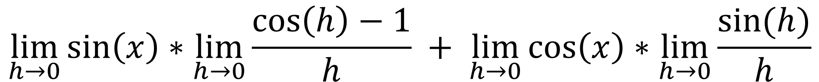
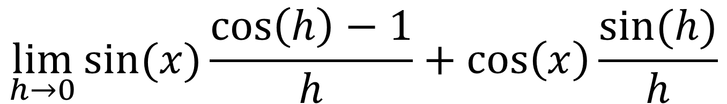
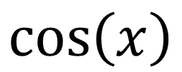
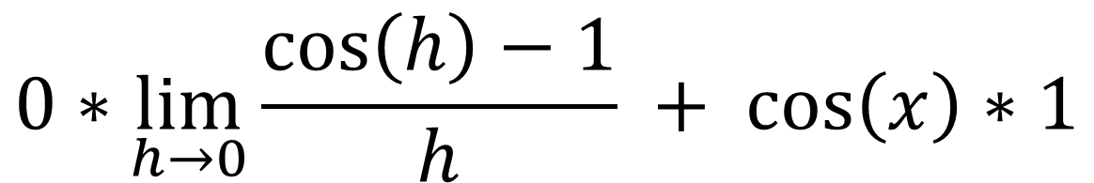
$$\lim_{h→0}{sin⁡(x)\frac{\cos\left(h\right)−1}{h}+\cos\left(x\right)\frac{sin⁡(h)}{h}}$$
$$\lim_{h→0}{\sin\left(x\right)∗\lim_{h→0}\frac{\cos\left(h\right)−1}{h} + \lim_{h→0}\cos\left(x\right)∗\lim_{h→0}\frac{sin⁡(h)}{h}}$$
$$0∗\lim_{h→0}{\frac{\cos\left(h\right)−1}{h} + \cos\left(x\right)∗1}$$
$$\cos\left(x\right)$$

Slide 3
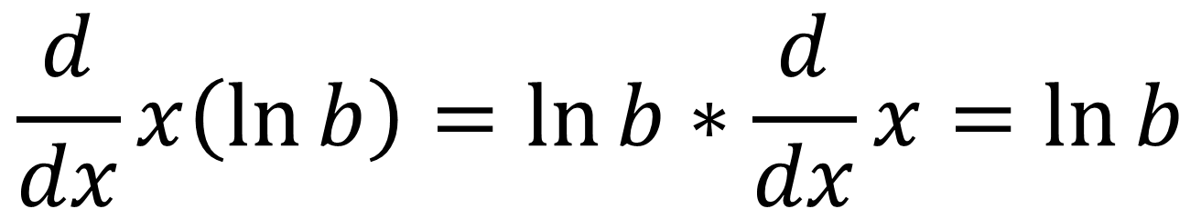
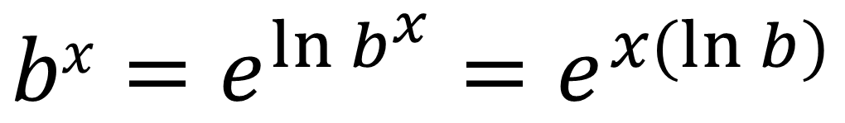
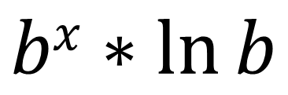
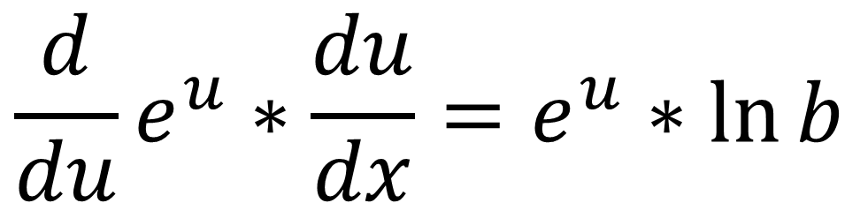
$$bx=e^{\ln{b^{x}}}=e^{x(\ln{b})}$$
$$\frac{d}{dx}x\left(\ln{b}\right)=\ln{b}∗\frac{d}{dx}x=\ln{b}$$
$$\frac{d}{du}e^{u}∗\frac{du}{dx}=e^{u}∗\ln{b}$$
$$bx∗\ln{b}$$

Slide 4
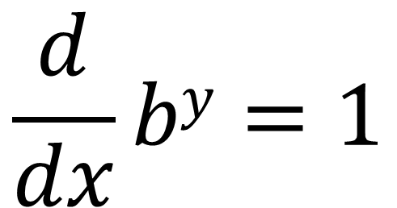
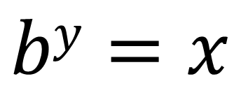
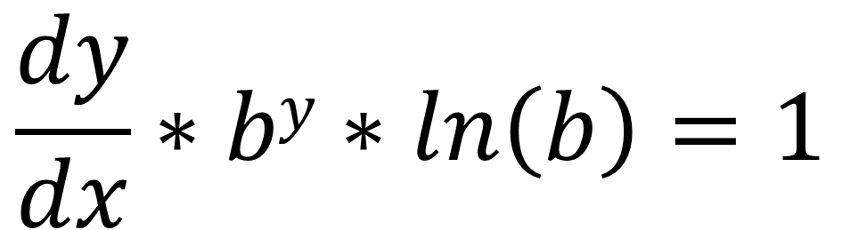
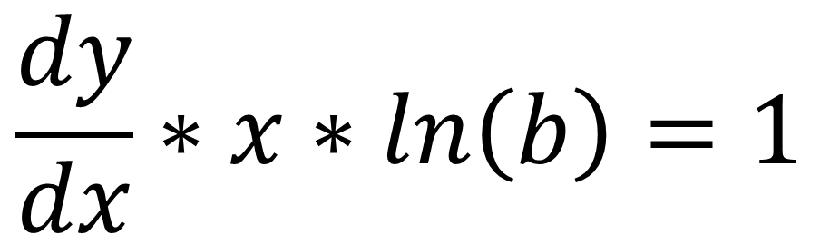
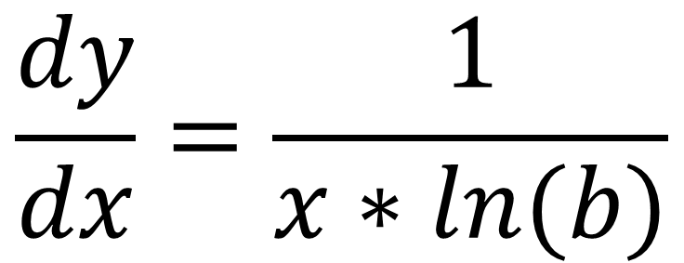
$$\frac{d}{dx}by=1$$
$$by=x$$
$$\frac{dy}{dx}=\frac{1}{x∗ln(b)}$$
$$\frac{dy}{dx}∗x∗ln\left(b\right)=1$$
$$\frac{dy}{dx}∗by∗ln\left(b\right)=1$$

Slide 5
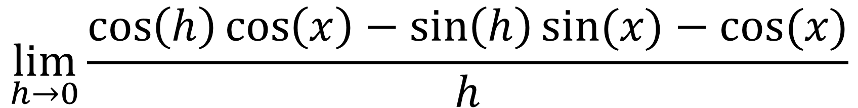
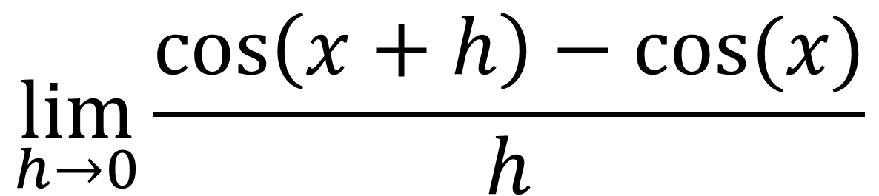
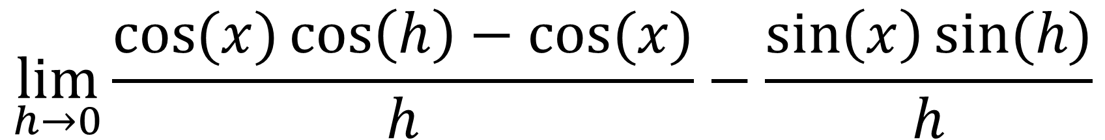
$$\lim_{h→0}{\frac{\cos\left(x+h\right)−cos⁡(x)}{h}}$$
$$\lim_{h→0}{\frac{\cos\left(h\right)\cos\left(x\right)−\sin\left(h\right)sin⁡(x)−cos⁡(x)}{h}}$$
$$\lim_{h→0}{\frac{\cos{(x)}\cos\left(h\right)−cos⁡(x)}{h}−\frac{\sin\left(x\right)sin⁡(h)}{h}}$$

Slide 6
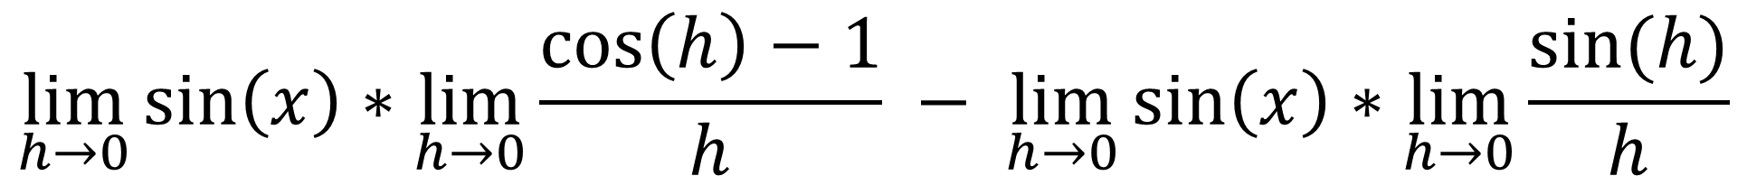
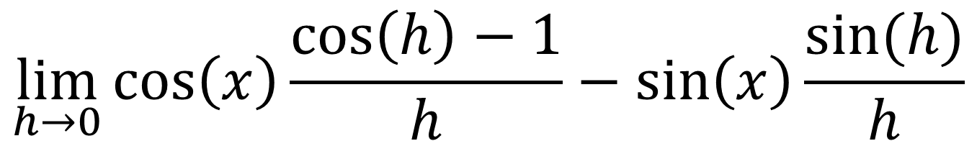
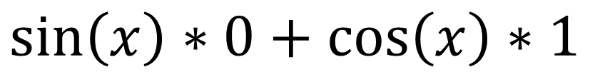
$$\lim_{h→0}{\cos\left(x\right)\frac{\cos\left(h\right)−1}{h}−\sin\left(x\right)\frac{sin⁡(h)}{h}}$$
$$\lim_{h→0}{\sin\left(x\right)∗\lim_{h→0}\frac{\cos\left(h\right)−1}{h} − \lim_{h→0}\sin\left(x\right)∗\lim_{h→0}\frac{sin⁡(h)}{h}}$$
$$\sin\left(x\right)∗0+\cos\left(x\right)∗1$$
$$\cos\left(x\right)$$

