Slide 1
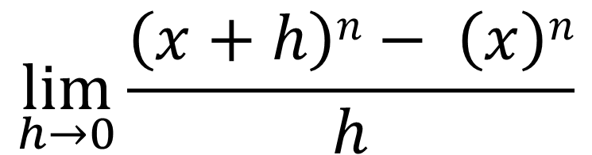
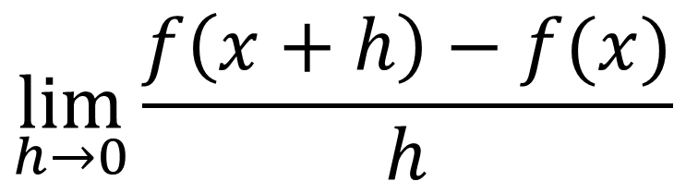
$$\lim_{h→0}{\frac{f\left(x+h\right)−f(x)}{h}}$$
$$\lim_{h→0}{\frac{\left(x+h\right)n− \left(x\right)n}{h}}$$
$$\lim_{h→0}\left({n \atop 1}\right)xn_1h0+\left({n \atop 2}\right)xn_2h1+…+\left({n \atop n−1}\right)x1hn_2+\left({n \atop n}\right)x0hn_1$$
$$\lim_{h→0}{\frac{ \left(\left({n \atop 0}\right)xnh0+\left({n \atop 1}\right)xn_1h1+\left({n \atop 2}\right)xn_2h2+…+\left({n \atop n−1}\right)x1hn_1+\left({n \atop n}\right)x0hn\right)−\left(x\right)n}{h}}$$

Slide 2
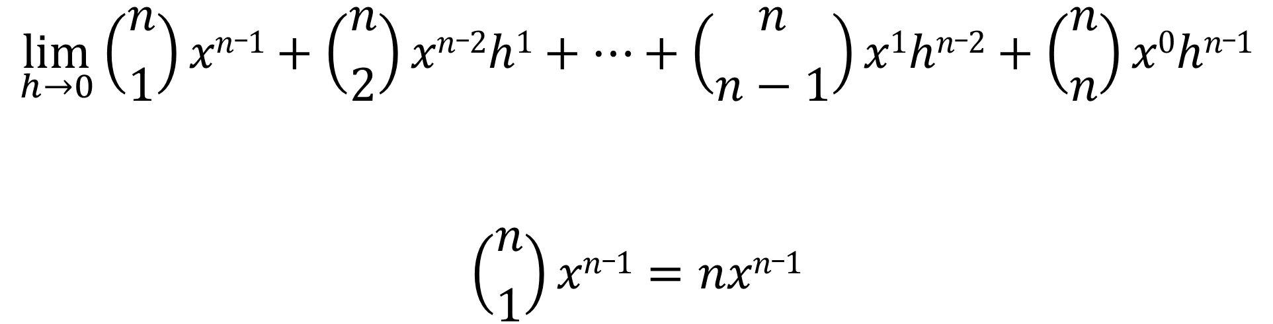
$$\lim_{h→0}\left({n \atop 1}\right)xn_1+\left({n \atop 2}\right)xn_2h1+…+\left({n \atop n−1}\right)x1hn_2+\left({n \atop n}\right)x0hn_1$$
$$\left({n \atop 1}\right)xn_1=nxn_1$$

Slide 3
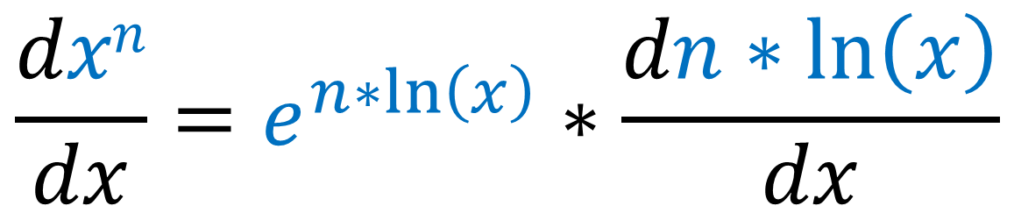
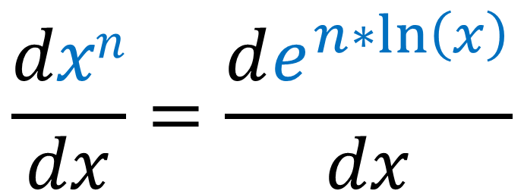
$$\frac{dxn}{dx}=\frac{de^{n∗\ln\left(x\right)}}{dx}$$
Chain Rule
$$\frac{dxn}{dx}=e^{n∗\ln\left(x\right)}∗\frac{dn∗\ln\left(x\right)}{dx}$$

Slide 4
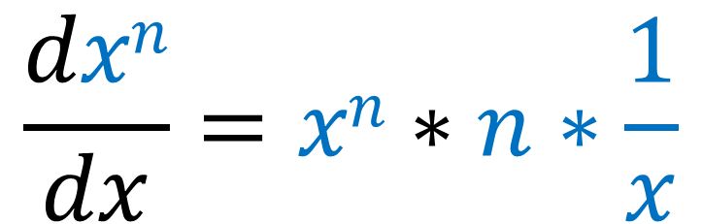
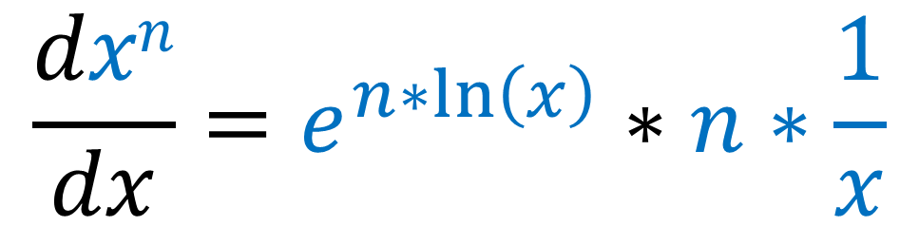
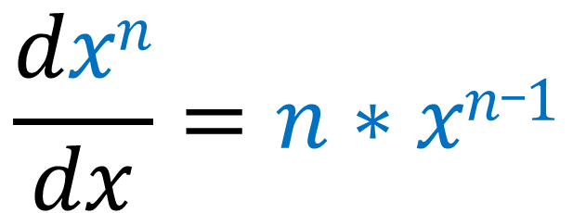
$$\frac{dxn}{dx}=e^{n∗\ln\left(x\right)}∗n∗\frac{1}{x}$$
$$\frac{dxn}{dx}=xn∗n∗\frac{1}{x}$$
$$\frac{dxn}{dx}=n∗xn_1$$

