Slide 1
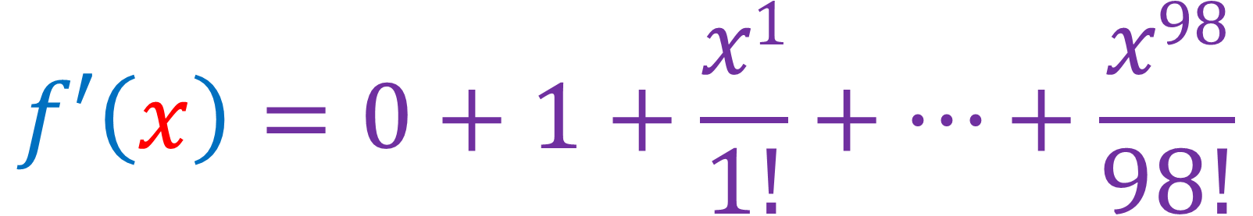
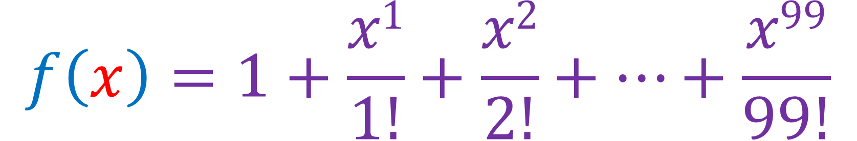
$$f\left(x\right)=1+\frac{x1}{1!}+\frac{x2}{2!}+…+\frac{x99}{99!}$$
$$f′\left(x\right)=0+1+\frac{x1}{1!}+…+\frac{x98}{98!}$$

Slide 2
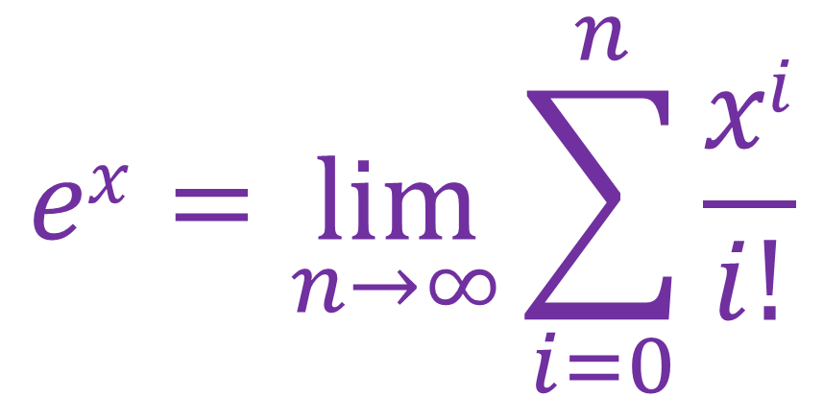
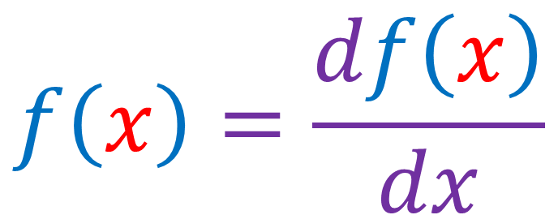
$$ex=\lim_{n→∞}{\sum_{i=0}^{n}{\frac{xi}{i!}}}$$
$$f\left(x\right)=\frac{df\left(x\right)}{dx}$$

