Slide 1
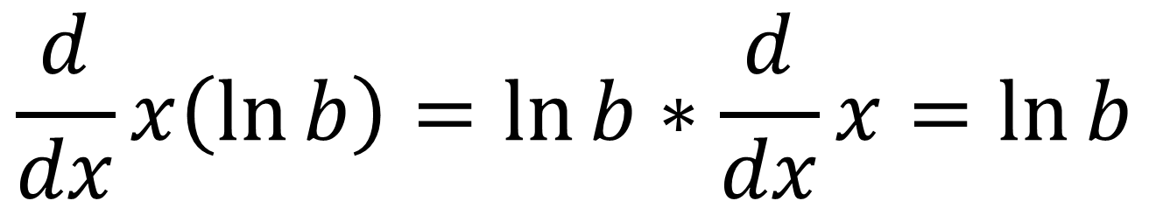
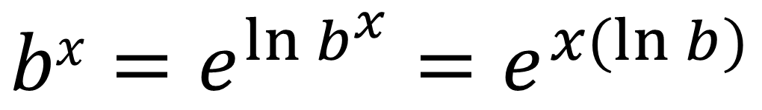
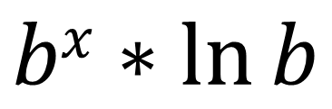
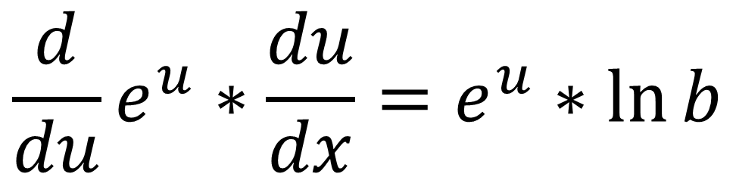
$$bx=e^{\ln{b^{x}}}=e^{x(\ln{b})}$$
$$\frac{d}{dx}x\left(\ln{b}\right)=\ln{b}∗\frac{d}{dx}x=\ln{b}$$
$$\frac{d}{du}e^{u}∗\frac{du}{dx}=e^{u}∗\ln{b}$$
$$bx∗\ln{b}$$

Slide 2
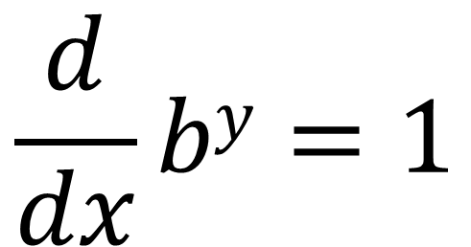
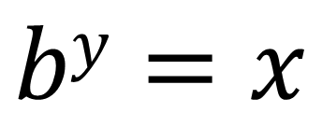
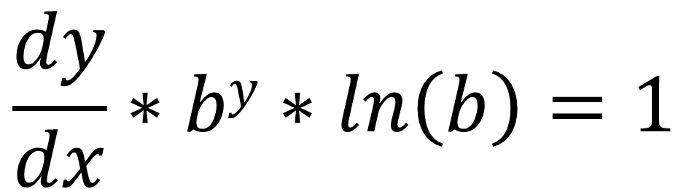
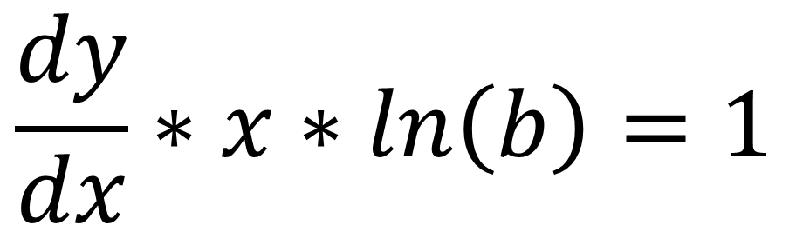
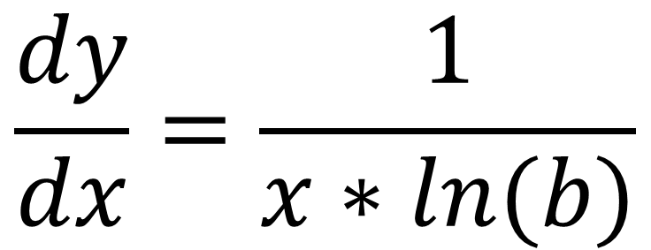
$$\frac{d}{dx}by=1$$
$$by=x$$
$$\frac{dy}{dx}=\frac{1}{x∗ln(b)}$$
$$\frac{dy}{dx}∗x∗ln\left(b\right)=1$$
$$\frac{dy}{dx}∗by∗ln\left(b\right)=1$$

