Slide 1

M
θ
N

Slide 2
M
θ
N

Slide 3

$$cos⁡(\text{θ})$$
Smaller circle
θ

Slide 4
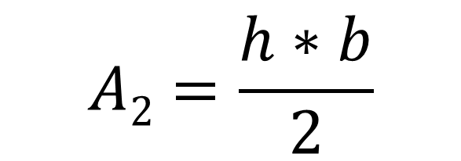


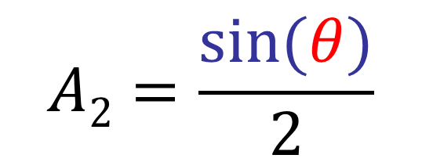
$$A3=π∗{cos⁡(θ) }^{2}∗\frac{θ}{2π}$$
$$A3=\frac{{cos⁡(θ) }^{2}∗θ}{2}$$
$$A2=\frac{h∗b}{2}$$
$$A2=\frac{sin⁡(θ)}{2}$$

Slide 5

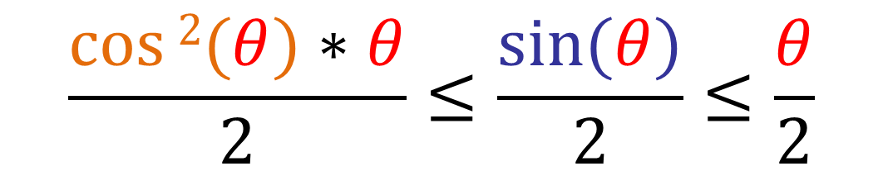

$$\frac{cos⁡2(θ)∗θ}{2}≤\frac{sin⁡(θ)}{2}≤\frac{θ}{2}$$
$$\lim_{θ→0}(\cos{2\left(θ\right)})≤\lim_{θ→0}\left(\frac{\sin\left(θ\right)}{θ}\right)≤\lim_{θ→0}(1)$$
$$\lim_{θ→0}(\cos{2\left(θ\right)})≤\lim_{θ→0}\left(\frac{\sin\left(θ\right)}{θ}\right)≤1$$

Slide 6


$$\lim_{x→a}f\left(g\left(x\right)\right)=f\left(\lim_{x→a}\left(g\left(x\right)\right)\right)$$
$$f\left(g\left(x\right)\right)=\sqrt[n]{g\left(x\right)}$$
$$\sqrt[n]{\lim_{x→a}g\left(x\right)}=\lim_{x→a}\sqrt[n]{g\left(x\right)}$$

Slide 7

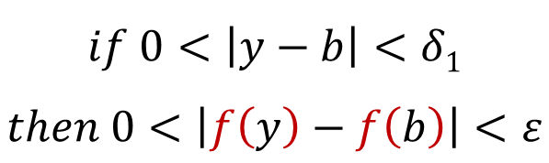
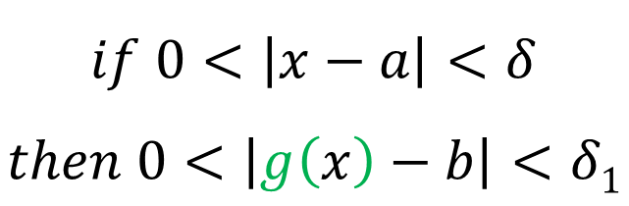
$$if f continous at b and \lim_{x→a}g\left(x\right)=f\left(b\right),then$$
$$if 0<\left|y−b\right|<δ1$$
$$then 0<\left|f\left(y\right)−f\left(b\right)\right|<ε$$
$$\lim_{y→b}f\left(y\right)=f\left(b\right)$$
$$if 0<\left|x−a\right|<δ$$
$$then 0<\left|g\left(x\right)−b\right|<δ1$$

Slide 8
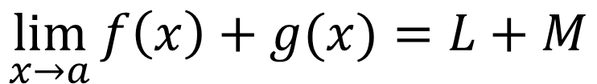
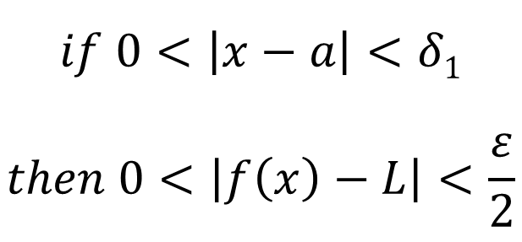
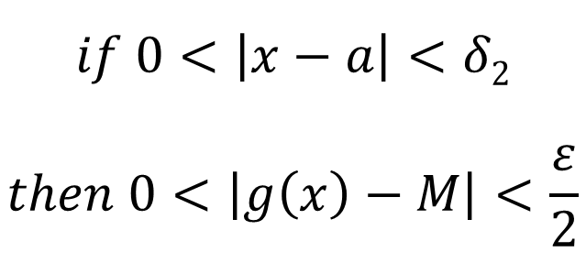
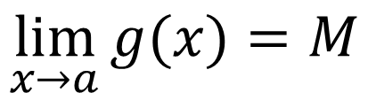
$$\lim_{x→a}{f\left(x\right)+g(x)}=L+M$$
$$\lim_{x→a}{g(x)}=M$$
$$if 0<\left|x−a\right|<δ1$$
$$then 0<\left|f\left(x\right)−L\right|<\frac{ε}{2}$$
$$if 0<\left|x−a\right|<δ2$$
$$then 0<\left|g\left(x\right)−M\right|<\frac{ε}{2}$$

Slide 9
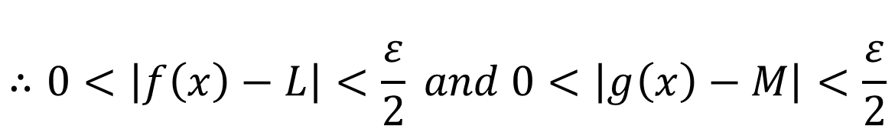
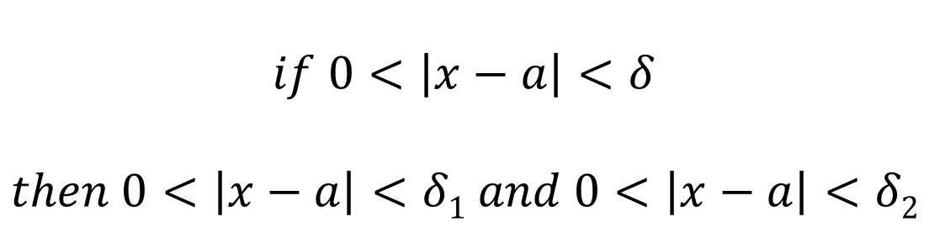
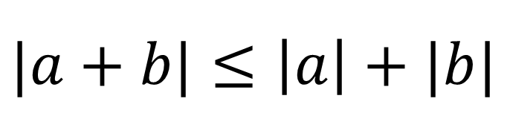
$$if 0<\left|x−a\right|<δ$$
$$then 0<\left|x−a\right|<δ1 and 0<\left|x−a\right|<δ2$$
$$∴0<\left|f\left(x\right)−L\right|<\frac{ε}{2} and 0<\left|g\left(x\right)−M\right|<\frac{ε}{2}$$
$$|a+b|≤\left|a\right|+|b|$$

Slide 10
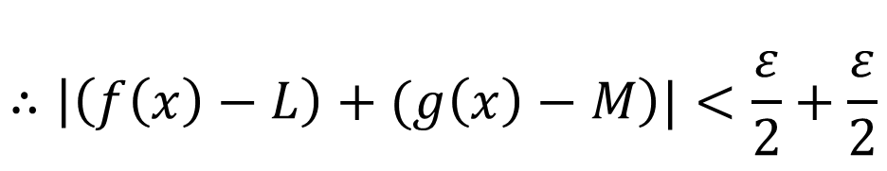
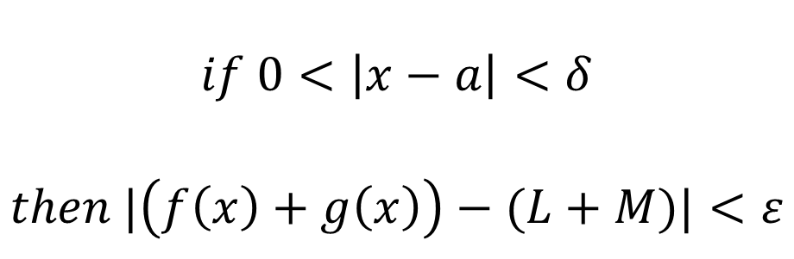

$$\left|\left(f\left(x\right)−L\right)+(g\left(x\right)−M\right)|≤\left|f\left(x\right)−L\right|+\left|g\left(x\right)−M\right|$$
$$∴\left|\left(f\left(x\right)−L\right)+(g\left(x\right)−M\right)|<\frac{ε}{2}+\frac{ε}{2}$$
$$∴$$
$$if 0<\left|x−a\right|<δ$$
$$then |\left(f\left(x\right)+g\left(x\right)\right)−(L+M)|<ε$$

Slide 11
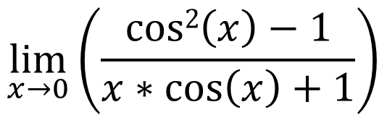
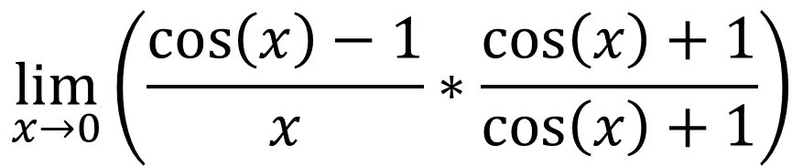
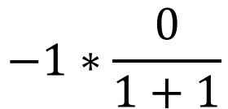
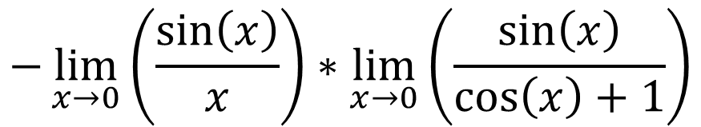
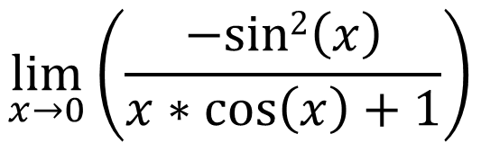
$$\lim_{x→0}\left(\frac{\cos\left(x\right)−1}{x}∗\frac{cos⁡\left(x\right)+1}{cos⁡\left(x\right)+1}\right)$$
$$\lim_{x→0}\left(\frac{cos2\left(x\right)−1}{x∗cos⁡\left(x\right)+1}\right)$$
$$\lim_{x→0}\left(\frac{−sin2\left(x\right)}{x∗cos⁡\left(x\right)+1}\right)$$
$$−\lim_{x→0}\left(\frac{\sin\left(x\right)}{x}\right)∗\lim_{x→0}\left(\frac{\sin\left(x\right)}{\cos\left(x\right)+1}\right)$$
$$−1∗\frac{0}{1+1}$$

Slide 12

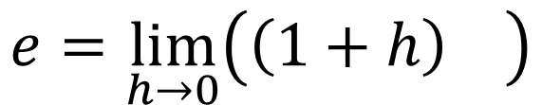
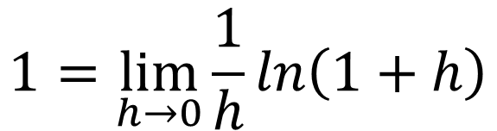


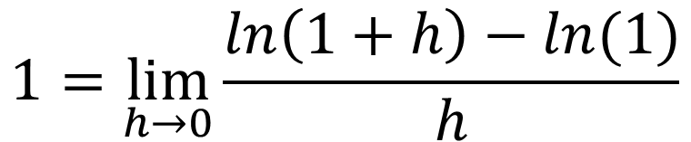




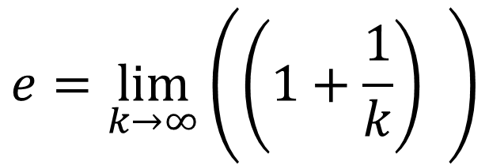




$$1=\lim_{h→0}{\frac{ln\left(1+h\right)−ln(1)}{h}}$$
$$e=\lim_{h→0}\left(\left(1+h\right) \right)$$
$$1/h$$
$$e=\lim_{k→∞}\left(\left(1+\frac{1}{k}\right) \right)$$
$$k$$
$$1=\lim_{h→0}{\frac{1}{h}ln\left(1+h\right)}$$
$$1/h$$
$$1 \lim_{h→0}{ln\left(\left(1+h\right) \right)}$$
$$e$$
$$=e$$
$$1/h$$
$$ln\left(\left(1+h\right) \right)$$
$$e$$
$$\lim_{h→0}{ }$$
$$= e$$

Slide 13

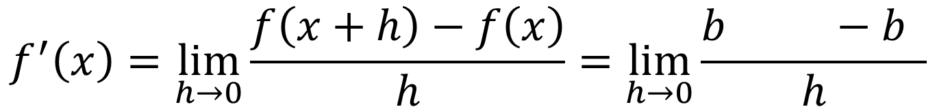
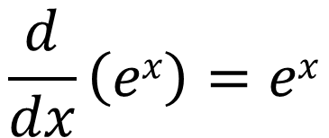
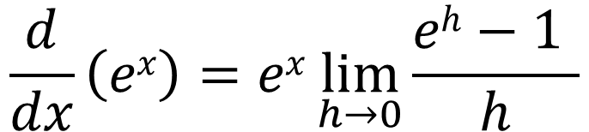
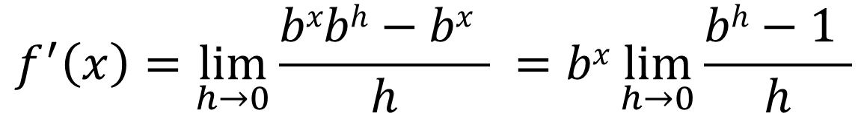
$$\left(x+h\right) x$$
$$f^{′}\left(x\right)=\lim_{h→0}{\frac{f\left(x+h\right)−f\left(x\right)}{h}}=\lim_{h→0}{\frac{b −b }{h}}$$
$$f^{′}\left(x\right)=\lim_{h→0}{\frac{bxbh−bx }{h}} =bx\lim_{h→0}{\frac{bh−1 }{h}}$$
$$\frac{d}{dx}\left(ex\right)=ex\lim_{h→0}{\frac{eh−1 }{h}}$$
$$\frac{d}{dx}\left(ex\right)=ex$$

Slide 14
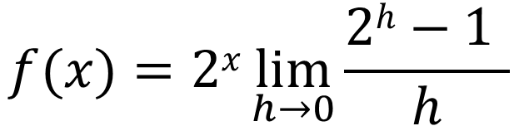
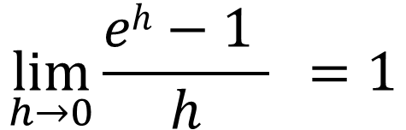
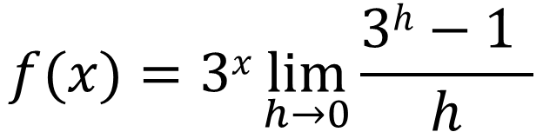
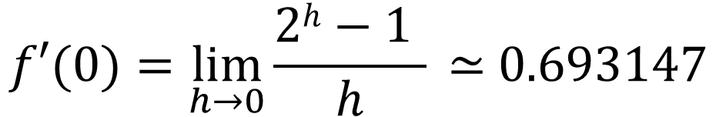
$$f(x)=2x\lim_{h→0}{\frac{2h−1 }{h}}$$
$$f(x)=3x\lim_{h→0}{\frac{3h−1 }{h}}$$
$$f′(0)=\lim_{h→0}{\frac{2h−1 }{h}} \text{≃} 0.693147$$
$$\lim_{h→0}{\frac{eh−1 }{h}} =1$$

Slide 15
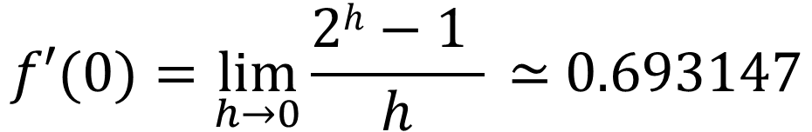
$$f′(0)=\lim_{h→0}{\frac{2h−1 }{h}} \text{≃} 0.693147$$

