Slide 1
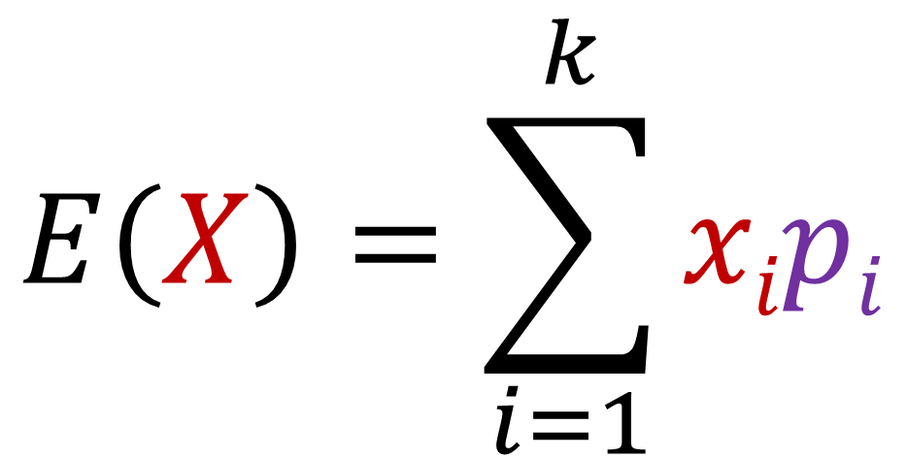
$$E\left(X\right)=\sum_{i=1}^{k}{xipi}$$
$$E\left(X\right)=x1p1+x2p2+…+xkpk$$

