Slide 1
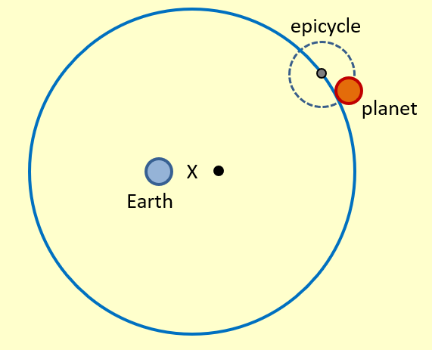
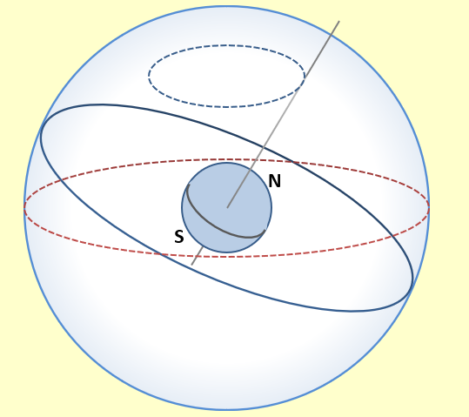
Learn about the geocentric model, what almost everyone believed until the European Renaissance

Slide 2
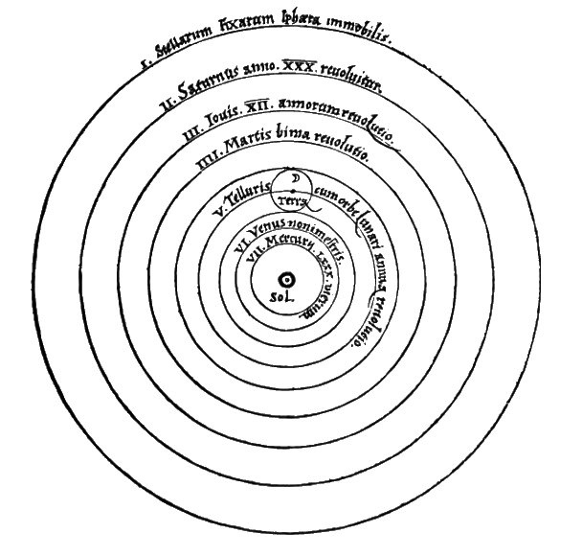
Learn about Nicolaus Copernicus and his book, De revolutionibus orbium coelestium, where he presents a model of the universe that placed the Sun at the center.

Slide 3
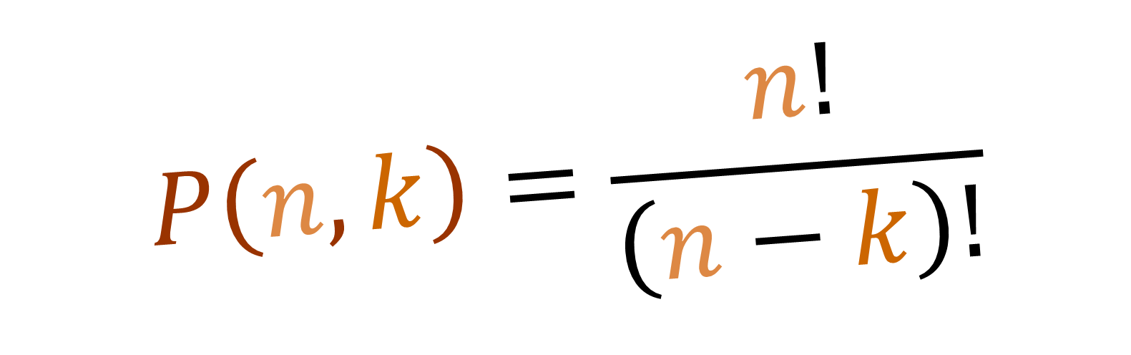
Learn about permutations (the number of different ways we can make a group of k elements from a larger group of n elements).
$$P\left(n,k\right)=\frac{n!}{\left(n−k\right)!}$$

Slide 4


Learn about the phlogiston theory, a superseded scientific theory that postulated that a fire-like element called phlogiston is contained within combustible bodies and released during combustion
O R E
M E T A L
$$+ PHLOGISTON =$$
M E T A L
R U S T
$$− PHLOGISTON =$$

Slide 5
