Slide 1
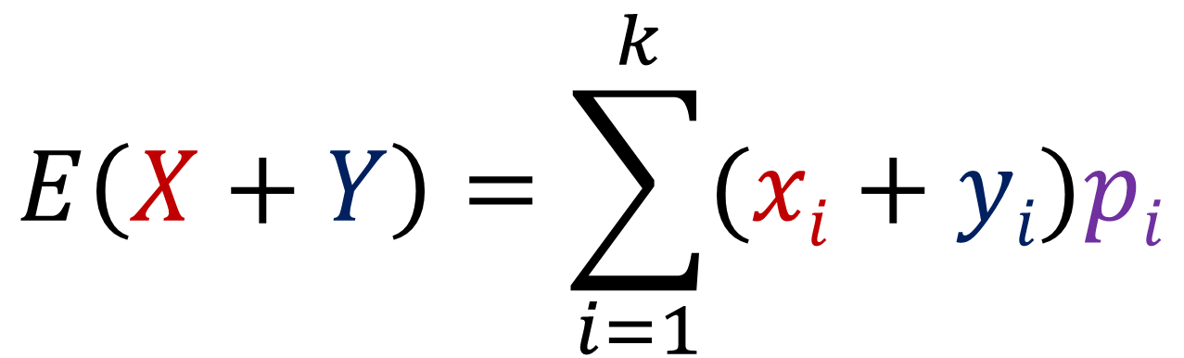
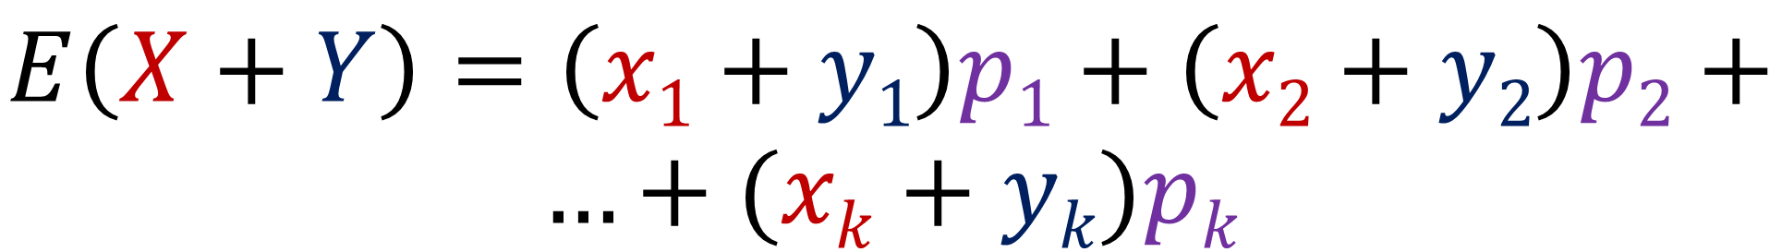
$$E\left(X+Y\right)=\sum_{i=1}^{k}{(xi+yi)pi}$$
$$E\left(X+Y\right)=\left(x1+y1\right)p1+\left(x2+y2\right)p2+$$
$$…+(xk+yk)pk$$

Slide 2
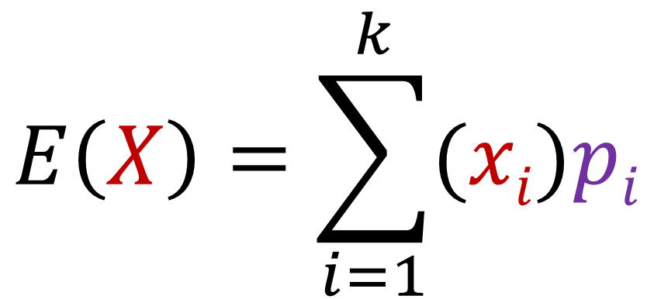

$$E\left(X\right)=\sum_{i=1}^{k}{(xi)pi}$$
$$E\left(X\right)=\left(x1\right)p1+\left(x2\right)p2+$$
$$…+xipk$$

Slide 3
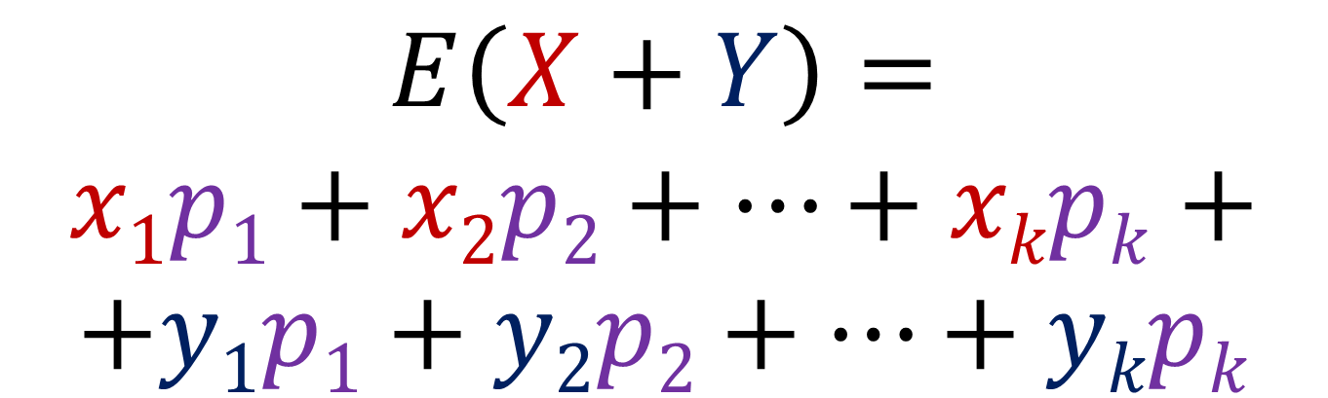
$$E\left(X+Y\right)=$$
$$x1p1+x2p2+…+xkpk+$$
$$+y1p1+y2p2+…+ykpk$$
$$E\left(X+Y\right)=E\left(X\right)+E\left(Y\right)$$

