Slide 1
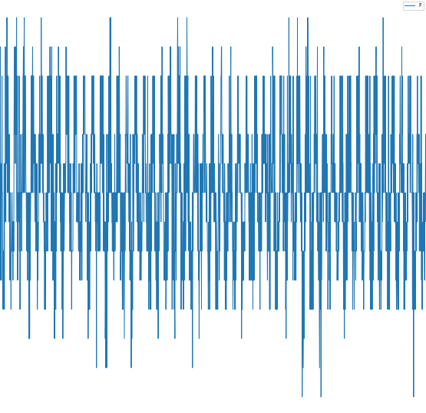
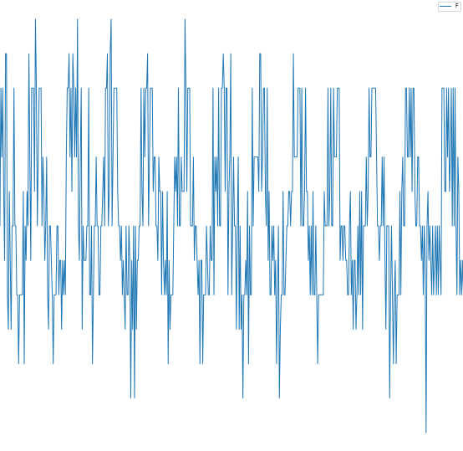
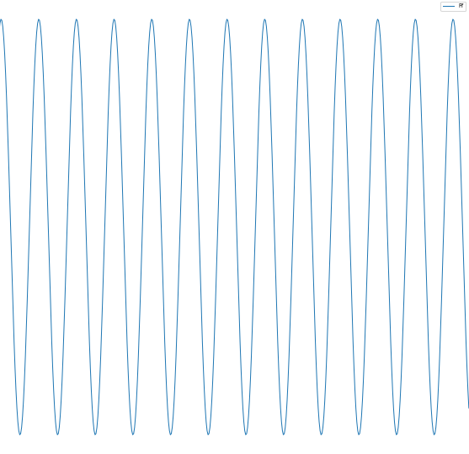

N >= 12000
N = 8000
= 2000
$$σ, ε, E$$
N = 2000
N = 2000
N = 2000

Slide 2














$$t, N_{total}>12000$$
$$n_{1}=2000$$
$$n_{2}=2000$$
$$n_{3}=2000$$
$$n_{4}=2000$$
Calibration
Measurements
$$σ$$
$$FFT \& IFFT$$
$$σ$$
$$E$$
$$ε$$
$$ε$$
Processing & Evaluation
$$Repeat for all subgroups and$$
$$overlay stress−strain curves$$
$$σ$$
$$ε$$

Slide 3
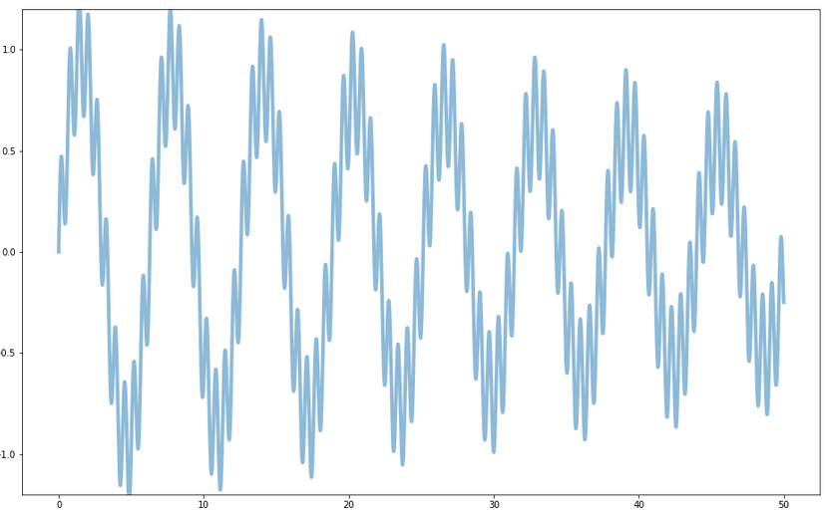
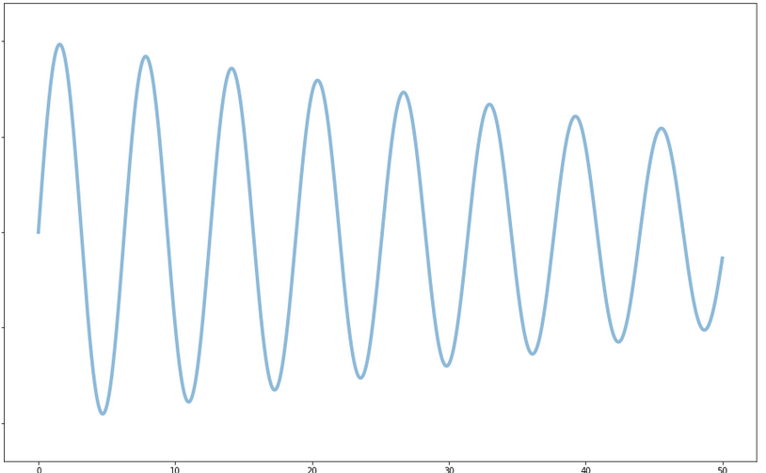




$$t, N_{total}>12000$$
$$n_{1}=2000$$
$$n_{2}=2000$$
$$n_{3}=2000$$
$$n_{4}=2000$$
Calibration
Measurements
I
$$F$$
II
IIIa
$$D$$
$$F$$
IV
$$E$$
$$D$$
IIIb
Processing & Evaluation

Slide 4





$$t, N_{total}>12000$$
$$n_{1}=2000$$
$$n_{2}=2000$$
$$n_{3}=2000$$
$$n_{4}=2000$$
Calibration
Measurements
I
$$σ$$
II
$$FFT \& IFFT$$
IIIa
$$ε$$
$$σ$$
IV
$$E$$
$$ε$$
IIIb
Processing & Evaluation

