Slide 1
Good Coding Style & Git
2/12/20

Slide 2
Coding Style Guide Overview

Slide 3
What is a coding style?
Wikipedia says, “a code style is a set of rules or guidelines used when writing the source code for a computer program.”
Rules address topics including (but not limited to):
Variable/function naming
Indentation
Commenting
Import statements
https://en.wikipedia.org/wiki/Programming_style
Notes:
https://en.wikipedia.org/wiki/Programming_style

Slide 4
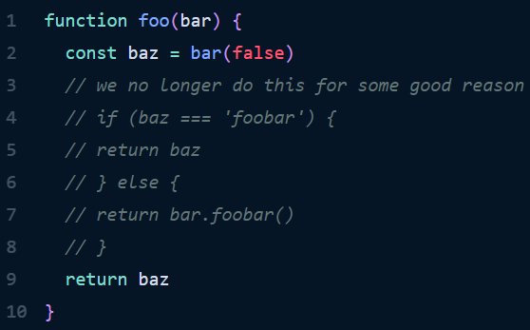
Why do we care about coding style?
Your program works? Great!
Now let’s say someone else wants to contribute and they see this:
https://kentcdodds.com/blog/please-dont-commit-commented-out-code
Notes:
https://kentcdodds.com/blog/please-dont-commit-commented-out-code

Slide 5
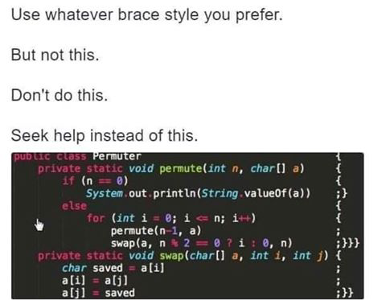
Inconsistent coding style results in:
Potential misunderstanding of code functionality between team members
Difficulty in finding bugs, and delays in project timeline
Increase in source control changes
Messy code, late nights, sadness, and major headaches
https://www.pinterest.com/pin/642607440552221963/
Notes:
https://www.pinterest.com/pin/642607440552221963/

Slide 6
Examples of widely used coding styles
Python
PEP8 (what I’ll be going over today)
Google’s Python Style Guide
C++
Google’s C++ Style Guide
C++ Core Guidelines
ROS
Python: http://wiki.ros.org/PyStyleGuide (extension of PEP8)
C++: http://wiki.ros.org/CppStyleGuide (extension of Google’s C++ Style Guide)
Other style guides from Google: http://google.github.io/styleguide/

Slide 7
PEP8 Guidelines

Slide 8
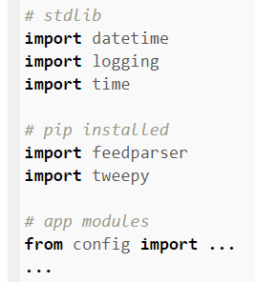
Import Statements
Write import statements on separate lines
Split statements into 3 groups:
Python Standard Library
Related 3rd party
Local application
Use specific absolute imports
Why?
Relative imports are gone in Python 3
More organized and cleaner to read
Python will give better error messages when using absolute import statements
https://pybit.es/pep8.html
Notes:
https://pybit.es/pep8.html
https://www.python.org/dev/peps/pep-0008/#imports

Slide 9
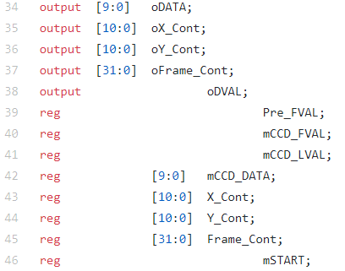
War of Tabs vs Space Indentation
Rule 1 of Python: don’t mix tab and space usage!
Python 3 does not allow mixing of tabs and spaces (Python 2 does)
It’s recommended to use 4 spaces to indent rather than tab
Different IDE’s output tabs differently, so I think it’s best to use 4 spaces as well
Notes:
https://www.python.org/dev/peps/pep-0008/#indentation

Slide 10
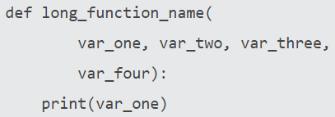
Line Character Limit & Whitespaces
Limit any line to having a maximum of 79 characters; here are some tips:
Avoid unnecessary whitespaces when:
Put function arguments on separate lines when long line of args
Situation | Example of Good Syntax
Inside parenthesis | (x[1], {Y: 2})
Right before comma, semicolon, or colon | print x, y; x, y = y, x
Right before parenthesis or bracket | return foo([0, 1, 2])
https://www.python.org/dev/peps/pep-0008/#indentation
Notes:
https://www.python.org/dev/peps/pep-0008/#pet-peeves
https://www.python.org/dev/peps/pep-0008/#indentation

Slide 11
Naming Conventions
Don’t use lowercase l (‘el’), uppercase O (‘oh’), or uppercase I (‘eye’) as names
Type | Convention | Examples
function | Lowercase words separated with underscores | my_function, function
variable | Lowercase words or letter separated with underscores | x, var, my_var
class | Start each word with a capital letter, not separated (camel case) | Class, MyClass
constant | Uppercase words or letter separated with underscores | CONSTANT, MY_CONSTANT
Notes:
https://realpython.com/python-pep8/#naming-conventions

Slide 12
# Comments
Use comments to explain “why you do something,” not what you’re doing
For example:
X = X + 1 # Increment vs X = X + 1 # Compensate for border ✔️
Comment Type | Convention | Example
Inline | Use sparingly, put at least 2 spaces between statement & comment | print(“hello”) # User intro
Block | Indent to same level as code, and each line begins with a # | # Return result of quadratic # equation formula return x_1, x_2
Documentation String | Enclosed in “”” “””, and appears on first line of func to describe functionality | “””Use the quadratic formula””” X_1 = arg
Notes:
https://realpython.com/python-pep8/#comments
https://www.python.org/dev/peps/pep-0008/#comments

Slide 13
PEP8 Style Checker - pycodestyle
pycodestyle is a python package that can tell you where there are lines of code that go against PEP8 conventions
https://pypi.org/project/pycodestyle/
Install package with ‘pip install pycodestyle’
Output lines that go against convention with ‘pycodestyle --first <file.py>’

Slide 14
Questions so far before we move onto Git?
As a recap, so far we’ve gone over:
What is a coding style, and why are they important
Examples of coding style guides
PEP8 guide for Python
Imports
Indentation
Whitespaces
Naming
comments

Slide 15
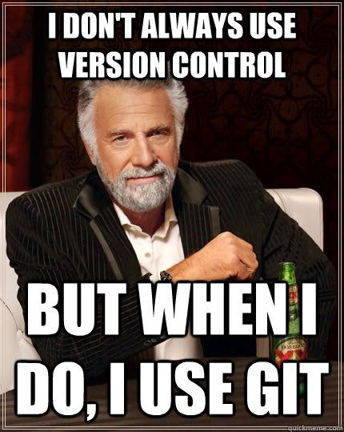
Time to ‘Git’ our game on!
https://codeburst.io/git-good-part-a-e0d826286a2a?gi=c08ae8342c92

Slide 16
What is a version control system (VCS)?
A VCS is a system that records changes to file(s) over time
This lets you recall specific versions whenever you want
VCS allows you to:
Revert files to another state
Revert the entire project to another state
Compare changes over time
See who introduced a specific change and when
And much much more!
This is great because if any of your files mess up at any point, you can go back to a previous working state

Slide 17
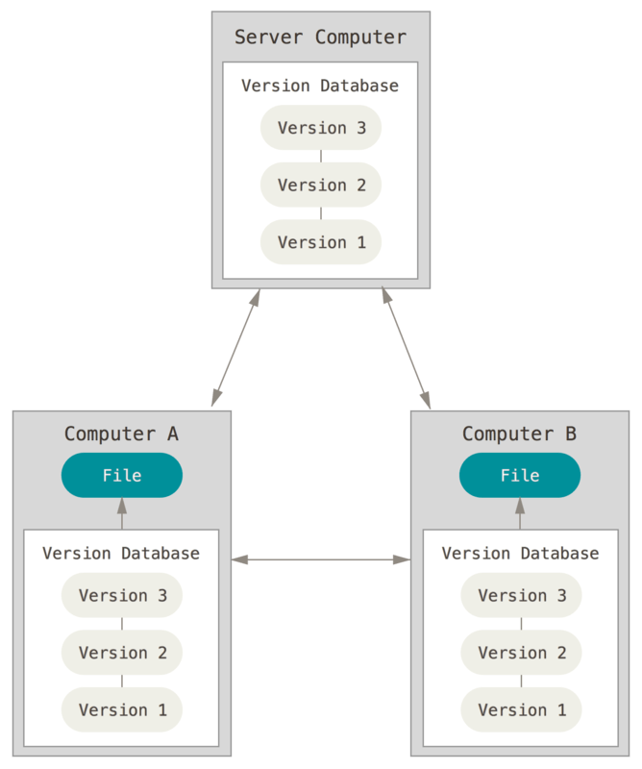
Then what’s Git?
Git is an example of a Distributed Version Control System (DVCS)
In a DVCS, clients check out an entire snapshot of the latest version of the repository, including its full history of changes
That way, if the server goes down, a client can push their local version to the server, and bring it back up to speed
From The Official Git Pro Book

Slide 18
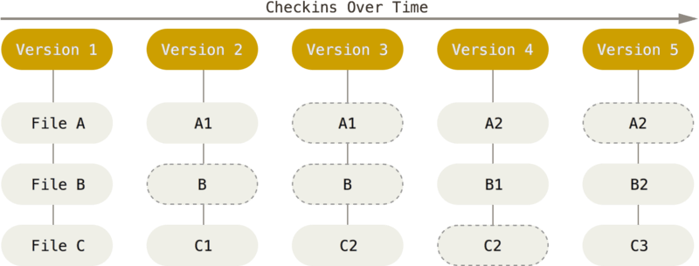
Basics of Git (1)
Git stores a series of snapshots of a project (filesystem)
When you change a local file, and then save the state of the project, Git takes a pic of what your files look like at that moment, and stores a reference to that snap
From The Official Git Pro Book

Slide 19
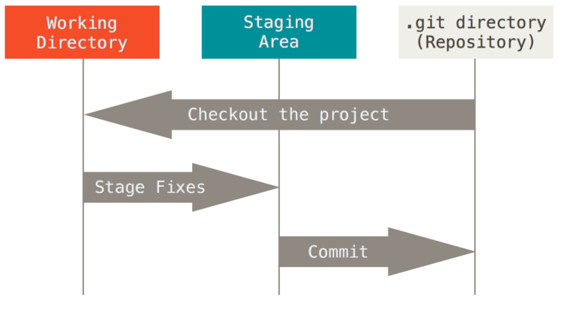
Basics of Git (2)
Files in a Git project are in 1 of 3 states at any time:
Modified
You’ve changed the file, but have not committed it to your local database yet
Staged
You’ve marked a modified file to go into your next commit snapshot
Committed
The data is safely stored in your local database
From The Official Git Pro Book

Slide 20
Getting Started with Git
Install Git on your local comp
Find your OS and install from here: https://git-scm.com/book/en/v2/Getting-Started-Installing-Git
First time Git setup for local comp
Open up a terminal
Look at your current git settings with ‘git config --list --show-origin’
Setup your identity with ‘git config --global user.name “<FirstName LastName>” ’ ‘git config --global user.email “<email@address.com>” ’
If you ever need help understanding what a command does, use ‘git help’

Slide 21
Getting a Git Repository
There are two ways to get a Git repo on your computer
You can turn a local directory that is not under version control into a Git repo
'cd </path/to/my/project>’
'git init’
Currently files aren’t being tracked yet, I’ll go over how to save them in the next slide
You can clone an existing Git repository onto your local computer
'cd </path/to/where/you/want/to/store/project>’
'git clone <url_of_repo> <name_you_want_to_call_folder>’
Notes:
https://help.github.com/en/github/importing-your-projects-to-github/adding-an-existing-project-to-github-using-the-command-line

Slide 22
Recording Basic Changes to Files
To see the status of which files in your git repo are untracked, unmodified, modified, or staged, use ‘git status’
To track an untracked file, or stage changes of a file, use ‘git add <filename>’
To stage changes of all files in current directory, use ‘git add .’
To stage changes of all files in current dir and all sub dirs, use ‘git add -A’
You can choose to ignore certain files when you use the add command with a gitignore file
Now you can commit those staged changes (take a new pic of the project) with ‘git commit -m “<message describing changes>” ’

Slide 23
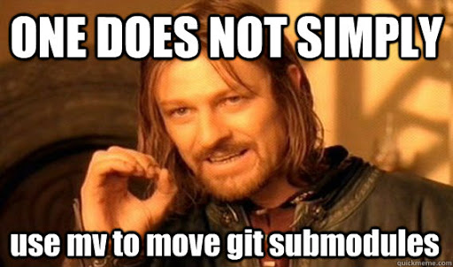
Removing or Renaming Files
To remove a file from Git
delete file from directory
execute ‘git rm’ to stage file’s removal
‘git commit -m “<commit_message>” ‘
To keep file in working directory, but remove from staging area (could happen if you forgot to make a gitignore file)
‘git rm --cached <filename>’
To rename a file
‘git mv <curr_file_name> <new_file_name>’
http://www.quickmeme.com/meme/3vkgy5

Slide 24
Undoing stuff
If you accidentally forgot to add some files in a commit, or want to change commit message
After your initial commit, run ‘git add <forgotten_file>’
Then run ‘git commit --amend’
you’ll end up with a single commit, instead of two of them
To unstage a staged file
Run ‘git reset HEAD <file_name_to_unstage>’
To unmodify a modified file
‘git checkout -- <file_name_to_revert>’
ONLY RUN if you know you don’t want those unsaved local changes

Slide 25
Working with Remotes
When you clone a repository, your local copy is able to communicate to the server you cloned from, called “origin”
Run ‘git remote -v’ to see the remote servers, and their given names
We can add more remote repositories by ourselves with ‘git remote add <short_name> <url_of _server>’
To fetch, pull, and merge changes from a remote into your local repo
‘git pull <remote_short_name> <remote_branch_to_pull_from>’
To push your changes to remote
‘git push <remote_short_name> <local_branch_to_push_up>’

Slide 26
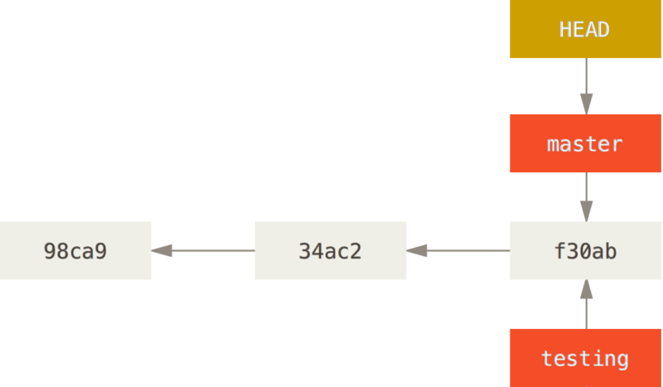
What’s a branch?
Remember, when we commit something on Git, it takes a snapshot of the current state of the project, and stores it with a history of all past snapshots.
Looks something like this tree, where each node is a committed snapshot:
‘master’, ‘testing’, and ‘HEAD’ are pointers to a certain commit Or you can call them branches
‘HEAD’ is a special pointer that points to the current local branch you’re working on
Here, you’re working on master, but you also have another branch called ‘testing’ pointing to the same commit
From The Official Git Pro Book

Slide 27
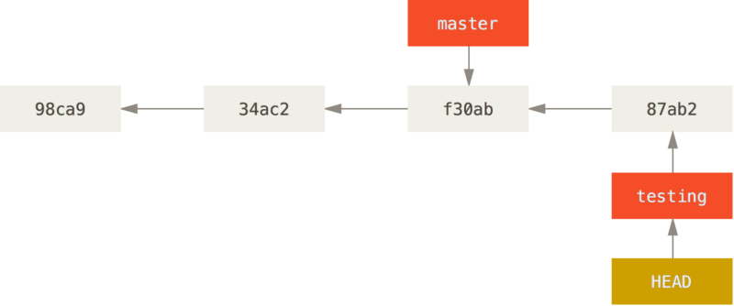
Branch Command Basics
To create a new branch, use ‘git branch <branch_name>’
This doesn’t switch you to that branch! To switch, use ‘git checkout <branch_to_switch_to>’
Switching branches changes your directory files to how they looked at that commit
For example, let’s say we add a new commit to the testing branch, then our commit tree will look like this:
From The Official Git Pro Book

Slide 28
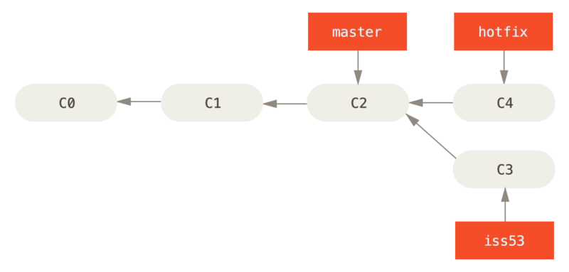
Divergent Branches and Merging (1)
Let’s say you’re in a situation where you’ve been working on ticket issue 53 for your project, and you got called saying you have to apply a hotfix for another problem immediately. Your tree may look like this:
From The Official Git Pro Book

Slide 29
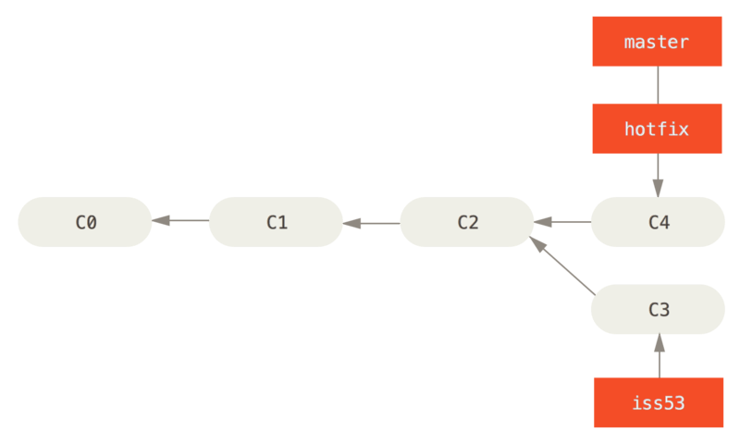
Divergent Branches and Merging (2)
We can deploy the hotfix changes to the master branch by running:
‘git checkout master’
‘git merge hotfix’
Now that we’re done with the hotfix pointer, we can delete it with ‘git branch -d <branch_to_delete>’
From The Official Git Pro Book

Slide 30
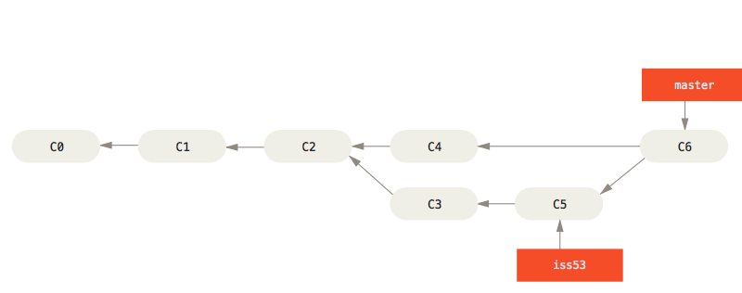
Divergent Branches and Merging (3)
After a few more commits in your iss53 branch, you’re ready to merge that work into master
Similar to the hotfix merge, we can run
‘git checkout master’
‘git merge iss53’
Delete the iss53 pointer with ‘git branch -d iss53’
From The Official Git Pro Book

Slide 31
Conflicts & Useful Branch Commands
If you try to merge two branches that modified the same file, Git will tell you to fix the merge conflict by choosing which of the two changes to keep in the merge.
Run ‘git mergetool’ to open a GUI to resolve the issues
To see all of your local branches with their latest commit message, run ‘git branch -v’
A star will be next to your current branch
To see all branches that have been merged into your current branch, run ‘git branch --merged’
Similarly, use ‘no-merged’ to see branches that haven’t been merged in yet

Slide 32
Git Resources
The Official Git Book
Good README Format
https://try.github.io/
Git & Github Resources
https://www.atlassian.com/git

Slide 33

Thanks for listening!
Any questions?
https://www.datafriends.rocks/single-post/Why-Git

