Slide 1
TrustPilot Scraper Initial Output Discussion
2023-11-27

Slide 2
Agenda
Overview
Key Findings
Methodology Insights
Results
Next Steps

Slide 3
Overview
Scraped TrustPilot data for the below categories:
Money & Insurance
Travel & Vacation
Food, Beverages & Tobacco
Restaurants & Bars
Events & Entertainment
Beauty & Well-being
Shopping & Fashion
Home & Garden
Vehicle & Transportation
Electronics & Technology
Animals & Pets
Conducted some high-level analysis and produced outputs.

Slide 4
Key Findings
≥1,000 minimum reviews likely too high: recommend decreasing.
≥40% containing key words likely too high: recommend decreasing.

Slide 5
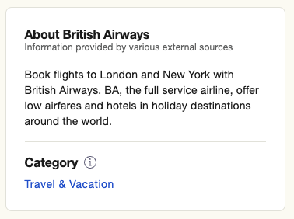
Methodology Insights
Parameters used:
Aggregate company score ≤3
≥1,000 reviews per company
Company is based in UK
≥40% of reviews contain keyword
≤3 scored companies filtered post-scrape.
Scraper ran with restrictions, took ~24 hours.
Some UK based companies don’t have contact information.

Slide 6
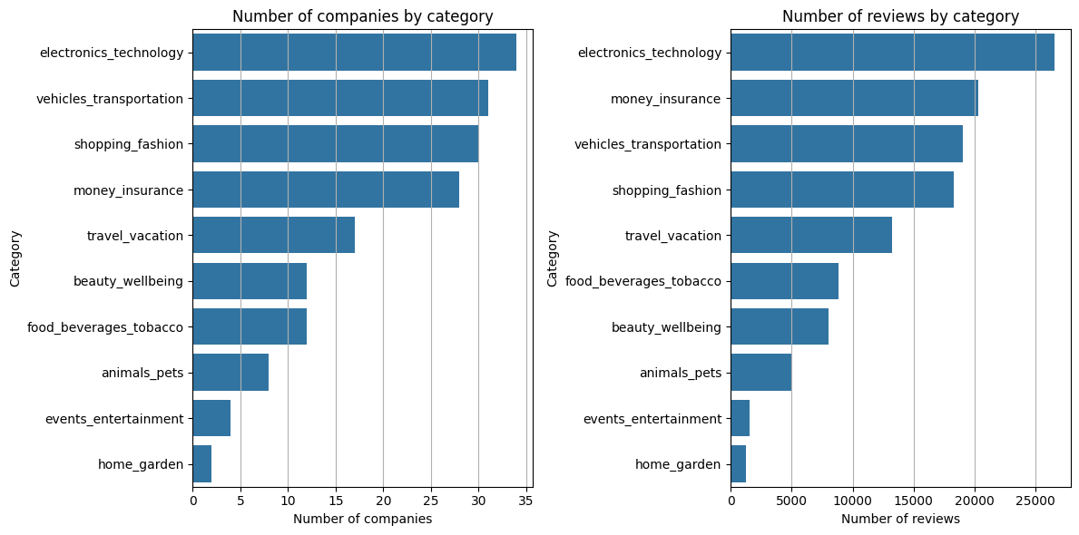
Results | Companies & Categories
171 companies, after initial filtering (excluding ≥40% keywords filter)

Slide 7
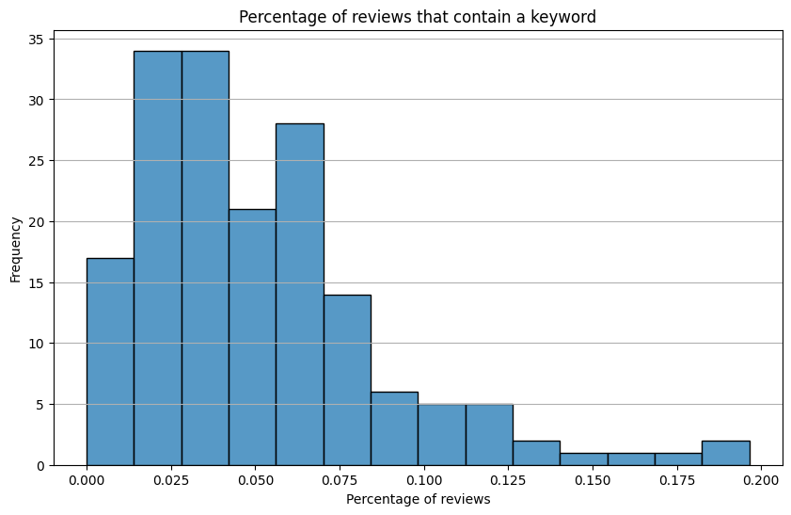
Results | Keywords

Slide 8
Next Steps
Rerun scraper with different parameters.
Rerun scraper for longer.
Continue analysis.

Slide 9
Thank you!

