Slide 1
ATTENDANCE SYSTEM
USING FACIAL RECOGNITION

Slide 2
TEAM MEMBERS:
AVIRAL SHARMA
RISHI B JHUNGARE
SANJEET KUMAR
TECH-STACKS :
HTML, CSS, JS, React.js, FastAPI
Python, Insight Face, Deep Learning

Slide 3
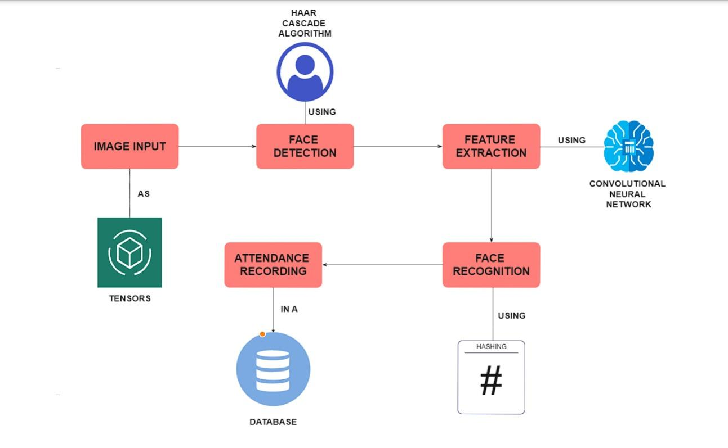

Workflow
INSIGHT FACE
CONVOLUTIONAL NEURAL NETWORK, DEEP LEARNING

Slide 4

Website Layout

Slide 5
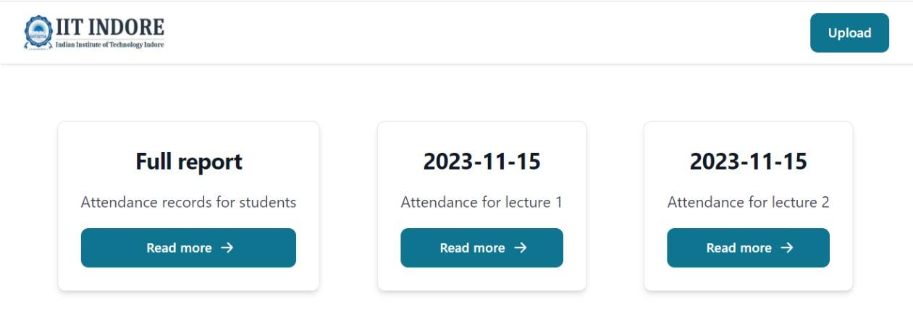
Website Layout

Slide 6
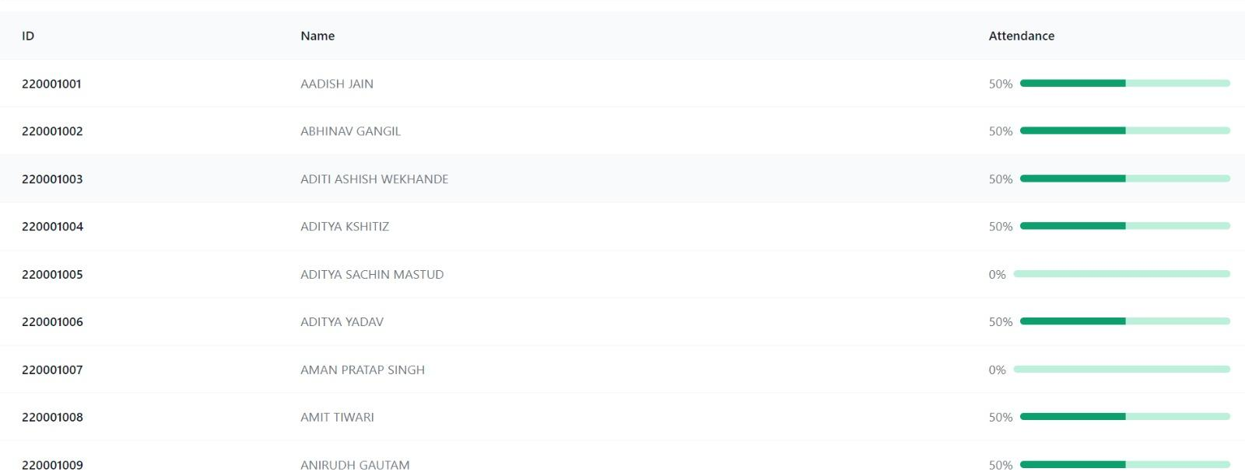
Website Layout

Slide 7
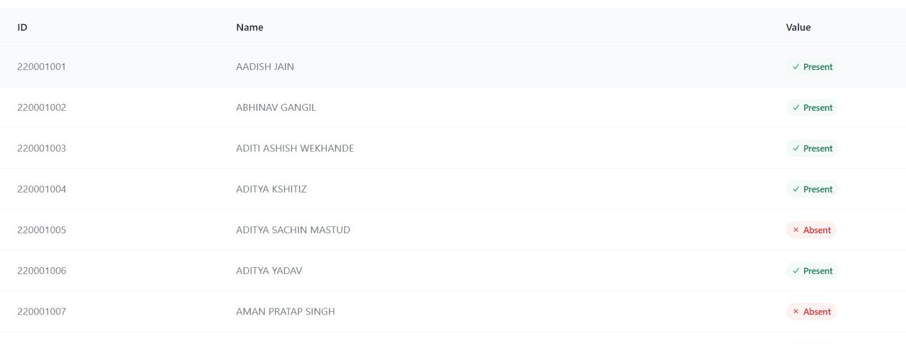
Website Layout

Slide 8
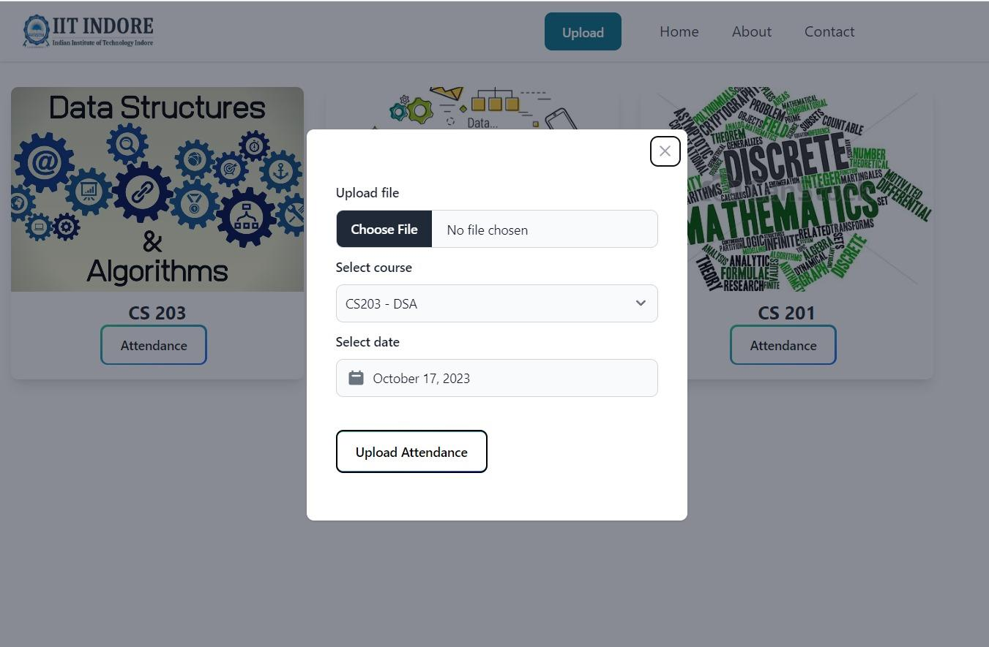
Website Layout

Slide 9
Data Structures Used:
Indexing for Efficient Retrieval
To optimize attendance retrieval, the system employs indexing and mapping, enabling quick access to attendance details for a particular date.
Arrays for Client-Server Interaction
To reciprocate data between client and server on API endpoints, the system uses arrays wrapped in JSON file structure.
Face Recognition Algorithm in Insightface
• Hash Tables: Insightface uses them for storing and accessing pre-computed features or for mapping facial features to unique identifiers.
• Queues and Stacks: Queues and stacks could be used in various stages of the recognition pipeline, managing the order of processing or storing temporary data.
• Matrices: They represent pixel values and be used in various mathematical operations during feature extraction and comparison.
• Sets: Sets might be used to store unique facial features or descriptors, facilitating efficient comparisons and eliminating duplicates.

Slide 10
InsightFace
An open source 2D&3D face analysis model that based on deep CNNs along with metric learning losses and robust data augmentation and alignment techniques.
Uses large-scale adversarial face recognition training, dropout, and principal component analysis (PCA) based noise injection
It uses both softmax loss for classification and triplet loss for metric learning. The combination allows it to learn highly discriminative facial features.
For alignment, it uses a coarse-to-fine strategy. An MTCNN face detector gives coarse alignment, then a affine transformation provides finer alignment. This makes it robust to pose variation.
Data augmentation techniques like horizontal flipping, image distortion, and lighting noise injection further improve its ability to handle real-world variations.

Slide 11
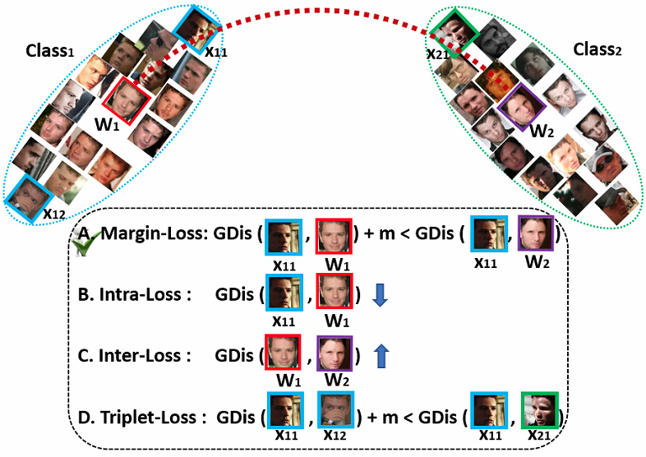
InsightFace

Slide 12
FUTURE IMPROVEMENTS:
Database Connection (preferably MongoDB)
Execution time of the model

